Slide 1


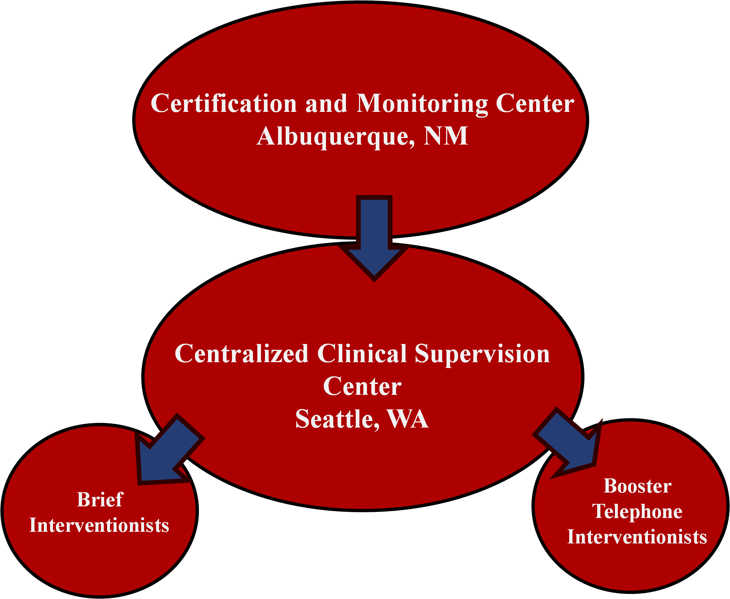
Fidelity Monitoring Model for an MI based brief-intervention conducted in the Emergency Department
A.A. Forcehimes¹, M.P. Bogenschutz¹, G. Sharma², K. Wilson¹, T. B. Moyers¹
¹University of New Mexico Center on Alcoholism, Substance Abuse, & Addictions
²EMMES
INTRODUCTION
RESULTS
DISCUSSION
Learning motivational interviewing (MI) is an ongoing process, involving much more than attendance at a single workshop (Miller & Rollnick, 2013). Once proficiency is achieved—to prevent skills from drifting and ensure continued fidelity to the spirit and style of MI—therapists benefit from ongoing coaching with individual feedback based on observed practice (Madson et al., 2009; Miller & Mount, 2001; Miller et al., 2004). The aim of this study was to assess the usefulness and outcomes of the unique training and supervision model employed in a recent trial of MI.
Interventionists
● Thirty-four interventionists/booster counselors received training across the two waves of the study. Interventionists were primarily Caucasian (82%) females (64%) in their early 30s (32.45 + 7.93 years old). On average, interventionists had little counseling experience (1.58 + 2.50 years) and less than a quarter of the interventionists were licensed as a counselor (21%). On the Understanding of Substance Use Scale (SUS; Humphreys et al., 1996), interventionists indicated they were most strongly influenced by the psychosocial treatment model with very low scores on the disease model.
Training and Certification
● Interventionists/booster counselors completed two pilot training cases and submitted these sessions for coding. To become certified, interventionists had to score at least 4.0 on the 5-point Global Clinician Rating from the MITI. Overall, interventionists/booster counselors scored an average of 4.45 + .51 on a scale of 1-5. These scores were above the threshold for competency (4.0) and higher than scores typically recorded after a standard two-day MI training.
.
Fidelity Monitoring
● Eleven percent of sessions were coded on an ongoing basis during the trial, with a total of 380 initial sessions (90%) and 83 booster sessions (20%) coded upon completion of the trial.
● Mean global scores for the initial sessions ranged from 4.25 to 4.67, and for the booster sessions from 4.64 to 4.86. These scores are well above the proficiency benchmark of 4.0.
● Inter-rater reliability assessed on a random sample of 124 tapes was excellent, with Intraclass Correlation Coefficients (ICCs) averaging 0.81 for global scores and 0.93 for behavior counts.
The CTN 0047 study employed a rigorous and novel plan for ensuring interventionists/booster counselors adhered to the style of MI. The thirty-four interventionists/booster counselors, most of whom had very little counseling experience, were successfully able to achieve and maintain proficiency in MI skill over time, as measured by expert coders.
The comprehensive strategy for successfully learning and maintaining skills in MI included a 2-stage training and 2-level supervision process:
This model may bestow an advantage for learning and implementing brief interventions based on a MI approach.
METHOD
Sample SUS Psychosocial treatment model question:
A person's environment plays an important role in determining whether he or she develops alcoholism or drug addiction
The intervention tested in the six-site NIDA CTN 0047 trial was a 30-minute MI-based brief intervention delivered while patients were in the emergency department followed by two telephone booster calls in the following weeks from a centralized call center (Bogenschutz et al., 2011; 2014).
Interventionist/Booster Counselor Selection and Assessment
● Sites were encouraged to conduct an empathy screen, asking candidates to demonstrate their best reflective listening, as part of the interviewing process.
● Prior to the trainings, all clinicians provided informed consent and completed questionnaires including demographic information, training and experience in psychosocial treatment modalities, knowledge of MI and other counseling approaches, and the Short Understanding of Substance Abuse Scale (SUS, Humphreys et al., 1996).
Training and Certification
● Thirty-one interventionists and 3 booster counselors were trained in the intervention using a 2-stage process: a two day local training in the MI process of engagement by a member of the Motivational Interviewing Network of Trainers (MINT), which focused on good listening skills, followed one month later by a 2-day training in MI led by a member of MINT. Follow up webinars based on feedback from expert coders were offered following the formal training (e.g., how to evoke and respond to change talk; effective use of rulers).
● Interventionists were certified in the study specific intervention after achieving satisfactory ratings on two pilot training cases. All interventions were digitally audio taped.
Fidelity Monitoring
● We employed a two-level model in which
the formal coding was separated from the
clinical supervision. One audio file per
Interventionist/booster counselor per week
was reviewed and coded by the centralized
clinical supervisor using the Motivational
Interviewing Treatment Integrity coding
system (MITI 3.1.1; Moyers et al., 2005).
● This written feedback was available to clinical supervisors using the electronic data capture system, so that it could be reviewed in biweekly individual telephone supervision sessions with therapists.
Use of an empathy screen during the hiring process
Two-day local training on good listening skills
Two-day centralized training in motivational interviewing
Conducting pilot training cases for certification
Follow up webinars based on expert coder feedback
Centralized coding using the MITI 3.1.1
Objective behavioral feedback given to interventionist by clinical supervisors
We explored interventionist characteristics that might account for variance in treatment fidelity. Correlates of treatment fidelity (pearson’s r) revealed no significant differences between self-reported use of MI approach, self-reported MI understanding, or years of experience
REFERENCES
Bogenschutz, M. P., Donovan, D. M., Adinoff, B., Crandall, C., Forcehimes, A. A., Lindblad, R., Mandler, R. N.,Oden, N., Perl, H. I., Walker, R. (2011) Design of NIDA CTN Protocol 0047: Screening, Brief Motivational Assessment, Referral, and Treatment in Emergency Departments (SMART-ED). American Journal of Drug and Alcohol Abuse, 37(5), 417-425.
Bogenschutz, M.P., Donovan, D.M., Mandler, R.N., Perl, H.I., Forcehimes, A.A., Crandall, C., Lindblad, R., Oden, N.L., Sharma, G., Metsch, L., Lyons, M.S., McCormack, R., Macias-Konstanopoulos, W., Douaihy, A., (2014). Brief intervention for patients with problematic drug use presenting in emergency departments: A randomized clinical trial. JAMA Internal Medicine, 174(11): 1736-1745.
Humphreys, K., Greenbaum, M.A., Noke, J.M., Finney, J.W. (1996). Reliability, validity, and normative data for a short version of the Understanding of Alcoholism Scale. Psychology of Addictive Behavior, 10, 38–44.
Madson, M.B., Loignon, A.C., & Lane, C. (2009). Training in motivational interviewing: A systematic review. Journal of Substance Abuse Treatment, 36, 101-109.
Miller, W.R., & Mount, K.A. (2001). A small study of training in motivational interviewing: Does one workshop change clinician and client behavior? Behavioural and Cognitive Psychotherapy, 29, 457-471.
Miller, W.R., Yahne, C.E., Moyers, T.B., Martinez, J., & Pirritano, M. (2004). A randomized trial of methods to help clinicians learn motivational interviewing. Journal of Consulting and Clinical Psychology, 72, 1050-1062.
Miller, W.R. & Rollnick, S. (2013). Motivational interviewing: Helping people change. New York: Guilford Press.
Moyers, T.B. Martin, T., Manuel, J.K., Hendrickson, S.M., & Miller, W.R. (2005). Assessing competence in the use of motivational interviewing. Journal of Substance Abuse Treatment, 28(1), 19-26.
MITI Global Scores
Global Dimension | Interventionist Scores Mean(SD) | Basic Competency | Proficiency
Evocation | 4.3(0.75) | Average of 3.5 | Average of 4.0
Collaboration | 4.4(0.70) | Average of 3.5 | Average of 4.0
Autonomy/Support | 4.4(0.61) | Average of 3.5 | Average of 4.0
Direction | 4.7(0.59) | Average of 3.5 | Average of 4.0
Empathy | 4.5(0.67 | Average of 3.5 | Average of 4.0
ACKNOWLEDGEMENTS
This research was supported by National Drug Abuse Treatment Clinical Trials Network. 5U10DA015833 (Bogenschutz)

