Slide 1
Amar K. Das, MD, PhD
Associate Professor of Biomedical Data Science, Psychiatry and Health Policy & Clinical Practice
Geisel School of Medicine at Dartmouth
Mining Big Healthcare Data: Tales from an Informatics Odyssey

Slide 2
Disclosure
No relationship of any of the authors or their life partners with commercial interests

Slide 3

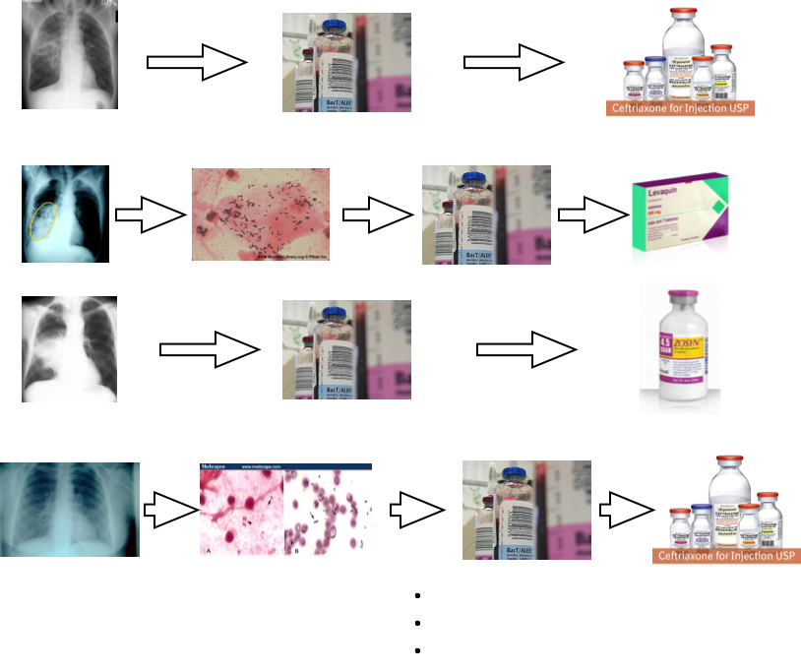
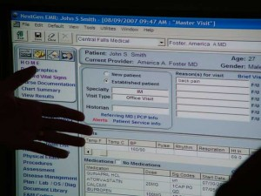

Sources of Big Healthcare Data

Slide 4
An Era of Big Healthcare Data
Traditional Vs of Big Data
  Volume
  Variety
  Velocity
  Veracity
Other Vs relevant to healthcare
  Value
  Viscosity
  Visualization
  Variability

Slide 5
Handling Big Healthcare Data
Data quality and complexity matters most.
Data is structured in a way that limits direct clinical interpretation
Data sources have a degree of error and are missing critical information
Data exploration is the first step in understanding the hidden complexity

Slide 6
Oncoshare Project
Project initiated with the support of the Richard and Susan Levy Gift Fund
A shared informatics resource that collects, integrates and links clinical data from multiple institutions
Data structure reflects patterns of breast cancer care and measures factors driving treatment decisions

Slide 7
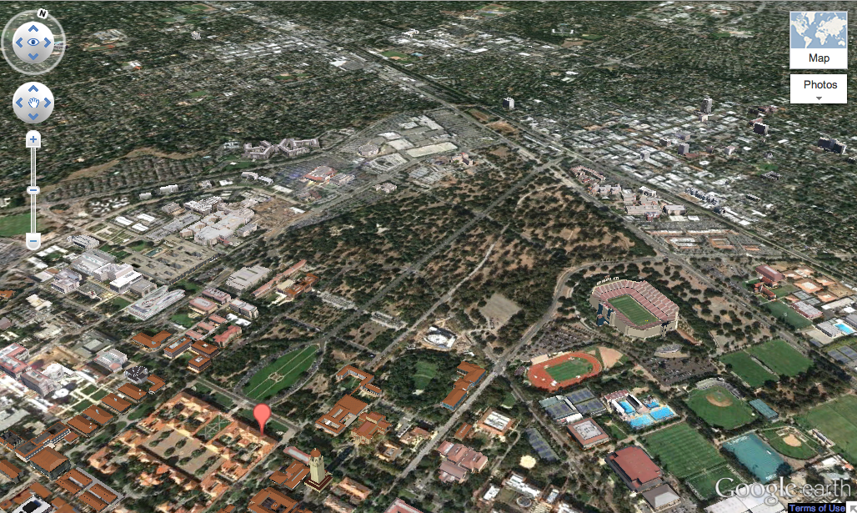
Overlapping Patient Populations
Palo Alto Medical Foundation
Stanford Hospital and Clinics
1 mile

Slide 8
Oncoshare Resource
Longitudinal data on 18,000-plus patients who have received breast cancer treatment at either setting since 2000
Includes over 400 data elements such as demographics, pathology, labs, imaging tests, procedures and medications
Contains over 200,000 full-text clinical, procedure and imaging notes

Slide 9
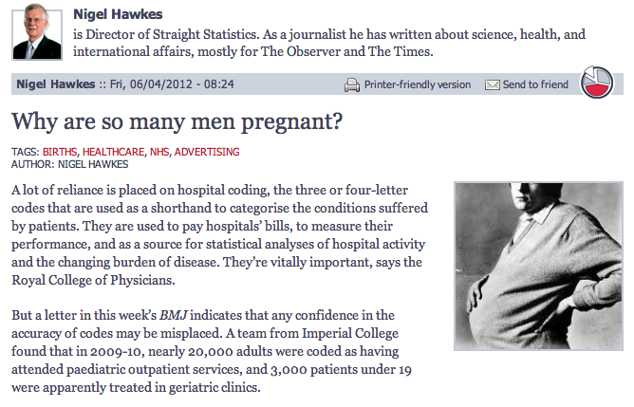
Data Quality
Source: StraightStatistics

Slide 10
All Data Sources
Stanford
Cancer
Registry
4,290
Stanford
EHR
10,593
PAMF
Cancer
Registry
2,847
PAMF
EHR
7,996
CPIC
Registry
5,996

Slide 11
Defining the Analytic Cohort
Registry source
  Systematically captures incident cases
  Gathers limited data on treatment
EHR source
  Provides coded billing data and clinic notes
  Can indicate visits for consultations
Need uniform criteria for cohort inclusion

Slide 12
Cohort Definition
Count
2%
4%

Slide 13
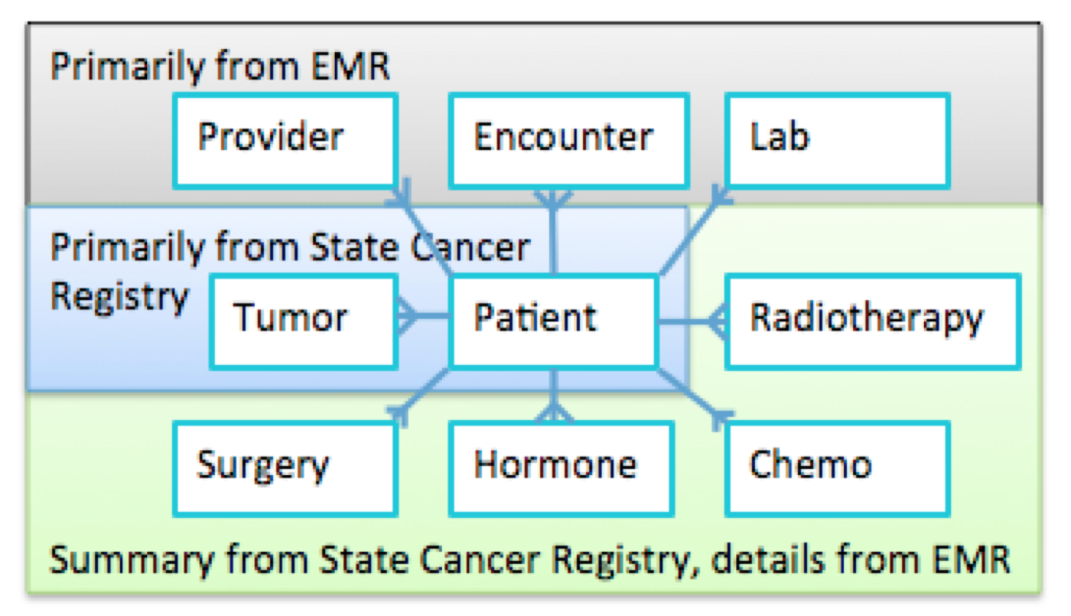
Data Integration Model
Source: AMIA (2012)

Slide 14
Data Sharing Infrastructure
Source: AMIA (2012)
Weber et al, manuscript submitted

Slide 15
Rates of Treatments before Linking
Treatment | Stanford (n = 8210) |  | PAMF (n = 5770)
Mastectomy | 43% |  | 38%
Billing |  | 22% |  | 17%
Registry |  | 41% |  | 36%
Chemotherapy | 42% |  | 35%
Billing |  | 10% |  | 19%
Registry |  | 39% |  | 30%
Radiotherapy | 52% |  | 46%
Billing |  | 25% |  | 25%
Registry |  | 47% |  | 41%
Source: Cancer (2014)

Slide 16
Rates of Treatments after Linking
Treatment | Stanford Only (n = 6321) |  | PAMF Only (n = 3886) |  | Both (n = 1902)
Mastectomy | 40% |  | 31% |  | 56%
Billing |  | 18% |  | 13% |  | 48%
Registry |  | 38% |  | 29% |  | 52%
Chemotherapy | 42% |  | 30% |  | 47%
Billing |  | 10% |  | 17% |  | 31%
Registry |  | 39% |  | 24% |  | 41%
Radiotherapy | 53% |  | 45% |  | 54%
Billing |  | 26% |  | 26% |  | 42%
Registry |  | 47% |  | 40% |  | 46%
Source: Cancer (2014)

Slide 17
Rate of Diagnostic MRI after Linking
Source: Cancer (2014)

Slide 18
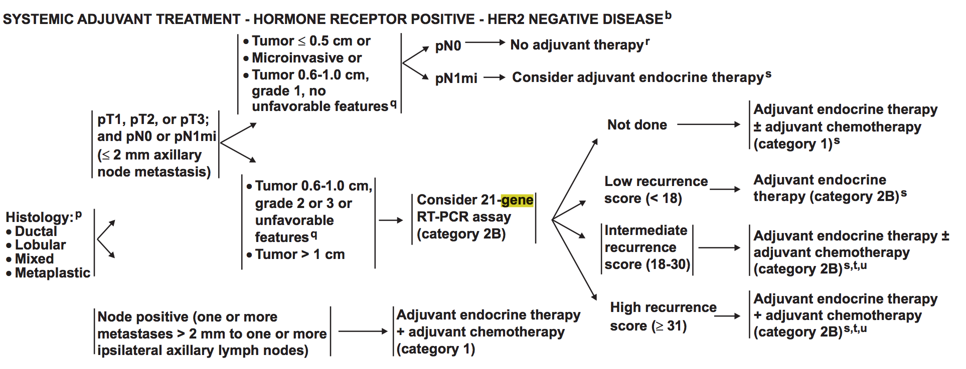
21-Gene Recurrence Score
NCCN guideline (2011)

Slide 19
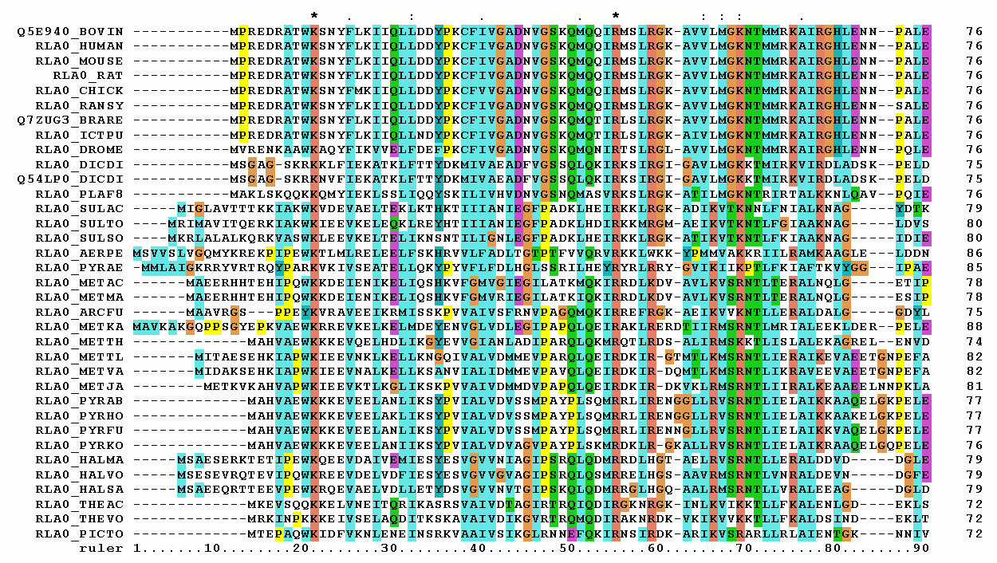
Big Data Analysis with Sequence Alignment
Wikimedia

Slide 20



Transactional Data as Sequences
Sequence of events across time
Many sources of such sequence data
C
C
A
B
D
E
D
E
Time
http://previews.123rf.com/images/limbi007/limbi0071201/limbi007120100030/12038019-Orange-cartoon-character-goes-shopping-and-saves-costs--Stock-Photo.jpg
http://www.climasyseng.com/climasys/pages/images/healthcare.jpg
http://i0.wp.com/bankreferralcoupon.com/wp-content/uploads/2015/05/bank01.jpg?zoom=1.5&resize=382%2C346

Slide 21
Transactional Data as Long Data
Long Data: a specific type of Big Data that has an essential temporal component, including the temporal distance between transactions
Application need: Find known templates (such as treatment patterns) in long data
Research approach: Extend sequence alignment to measure temporal similarity between templates and long data

Slide 22
Convert Long Data into Sequences
Raw
Long
Data
A
B
C
D
E
F
t_{AB}
t_{BC}
t_{CD}
t_{DE}
t_{EF}
Time
...
Sequences
0.A t_{AB}.B t_{BC}.C t_{CD}.D t_{DE}.E t_{EF}.F
Encoded temporal distance

Slide 23
Convert Regimens into Sequences
14
14
14
14
7
…
Regimen 1
AC
AC
AC
AC
P
P
P
14
14
14
14
14
…
Regimen 2
AC
AC
AC
AC
P
P
P
Regimen 3
FEC
…
FEC
P
…
P
Z
…
Z
H
…
H
...
Sequence for Regimen 1
0.AC 14.AC 14.AC 14.AC 14.P 7.P 7.P
Encoded temporal distance

Slide 24
Using Sequence Alignment on Long Data
Sequence alignment approach
  Widely used approach in Bioinformatics
  Aligns sequences for maximal overlap
Needleman-Wunsch algorithm
  Global alignment approach
  Guarantees an optimal alignment for a given scoring scheme and gap penalty
  Does not account for temporal distance between sequence elements

Slide 25
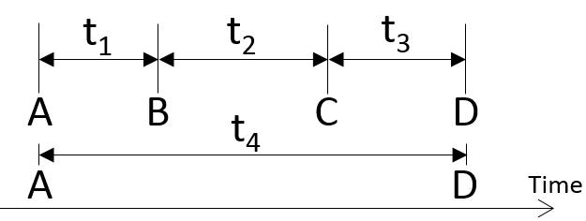
Needleman-Wunsch
Sequence 1
Sequence 2
Aligned Sequences:
A B C D
A D
_
_
1 + -g + -g + 1 = 2 - 2g

Slide 26
Needleman-Wunsch
Align:
A B C D
A D
 |  | A | B | C | D
 | 0 | 0 | 0 | 0 | 0
A | 0
D | 0
Optimal
Alignment
A
A
B
-
C
-
D
D
0+1
0 - .1
.9
.7
1
.8
0 - .1
.9
.9
.9
1.8
Value from Scoring matrix
M[i-1, j-1] + S[A[i], B[j]]
M[i-1, j] – gap_penalty
M[i, j-1] – gap_penalty
M[i, j] = max

Slide 27
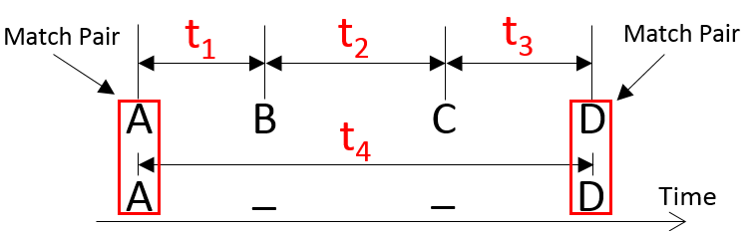
Temporal Needleman-Wunsch
Sequence 1
Sequence 2
1
-g
-g
1-f(t₁+t₂+t₃, t₄)
Aligned Sequences:
A B C D
A D
_
_
1 + -g + -g + 1 – f(t₄,t₄)

Slide 28
Results and Comparison of Methods
Study: Match 115 patients who were manually annotated to a
treatment regimen to 44 regimen templates using sequence alignment
Temporal
Needleman-Wunsch
Needleman-Wunsch*
# correctly identified regimen (top match) | # correctly identified regimen (top 2 matches) | # correctly identified regimen (top match) | # correctly identified regimen (top 2 matches)
83 (91%) | 89 (98%) | 107 (93%) | 113 (98%)
*Results for 91 patients (24 patients could not be resolved
because they matched more than one encoded regimen)
Source: DSAA (2015)

Slide 29
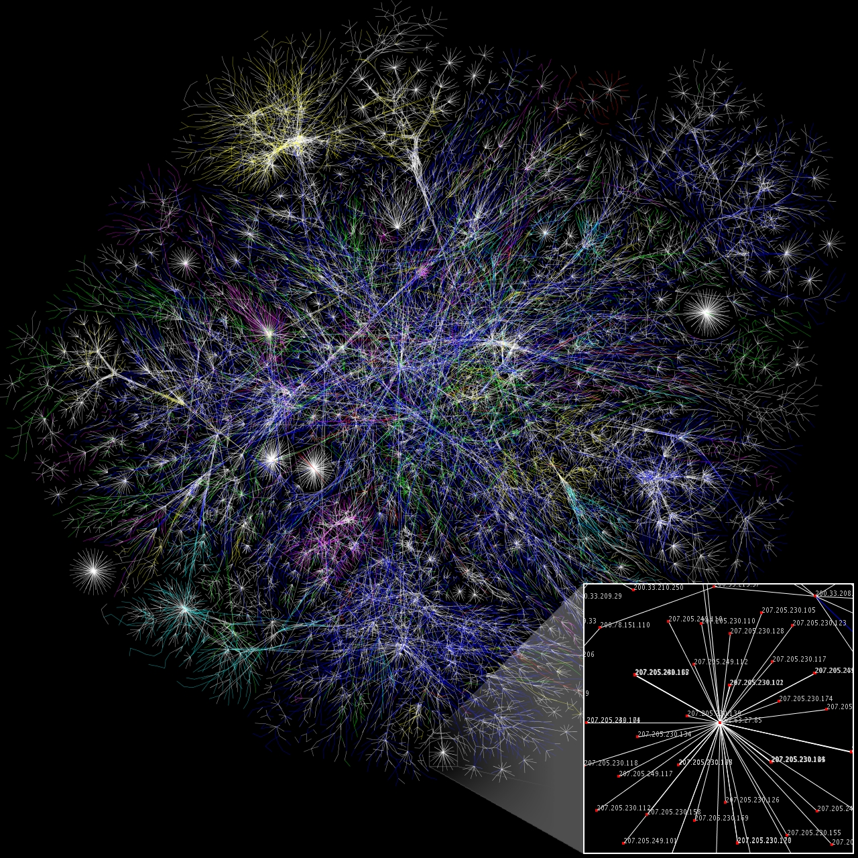
Big Data Analysis with Network Science
Wikimedia

Slide 30
Understanding Patterns of Care
How are physicians linked across sites and specialty in providing care?
  Solution: Create a ‘social network’ of physicians linked by patients they have co-treated

Slide 31
Provider Network of Care
146 physicians
331 links
Source: AMIA (2011)

Slide 32
Provider Network of Care
Source: AMIA (2011)

Slide 33
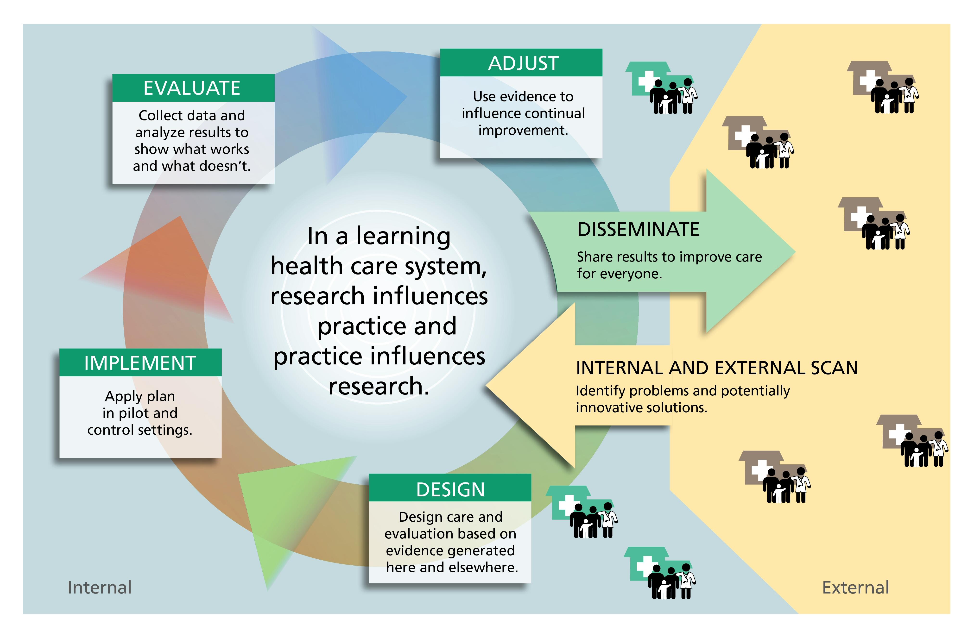
Learning Health System

Slide 34
Lessons from an Informatics Odyssey
Understand the sources of data and their limitations in structure, scope, and quality
Get more data (more variety of data) if possible
Create new methods to explore hidden patterns in long data

