Slide 1



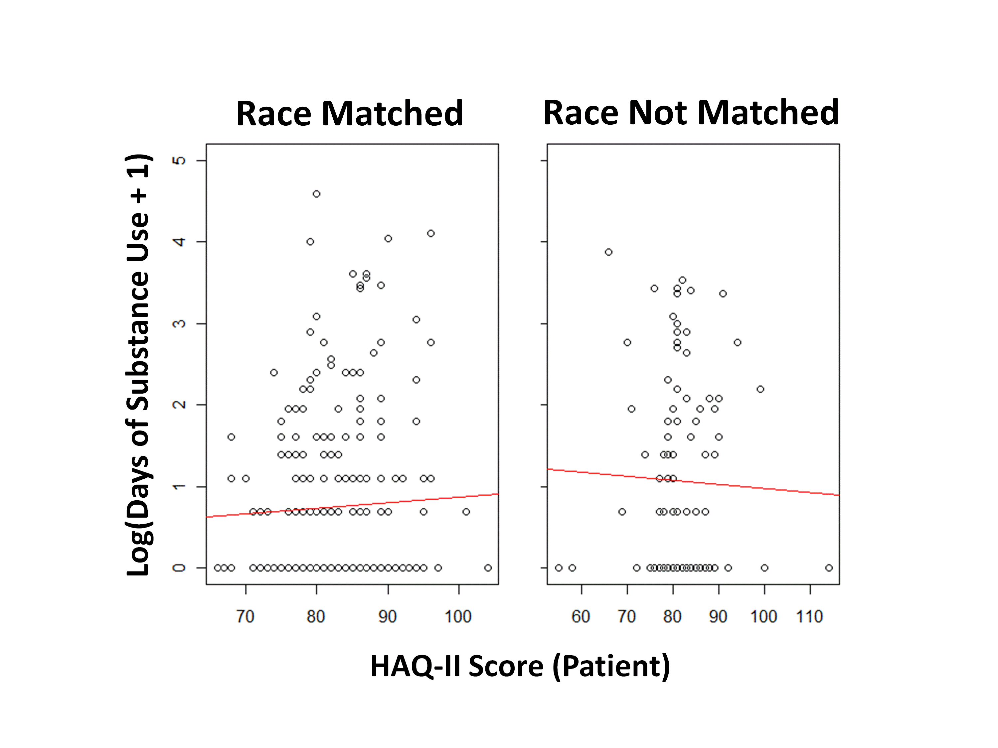
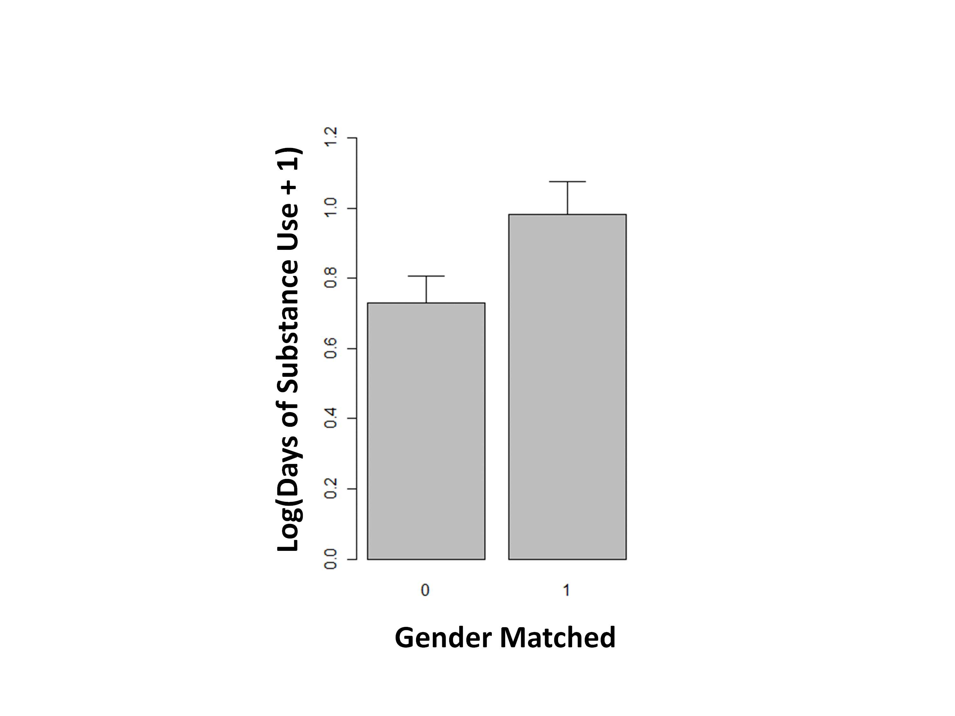
The Relationship between Therapist and Patient Gender/Race Matching and Substance Use Outcomes across Two Motivational Enhancement Therapy Trials
A.A. Forcehimes¹, M. Nakazawa.¹, L. Montgomery², K.A. Burlew², A. Kosinski³ , P. Kothari⁴
¹University of New Mexico Center on Alcoholism, Substance Abuse, & Addictions
²University of Cincinnati
³Duke Clinical Research Institute
⁴ Synergy Enterprises
INTRODUCTION
Procedure:
All participants completed the Helping Alliance Questionnaire (HAQ-II) at the end of the 3 sessions of treatment. Therapists also completed a parallel version of the HAQ form as a measure of the level of alliance they perceived with a particular patient. The, Addiction Severity Index-Lite was administered at the 4-week follow up period. Patient’s perception of their therapist’s race or gender was extracted from the Posttreatment Attitudes and Expectations Questionnaire. Of the 677 patients randomized to 0004 and 0021, 345 had complete data (i.e., HAQ-II patient and therapist scores, perceptions of therapist’s race and gender, and self-reported days of substance use at week 4).
The relationship among the variables was examined using ANCOVAs. The primary outcome variable was self-reported days of alcohol and drug use at week 4 assessed with ASI (possible range: 0-360, 30 days for each of the 12 drug categories, observed range: 0-100). The covariates were HAQ-II patient and therapist scores and baseline substance use days, and the fixed variable was race or gender match. Both HAQ-II scores were centered so that the intercept would be at the means of these scores, instead of 0. Log transformation was applied to the outcome variable to reduce its skewness. Effect size was indicated by Cohen’s d.
Hypotheses:
Patients’ perception of their therapists’ race will affect the amount of substance use, defined as self-reported days of substance use at the end of the active phase of treatment, and patients’ perception will moderate the relationship between therapeutic alliance, defined by patient as well as therapist scores on the HAQ-II at the end of the active phase of treatment, and substance use.
Patients’ perception of their therapists’ race will affect the amount of substance use, defined as self-reported days of substance use at the end of the active phase of treatment, and patients’ perception will moderate the relationship between therapeutic alliance, defined by patient as well as therapist scores on the HAQ-II at the end of the active phase of treatment, and substance use.
DISCUSSION
One of the strongest determinants of addiction treatment outcome is the relationship between the provider and the patient (McLellan, Woody et al. 1988; Leake & King, 1977). Therapeutic alliance, describing the quality of the relationship between the patient and provider, appears to be a strong contributing factor defining the quality of the relationship between the patient and provider.. Both motivational interviewing (MI) and motivational enhancement therapy (MET) are rooted in a belief that change is facilitated through a strengthening of a collaborative therapeutic relationship. The successful use of MI may depend on the therapist’s ability to develop strong alliance (Miller & Rose, 2009).
There have been few studies examining alliance and treatment outcome for MI based interventions. A positive outcome was found in Project MATCH (Connors, Carroll et al. 1997), in which alliance was positively associated with percent days abstinent and negatively related to drinks per drinking day during both the treatment and follow-up periods. Other studies have failed to find a significant relationship in alliance and treatment outcome for MI based interventions. For instance, Feldstein and Forcehimes (2007) did not find a significant relationship between alliance and drinking outcomes in college students with a history of problem drinking. More recently Crits-Cristoph, et al. (2009) found that MET did not produce higher alliance scores than treatment as usual. To understand what factors might be influencing therapeutic alliance, it is important to look at potential moderators. One possibility is that alliance, may vary depending on ethnicity or gender matches (or mismatches) between the patient and therapist.
Although some research supports patient/therapist similarity (i.e., matching) in developing a therapeutic alliance more successfully (Thompson,Worthington, et al., 1994), findings in this area are mixed (Fiorentine & Hillhouse, 1999). The aim of this study was to examine the moderating effects of gender/race matching between therapists and patients on therapeutic alliance and substance use outcomes.
The aim of this study was to examine the moderating effects of gender/race matching between therapists and patients on therapeutic alliance and substance use outcomes across participants in two MET trials in the CTN. Our examination of how these gender and race matches or mis-matches impacted substance use outcome and therapeutic alliance resulted in some unexpected findings:
● Matches in race resulted in significantly less substance use compared to patients and
therapists whose race did not match.
● Patients’ perception of perceived race matches did moderate therapeutic alliance
scores, but surprisingly this was true only for therapist alliance scores, not patient
ratings of alliance. This suggests that therapists in this study seemed to have an
easier time building alliance when working with a patient whose race matched their
own.
● Unlike matches in race, matches in perceived gender between therapist and
patient do not seem to be a helpful in decreasing substance use. Patients who
perceived their therapist’s gender to be the same as their own gender actually had
more days of substance use. Gender similarity also didn’t increase therapeutic
alliance as perceived by patients or therapists.
A few limitations are worthy of mention when interpreting these results:
● This study only examined patients’ perceptions of gender and race. It cannot be assumed that the therapists had the same impression, and it remains unknown whether these impressions might have resulted in different outcomes.
●Asking patients about their therapist’s race may have been confusing for patients who were Latino or Hispanic, since many consider “Latino” to be an ethnic group rather than a race. Race may have been defined differently, thus results may have differed if the question would have been “Was your counselor the same ethnicity as you?”
● There were many more males than females in this study, which may have influenced the results. There were also very few African Americans, which is too few to make conclusions about matching African American patients with same race therapists.
Overall, findings from this study support a recommendation of matching patients to providers of the same race, but do not support a recommendation of routinely matching patients to providers of the same gender.
Hypothesis 1:
● As hypothesized, racially matched patients reported significantly fewer days of drug use (t(341) = -2.40, p = 0.02, d = -0.26). This effect equals to a 26% reduction in days of substance use from 5.2 to 3.9.
● However, racial match was unrelated to patient perceived helping alliance (t(341) = 0.65, p = 0.52, d = 0.07).
● When HAQ-II therapists’ scores were included in the model, racially matched patients again reported significantly fewer days of drug use (t(341) = -2.36, p = 0.02, d = -0.26).
● Race matching significantly moderated the relationship between helping alliance perceived by therapists and substance use (t(341) = 2.03, p = 0.04, d = 0.22, fig. 1).
● There were no differences in matching between CTN 0004 and 0021.
IMAGE???
Hypothesis 2:
● Gender matched patients reported significantly more days of drug use (t(341) = 2.17, p = 0.03, d = 0.23, fig. 2; a 57% increase from 3.4 to 5.3 days,) even after HAQ-II therapists scores were included in the model (t(341) = 2.01, p = 0.045, d = 0.22). There were no differences in matching between CTN 0004 and 0021.
● Perceived gender similarity did not significantly affect the level of helping alliance indicated by patients (t(341) = 1.72, p = 0.09, d = 0.19) or therapists (t(341) = 0.56, p = 0.58, d = 0.06).
● There were no differences in matching between CTN 0004 and 0021.
IMAGE???
METHOD
RESULTS
Identical measures were obtained in two CTN trials of MET:
3 sessions of individual MET vs. Treatment as Usual (TAU) (CTN 0004)
3 sessions of individual MET delivered in Spanish vs. TAU delivered in Spanish (CTN 0021)
Participants
Participants were patients (valid N=345, 35% of N at randomization) and therapists (valid N=24) participating in 0004 and 0021 who had completed the Helping Alliance Questionnaire-II (measuring therapeutic alliance) at the end of treatment, had self reported substance use data from the ASI-lite at baseline and at week 4 (post-treatment) and had complete data on two questions from a post-treatment questionnaire indicating perceptions of their provider’s race and gender. The two studies included 64 females and 281 males with a mean age of 33.7 (SD = 9.2). 43% of participants reported their race as white, 30% reported Latino, and 1% reported African American.
Measures
The Helping Alliance Questionnaire-II (HAQ-II) Levels of perceived therapeutic alliance for both therapists and clients was assessed using total scores on the HAQ-II. There are 19 items on the HAQ-II that are rated on a scale of 1-6 from “strongly disagree” to “strongly agree”. (Luborsky, Barber, Siqueland, & Johnson, 1996). Higher scores on the HAQ indicate a stronger alliance between the therapist and patient. According to Luborsky et al. (1996), scores below 86 are considered poor alliance (range from 19 to 114).
The Addiction Severity Index-Lite Severity of substance use and substance-related problems were be measured by composite scores of the Addiction Severity Index Lite (McLellan, Kushner et al., 1992). The ASI is the most widely-used instrument for assessment of substance use and related problems and its psychometric properties are well established (Cacciola, Alterman et al. 2007).
Posttreatment Attitudes and Expectations Questionnaire. This self-report form adapted from the National Institute of Mental Health Treatment of Depression Collaborative Research Program (Elkin, Parloff et al. 1985) has been modified for use with drug dependent individuals. The 36-item self-report form queries satisfaction with treatment, counselor’s level of understanding and specific behaviors . The two questions used for this study were patient’s perception of the gender and ethnicity similarity to their therapist: “Was your counselor the same gender as you?” and “Was your counselor the same race as you?”
REFERENCES
Cacciola, J. S., A. I. Alterman, et al. (2007). "Initial evidence for the reliability and validity of a 'Lite' version of the
Addiction Severity Index." Drug and Alcohol Dependence 87(2): 297-302.
Crits-Christoph, P., R. Gallop, et al. (2009). "The alliance in motivational enhancement therapy and counseling as usual for
substance use problems." Journal of Consulting and Clinical Psychology 77(6): 1125-1135.
Connors, G. J., K. M. Carroll, et al. (1997). "The therapeutic alliance and its relationship to alcoholism treatment participation
and outcome." Journal of Consulting and Clinical Psychology 65(4): 588-598.
DiClemente, C. C., Carroll, K. M., Miller, W. R., Connors, G. J., & Donovan, D. M. (2003). A look inside treatment:
Therapist effects, the therapeutic alliance, and the process of intentional behavior change. In T. F. Babor & F. K.
Del Boca (Eds.), Treatment matching in alcoholism (pp. 166-183). New York: Cambridge University Press.
Feldstein, S. W. and A. A. Forcehimes (2007). "Motivational interviewing with underage college drinkers: A preliminary look at
the role of empathy and alliance." The American Journal of Drug and Alcohol Abuse 33(5): 737-746.
Fiorentine, R. and M. P. Hillhouse (1999). "Drug treatment effectiveness and client-counselor empathy." Journal of Drug Issues
29(1): 59-74.
Horvath, A. O., & Symonds, B. D. (1991). Relation between working alliance and outcome in psychotherapy: A meta-
analysis. Journal of Counseling Psychology, 38(2), 139-149.
Luborsky, L., Barber, J. P., Siqueland, L., & Johnson, S. (1996). The revised Helping Alliance questionnaire (HAQ-II):
Psychometric properties. Journal of Psychotherapy Practice & Research, 5(3), 260-271.
Leake, G. J. and King, A.S. (1977). "Effect of counselor expectations on alcoholic recovery." Alcohol Health & Research
World 11(3): 16-22.
McLellan, A.T., Kushner, H., Metzger, D., Peters, R., Smith, I., Grissom, G., Pettinati, H., & Argerious, M. (1992). The
fifth edition of the Addiction Severity Index. Journal of Substance Abuse Treatment, 9, 199-213.
McLellan, A. T., G. E. Woody, et al. (1988). "Is the counselor an "active ingredient" in substance abuse rehabilitation? An
examination of treatment success among four counselors." Journal of Nervous and Mental Disease 176: 423-430.
Miller, W. R., & Rose, G. S. (2009). Toward a theory of motivational interviewing. American Psychologist, 64, 527–537.
Project MATCH Research Group (1998). "Therapist effects in three treatments for alcohol problems." Psychotherapy
Research 8: 455-474.
Summers, R. F. and J. P. Barber (2003). "Therapeutic Alliance as a Measurable Psychotherapy Skill." Academic Psychiatry
27(3): 160-165.
Thompson, C. E., R. Worthington, et al. (1994). "Counselor content orientation, counselor race, and Black women's cultural
mistrust and self-disclosures." Journal of Counseling Psychology 41(2): 155-161.
ACKNOWLEDGEMENTS
This research was supported by NIDA’s Clinical Trials Network

