Slide 1


NIDA’s Clinical Trials Network:
Science, Practice & Reality
Harold I Perl, PhD
Center for the Clinical Trials Network
National Institute on Drug Abuse
NIATx Summit and SAAS National Conference
Boston, MA
July 13, 2011

Slide 2


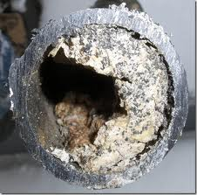


Pick Your Favorite Metaphor …

Slide 3

IOM Report Decries the “Gap”
  NIDA responds to IOM report
  National Drug Abuse Treatment Clinical Trials Network (CTN) 1999
Blending Initiative 2001
Based on “Bi-Directionality”
  Clinicians & Researchers collaborating

Slide 4

CTN Mission
  Study behavioral and pharmacological treatments that have high potential for success in community treatment settings
  Get research findings into the hands of clinicians who can make the best use of them – as fast as possible
Notes:
4

Slide 5
CTN Across the Nation
Regional Research and Training Center (RRTC)
State with Community Treatment Program (CTP)

Slide 6

NIDA/SAMHSA Blending Initiative
Blending Conferences
  Clinical and research experts present latest scientific findings to front-line clinicians and managers
Single State Agency Directors
  Facilitate broader adoption of research-supported tx
Blending Teams & Blending Products
  Operationalize implementation of research findings in the field

Slide 7
Suite of Blending Products
Buprenorphine Treatment: Training for Multidisciplinary Addiction Professionals
Short-Term Opioid Withdrawal Using Buprenorphine
Buprenorphine Treatment for Young Adults
Treatment Planning MATRS: Utilizing the ASI to Make Required Data Collection Useful
Motivational Interviewing Assessment: Supervisory Tools for Enhancing Proficiency (MIA-STEP)
Promoting Awareness of Motivational Incentives (PAMI)

Slide 8
Selecting Blending Products
Specific intervention models drawn from the findings of CTN and other research
Decisions based on key principles of Treatment Research and Implementation Science
  Relevance to intended users
  Demonstrated efficacy and effectiveness
  Potential reach, feasibility and sustainability across array of ecological and organizational settings
  Faithful adoption can be enhanced by comprehensive training and ongoing clinical supervision

Slide 9
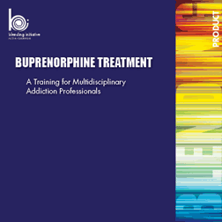
Buprenorphine Treatment Suite
Training for Multidisciplinary Addiction Professionals
  Broad overview of
    Buprenorphine use and effects
    Role of non-prescribers in patient care
  6-hour classroom training program and video
  Self-paced CD-ROM awareness course
Short-Term Opioid Withdrawal Using Buprenorphine
  Teaches the 13-day Buprenorphine taper intervention
  4-hour classroom training program
Buprenorphine Treatment for Young Adults
  Effectiveness of longer term treatment for young adults
  3-hour classroom training and PowerPoint presentation

Slide 10

Motivational Interviewing Assessment: Supervisory Tools for Enhancing Proficiency (MIA:STEP)
Tools for clinical supervisors to fortify ability to deliver effective supervision to front-line counselors
Teaching tools for assessing and enhancing counselor’s MI Skills
Supervisor training curriculum for 6-10 hour workshop
Audiotaped treatment sessions and supervisory tape rating guide
Notes:
10

Slide 11

Promoting Awareness of Motivational Incentives (PAMI)
Explains research findings that show low-cost incentives can increase drug abstinence and enhance patient retention in treatment – speaks to the clinic’s “Bottom Line”
Motivational Incentives Awareness Video
PowerPoint presentations for clinicians and policy makers
Toolkit (activities, sample materials, etc.)
Resources (bibliography, articles, FAQ, etc.)
Notes:
11

Slide 12
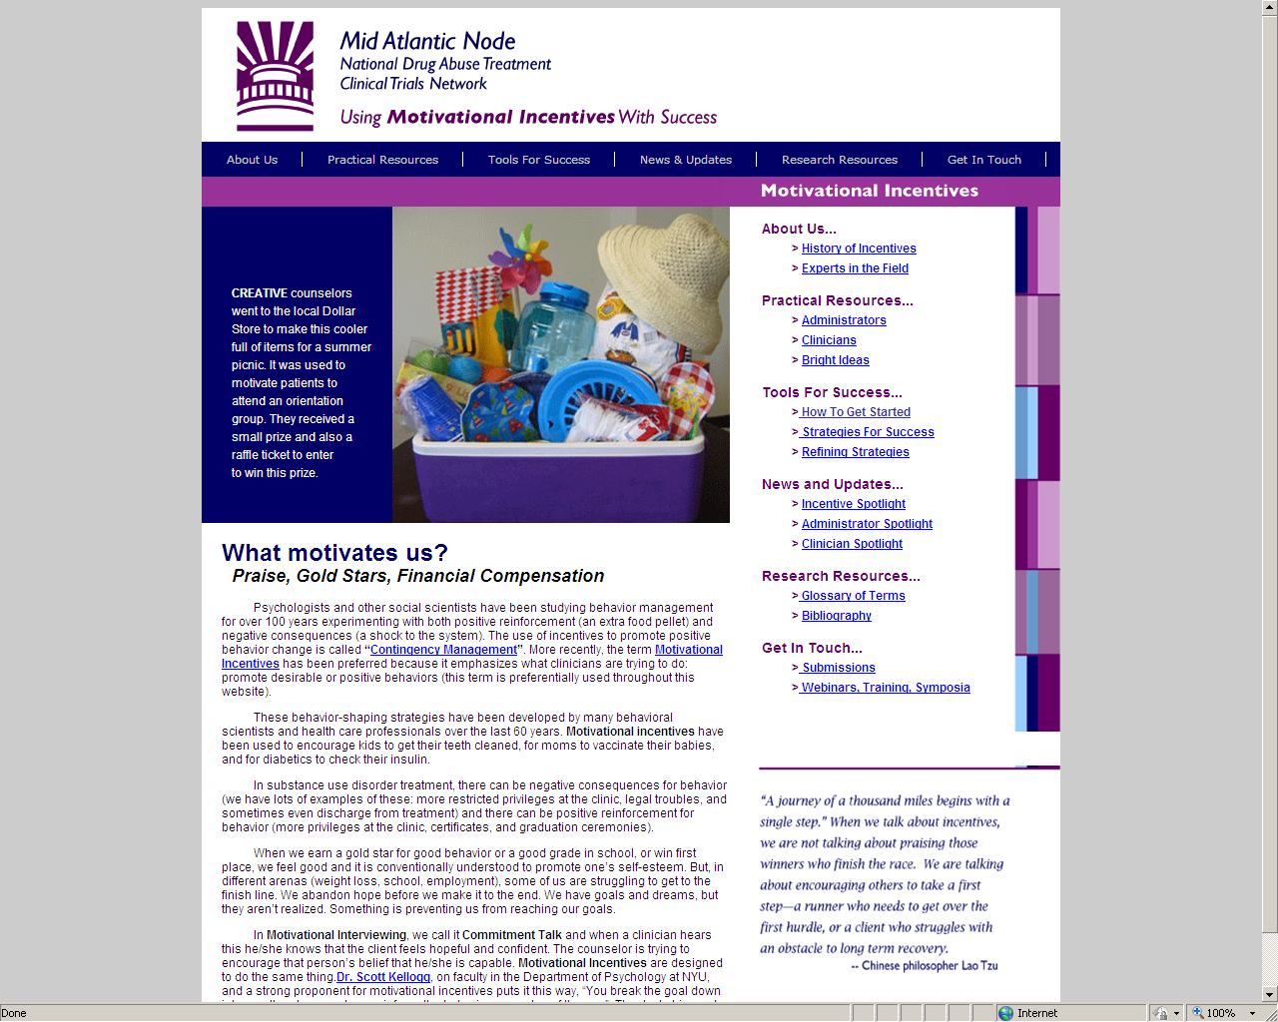

Slide 13
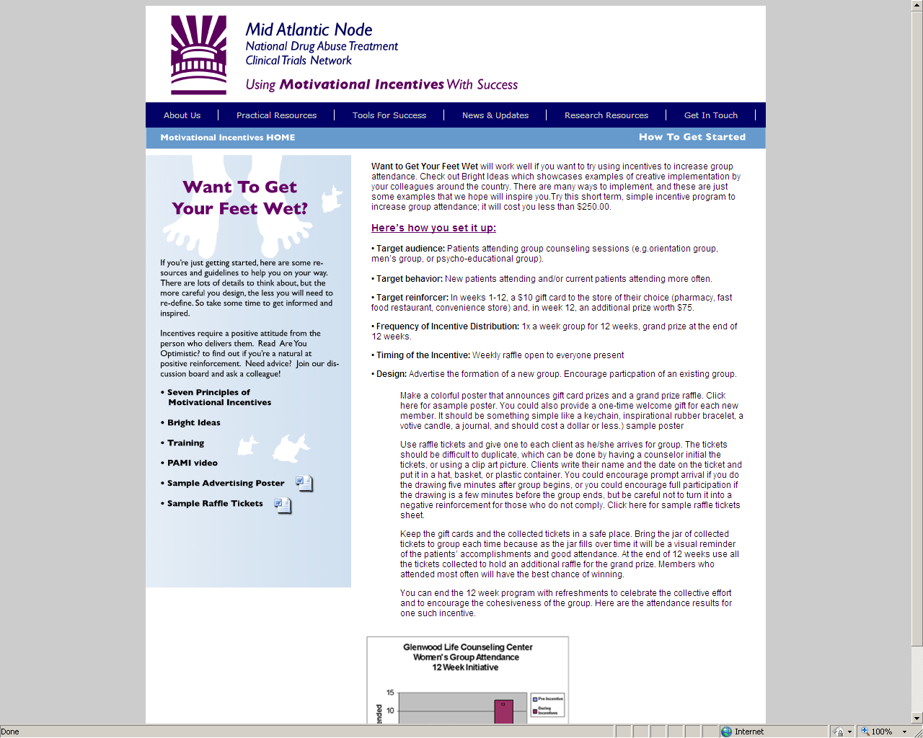
motivationalincentives.org

Slide 14
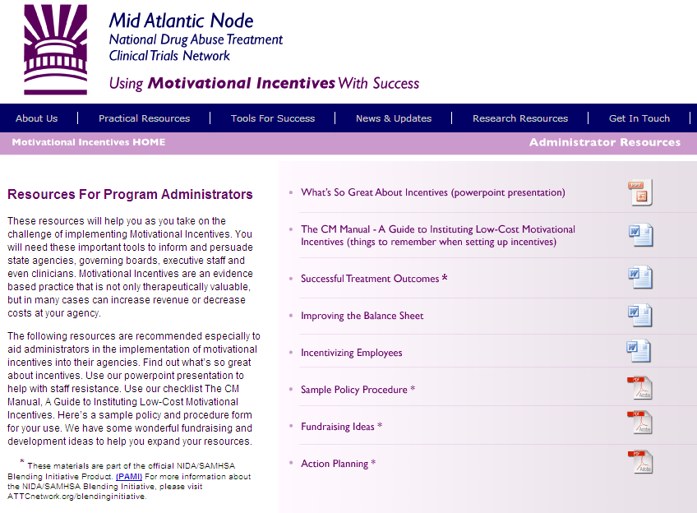
motivationalincentives.org

Slide 15
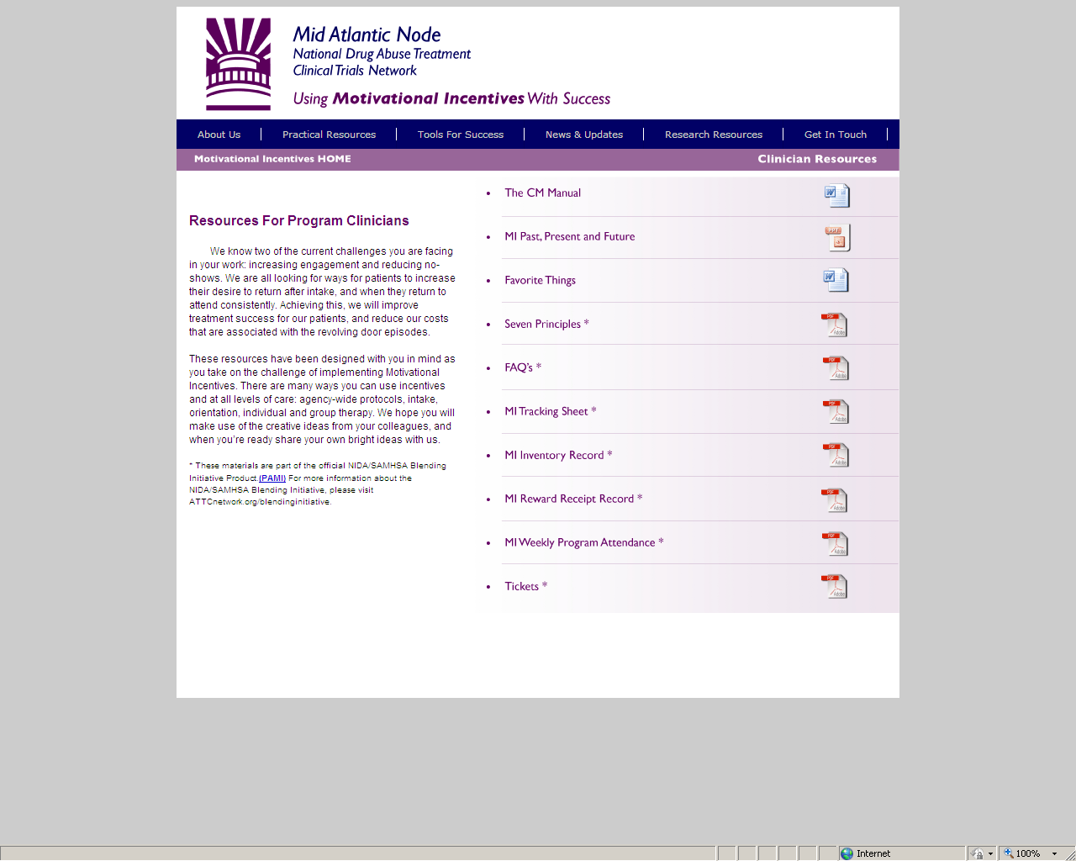
motivationalincentives.org

Slide 16

Notes:
Motivational Incentives: Positive Reinforcements to Enhance Successful Treatment Outcomes (MI PRESTO)
6-Module, On-Demand, Self-Paced Course
Nuts and Bolts of how to establish a Motivational Incentive Program
Motivational Incentives Implementation Software (MIIS)
Program to utilize and apply incentives in clinic setting
Maintain information on patient outcomes, attendance, etc.

Slide 17
New Blending Products
Currently under development
Prescription Opioid Addiction Treatment Study (POATS)
HIV Rapid Testing and Counseling

Slide 18
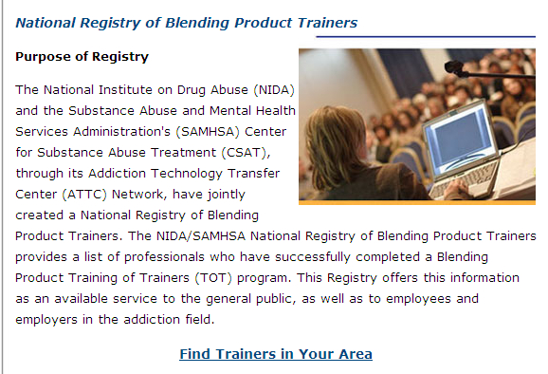
Find a Trained Trainer

Slide 19
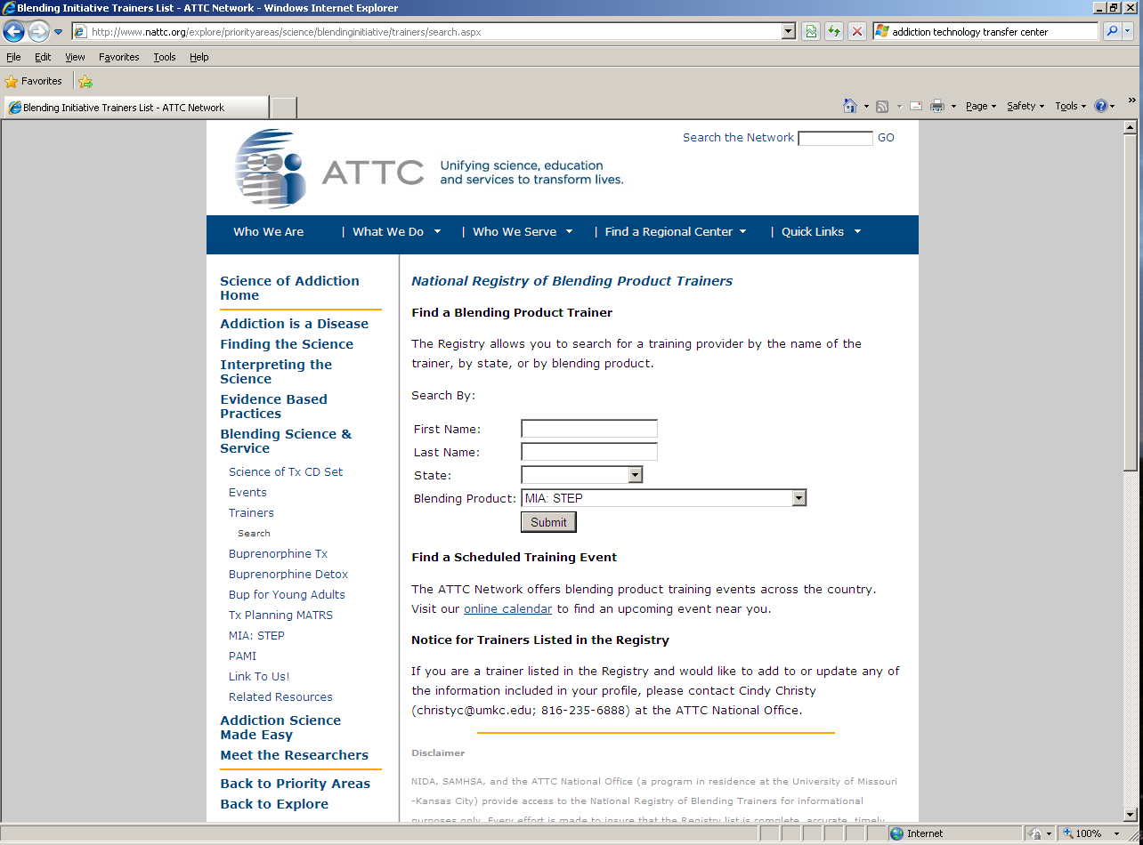
Find a Trained Trainer

Slide 20
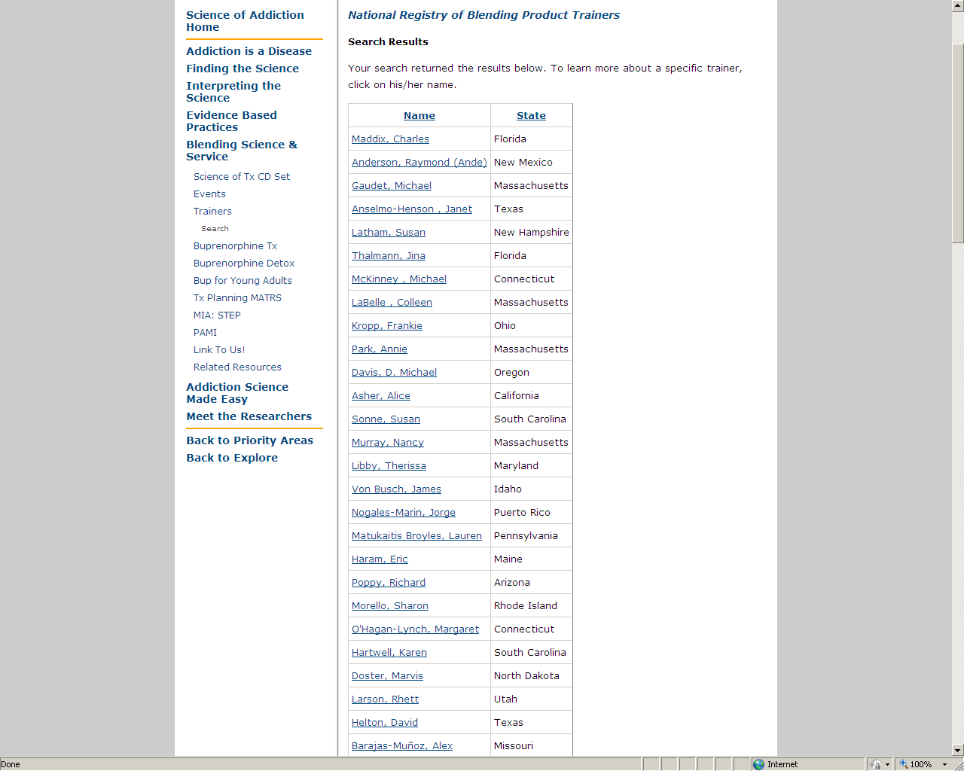
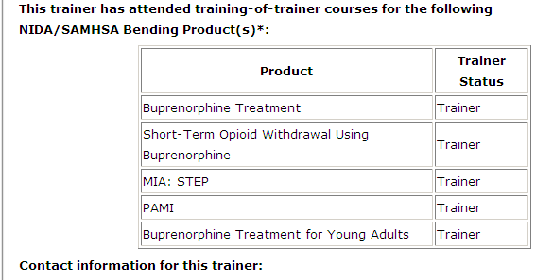
Find a Trained Trainer

Slide 21
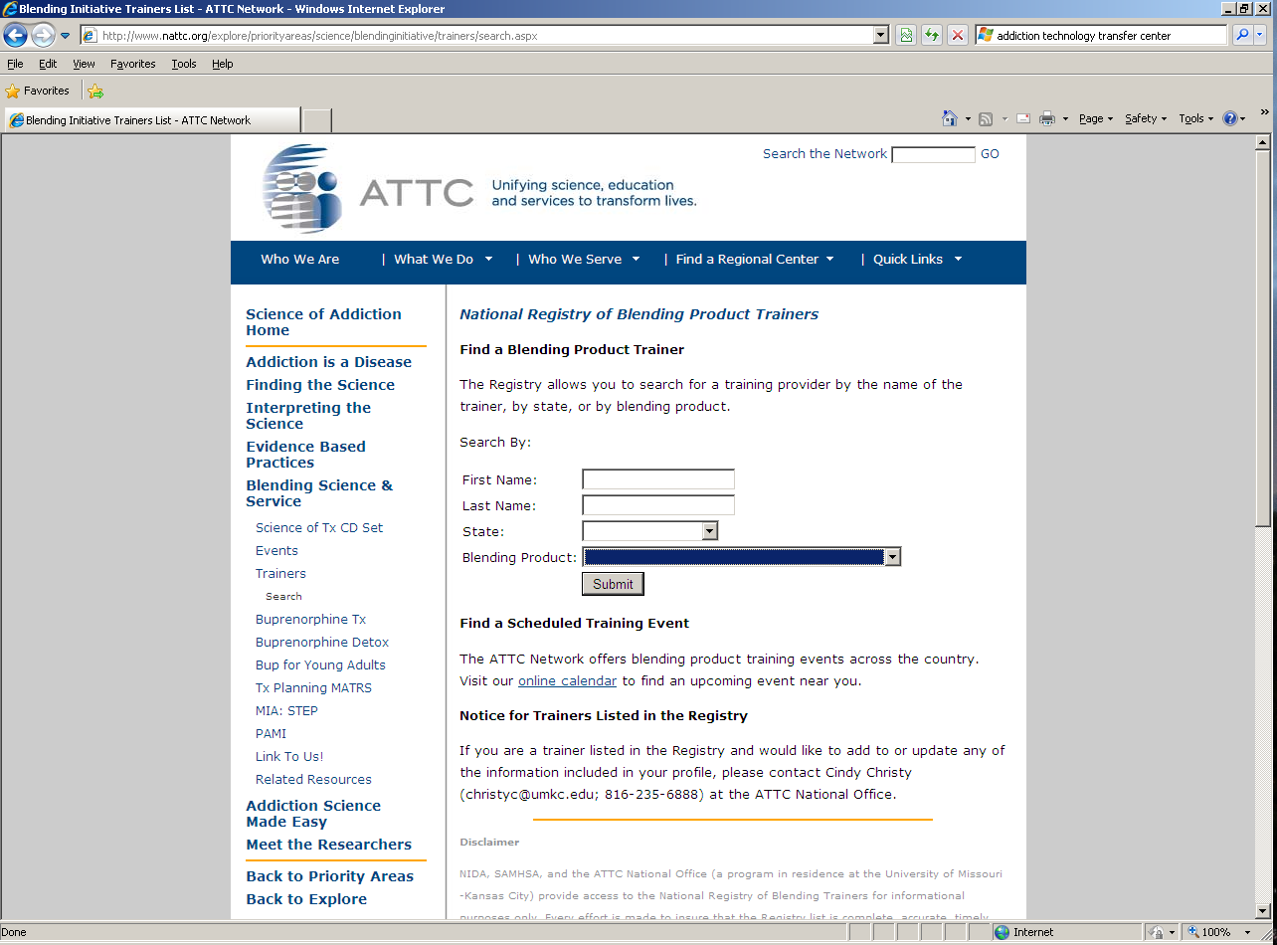
Find a Training Event

Slide 22
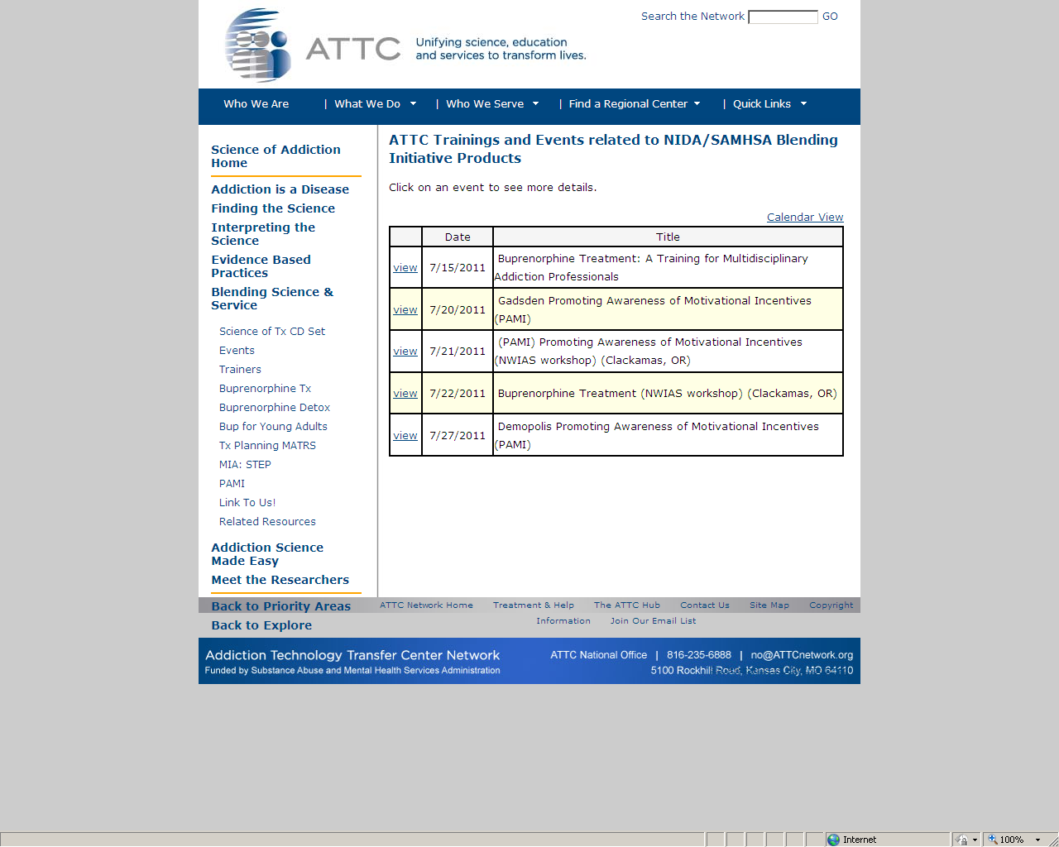
Find a Training Event

Slide 23
CTN Impact on Adopting EBPs
Adoption of CTN-tested protocols in CTPs ¹
  41.9% : Buprenorphine treatment
  61.4% : Motivational Incentives
Adoption of EBPs tested outside CTN ²
  CTN CTPs 3 times more likely to adopt acamprosate or naltrexone for AUDs than non-CTN programs
CTN CTP staff who participate in research are more likely to use EBPs in clinical practice ³
¹Roman, Abraham, Rothrauff & Knudsen (2010)
²Abraham, Knudsen, Rothrauff & Roman, P. M. (2011)
³Pinto , Yu, Spector, Gorroochurn & McCarty (2010)
Notes:
¹Roman, Abraham, Rothrauff, & Knudsen (2010) A longitudinal study of organizational formation, innovation adoption, and
dissemination activities within the National Drug Abuse Treatment Clinical Trials Network Journal of Substance Abuse Treatment 38 (Suppl 1) S44–S52
²Abraham, A. J., Knudsen, H. K., Rothrauff, T. C., & Roman, P. M. (2011). The adoption and implementation of alcohol pharmacotherapies
in the Clinical Trials Network. Journal of Substance Abuse Treatment
³Pinto , Yu, Spector, Gorroochurn & McCarty (2010) Substance abuse treatment providers' involvement in research is associated
with willingness to use findings in practice Journal of Substance Abuse Treatment 39 188–194

Slide 24
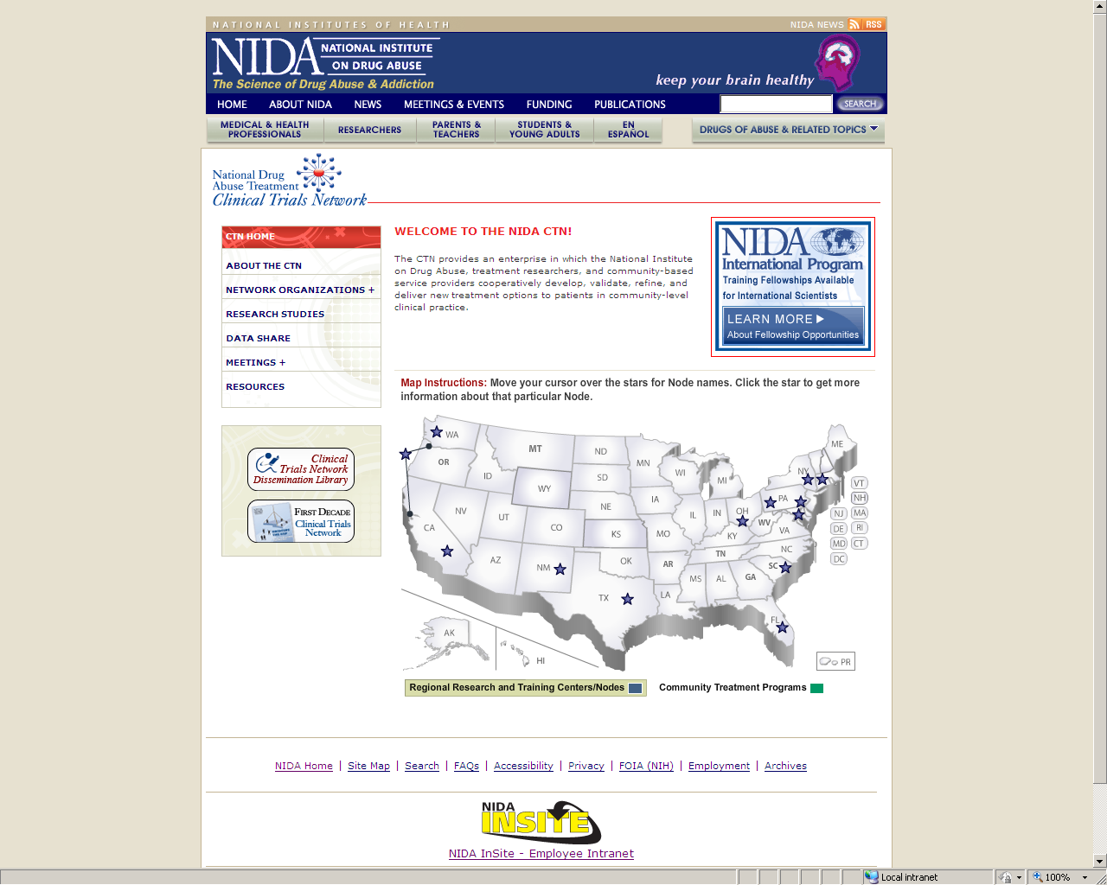

Slide 25
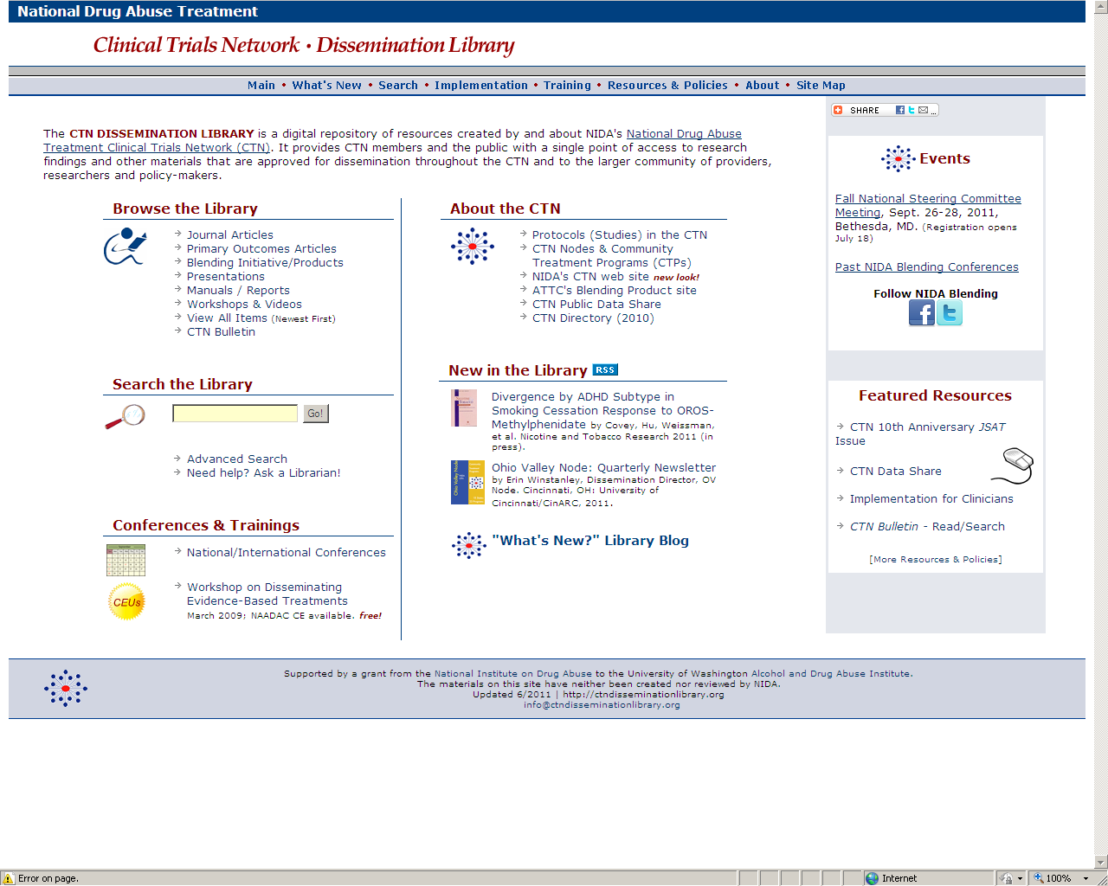

Slide 26
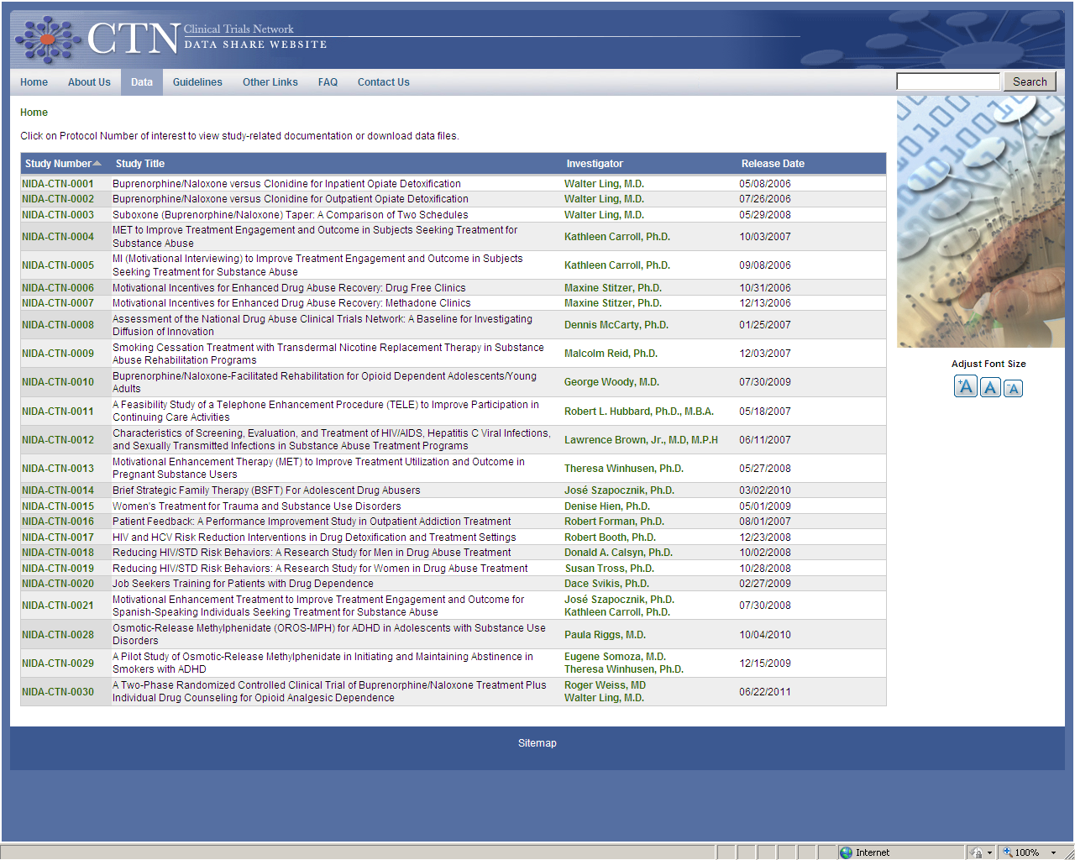
ctndatashare.org

Slide 28
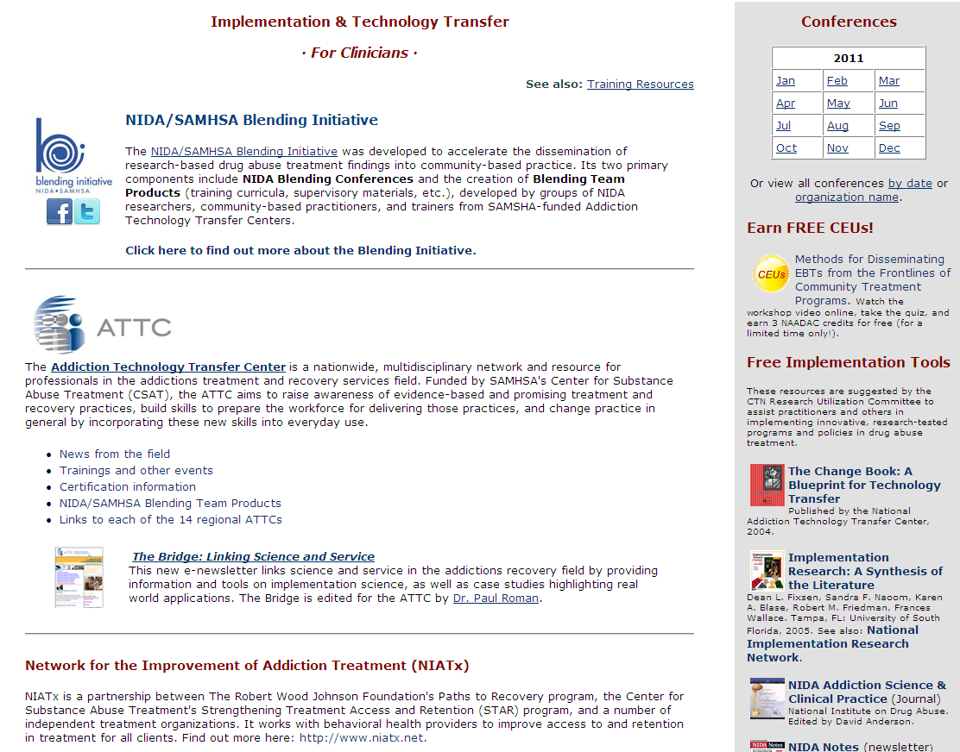

Slide 29
A Closing Thought
“The future is already here –
it's just not evenly distributed.”
William Gibson (science fiction writer)
as quoted in The Economist, December 4, 2003

Slide 30
Harold I Perl, PhD
Senior Lead for Behavioral Research, Dissemination and Training
Center for the Clinical Trials Network
National Institute on Drug Abuse
301/443-9982
hperl@nida.nih.gov
nida.nih.gov/CTN
ctndisseminationlibrary.org
nida.nih.gov/blending
motivationalincentives.org
attcnetwork.org

