Slide 1
Substance Use Treatment with Ethnic Minorities: Lessons Learned in the Clinical Trials Network of the National Institute on Drug Abuse
2011 Annual APA Convention
August 5th, 2011
Kathy Burlew, PhD (Chair)
Carmen Rosa, MS
Audrey Brooks, PhD
Jerren Weekes, MA
Alyssa Forcehimes, PhD

Slide 2
Background on NIDA Clinical Trials Network
Established in 1999
Improve substance abuse treatment by bridging the gap between practice and research

Slide 3
National Drug Abuse Treatment
Clinical Trials Network
Regional Research and Training Center (RRTC)
State with Community Treatment Program (CTP)
Appalachian Tri-State Node
University of Pittsburgh
Delaware Valley Node
University of Pennsylvania
Florida Node Alliance
University of Miami
Greater New York Node
New York State Psychiatric Institute
New York University
Mid-Atlantic Node
The Johns Hopkins University
Friends Research Institute, Inc.
New England Consortium
McLean Hospital
Yale University
Ohio Valley Node
University of Cincinnati
Pacific Northwest Node
University of Washington
Washington State University
Pacific Region Node
University of California, Los Angeles
Southern Consortium Node
Medical University of South Carolina
Duke University Medical Center
Southwest Node
University of New Mexico
Texas Node
Univ. of Texas, Southwestern Med Cen.
Western States Node
University of California, San Francisco
Oregon Health & Science University

Slide 4
Today’s Presenters
Carmen Rosa. Participation in Substance Abuse Clinical Trials: Comparing Gender, Racial/Ethnic, and Age Groups.
Audrey Brooks. Racial/Ethnic Differences in the Rates and Correlates of HIV Risk Behaviors Among Drug Abusers.
Jerren Weekes. The Relation of Racial/Ethnic Matching to the Engagement, Retention, and Treatment Outcomes of Adolescent Substance Users.
Alyssa Forcehimes. The Relationship between Therapist and Patient Gender/Race-Matching and Substance Use Outcomes across Two Motivational Therapy Trials.

Slide 5
Participation in Substance Abuse Clinical Trials: Comparing Gender, Racial/Ethnic and Age Groups
Carmen Rosa
NIH/NIDA

Slide 6
Background
REM/Women historically under-represented in clinical trials
Much literature regarding recruitment, less on retention
Greater vulnerability of these populations to adverse medical/social consequences of SUD
Need to successfully retain in research studies

Slide 7
Background (cont)
Reported that REM have lower retention than NHW (both in treatment and research)
Others have not seen differences in some SUD studies
Similar reports regarding age and gender
Most analyze retention based on study completion or attendance to F/U sessions

Slide 8
Methods
Analyzed 24 RCTs completed in the CTN
CTN established several strategies for RR
9 Rx/combination and 15 psychosocial trials
~11,449 subjects across 190 CTP
Retention was measured using 3 criteria:
Availability of primary outcome measure(s)
Treatment exposure
Attendance at follow up visits

Slide 9
Results: Demographic Characteristics
 | Count | Percent
Male | 6795 | 59.4%
Female | 4646 | 40.6%
Non-Hispanic White | 6099 | 53.3%
Non-Hispanic African-American | 2428 | 21.2%
Hispanic | 1966 | 17.2%
Multi-Race | 689 | 6.0%
Non-Hispanic American-Indian/Alaska Native | 124 | 1.1%
Age Groups
<18 | 729 | 6.4%
18 to <25 | 1623 | 14.2%
25 to <35 | 2990 | 26.1%
35 to <45 | 3200 | 28.0%
45 to <55 | 2415 | 21.1%
55 to <65 | 447 | 3.9%

Slide 10
Measures of participation based on 24 clinical trials on drug abuse (in %)
Demographic Category | (APOM) | (TE) | (FU)
Female | 74.2 | 75.2 | 72.8
Male | 73.6 | 76.6 | 71.3
Non-Hispanic African-American | 71.7 | 71.2 | 68.5
Multi-Race | 70.2 | 72.4 | 70.4
Hispanic | 73.2 | 72.4 | 73.9
Non-Hispanic White | 73.8 | 74.5 | 72.2
18 to <25 | 66.8 | 68.9 | 64.3
25 to <35 | 68.6 | 67.4 | 67.9
35 to <45 | 73.2 | 71.9 | 70.8
45 to <55 | 76.8 | 75.9 | 75.2
55 to <65 | 80.1 | 75.8 | 79.4
Overall* | 74.0 | 73.3 | 70.5

Slide 11
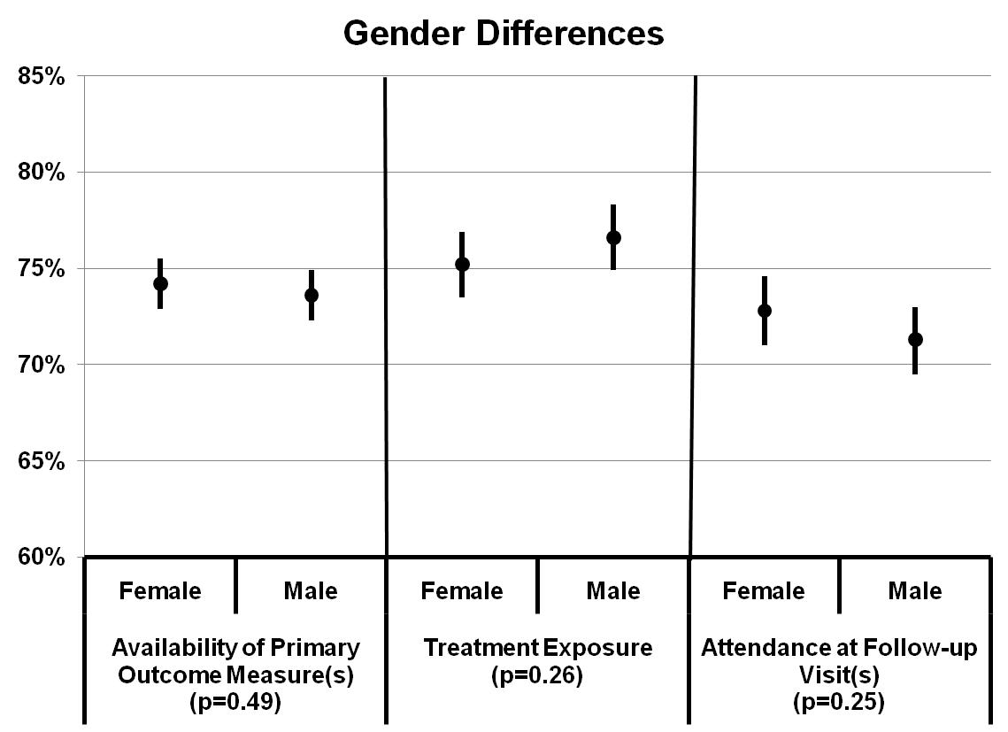

Slide 12
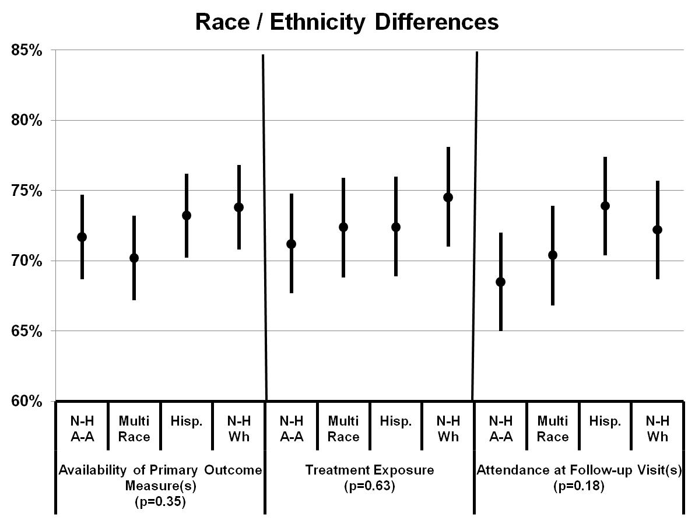

Slide 13
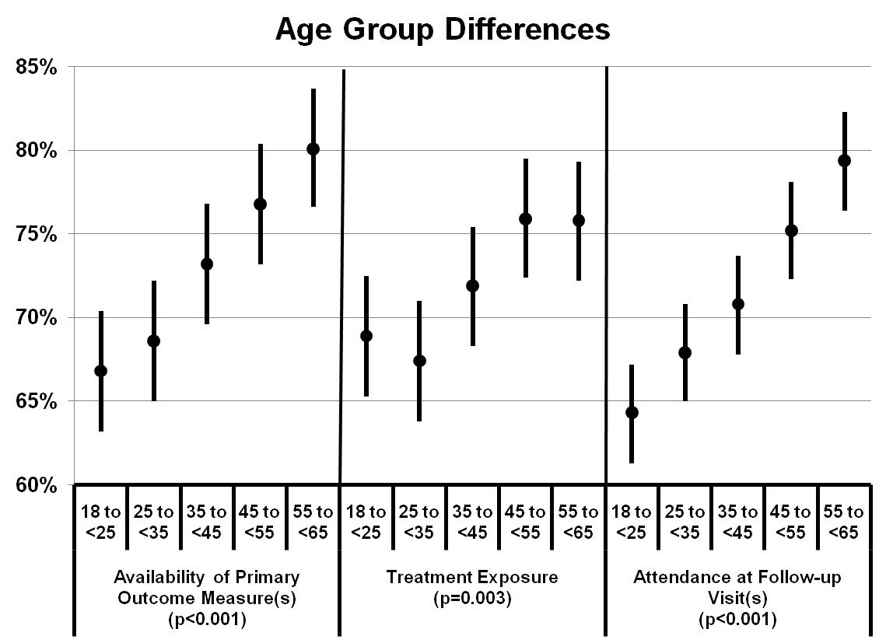

Slide 14
Discussion
No statistically significant differences among gender or race/ethnic groups
Difference for some indicators in some of the trials, showing that NHW and Hispanics remain in certain studies longer than NHAA
Differences among age groups: retention was higher for older participants

Slide 15
Recommendations
Include more AIAN and AAPI participants in clinical trials
CTN researching barriers to TX and expanding to include treatment programs
CBPR with AIAN populations
Increase efforts in retention of younger and NHAA participants
Investigate reasons for lower retention in younger populations

Slide 16
Limitations
Observational analysis
Several factors may affect retention
Primary drug use/patterns of drug use
Trial specific definition of retention indicators
Did not analyze data for specific reasons for attrition

Slide 17
Racial/Ethnic Differences in the Rates and Correlates of HIV Risk Behaviors Among Drug Abusers
Audrey Brooks,
University of
Arizona

Slide 18

Racial/Ethnic Differences in the Rates and Correlates of HIV Risk Behaviors Among Drug Abusers
Audrey J. Brooks, Ph.D., University of Arizona
Yuliya Lokhnygina, Ph.D., Duke Clinical Research Institute
Christina S. Meade, Ph.D., Duke University School of Medicine
Jennifer Sharpe Potter, Ph.D., M.P.H, University of Texas Health Science Center at San Antonio
Donald A. Calsyn, Ph.D., University of Washington
Shelly F. Greenfield, M.D., M.P.H., Harvard Medical School
This research was supported by NIDA’s Clinical Trials Network
NIDA Clinical Trials Network

Slide 19
Background
HIV infection disproportionately impacts minorities in the United States.
HIV infection is estimated to be 7 times higher for African-Americans and 3 times higher in Hispanics than among Whites.
Multiple risk factors for HIV risk behaviors have been identified.
Whether the relationship between risk factor and risk behavior varies by ethnicity has rarely been examined.

Slide 20
Purpose
This study examined racial/ethnic differences in the rates of HIV risk behaviors and whether the relationship between HIV risk factors and HIV risk behaviors varies by race/ethnicity in clients participating in NIDA Clinical Trials Network multi-site trials.

Slide 21
Methods
Secondary data analysis of randomized participants from 7 CTN multi-site trials.
Buprenorphine/Naloxone vs. Clonidine for Inpatient & Outpatient Opiate Detoxification
Motivational Incentives for Stimulant Users in Outpatient Clinics & Methadone Clinics
Motivational Enhancement Treatment to Improve Treatment Engagement and Outcome – English & Spanish-speaking
Motivational Interviewing in Outpatient Clinics

Slide 22
Measures
HIV Risk Behavior Scale - past 30 days
Drug risk behaviors: frequency of injection drug use, receptive and distributive needle sharing, and needle cleaning
Sex risk behaviors: number of partners, sex trading, anal sex and condom use
Addiction Severity Index – Lite
Sociodemographic variables
Alcohol & drug use, psychiatric, legal, family/social, employment composites

Slide 23
Sample Characteristics (N=2,063)
41% non-Hispanic White
32% non-Hispanic African-American
27% Hispanic American
35% Female
Average Age 36.5 years, 18-73 range
Average Education 11.8 years, 0-27 range
55% Employed Full-time
28% Stimulant; 14% Heroin/Opiate; 27% Both, 31% Other

Slide 24
Racial/Ethnic Differences Demographics
Variable | White N=838 (41%) | African-American N=665 (32%) | Hispanic N=560 (27%) | Total Sample N=2063 *p<0.001
Age | 34.3±9.8 | 42.1±7.7 | 33.1±9.1 | 36.5±9.8*
Education | 12.7±2.1 | 12.0±1.9 | 10.0±3.2 | 11.8±2.6*
Female | 379 (45.2%) | 279 (42.0%) | 75 (12.9%) | 730 (35.4%)*
Employed FT | 463 (55.3%) | 324 (48.7%) | 355 (63.4%) | 1142 (55.4%)*
Employed PT | 151 (18.0%) | 76 (11.4%) | 66 (11.8%) | 293 (14.2%)
Living w-Partner | 322 (38.4%) | 267 (40.2%) | 48 (8.6%) | 637 (30.9%)*
Heroin/Opiates | 162 (19.3%) | 59 (8.9%) | 67 (12.0%) | 288 (14.0%)*
Stimulants | 196 (23.4%) | 224 (33.7%) | 152 (27.1%) | 572 (27.7%)
Opiates /Stimulants | 226 (27.0%) | 277 (41.7%) | 59 (10.5%) | 562 (27.2%)
Other Drug | 254 (30.3%) | 105 (15.8%) | 282 (50.4%) | 641 (31.1%)
Notes:
Conducted chi-square categorical & Kruskal-Wallis continuous

Slide 25
Racial/Ethnic Differences Demographics
Hispanics:
Fewer females
Less education
Most likely to be employed FT
Least likely to live with a sexual partner
Most likely to report “other” drug use
African-Americans
Older
Most likely to report Stimulant/Opiate use
Whites
Most likely to report Heroin/Opiate use

Slide 26
Racial/Ethnic Differences HIV Sex Risk Behaviors
Variable | White | African-American | Hispanic | Total Sample
Sexually Active | 513 (61.2%) | 393 (59.1%) | 355 (63.4%) | 1261 (61.1%)
2+ Partners | 86 (16.8%) | 80 (20.4%) | 36 (10.1%) | 202 (16.0%)*
UPS - Partner | 379 (73.9%) | 276 (70.2%) | 270 (76.1%) | 925 (73.4%)
UPS - Casual Sex | 57 (11.2%) | 28 (7.4%) | 39 (11.0%) | 124 (10.0%)**
No Trading Sex | 472 (92.9%) | 340 (89.9%) | 330 (93.2%) | 1142 (92.1%)
UPS - Trading Sex | 23 (4.5%) | 18 (4.8%) | 19 (5.4%) | 60 (4.8%)***
No Anal Sex | 465 (91.5%) | 368 (94.4%) | 323 (91.2%) | 1156 (92.3%)
UPS - Anal Sex | 33 (6.5%) | 15 (3.9%) | 22 (6.2%) | 70 (5.6%)
Sex Risk Total | 5.9±2.8 | 5.7±2.7 | 5.9±3.1 | 5.9±2.8
UPS = Unprotected Sex *p<0.001; **p=0.009; ***p=0.036

Slide 27
Racial/Ethnic Differences HIV Sex Risk Behaviors
Two-thirds sexually active
African Americans most likely to report multiple partners & trading sex but least likely to report unprotected sex with a casual partner
Hispanics least likely to report trading sex but most likely to report unprotected sex when trading sex

Slide 28
Racial/Ethnic Differences HIV Drug Risk Behaviors
Variable | White | African-American | Hispanic | Total Sample
Any IDU | 232 (27.7%) | 111 (16.7%) | 69 (12.3%) | 412 (20.0%)*
Daily IDU | 163 (70.3%) | 55 (49.5%) | 52(75.4%) | 270 (65.5%)*
Receptive Needle Sharing | 42 (21.0%) | 13 (12.7%) | 16 (23.2%) | 71 (19.1%)
Distributive Needle Sharing | 52 (23.2%) | 18 (16.4%) | 25 (37.3%) | 95 (23.7%)**
Inconsistent Needle Cleaning Before Use | 112 (54.4%) | 60 (56.6%) | 46 (66.7%) | 218 (57.2%)
Drug Risk Composite | 8.9±5.2 | 7.0±4.3 | 9.7±4.4 | 8.5±4.9*
*p<0.001; **p=0.006

Slide 29
Racial/Ethnic Differences HIV Drug Risk Behaviors
20% reported IDU
66% daily users; 32% shared needles
57% inconsistently cleaned needles
Hispanics least likely to report IDU but highest distributive needle sharing & overall drug risk behaviors
African-Americans least likely to report daily IDU, distributive needle sharing & overall drug risk behaviors

Slide 30
Correlates of HIV Risk Behavior Analysis
Ordinal logistic regressions using partial proportional odds model were conducted to identify variables associated with sex risk.
Compared high vs. medium & low risk
Compared high & medium vs. low risk
Linear regressions were conducted to identify variables associated with drug risk.
Predictors: Interaction between ASI composites & race/ethnicity

Slide 31
Correlates of HIV Sex Risk Behavior (n=1261)
African-Americans less likely to report high/moderate sexual risk behaviors compared to low risk than Whites (O.R. 0.60; 95% CI 0.44-0.83)
African-Americans with greater alcohol severity more likely to report high vs. moderate & low risk (O.R. 1.16; 95% CI 1.06-1.28)

Slide 32
Correlates of HIV Sex Risk Behavior (n=1261)
African-Americans with greater psychiatric severity more likely to report high vs. moderate & low risk (O.R. 1.15; 95% CI 1.04-1.28)
Whites with greater psychiatric severity more likely to report high/moderate vs. low risk (O.R. 1.11; 95% CI 1.02-1.20)
Stimulant use, drug use severity, abuse history, legal involvement severity associated with sex risk behaviors

Slide 33
Correlates of HIV Drug Risk Behavior (n=412)
Whites with greater drug use severity had higher HIV drug risk behavior (β = 1.11)
Hispanics with greater drug use severity had a more pronounced association with higher HIV drug risk behavior (β = 1.68)
Greater psychiatric severity was possibly associated with higher drug risk behavior in Whites and lower drug risk behavior in African Americans* and Hispanics
*p=0.056

Slide 34
Conclusions
Racial/Ethnic differences in risk behaviors:
African-Americans engaged in less HIV sexual risk behaviors overall than Whites
African-Americans reported more specific high risk sexual encounters but greater use of protection
Whites were most likely to be IDUs
Hispanics least likely to be IDUs but engaged in more high risk HIV drug risk behaviors

Slide 35
Conclusions
Relationship between certain HIV risk factors and HIV risk behaviors differed between ethnic groups:
Alcohol use and psychiatric severity was related to engaging in higher sex risk behaviors for African-Americans
Psychiatric severity was related to engaging in higher sex risk behaviors for Whites
Drug use severity was associated with engaging in higher risk drug behaviors for Hispanics, and to a lesser degree, Whites

Slide 36
Conclusions
The findings from the present study suggest that there is a context (or culture) in which HIV high risk behaviors occur within racial/ethnic groups as well as differences in the presence of risk factors associated with engaging in HIV risk behaviors.
This is consistent with calls to culturally adapt evidence based interventions.

Slide 37
The Relation of Race/Ethnic-Matching to the Engagement, Retention, and Treatment Outcomes of Adolescent Substance Users
Jerren C. Weekes,
University of Cincinnati

Slide 38
Acknowledgments
Dr. Kathy Burlew
Dr. Dan Feaster
Ms. Natali Teszler
Dr. Mike Robbins
NIDA CTN
University of Cincinnati Research Council (funding)

Slide 39
Background
Treatment Barriers
Cultural dis/mistrust
Racial/cultural dissimilarity
Lack of cultural relevance of current treatments
Informative purposes
Inform about ethnic minority preferences
Translate findings
Notes:
Racial/ethnic differences can lead to poorer communication, understanding, and rapport (Sue & Sue, 1977; Watkins, Terrell, Miller, & Terrell, 1989).
EBTs are largely based on data from White (middle class, English speaking) participants (Hall, 2001).
Culturally sensitive therapies (CSTs) may serve to effectively engage and retain minority clients more so than “mainstream” EBTs (Hall, 2001).

Slide 40
Background
Surface Modification (Resnicow et al., 2000): -Involves modifying “superficial” treatment components to increase treatment receptivity.
Persons Dimension (Bernal & Saez-Santiago, 2006):
Consider the role of the existing client-therapist racial/ethnic similarity/dissimilarity

Slide 41
Gaps in the Literature
(1) Few Racial and Ethnic Matching (REM) studies have examined the relation of REM to engagement, retention, and treatment outcomes of substance using youth.
(2) Lack of analysis for specific racial/ethnic minority groups.
(3) No study has examined family functioning as a moderator variable.

Slide 42



The Current Study: A secondary analysis of existing data from a NIDA funded study evaluating Brief Strategic Family Therapy vs. Treatment as Usual .

Slide 43
Aim of Current Study
Aim 1: To conduct exploratory analyses to determine if the relation of REM to treatment outcomes varies with the initial functioning of the family.
Hypothesis: Family functioning would moderate the relationship between REM and treatment outcomes.

Slide 44
Participants
Adolescents enrolled in treatment at one of eight sites participating in the national study sponsored of BSFT vs. TAU by the NIDA Clinical Trials Network (NIDA CTN-0014).
Inclusion criteria:
(1) 12-17 years-old,
(2) self-report use of some illicit substance in the 30 days prior to enrollment
(3) family was willing to participate in family therapy
(4) lived near treatment center.

Slide 45
Sample Characteristics
Table 1. Demographic Characteristics of the Adolescent Participants
Characteristic |  |  | % Matched
Race/Ethnicity, N (%)
African American | 110 (23) |  | 44% (n= 48)
Hispanic/Latin | 213 (44) |  | 44% (n =94)
White | 148 (31) |  | 76% (n = 112)
Gender, N (%)
Female | 103 (22)
Male | 377 (78)
Age, M (SD) | 16.01 (1.8)

Slide 46
Study Variables
Variable | Measure | Analysis
Demographics | Demographic Form
Engagement/ Retention | E = 2+ sessions; R = 8+ sessions (therapists interviews) | Logistic Regression
Drug Use | TLFB; Urine Screens | Logistic Regression
Externalizing Behaviors | The National Youth Survey The Total Delinquency scale The Youth Self Report (YSR) Diagnostic Interview Schedule for Children | Multiple Regression
Family Functioning | Parenting Practices Questionnaire Scales Family Environments Scale [Conflict & Cohesion scales]
Notes:
Composite scores for family functioning and externalizing behaviors were created in an effort to collapse the multiple scores from the family functioning and externalizing measures into total composite scores for each variable. To create the composite scores, Z-scores were obtained for each scale and the scores were summed to obtain the total composite scores (Feaster et al., 2010). This method (i.e., the use of Z-scores) ensured that (1) each measure was based on the same metric and (2) each scale contributed equally to the total composite score for the externalizing and family functioning variables. The measures/subscales included in the composite score for family functioning include the adolescent and parent reports on the FES and the Parenting Practices Questionnaire. The measures/subscales included in the composite score for externalizing behaviors include the adolescent and parent reports on the NYS, YSR, and DISC-PS.

Slide 47
Data Analysis
Logistic Regression:
Drug Use
Engagement
Retention
REM, family functioning, and the interaction term were in each model.

Slide 48
Results
Hypothesis: Family functioning would moderate the relationship between race/ethnic-matching and the outcome variables.
This hypothesis was not supported for the Hispanic or White youth.
Baseline family functioning did moderate the relationship between race/ethnic-matching and the engagement outcome for African American adolescents (OR= 1.53, 95%CI = .57-4.09, p≤ .01)
African Americans who had lower levels of family functioning were more likely to be engaged in treatment if they were racially matched with their therapist.

Slide 49
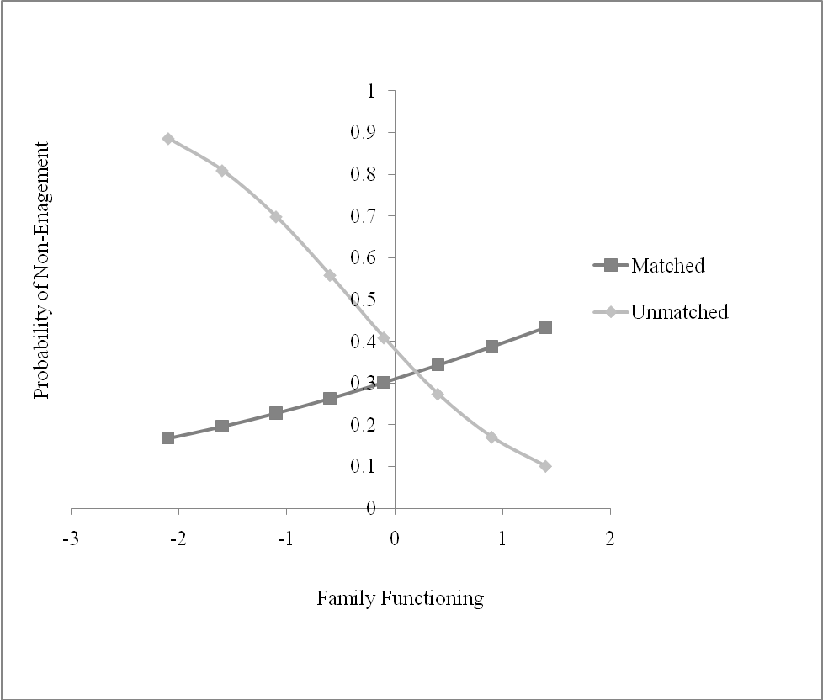
Probability of Non-engagement by Family Functioning for Matched and Non-matched African Americans
Figure 1. The moderation effects of family functioning on the relationship between REM and treatment engagement for African American adolescents.

Slide 50
Implications
REM matters for various subgroups
Deep structure rather than surface structure?
Importance of family functioning

Slide 51
Strengths & Limitations
Strengths:
This study addressed several existing gaps in the literature
A diverse sample was used
Appropriate statistical analyses were used
Data was from a randomized controlled trial
Limitations:
Culture related measures were not used
The Hispanic participants were matched on ethnicity rather than country of origin.

Slide 52
The Relationship between Therapist and Patient Gender/Race Matching and Substance Use Outcomes across Two Motivational Enhancement Therapy Trials
A.A. Forcehimes¹, M. Nakazawa.¹, L. Montgomery², K.A. Burlew², A. Kosinski³ , P. Kothari⁴ ¹University of New Mexico Center on Alcoholism, Substance Abuse, & Addictions ²University of Cincinnati ³Duke Clinical Research Institute ⁴ Synergy Enterprises
Alyssa Forcehimes,
University of New Mexico

Slide 53
Introduction
One of the strongest determinants of addiction treatment outcome is the relationship between the provider and the patient (McLellan, Woody et al., 1998)
Both motivational interviewing (MI) and motivational enhancement therapy (MET) are rooted in a belief that change is facilitated through a strengthening of a collaborative therapeutic relationship.
The successful use of MI/MET may depend on the therapist’s ability to develop strong alliance (Miller & Rose, 2009)

Slide 54
Therapeutic Alliance and Treatment outcome
A positive outcome was found in Project MATCH (Connors, Carroll et al. 1997), in which alliance was positively associated with percent days abstinent and negatively related to drinks per drinking day during both the treatment and follow-up periods
Other studies have failed to find a significant relationship in alliance and treatment outcome for MI based interventions (Crits-Cristoph, et al. 2009)

Slide 55
What might Influence Alliance: Looking at Potential Moderators
Alliance may vary depending on ethnicity or gender matches (or mismatches) between the patient and therapist
Some research supports patient/therapist similarity (matching) in developing alliance more successfully (Thompson, Worthington, et al., 1994), but findings are mixed (Fiorentine & Hillhouse, 1999).

Slide 56
Aim of this Study
Examine the moderating effects of gender/race matching between therapists and patients on therapeutic alliance and substance use outcomes

Slide 57
Method
Identical measures were obtained in two CTN trials of MET:
3 sessions of individual MET vs. Treatment as Usual (TAU) (CTN 0004)
3 sessions of individual MET delivered in Spanish vs. TAU delivered in Spanish (CTN 0021)
The two studies included 64 females and 281 males with a mean age of 33.7 (SD = 9.2).
43% of participants reported their race as white, 30% reported Latino, 26% reported “other”, and 1% reported African American

Slide 58
Method, continued
Measures
The Helping Alliance Questionnaire-II (HAQ-II)
The Addiction Severity Index-Lite
Posttreatment Attitudes and Expectations Questionnaire
Procedure
HAQ-II, administered at the end of 3 sessions of treatment
Therapists also completed a parallel version of the HAQ
ASI-Lite, administered at the 4 week follow-up
Patient’s perception of their therapist’s race or gender was extracted from the Posttreatment Attitudes and Expectations Questionnaire

Slide 59
Analytic Plan
Relationship between variables examined using ANCOVAs
Primary outcome variable was self-reported days of alcohol and drug use at week 4 assessed with ASI
possible range: 0-360; 30 days for each of the 12 drug categories; observed range 0-100.
Covariates
HAQ-II patient and therapist scores and baseline substance use days
Fixed variable
Race or gender match
Both HAQ-II scores were centered so intercept would be at the means of these scores instead of 0.
Log transformation was applied to the outcome variable to reduce its skewness
Effect size indicated by Cohen’s d

Slide 60
Hypotheses
(1) Patients’ perception of their therapists’ race will affect the amount of substance use, defined as self-reported days of substance use at the end of the active phase of treatment, and patients’ perception will moderate the relationship between therapeutic alliance, defined by patient as well as therapist scores on the HAQ-II at the end of the active phase of treatment, and substance use.
(2) Patients’ perception of their therapists’ gender will affect the amount of substance use, defined as self-reported days of substance use at the end of the active phase of treatment, and patients’ perception will moderate the relationship between therapeutic alliance, defined by patient as well as therapist scores on the HAQ-II at the end of the active phase of treatment, and substance use.

Slide 61
Results: Hypothesis 1
As hypothesized, racially matched patients reported significantly fewer days of drug use (t(341) = -2.40, p = 0.02, d = -0.26).
This effect equals to a 26% reduction in days of substance use from 5.2 to 3.9.
However, racial match was unrelated to patient perceived helping alliance (t(341) = 0.65, p = 0.52, d = 0.07).
When HAQ-II therapists’ scores were included in the model, racially matched patients again reported significantly fewer days of drug use (t(341) = -2.36, p = 0.02, d = -0.26).
Race matching significantly moderated the relationship between helping alliance perceived by therapists and substance use (t(341) = 2.03, p = 0.04, d = 0.22, fig. 1).
There were no differences in matching effects between CTN 0004 and 0021.

Slide 62
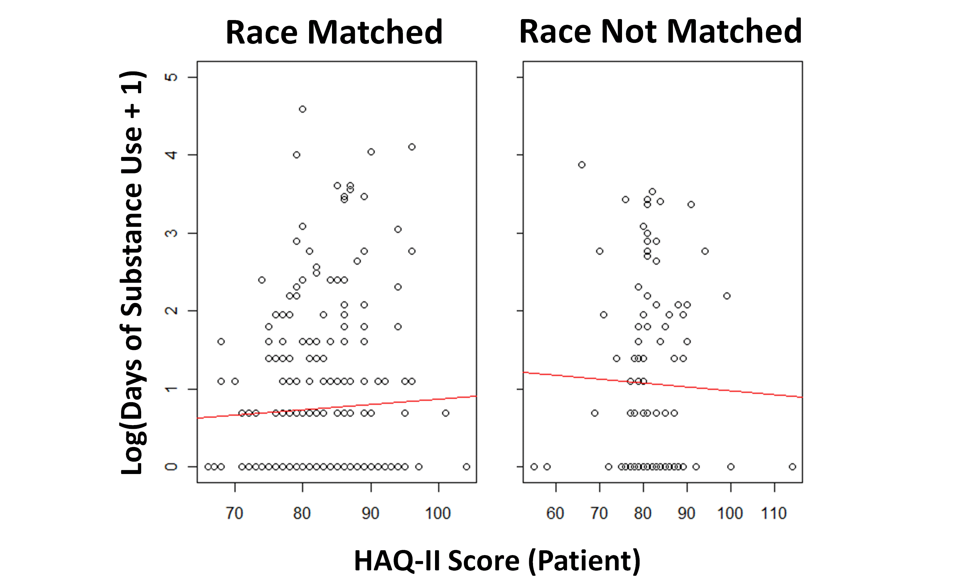
Results: Hypothesis 1

Slide 63
Results: Hypothesis 2
Gender matched patients reported significantly more days of drug use (t(341) = 2.17, p = 0.03, d = 0.23, fig. 2; a 57% increase from 3.4 to 5.3 days,) even after HAQ-II therapists scores were included in the model (t(341) = 2.01, p = 0.045, d = 0.22).
Perceived gender similarity did not significantly affect the level of helping alliance indicated by patients (t(341) = 1.72, p = 0.09, d = 0.19) or therapists (t(341) = 0.56, p = 0.58, d = 0.06).
There were no differences in matching effects between CTN 0004 and 0021.

Slide 64
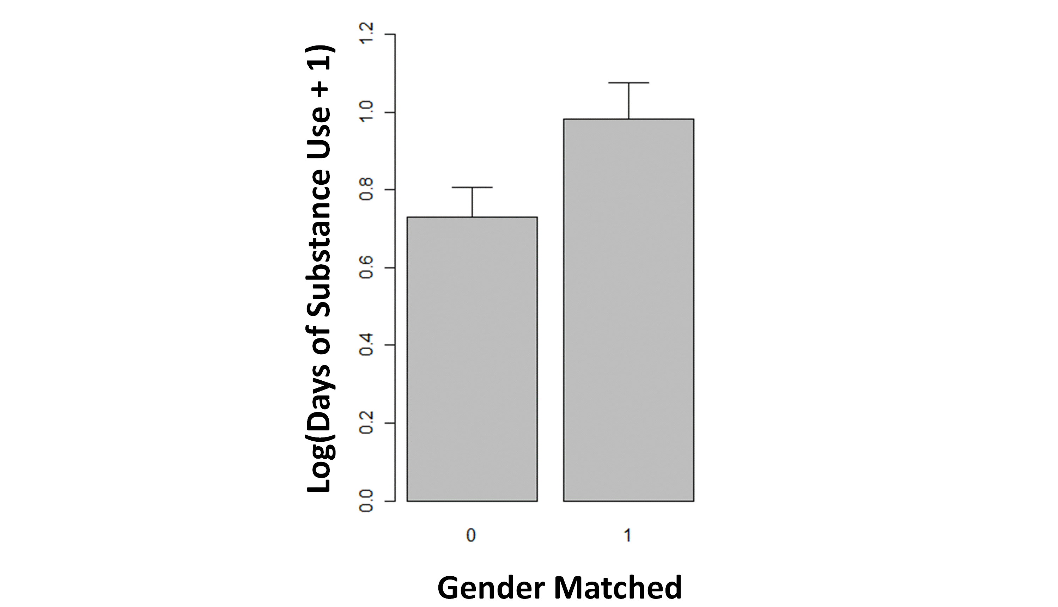
Results: Hypothesis 2

Slide 65
Discussion
Some unexpected findings:
Matches in race resulted in significantly less substance use compared to patients and therapists whose race did not match.
Therapists’ ratings of alliance varied by race matching, but patients’ ratings didn’t. This suggests that therapists in this study seemed to have an easier time building alliance when working with a patient whose race matched their own.
Unlike matches in race, matches in perceived gender between therapist and patient do not seem to be a helpful in decreasing substance use. Patients who perceived their therapist’s gender to be the same as their own gender actually had more days of substance use. Gender similarity also didn’t increase therapeutic alliance as perceived by patients or therapists

Slide 66
Limitations
A few limitations are worthy of mention when interpreting these results:
This study only examined patients’ perceptions of gender and race. It cannot be assumed that the therapists had the same impression, and it remains unknown whether these impressions might have resulted in different outcomes.
Asking patients about their therapist’s race may have been confusing for patients who were Latino or Hispanic, since many consider “Latino” to be an ethnic group rather than a race. Race may have been defined differently, thus results may have differed if the question would have been “Was your counselor the same ethnicity as you?”
There were many more males than females in this study, which may have influenced the results. There were also very few African Americans, which is too few to make conclusions about matching African American patients with same race therapists.

Slide 67
Summary
Overall, findings from this study support a recommendation of matching patients to providers of the same race, but do not support a recommendation of routinely matching patients to providers of the same gender.

Slide 68
Research Support
This research was supported by NIDA’s Clinical Trials Network

Slide 69
References
Crits-Christoph, P., R. Gallop, et al. (2009). "The alliance in motivational enhancement therapy and counseling as usual for substance use problems." Journal of Consulting and Clinical Psychology 77(6): 1125-1135.
Connors, G. J., K. M. Carroll, et al. (1997). "The therapeutic alliance and its relationship to alcoholism treatment participation and outcome." Journal of Consulting and Clinical Psychology 65(4): 588-598.
Fiorentine, R. and M. P. Hillhouse (1999). "Drug treatment effectiveness and client-counselor empathy." Journal of Drug Issues 29(1): 59-74.
McLellan, A. T., G. E. Woody, et al. (1988). "Is the counselor an "active ingredient" in substance abuse rehabilitation? An examination of treatment success among four counselors." Journal of Nervous and Mental Disease 176: 423-430.
Miller, W. R., & Rose, G. S. (2009). Toward a theory of motivational interviewing. American Psychologist, 64, 527–537.
Thompson, C. E., R. Worthington, et al. (1994). "Counselor content orientation, counselor race, and Black women's cultural mistrust and self-disclosures." Journal of Counseling Psychology 41(2): 155-161.

Slide 70

Contact Information:
Kathy Burlew, Ph.D.
University of Cincinnati
rkburlew@juno.com
Carmen Rosa, M.S.
National Institute on Drug Abuse
crosa@nida.nih.gov
Audrey J. Brooks, Ph.D.
University of Arizona
brooksaj@email.arizona.edu
Jerren Weekes, M.A.
University of Cincinnati
weekesjc@mail.uc.edu
Alyssa Forcehimes, Ph.D.
University of New Mexico
Aforcehimes@comcast.net

