Slide 1
Implementing Rapid HIV Testing with or without Risk-Reduction Counseling in Drug Treatment Centers: Results of a Randomized Trial
Louise Haynes MSW
Medical University of South Carolina
Lead Investigators:
Lisa Metsch PhD
Miller School of Medicine, University of Miami
Grant Colfax MD
San Francisco Department of Public Health

Slide 2

International Society for Addiction Medicine Oslo, Norway 2011

Slide 3
Supported by National Institute on Drug Abuse Clinical Trials Network (1 U10 DA13727). PI - Kathleen Brady MD PhD
No conflicts of interest to report

Slide 4
Co-Authors L. Metsch¹, D. Feaster¹, L. Gooden¹, T. Matheson², R. Mandler³, L. Haynes⁴, S. Tross⁵, T. Kyle⁶, D. Gallup⁷, A. Kosinski⁸, A. Douaihy⁹, B. Schackman¹⁰, M. Das², R. Lindblad¹¹, S. Erickson¹², P. Korthuis¹³, S. Martino¹⁴, J. Sorensen¹⁵, J. Szapocznik¹, R. Walensky¹⁶, G. Colfax²
¹University of Miami Miller School of Medicine, Miami, ²San Francisco Department of Public Health, ³Center for the Clinical Trials Network, National Institute on Drug Abuse, ⁴Medical University of South Carolina, ⁵Columbia University and New York State Psychiatric Institute, ⁶Center for Drug-Free Living, Inc., ⁷Duke Clinical Research Institute, ⁸Department of Biostatistics and Bioinformatics at Duke University Medical Center and Duke Clinical Research Institute, ⁹University of Pittsburgh School of Medicine, Department of Psychiatry, Western Psychiatric Institute and Clinic, ¹⁰Weill Cornell Medical College, ¹¹EMMES Corporation, Inc., ¹²University of New Mexico, ¹³Department of Medicine, Oregon Health Science University, ¹⁴Yale University, ¹⁵University of California, San Francisco, ¹⁶Massachusetts General and Brigham and Women’s Hospitals and Harvard Medical School.

Slide 5
Background
In the United States, more than one-fifth of HIV cases are undiagnosed.
Multiple efforts have been undertaken to increase HIV testing, but the efficacy of risk-reduction counseling in these efforts warrants further examination.

Slide 6
HIV in the United States
HIV infected 1,106,400
Unaware of their 232,700
HIV infection (21%)
Annual incidence 56,300
Campsmith 2010 J Acquir Immune Decfic Syndr; Hall 2008 J Acquir Immune Decfic Syndr

Slide 7
Estimated Percentages of Newly Diagnosed HIV/AIDS Cases among Adults and Adolescents, by Transmission Category (2007—34 states)
DHHS and CDC

Slide 8
Benefits of HIV Testing
Decreases HIV transmission
HIV diagnosis is associated with reduction in high risk sexual and injection behaviors
Improves survival
Linkage to care and treatment
Lower viral load associated with decreased infectivity
Marks 2004 Curr Infect Dis Rep; Colfax 2002 AIDS; Quinn 2000 AIDS

Slide 9
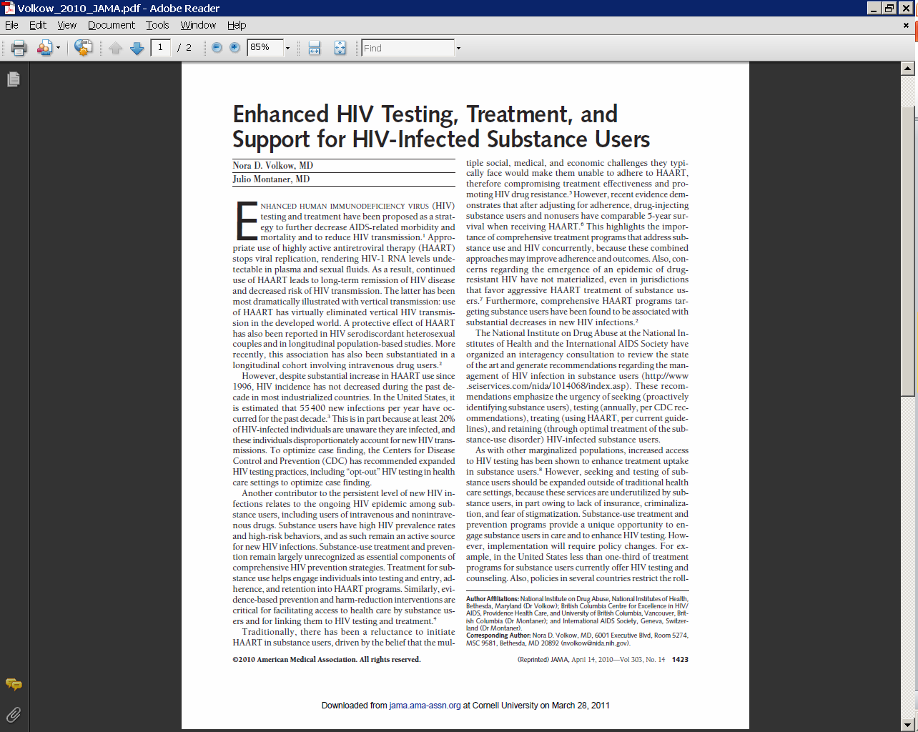
“Seek, Test, Treat, and Retain”

Slide 10
National HIV/AIDS Strategy
Target: Increase proportion of people living with HIV who know their status to 90% by 2015
“SAMHSA and other relevant HHS agencies will consider guidance requiring federally funded substance abuse and mental health treatment clinics to offer voluntary routine HIV testing to their clients.”
“CDC will updated and issue guidelines on the provision of HIV counseling and testing in non-clinical settings.”

Slide 11
HIV Testing in Substance Abuse Treatment Programs
Fewer than one-third of U.S drug treatment programs offer HIV testing and counseling. *
Fewer than half of CTN community treatment programs made HIV testing available either in the CTP, or through referral.**
Need for changes in policy and organizational culture***
SAMSHA, 2004, Pollack and D’Aunno, 2010 *
Brown et al. JSAT, 2006, AJPH, 2007 **
Haynes et al. EPP, 2011***

Slide 12
Aim
This randomized clinical trial examined the efficacy of on-site rapid HIV testing with risk-reduction counseling in:lRC) on
increasing receipt of HIV test results and
reducing HIV risk behaviors among persons in drug treatment.

Slide 13
Methods
Between January and May 2009, adults who reported no receipt of HIV results for a test performed in the last 12 months were randomized in 12 community-based drug treatment programs.

Slide 14
3 Arms
Participants were randomly assigned to:
1) referral for off-site HIV testing (n=429);
2) HIV risk-reduction counseling with the offer of on-site rapid HIV testing (n=433); or
3) verbal information about testing only with the offer of on-site rapid HIV testing (n=419),

Slide 15
Participating Sites
CODA
MCCA
Wheeler
CPCDS
Glenwood
Gibson Recovery
Chesterfield
Life Link
Daymark
LRADAC
Morris Village
La Frontera

Slide 16
Baseline Drug Use
Injected Drugs in Lifetime 48.6%
Injected Drugs in Last 6 Mo 20.6%
Used Opiates in Last 6 Mo 37.0%
Used Stimulants in Last 6 Mo 43.6%
High Drug Use Severity 53.6%
Binge Drinking 71.8%

Slide 17
Of 1,281 participants
39% were women
20.5% were African-American
64.4% were white
63% reported unprotected anal or vaginal sex with at least one partner in the prior six months.

Slide 18
Retention at 1-month was 99.2%
At 6-months retention was 93.7%;
There was no statistical difference among study arms.
The combined on-site rapid testing participants received more HIV test results than off-site testing referral participants (p<0.001)
At 6-month follow-up, there were no significant differences in unprotected intercourse among the three groups (p=0.66)

Slide 19
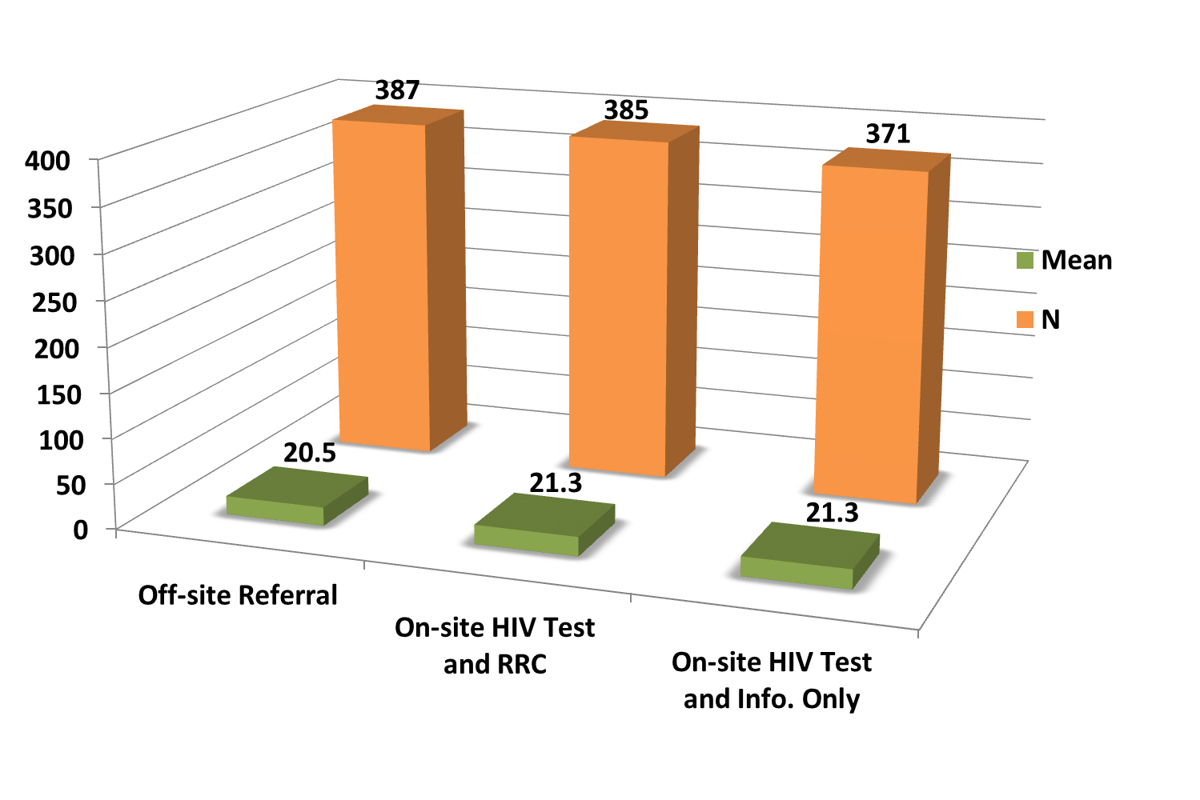
Number of Risky Sexual Behaviors, 6 Months Post-Randomization

Slide 20
Self-Report Receipt of HIV Test Results, 1 Month Post-Randomization

Slide 21
Conclusions:
This study demonstrated the value of on-site rapid HIV testing in drug treatment centers and found no additional benefit from HIV sexual risk-reduction counseling.

Slide 22
Implications
Broad clinical and public health ramifications
Offering HIV rapid testing on-site in drug treatment substantially increases the receipt of test results
No beneficial effect of brief risk-reduction counseling on reducing unprotected intercourse
Results support the implementation of routine rapid HIV testing with information only among patients without recent HIV testing in drug treatment centers

Slide 23
The cost-effectiveness of on-site rapid HIV testing in substance abuse treatment: results of the CTN 0032 randomized trial
Schackman BR, Metsch LR,
Colfax GN, Leff JA, Wong A,
Scott CA, Feaster DJ, Gooden L, Matheson T, Mandler RN,
Haynes LF, Paltiel AD,
Walensky RP

Slide 24
Objective
To project the life expectancy gains, costs and cost-effectiveness of 3 HIV testing strategies in substance abuse treatment centers evaluated in the CTN Rapid Testing and Counseling Study randomized controlled trial (CTN 0032)

Slide 25
Conclusions
In substance abuse treatment centers:
Referral for off-site testing is less costly but also less efficient than on-site testing
On-site risk reduction counseling adds cost without either reducing sexual risk behavior or increasing acceptance of HIV testing, and is not cost-effective
Offering rapid HIV testing on-site in substance abuse treatment programs is cost-effective using the current US threshold of <$100,000/QALY

Slide 26


