Slide 1

Factors Associated with Effective Implementation of SBIRT Delivered in an Emergency Department Setting
Alyssa A. Forcehimes, Ph.D.
Cameron Crandall, M.D.
Michael P. Bogenschutz, M.D.
Dennis Donovan, Ph.D.
Robert Lindblad, M.D.
Robrina Walker, Ph.D.

Slide 2
Presentation Aims
Discuss implementation and training procedures used in the NIDA CTN six-site SMART-ED trial, specifically:
Site selection
Staff selection
RA and interventionist training
Site preparation
Data collection
Present “lessons learned” from the implementation of this study
Notes:
SBIRT programs require adaptations to function effectively in a high-volume hospital ED setting

Slide 3
Site Selection Process
Developed list of desirable characteristics of participating EDs, including:
Large volume of patients who use drugs
Research experience
Ability to present a convincing plan for patient flow and space utilization
Have or are able to hire appropriate staff to conduct the study (in conjunction with the university research center)
Have an ED physician who can serve as protocol PI or otherwise be actively involved in the protocol

Slide 4
Characteristics of Nominated EDs
In response to our site survey request we received 17 responses from 14 nodes
The majority of respondents:
Large EDs with academic affiliation and significant research experience
Average of 447 patients eligible per month
Variability among prospective sites with regard to:
Department and ED staff buy-in
ED physician involvement
Commitment of leadership to the implementation process

Slide 5
Site Selection Process
Rating forms completed by executive committee members
Telephone interviews with 11 sites
Site visits to 8 EDs with lead investigator, project director, ED physician and lead QA monitor
Met with proposed research team
Walk through to understand patient flow
Brought information back to executive committee to make the final decisions

Slide 6
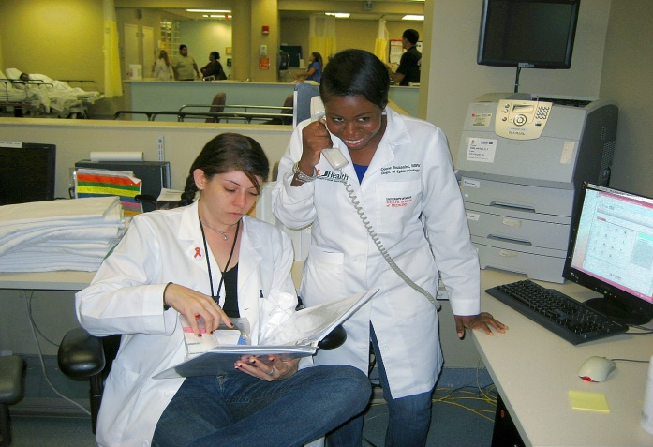
Staff Selection
Research Assistants/Interventionists
Personnel Fit
Needed to consider whether person could work effectively in the fast-paced ED setting
Need to be flexible and adaptable
Interruptions are common and unavoidable
Empathy and Research Abilities
Empathy necessary to deliver an MI based intervention (Miller, Taylor et al., 1980)
Research skills necessary for protocol adherence

Slide 7
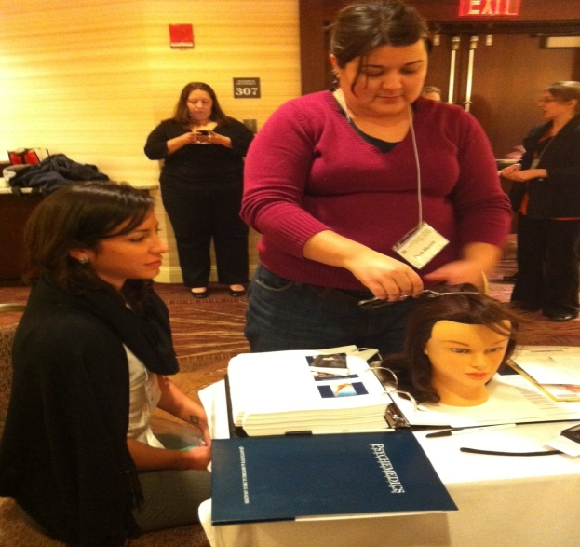
RA Training
Pre-training webinars
National training
Didactic presentation, demonstrations, opportunities to practice key skills
Post-training webinars
Role plays at the site
Weekly calls

Slide 8
Interventionist Training
In-person trainings included didactic presentation and role-playing
Local 2-day pre-training in patient-centered counseling skills
National 2 day training in MI/MET
Worked on role plays with other RAs/Interventionists at sites
Completed two pilot sessions with ED patients who met criteria for enrollment
Submitted these sessions for certification
Post-training booster MI webinar incorporating questions from sites and areas for improvement from certification sessions
Notes:
Willing to work within a structured program and put aside other training (e.g., case management)

Slide 9
Interventionist Coaching
Providers who attend only a 2-day training without receiving ongoing coaching and training often drift (Miller, Yahne et al., 2004)
Coaching successfully prevents drift (Martino, Ball et al., 2011)
Centralized monitoring center
MITI and content coding on 5% of sessions
Feedback uploaded to online system for supervisor review
Initiates red-line warnings and red-lines for interventionists
Centralized supervision center
Listen to one session per supervisee per week, assess and offer feedback
Ongoing bi-weekly individual and group coaching based on reviews of the intervention recordings and feedback on compliance with study procedures

Slide 10
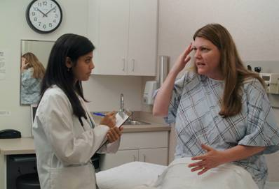
Site Preparation
Standardized patient visits
Real world practice
conducting protocol procedures
Improved confidence in delivering study procedures and intervention
Troubleshooting
Debriefing by SP team at the end of the day
Detailed written feedback sent to the lead team

Slide 11
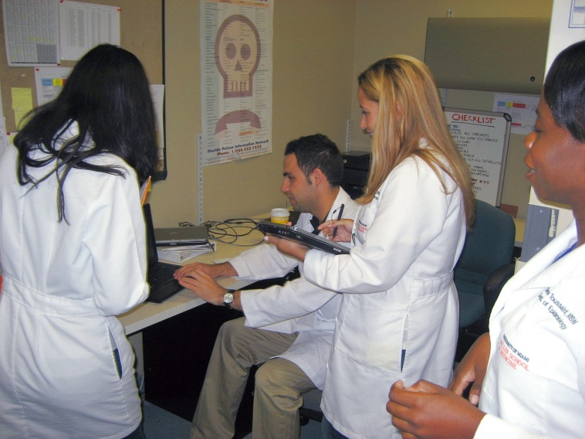

Data Collection
Screening data
Collected by the RA and by participant self-report
Direct entry into tablet computers
Centralized web based system
No data stored on the tablets
Facilitates rapid screening and mobility within the ED setting
Enhanced privacy
Access for remote brief intervention
Data accessible for booster callers
Less burden on the ED

Slide 12

Unique Factors Associated with Effective Implementation of SBIRT in an ED Setting
Leadership champions and buy-in at all organizational levels
Well-trained staff able to follow protocol procedures and “fit” in the ED setting
Strong focus on training and other pre-implementation efforts
Ongoing coaching to prevent drift
Effective use of technology

Slide 13
Lessons Learned
Protocol is acceptable to patients as well as medical staff
Contribute to a paradigm shift regarding addiction intervention and treatment
Fill gaps in service to nondependent substance abusers
Promote linkages between general medicine and specialty addiction treatment

