Slide 1



Innovative Methodologies for Testing SBIRT in Six Emergency Departments: The Clinical Trials Network's SMART-ED Trial
Harold I Perl, PhD
Center for the Clinical Trials Network
National Institute on Drug Abuse
8th Conference of INEBRIA
Boston, MA
September 23, 2011

Slide 2


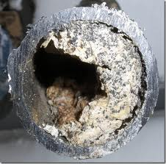


Pick Your Favorite Metaphor …

Slide 3

IOM Report Decries the “Gap”
  NIDA responds to IOM report
  National Drug Abuse Treatment Clinical Trials Network (CTN) 1999
Based on “Bi-Directionality”
  Clinicians & Investigators collaborate to design and conduct relevant research

Slide 4
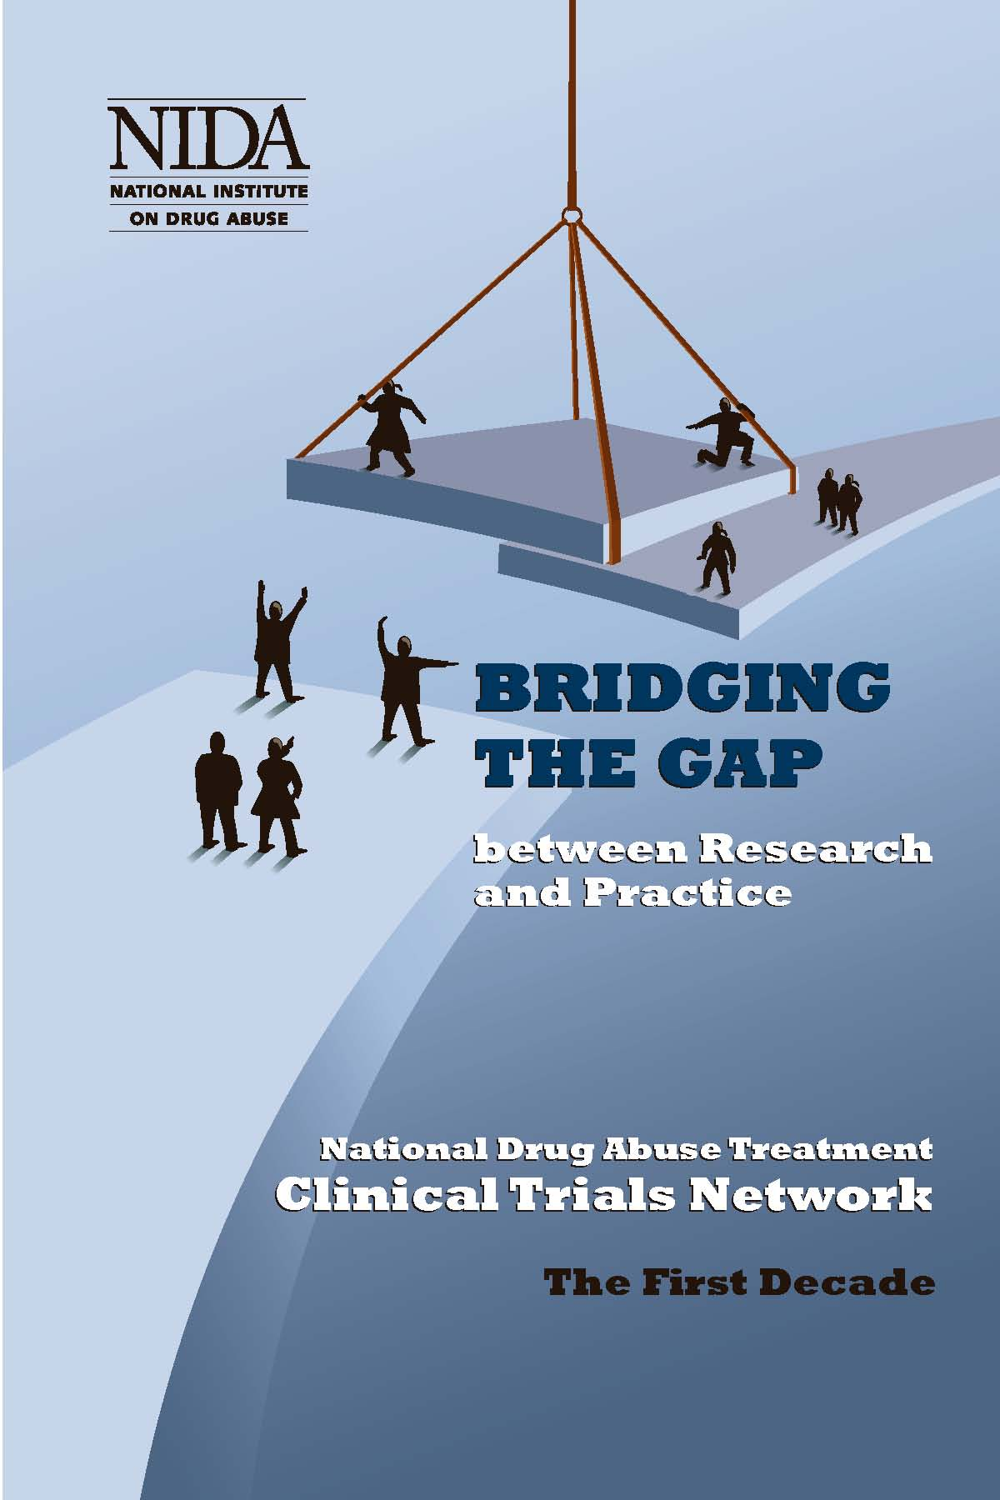
CTN Mission
  Study behavioral and pharmacological treatments that have high potential for success in community settings
  Get research findings into the hands of clinicians who can make the best use of them – as fast as possible
Notes:
4

Slide 5
National Drug Abuse Treatment
Clinical Trials Network
Ohio Valley Node
University of Cincinnati
Appalachian Tri-State Node
University of Pittsburgh
Pacific Northwest Node
University of Washington
Washington State University
New England Consortium Node
McLean Hospital
Yale University
Greater New York Node
New York State Psychiatric Institute
New York University
Western States Node
University of California, San Francisco
Oregon Health & Science University
Delaware Valley Node
University of Pennsylvania
Pacific Region Node
University of California, Los Angeles
Mid-Atlantic Node
The Johns Hopkins University
Friends Research Institute, Inc.
Southern Consortium Node
Medical University of South Carolina
Duke University Medical Center
Florida Node Alliance
University of Miami
Southwest Node
University of New Mexico
Texas Node
Univ. of Texas, Southwestern Med Cen.

Slide 6
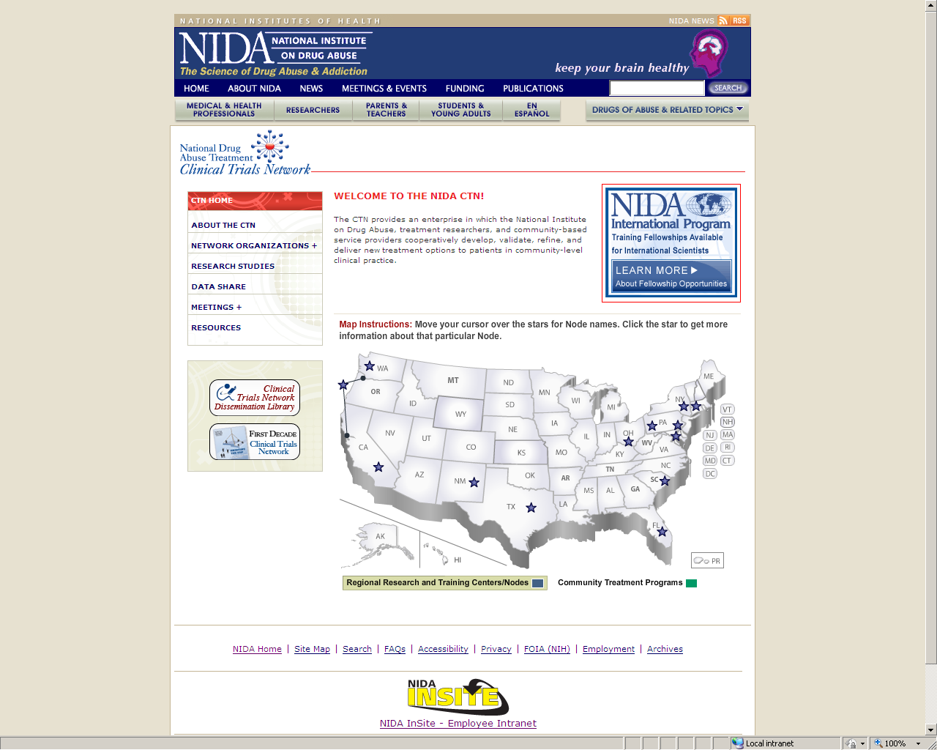
www.nida.nih.gov/ctn

Slide 7
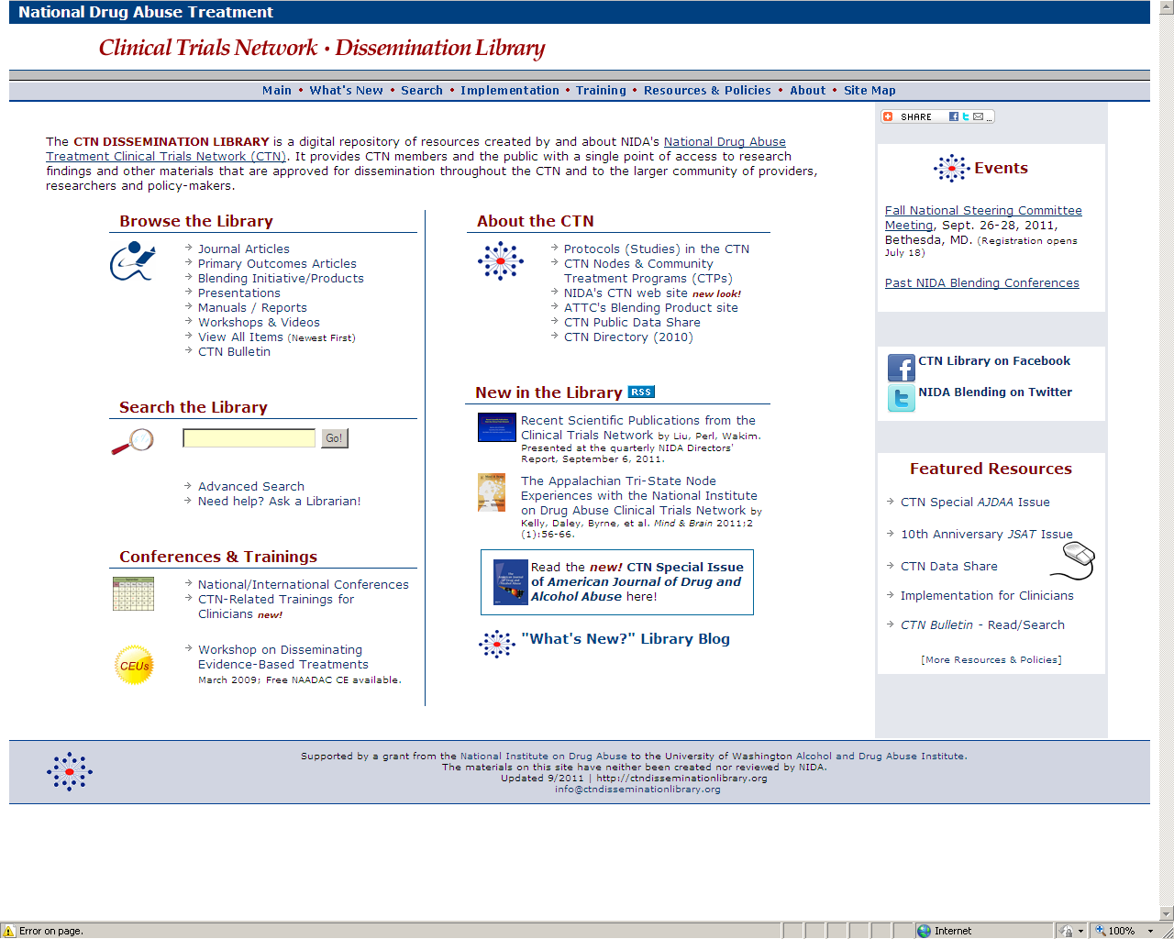
ctndisseminationlibrary.org

Slide 8
Dan Fischer, MEd
University of New Mexico
A Review of Published Research on SBIRT in EDs for AUDs/SUDs: Intervention Design, Outcomes, Implementation, and Cost Analyses

Slide 9
Dennis Donovan, PhD
University of Washington
SMART-ED Study Design
to Examine the Potential Role of
Assessment Reactivity in SBIRT

Slide 10
Alyssa Forcehimes, PhD
University of New Mexico
Factors Associated with Effective Implementation of SBIRT Delivered in an Emergency Department Setting

Slide 11
Michael Bogenschutz, MD
University of New Mexico
Screening Procedures to Identify Problematic Substance Users in Medical Emergency Departments

