Slide 1

NIDA
NATIONAL INSTITUTE ON DRUG ABUSE
National Drug Abuse Treatment
Clinical Trials Network
12-Step Facilitation:
New Evidence from the
National Drug Abuse Clinical Trials Network
Dennis M. Donovan, Ph.D.
University of Washington
Dennis C. Daley, Ph.D.
University of Pittsburgh
Presented at the 22nd Annual Meeting of the
American Academy of Addiction Psychiatry
Scottsdale, Arizona
December 11, 2011
Notes:
NIDA, NIH, DHHS

Slide 2
Objectives of Session
Review evidence supporting benefit of engaging individuals in 12-step programs
Provide background and rationale for development of STAGE-12
Review the clinical components of the STAGE-12 intervention
Provide an overview of initial preliminary results from a multi-site clinical trial

Slide 3
Professionals need to understand the 12-steps of AA and AA members need to understand what professional counseling is all about, because it is the interaction between these two programs that brings about the powerful result of recovery.
~Terence Gorski

Slide 5
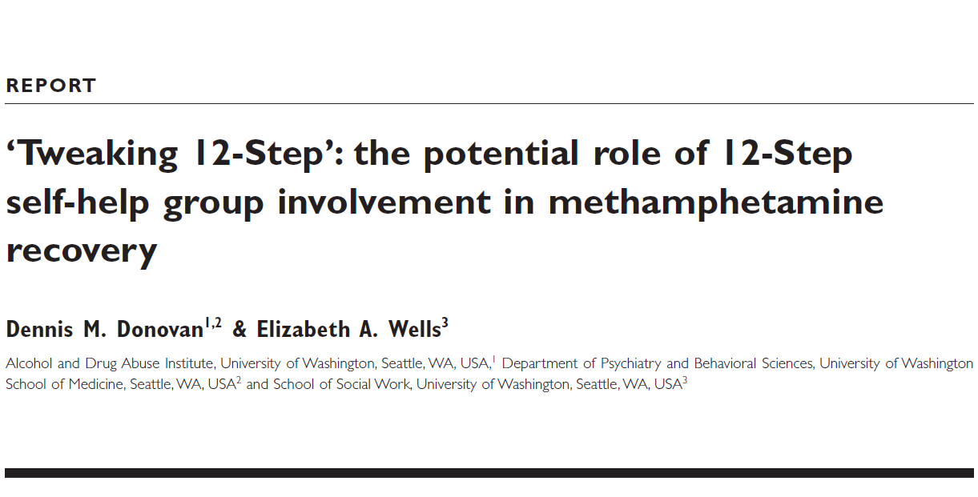
Background and Rationale for STAGE-12
Addiction, 102 (Supplement 1), 121-129, 2007

Slide 6
Why Consider 12-Step Approaches?
12-step orientation/philosophy is the predominant approach found in U.S. substance abuse treatment
12-step groups represent a readily available, no-cost recovery resource
An annual average of 5.0 million persons aged 12 or older in the U.S attended a self-help group in the past year because of their use of alcohol or illicit drugs, with increased evidence of its effectiveness
Consistent with community-based treatment program and counselor treatment philosophy

Slide 7
Why Consider 12-Step Approaches?
Applicable to a broad range of clients in different settings and can augment a wide range of standard treatments
A high priority of the NIDA Clinical Trials Network community-based treatment programs
Recent development of efficacious interventions to facilitate 12-Step involvement
Availability of 12-Step Facilitation therapy manuals and training materials

Slide 8
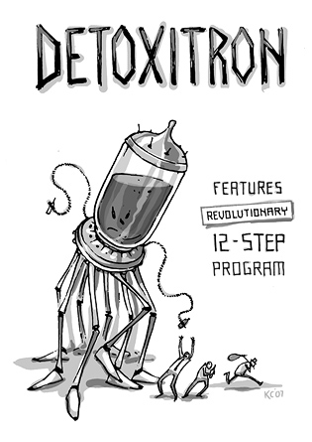
Does Involvement in 12-Step Programs Improve Outcomes?
YES!!!

Slide 9
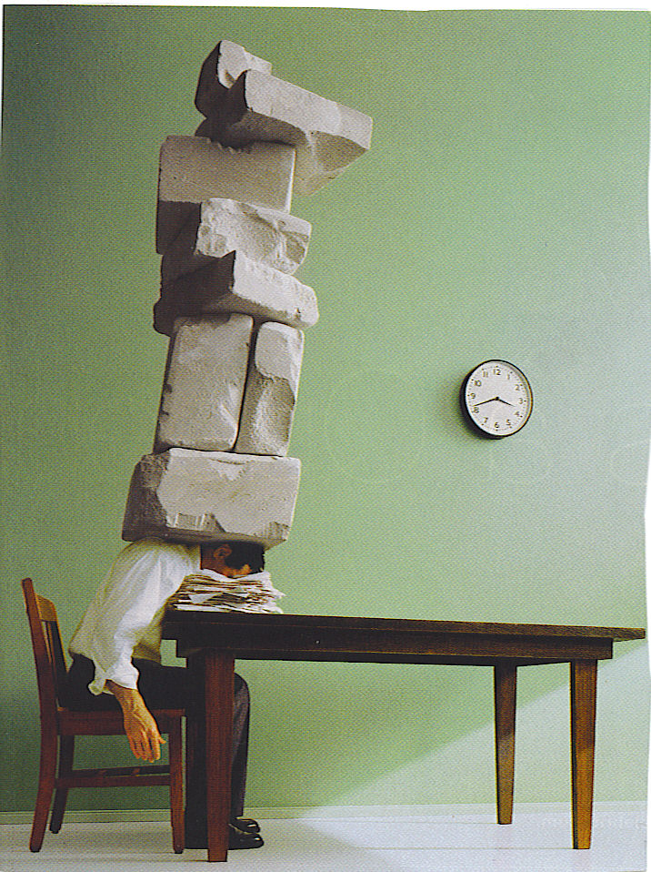
The Crushing Weight of the Data Support the Potential Positive Benefits of 12-Step Involvement

Slide 10
Findings from Previous Research on 12-Step Involvement
AA and NA participation is associated with greater likelihood of abstinence, improved psychosocial functioning, and greater self-efficacy
12-Step self-help groups significantly reduce health care utilization and costs
Combined 12-Step and formal treatment leads to better outcomes than found for either alone
Engaging in other 12-Step group activities seems more helpful than merely attending meetings

Slide 11
Findings from Previous Research on 12-Step Involvement
Consistent and early attendance/involvement leads to better substance use outcomes
Even small amounts of participation may be helpful in increasing abstinence, whereas higher doses may be needed to reduce relapse intensity
Reductions in substance use associated with 12-Step involvement are not attributable to potential third variable influences such as motivation, psychopathology, or severity

Slide 12
Summary and Recommendations from William Miller on 12-Step Involvement
12-Step approaches cannot be ignored in understanding treatment outcomes.
Treatment is the time to initiate 12-Step attendance. If 12-Step attendance is not initiated during the period of treatment, it is quite unlikely to happen. Treatment, then, is a good time to encourage sampling of the program and meetings of 12-Step.
It is possible to facilitate 12-Step attendance. Without question, there are counseling procedures that significantly increase 12-Step attendance, at least during and often after treatment. TSF therapy clearly did this in Project MATCH. Systematic encouragement can significantly increase attendance.
Owen, Slaymaker et al. 2003

Slide 13
Summary and Recommendations from William Miller on 12-Step Involvement
Attendance is not involvement. When frequency of 12-Step meeting attendance is measured separately from behavioral indicators of involvement in the 12-Step program and fellowship, the two measures are moderately correlated .
12-Step attendance may decline over the course of time while 12-Step involvement may remain steady or increase. This suggests a gradual process of internalization of the 12-Step.
12-Step involvement tends to be a stronger predictor of outcome than 12-Step attendance.
Owen, Slaymaker et al. 2003

Slide 14

Beating a Dead Horse
Using evidence-based 12-step facilitative approaches
increases self-help group attendance and improves
substance use outcomes!!!

Slide 15
Why Focus on Facilitating
12-Step Involvement?

Slide 16
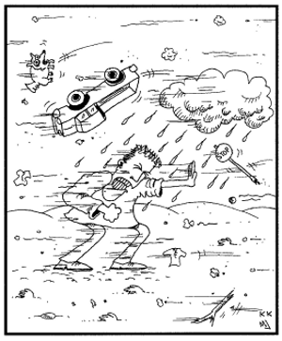
Jones would walk through a blizzard to score his dope.
The question remains: what will he do to get to a meeting?
Will he go?
Maybe,
but maybe not!!
http://recoveryjonescartoons.com/book_1.htm

Slide 17
“An increasingly rigorous body of evidence suggests consistent benefits of self-help group involvement. Dropout and nonattendance rates are high, despite clinical recommendations to attend.”
(emphasis added)
Kelly, 2003

Slide 18
Recommendations from Expert VA/CSAT Consensus Panel on Self-Help Organizations
Community-based treatment programs, even those that label and represent themselves as “12-step oriented,” should evaluate whether their current program practices actively support involvement in 12-step self-help groups.
Further, they should examine the methods employed by their counselors. Typically when counselors do attempt to support 12-step self-help group involvement, they rarely use empirically supported methods.
When clinicians use empirically validated techniques to support mutual help group involvement, it is far more likely to occur.
Humphreys, et al., 2004

Slide 19
Don’t We Already Do 12-Step Facilitation?
“Making the case that treatment programs should prioritize self-help group involvement can be difficult because many treatment providers believe they ‘do this already’; indeed, that every program does.”
“In practice, however, what this often means is that at some point during treatment a counselor gives the patient a list of local self-help groups and suggests that the patient attend a meeting, which is a minimally effective clinical practice.”
“We therefore encourage treatment providers to use the more intensive methods of promoting self-help group involvement empirically demonstrated to be effective …such efforts will maximize the maintenance of treatment gains.”
Humphreys & Moos, 2007

Slide 20
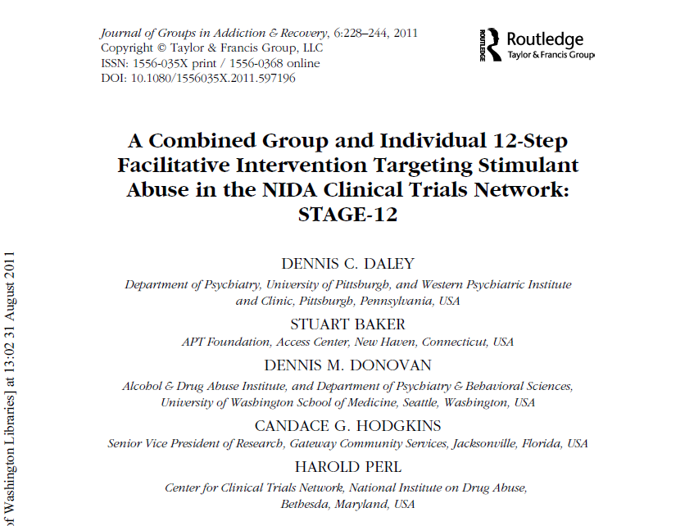
Elements of the STAGE-12 Intervention

Slide 21
Objectives of This Portion of Session
Review clinical details of the STAGE-12 group sessions that patients attend
Review clinical details of the STAGE-12 individual sessions that patients attend
Engage in interactive discussion on addiction physicians’ roles in helping clients understand, engage in, and actively utilize 12-step programs

Slide 22
STAGE-12 Therapy Manual
Based on and adapted from Twelve Step Facilitation Therapy for Drug Abuse and Dependence
Adapted for use in group delivery format from Brown, et al. 2002
Integrated with Intensive Referral procedures developed by Timko, et al., 2006

Slide 23
What Is STAGE-12?
Combined group- and individual-based intervention
Combines elements of Twelve-Step Facilitation Therapy and Intensive Referral
Introduces participants to concepts and principles involved in 12-Step groups
Actively attempts to get participants involved in 12-Step meetings

Slide 24
Rationale for Combining Intensive Referral with Twelve Step Facilitation
Interventions that are effective in increasing attendance may be insufficient to ensure active involvement.
Early attrition from attending meetings may, in part, be due to individuals’ inability to embrace or utilize other aspects of the 12-step program
Individuals who are attending 12-step groups but are having difficulty embracing key aspects of the program may need professional assistance that focuses more on 12-step practices and tenets and less on meeting attendance
Caldwell & Cutter,1998

Slide 25
STAGE-12 Interventions
-5 group sessions
-3 individual sessions

Slide 26
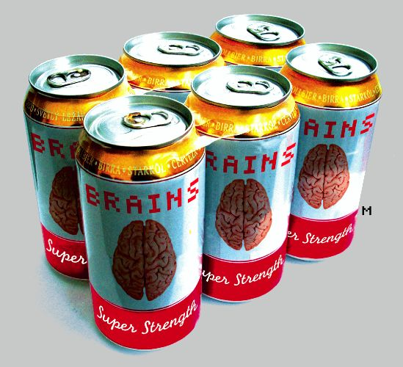
12-Step “Six Pack”: General Guidelines for Recovery Based on 12-Step Philosophy
Don’t drink or use drugs
Go to meetings
Ask for help
Get a sponsor
Join a group
Get active
(Caldwell & Cutter 1998)

Slide 27
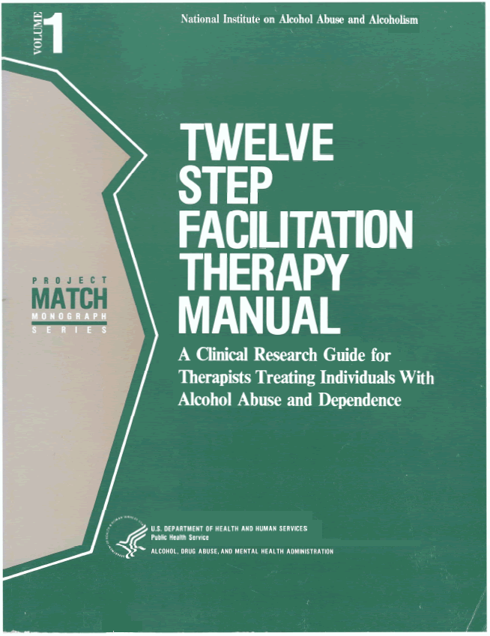
Twelve-Step Facilitation Therapy

Slide 28
Discussion Questions
What is the addiction physician’s roles in helping patients learn about, engage in, and use 12-step programs?
How do you deal with patients who resist 12-step programs (or other mutual support programs)?

Slide 29
Focus of Group Sessions
Acceptance (Step 1)
People, Places, Things
Surrender (Steps 2 & 3)
Getting Active
Managing Emotions

Slide 30
Structure of Groups
Rolling admission to group
Held weekly x 90 minutes
Check-in 15-20 minutes
Experiences, concerns about 12-step programs
Close calls, cravings, lapses or relapses
Review educational material 45-50 minutes
Each group has objectives & points to cover
Check-out 15-20 minutes
Plan for upcoming week
Reading assignments

Slide 31
Session #1: Acceptance (Step 1)
Review format of sessions and use of journals and reading assignments
Provide overview of 12-step programs
Review Step 1
Powerlessness & Unmanageability
Grief (giving up active addiction)
Assign readings and task (e.g., Step 1 worksheet)

Slide 32
Session #2: People, Places, Things
Check-in
Review journal, meetings, readings
Review experiences in 12-Step programs
Also discuss resistances
Discuss P,P,T and impact on recovery
Who to avoid
How to manage P,P,T (social pressure)
Check out & assign readings and tasks (e.g., changing old routines)

Slide 33
Session #3: Surrender (Steps 2 & 3)
Check-in
Review journal, meetings, readings
Review experiences in 12-Step programs
Discuss Steps 2 & 3
Spirituality in recovery (vs. religion)
Higher Power
Check out & assign readings and tasks (e.g., spirituality worksheet)

Slide 34
Session #4: Getting Active
Check-in
Journal, meetings, readings
Review experiences in 12-Step programs
Discuss “program of action or change”
Recovery domains: physical, spiritual, mental, social; how 12-Step programs help
How to use a sponsor; telephone use
Check out and assign readings and tasks (e.g., NA Basic Text reading)

Slide 35
Session #5: Managing Emotions
Check-in
Journal, meetings, readings
Review experiences in 12-Step programs
Also discuss resistances
Emotions and recovery and relapse
Anger, anxiety, boredom, depression, shame
Using 12-Step program to manage emotions
Meetings, sponsors, peers, slogans, readings
Assign readings and tasks (e.g., resentment worksheet; being grateful)

Slide 36
Discussion Question
When you see a patient who is involved in group treatment programs at your agency or program, do you monitor attendance and discuss this experience with the patient?
If no, why not?
If yes, what is the benefit?

Slide 37
Focus of
Individual Sessions

Slide 38
STAGE-12 Individual Session 1

Slide 39
STAGE-12 Individual Sessions: General
Complement group sessions
Incorporate clinical strategies from the Intensive Referral Program (Timko et al)
Focus on client’s use of 12-Step program
Emphasize meeting attendance and active participation in 12-Step activities as a primary means to recovery from addiction

Slide 40
STAGE-12 Individual Sessions: Encourage Client to
Attend 12-Step meetings
Secure a “sponsor” as a mentor in recovery
Turn to the fellowship to gain support from others to help change thinking and behaviors
“Work” the 12 Steps
Increase social involvement with other 12-Step members

Slide 41


Intensive Referral Procedure

Slide 42
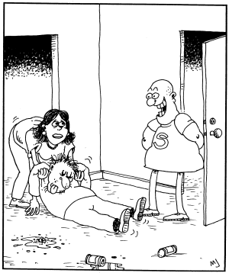
"Did I hear a need for a sponsor?"
http://www.recoveryjonescartoons.com/cartoons.htm

Slide 43
Acceptance
Willpower alone isn’t enough to help client
Addiction is a chronic and progressive illness (disease)
Loss of ability to control substances
There is no effective “cure” for addiction
Abstinence is necessary for recovery

Slide 44
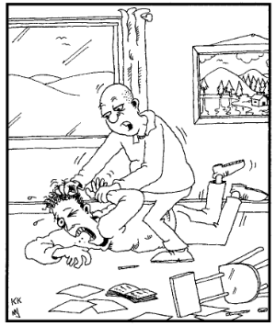
"Stop fighting and surrender, Jones. As your
sponsor, all I ask is that you attend 90 meetings
in 90 days."
http://recoveryjonescartoons.com/more_cartoons!.htm

Slide 45
Surrender
Reach out to others
Follow the 12-Step program
There is HOPE for Recovery
Only through accepting loss of control and by having faith that a HIGHER POWER can help
The 12-Step fellowship has helped millions of addicts to sustain their recovery
The best chance for success is to follow the path of NA, CA, CMA or AA.

Slide 46
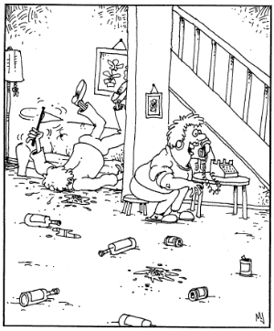
“Guess what?!
I think our Michael
has finally surrendered!"
http://www.recoveryjonescartoons.com/cartoons.htm

Slide 47
STAGE-12 Individual Session 2

Slide 48
STAGE-12 Individual Session 2
The focus and content varies, depending on whether the client attended meetings since session #1
If yes, the client’s reactions to the meeting and recovery tasks
If no, focus on the perceived and actual barriers to attendance and a 12-Step volunteer will again be contacted

Slide 49
STAGE-12 Individual Session 2: Objectives
Determine if client has hooked up with 12-Step “buddy”
Determine if client has attended a 12-Step meeting
Focus of remaining portion of session varies based on whether or not the client has attended a meeting

Slide 50
STAGE-12 Individual Session 2
Discuss reactions to meetings attended
Provide a list of sponsors and recommend that the client obtain a temporary sponsor
Explain that this sponsor could be replaced by a more permanent one when the participant is more familiar with other 12-Step members
Address any concerns the client may have about asking for and working with a sponsor

Slide 51
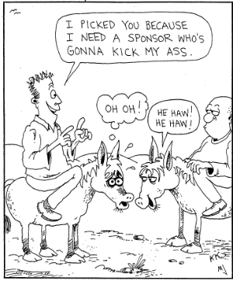
http://www.recoveryjonescartoons.com/cartoons.htm

Slide 52
STAGE-12 Individual Session 2
If no meetings were attended, or client is reluctant to attend meetings, explore this resistance.
Try again to contact a volunteer with the client as in Session 1.
The client and counselor agree on the 12-Step meetings to be attended before the next session, and this agreement is written into the journal.

Slide 53
STAGE-12 Individual Session 2
Review reaction to readings or journal; work through barriers on becoming active in 12-Step programs.
Follows up on other recovery tasks such as contacting a sponsor or taking on service work at a meeting.
Discuss and agree to suggested recovery tasks, which are entered into the client’s journal.

Slide 54
STAGE-12 Individual Session 3

Slide 55
STAGE-12 Individual Session 3
Help client evaluate treatment experience and set goals for the future
Review views of addiction and 12 step programs compared to prior to treatment
Contact a12-Step volunteer if needed
Review journal and the agree for the next week's 12-Step meeting attendance
Discuss whether sponsor was sought, or what client did with sponsor if had one.

Slide 56
STAGE-12 Individual Session 3
Discussing barriers to participation if client still not going to meetings
Determining goals and plans for future 12-Step meeting attendance and involvement in the program
Reviewing the client’s willingness to continue keeping a written recovery journal

Slide 57
STAGE-12 Individual Session 3: Review of Tx
Most helpful parts of STAGE-12
Least helpful parts of STAGE-12
Group sessions
Individual sessions
The need for ongoing participation in 12-Step programs
Keeping a journal as part of ongoing recovery

Slide 58
Written Journal and Readings
Written Journal:
Meetings attended since the last group sessions
Personal reactions to the meetings
Any substance use; how managed cravings
Readings: recovery & 12-Step related
Reactions to suggested readings
Reactions to recovery tasks

Slide 59
Examples of Resources Used with Clients
Workbook on 12-Step Programs
Recovery Journal
Readings
Written Recovery Tasks

Slide 60
Information About 12-Step Programs in the Recovery Process
Provides introduction to 12-Step philosophy, structure and terminology of 12-Step programs
Addresses common concerns about participation
Encourages client to set goals for attending meetings, working the first few Steps, joining a home group and obtaining a sponsor.

Slide 61
Overview of STAGE-12 Written Journal
Meetings attended since the last group sessions (dates, times, places)
Reactions to the meetings (thoughts, feelings, experiences)
Reactions to suggested readings
Any episodes of drug or alcohol use (lapses or relapses)
Reactions to recovery tasks assigned
Strong cravings or urges to use drugs and how these were managed

Slide 62
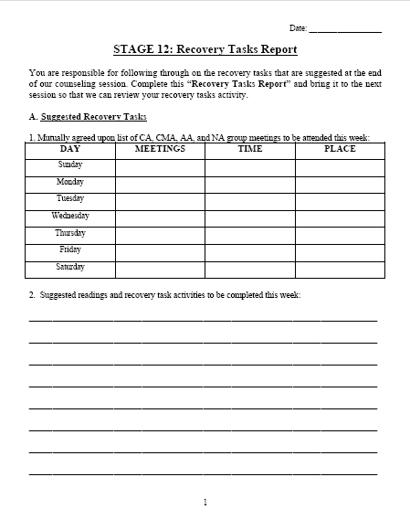
STAGE-12 Participant Journal
A primary component of both group and individual sessions is the Participant Journal: Recovery Task Report
Page 1 involves
listing of 12-Step meetings the client agrees to attend
12-Step readings and other activities the person agrees to do

Slide 63
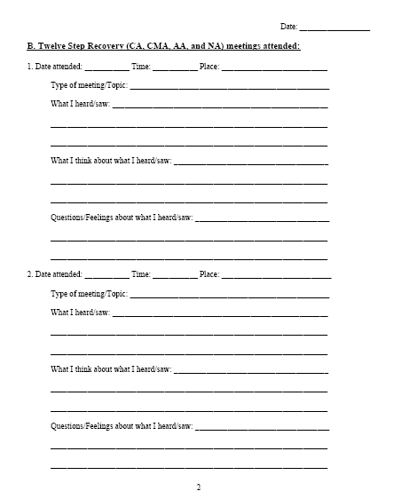
STAGE-12 Participant Journal
Pages 2 & 3 involve:
Reports on meetings attended
Type of meeting
Date, time, place
“What I heard/saw”
“What I think about what I heard/saw”
“Questions/feelings about what I heard/saw”

Slide 64
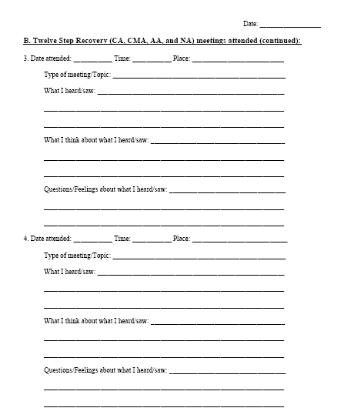
STAGE-12 Participant Journal
Page 4 involves:
Reactions to suggested readings/tapes
“Slips” that occurred, how used/drank, and what done about it
Cravings or urges to use/drink; when it happened, what done about it

Slide 65
Recovery Tasks and Readings

Slide 66
Recovery Tasks and Readings
Engaging in 12-Step activities is better predictor of outcomes than just attendance
Completing “homework” assignments or recovery tasks” has been demonstrated to improve outcomes
Each group session has specific recovery tasks and recommended 12-Step and recovery-oriented readings assigned
Whether or not clients have completed these tasks, as well as their reactions to them, are discussed during “check-in”

Slide 67
Recovery Readings
Readings from NA, CA, CMA or AA texts:
Alcoholics Anonymous (“The Big Book” of AA).
Twelve Steps and Twelve Traditions.
Narcotics Anonymous (“The Basic Text of NA”).
Living Sober
Hope, Faith & Courage
Other readings (counselor determines)

Slide 68
Basic Study Questions
Does STAGE-12 improve stimulant drug use outcomes in stimulant users compared to treatment-as-usual?
Substance Use Calendar
Urinalysis
Does STAGE-12 improve attendance and involvement in 12-step groups compared to treatment-as-usual ?
Substance Use Calendar
Self-Help Activities Questionnaire

Slide 69
Individual presents to CTP for Tx
Screen for study eligibility
Informed consent
Baseline assessment
Randomized to condition
Treatment as
Usual (TAU)
STAGE-12
Integrated into TAU
During Intervention
Assessment
End of Intervention
Assessment
3-, 6-Month Posttreatment
Follow-ups

Slide 70
STAGE-12 Baseline Participant Demographic Information
Characteristics | TAU (N = 237) |  | STAGE-12 (N = 234) | Total (N = 471)
Gender
Female | 55.7% |  | 62.0% | 58.8%
Age
Mean (Std.) | 38.5 (9.4) |  | 38.2 (10.04) | 38.4 (9.7)
Ethnicity
Hispanic or Latino | 6.3% | 6.4% |  | 6.4%
Race
Caucasian | 49.0% | 46.2% |  | 47.6%
Black/African American | 35.0% | 37.6% |  | 36.3%
Marital Status
Married | 9.8% | 15. 5% |  | 12.6%
Widowed | 3.8% | 0.9% |  | 2.4%
Separated | 11.4% | 10.3% |  | 10.9%
Divorced | 22.9% | 24.0% |  | 23.5%
Never Married | 51.3% | 49.4% |  | 50.3%

Slide 71
STAGE-12 Baseline Participant Demographic Information
Characteristics | TAU (N = 237) | STAGE-12 (N = 234) | Total (N = 471)
Education
Mean (Std.) | 12.1 ( 1.6) | 12.2 (1.7) | 12.2 (1.6)
Usual Employment Pattern
Full Time | 37.1% | 35.5% | 36.3%
Part Time, Regular | 10.1% | 8.6% | 9.3%
Part Time, Irregular | 13.5% | 16.2% | 14.9%
Student | 1.3% | 0.4% | 0.9%
Retired, Disability | 1.7% | 3.0% | 2.3%
Unemployed | 35.4% | 34.6% | 35.0%
Court Mandated
Yes | 20.7% | 22.2% | 21.4%

Slide 72
DSM-IV Dependence and Abuse Diagnoses
Dependence | TAU (N = 237) | Stage-12 (N=234) | Total (N =471)
Cocaine | 70.9% | 72.7% | 71.8%
Methamphetamine | 38.4% | 33.8% | 36.1%
Amphetamine | 6.8% | 6.8% | 6.8%
Other Stimulants | 1.7% | 2.6% | 2.1%
Alcohol | 45.6% | 44.9% | 45.2%
Marijuana/Hashish | 18.6% | 21.4% | 20.0%
Opiates | 14.8% | 20.9% | 17.8%
Benzodiazepines | 7.2% | 8.1% | 7.6%
Abuse
Cocaine | 71.3% | 74.8% | 73.0%
Methamphetamine | 38.0% | 35.9% | 36.9%
Amphetamine | 7.2% | 7.7% | 7.4%
Other Stimulants | 1.7% | 3.0% | 2.3%
Alcohol | 63.7% | 62.0% | 62.9%
Marijuana/Hashish | 34.2% | 39.7% | 36.9%
Opiates | 18.1% | 21.4% | 19.8%
Benzodiazepines | 10.1% | 12.4% | 11.3%

Slide 73
Percent of Sample Endorsing Primary Drug from the Drug Section of the ASI
 | TAU | STAGE-12 | Total
Primary Drug (%) | (n=237) | (n=234) | (n=471)
Cocaine | 33.3% | 32.9% | 33.1%
Amphetamine/Methamphetamine | 23.2% | 20.1% | 21.7%
Heroin | 1.3% | 2.2% | 1.3%
Cannabis | 2.1% | 2.6% | 2.3%
Alcohol Use Only | 0.4% | 1.3% | 0.8%
Alcohol + 1 or more drugs | 30.4% | 28.6% | 29.5%
No Alcohol + 1 or more drugs | 7.6% | 8.1% | 7.9%

Slide 74
STAGE-12 Baseline Clinical and Trial-Related Characteristics
Characteristics | TAU (N = 237) | STAGE-12 (N = 234) | Total (N = 471)
Addiction Severity Index Composite Scores: Mean (Std.)
Alcohol | .162 (.21) | .159 (.20) | .161 (.21)
Drug | .157 (.09) | .155 (.09) | .156 (.09)
Audit-C: Mean (Std.) | 6.5 (3.8) | 6.3 (3.8) | 6.39 (3.8)

Slide 75
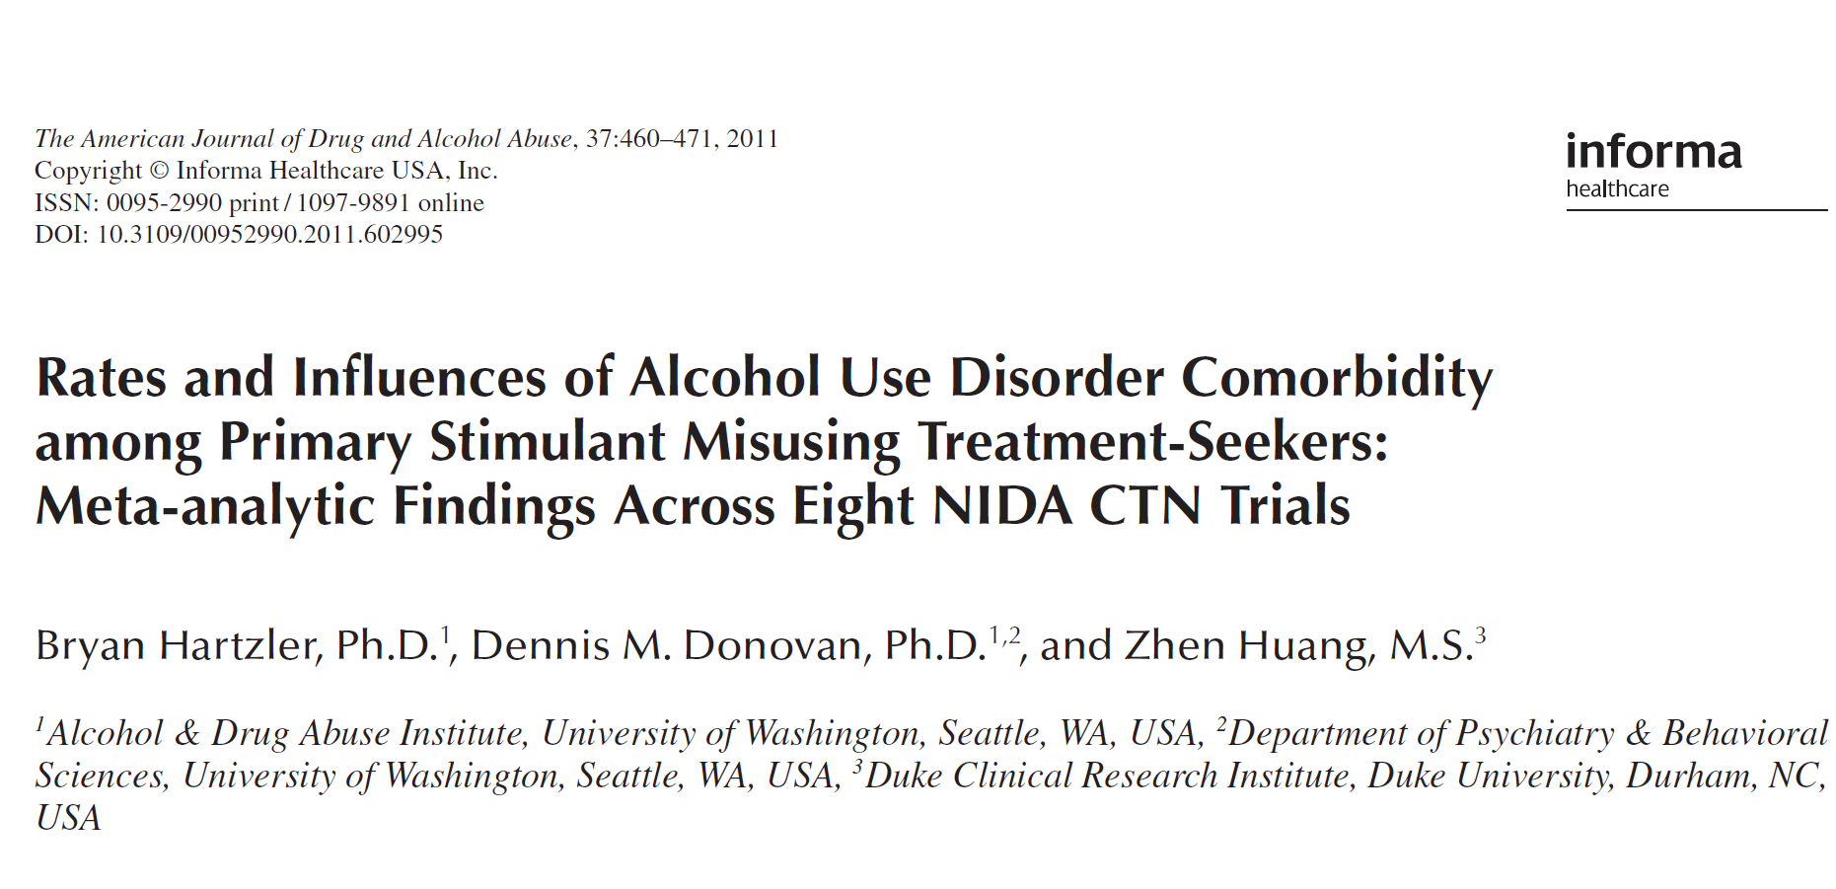

Slide 76
Percent of Sample Endorsing Items from the Drug Section of the ASI
 | TAU | STAGE-12 | Total
How troubled by Drugs | (n=234) | (n=231) | (n=465)
Not at all | 17.1 | 16.5 | 16.8
Slightly | 10.7 | 12.6 | 12.6
Moderately | 20.5 | 16.5 | 16.5
Considerably | 20.9 | 22.5 | 22.5
Extremely | 30.8 | 32.0 | 32.0
Need Treatment for Drugs
Not at all | 17.9 | 19.0 | 18.5
Slightly | 1.7 | 3.5 | 2.6
Moderately | 3.8 | 3.9 | 3.9
Considerably | 8.1 | 10.8 | 9.5
Extremely | 68.4 | 62.8 | 65.6

Slide 77
12-Step Experiences & Expectations
 | TAU | STAGE-12 | Total
Ever involved in Self-Help groups for alcohol or drug problems in past | Yes = 59.4% | Yes = 62.9% | Yes = 61.1%
Median Total Meetings Attended and Number of People Having Attended [N]
Alcoholic Anonymous | 50.0 [112] | 35.0 [112] | 50.0 [224]
Narcotics Anonymous | 50.0 [112] | 30.0 [115] | 30.0 [227]
Cocaine Anonymous | 10.0 [43] | 10.0 [37] | 10.0 [80]
Crystal Meth Anonymous | 0.0 [6] | 1.5 [4] | 1.0 [10]
Secular Org. for Sobriety | 0.0 [3] | 2.0 [5] | 1.0 [8)
Rational Recovery | 0.0 [5] | 15.0 [5] | 2.5 [10]
Women for Sobriety | 40.0 [9] | 1.0 [13] | 6.5 [22]
SMART Recovery | 0.0 [4] | 3.0 [8] | 1.0 [12]

Slide 78
Outcome Analyses

Slide 79
Percent of Participants Entering Trial Stimulant-Free based on Baseline Self-Report and Urinalysis

Slide 80
Interpretation of Zero-Inflated Negative Binomial Models
Zero-inflated negative binomial random-effects model utilized allows for:
Missing data across time
Model-based predictions of the
probability of abstinence and
rate of stimulant substance use
within a 30-day window of assessment for all subjects at each time point, based on maximum-likelihood estimation procedures.

Slide 81
Interpretation of Zero-Inflated Negative Binomial Models
The logistic portion (abstinence) and the negative binomial (or count) portion are typically interpreted and described separately
Generally presented and interpreted in terms of odds ratios (logistic) and incidence rate ratios (negative binomial) with corresponding 95% confidence limits to assess statistical significance.

Slide 82
Interaction Odds Ratios and Incidence Rate Ratios: Days of Stimulant Substance Use within 30-day Window of Assessment
 | Logistic (Abstinence) |  | Negative Binomial (Count)
 | Odds Ratio | 95% CI for Odds Ratio | Rate Ratio | 95% CI for Rate Ratio
Mid-Treatment | 3.34* | 1.20, 9.28 | 1.66* | 1.05, 2.60
End-of-Treatment | 2.44* | 1.01, 5.86 | 1.50* | 1.01, 2.24
First Follow-up | 1.78 | 0.81, 3.90 | 1.36 | 0.93, 1.98
Second Follow-up | 1.30 | 0.60, 2.79 | 1.23 | 0.84, 1.79
Third Follow-up | 0.95 | 0.42, 2.15 | 1.11 | 0.74, 1.66
Last Follow-up | 0.69 | 0.27, 1.77 | 1.00 | 0.64, 1.57

Slide 83
Primary Outcome: Observed Percentage of Zero Days of Stimulant Use within 30-day Window

Slide 84
Primary Outcome: Observed Average Number of Stimulant Use Days within 30-day Window

Slide 85
Probability of End-of Treatment Abstinence Based on Treatment Condition and Mid-Treatment Use
Odds Ratio = 2.77*
(95% CI = 1.08, 7.08)
*P< .05; **p< .025

Slide 86
Average Number of Days of Stimulant Use at End-of-Treatment Based on Treatment Condition and Mid-Treatment Use
Rate Ratio = 1.79*
(95% CI = 1.05, 3.04)
*p< .05; **p< .001
Notes:
Dennis Daley

Slide 87
Model-based Average Predicted Probabilities of Having a Positive Urine Screen for Stimulants

Slide 88
Percentage of Subjects with ASI Drug Composite Scores = 0 and Means for those with Scores > 0
Percent of Subjects with ASI Drug Composite Score = 0
Mean ASI Composite Score for Those
With Scores > 0

Slide 89
Secondary Outcome Measures on which Differences were Found between STAGE-12 and TAU
Number of days of AA, NA, CA or CMA meeting attendance (SHAQ) at baseline and mid-treatment, RR = 1.21 and RR = 1.18, respectively (SHAQ)
Number of types of other activities engaged in during 30 day assessment windows (SHAQ)
Maximum number of days of self-reported duties at meetings at end-of-treatment and the first and last follow-up periods within a 30-day assessment window (SHAQ)

Slide 90
Number of Other Self-Help Activities and Days of Doing Duties at 12-Step Meetings (SHAQ)
* * * * *
Number of days of Duties at Self-Help
Meetings
Average Number of Other Self-Help Activities

Slide 91
Secondary Outcome Measures on which No Differences were Found between STAGE-12 and TAU
Probability of abstinence and the number of days of non-stimulant drug use
Probability of attending and the number of days of self-help meeting attendance (SUC)
Maximum number of days of self-reported speaking at meetings (SHAQ)

Slide 92
Summary: STAGE-12 vs TAU
STAGE-12 increases the probability of abstinence from stimulants during and in the last 30 days of the active treatment phase
If abstinence is not achieved during this period, rates of use appear greater among STAGE-12 participants
STAGE-12 associated with significantly lower ASI Composite score at 3-month follow-up and greater change in this measure from baseline to 3-month follow-up
STAGE-12 associated with greater number of
days of 12-step self-help meeting attendance
types of other 12-step activities engaged in
maximum number of days of self-reported duties at meetings at different periods during and following the active treatment phased

Slide 93


Slide 94
Comparison of STAGE-12 Completers vs Non-Completers
Completion of STAGE-12 was defined
a priori as the completion of 2 or more individual sessions and 3 or more group sessions

Slide 95
Odds Ratios and Incidence Rate Ratios STAGE-12 Completion Status: Days of Stimulant Substance Use within 30-day Window of Assessment
 | Logistic (Abstinence) |  | Negative Binomial (Count)
 | Odds Ratio | 95% CI for Odds Ratio | Rate Ratio | 95% CI for Rate Ratio
Mid-Treatment | 41.3* | 6.55, 260.46 | 0.42* | 0.22, 0.81
End-of-Treatment | 20.4* | 4.07, 102.05 | 0.51* | 0.28, 0.93
First Follow-up | 10.1* | 2.32, 43.54 | 0.63 | 0.36, 1.10
Second Follow-up | 5.0* | 1.18, 20.76 | 0.76 | 0.43, 1.34
Third Follow-up | 2.5 | 0.54, 11.15 | 0.93 | 0.51, 1.70
Last Follow-up | 1.2 | 0.22, 6.63 | 1.14 | 0.58, 2.23

Slide 96
STAGE-12Completers vs Non-completers: Observed Percentage of Zero Days of Stimulant Use within 30-day Window

Slide 97
STAGE-12Completers vs Non-completers: Observed Average Number of Stimulant Use Days within 30-day Window

Slide 98
Average Predicted Probabilities of Having a Positive Urine Screen for Stimulants Stage-12 Completers versus Non-completers

Slide 99
Odds Ratios of Not Attending and Incidence Rate Ratios for Days of Attending Self-Help Meetings: Stage-12 Completers vs Non-Completers.
 | Logistic (Not Attending) |  | Negative Binomial (Count)
 | Odds Ratio | 95% CI for Odds Ratio | Rate Ratio | 95% CI for Rate Ratio
Mid-Treatment | 0.05* | 0.09, 0.28 | 1.79* | 1.41, 2.28
End-of-Treatment | 0.06* | 0.01, 0.29 | 1.59* | 1.27, 1.99
First Follow-up | 0.08* | 0.02, 0.33 | 1.41* | 1.13, 1.76
Second Follow-up | 0.11* | 0.03, 0.41 | 1.25 | 0.99, 1.58
Third Follow-up | 0.14* | 0.03, 0.55 | 1.11 | 0.86, 1.44
Last Follow-up | 0.18* | 0.04, 0.80 | 0.99 | 0.74, 1.32

Slide 100
Secondary Outcome Measures on which Differences were Found between STAGE-12 Completers and Non-Completers
Probability of abstinence and the number of days of non-stimulant drug use (SUC)
Number of types of other activities engaged in during 30 day assessment windows (SHAQ)
Maximum number of days of self-reported duties at meetings at end-of-treatment and the first and last follow-up periods within a 30-day assessment window (SHAQ)

Slide 101
Secondary Outcome Measures on which No Differences were Found between STAGE-12 Completers and Non-Completers
Maximum number of days of self-reported speaking at meetings within a 30-day assessment window

Slide 102
Summary: STAGE-12 Completers vs Non-Completers
Compared to Non-Completers, STAGE-12 Completers have:
Higher odds of abstinence from and lower rates of stimulant drug use
Lower probabilities of stimulant positive urines
Higher odds of abstinence from and lower rates of non-stimulant drug use
Lower odds of not attending and higher rates (days) of attending 12-step self-help groups
Number of types of other activities engaged in during 30 day assessment windows
Maximum number of days of self-reported duties at meetings

Slide 103
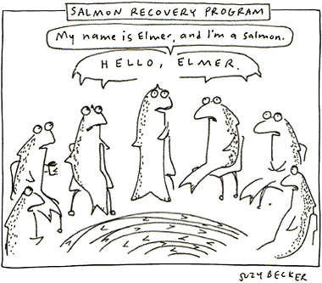
12-Step Salmon Recovery Program
http://www.grist.org/comments/ha/2002/02/04/becker-salmon/

Slide 104
Stimulant Use Outcomes Based on Gender and Race

Slide 105
Summary: Gender Effects
Women were somewhat (p = .08) more likely than men to meet criteria for STAGE-12 Completer status
Women in STAGE-12 had higher odds of abstinence from simulant drugs from baseline through the 1st follow-up than those in TAU but if they used, the rates were higher from baseline to mid-treatment
Within STAGE-12, women had higher odds of abstinence from stimulants than men from baseline through the end of treatment

Slide 106
Summary: Race Effects
No differences between Caucasian and African Americans with respect to meeting criteria for STAGE 12 Completer status
Caucasians had higher odds of abstinence from stimulants in STAGE-12 than TAU during active treatment phase
African Americans have similar odds favoring STAGE-12 versus TAU but these did not reach significance
No statistically significant interaction odds ratios or incidence rate ratios between African American and Caucasian subjects in either STAGE-12 or TAU

Slide 107
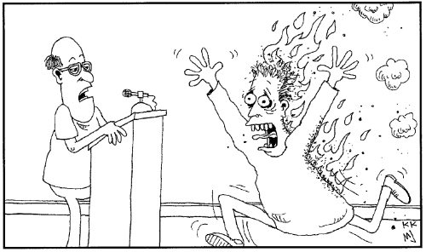
"Does anyone have a burning desire to share?"
http://recoveryjonescartoons.com/more_cartoons!.htm

Slide 108
Questions?

