Slide 1

NIDA’s clinical trials network: a source of social work practice-relevant knowledge
Elizabeth Wells Dennis Daley
School of Social Work Western Psychiatric Institute
University of Washington University of Pittsburgh
Supported by Grants # U10 DA020036 and
U10 DA013714 from the National Institute on Drug Abuse
Notes:
My job today:
Provide a context for presentations from my colleagues, Aimee Campbell and Allison Kristman- Valente.
Explain the National Institute on Drug Abuse Clinical Trials Network – a network that has been in existence for over 10 years but that has not been featured at this conference.
Talk about what I think it has to offer Social Workers and Social Work researchers.
Want to thank my colleague, Dennis Daley, a Social Worker and
Chief of Addiction Medicine Service
Western Psychiatric Institute and Clinic
University of Pittsburgh School of Medicine
He has an ongoing interest in getting more of what the CTN is doing into the hands of Social Workers

Slide 2

“…serious gaps of communication exist between the research community and community-based drug treatment programs.”*
*IOM, 1998 – Executive Summary
Notes:
There has been a gap between research and practice in addiction treatment, part of which has been attributed to cultural and language differences between providers and researchers.
Gap identified in a 1998 IOM report. The CTN is an outgrowth of recommendations from this report.

Slide 3

CTN Mission
  Study behavioral and pharmacological treatments that have high potential for success in community treatment settings
  Get research findings into the hands of clinicians who can make the best use of them – as fast as possible
Notes:
The Mission of the CTN is to study treatments in community settings and facilitate closing the gap.
3

Slide 4
CTN Across the Nation
Regional Research and Training Center (RRTC)
State with Community Treatment Program (CTP)
Notes:
Network was established as a set of cooperative agreements between NIDA and a set of nodes.
Currently, there are 13 “nodes” distributed around the country. The red stars on this map represent nodes.
Each node is a university-based research center and its community treatment program partners.
The grey states are those that have at least one (usually more) CTP partner participating in the network.

Slide 5
Node Structure
Parent-Child
Assistance
Program
Daybreak
Youth
Services
Recovery
Centers of King
County
Residence
XII
Providence
Behavioral
Health
Seattle
Counseling
Services
University of WA
(D. Donovan)
WA State University
(J. Roll)
WA
Physicians
Health Prog.
C.H.A.M.M. P.
Evergreen
Manor
Puget
Sound VA
Group
Health
Cooperative
Triumph
Treatment
Services
Evergreen
Treatment
Services
S.E. Alaska
Regional Health
Consortium
Notes:
A node looks like this (I’m using my own node, the Pacific Northwest Node, as an example).
There is a research center (RRTC) – in this case we have multiple Pis, one at the ADAI at UW and the other at School of Nursing, WSU.
We have a group of collaborating partners (CTPs) that have agreed to participate with us in this venture. Some have been with us for 10 years. Some recently joined us at the point of our 3rd competing renewal.
They range from a small women’s residential and outpatient center and an LGBT-serving center to a regional Alaska Native health consortium and a large HMO and Veterans Hospital.
6 have actually participated in a CTN-sponsored study, but all are potential collaborators with us in non-CTN studies, and all provide input .

Slide 6
Regional Research and Training Center (RRTC)
Initiates and Develops Protocols
Arranges Community Treatment Program (CTP) Participation
Conducts Training
Conducts Studies
Disseminates Regionally
RRTC
Notes:
The RRTC has a specific set of responsibilities within the CTN.

Slide 7
Community Treatment Program (CTP)
Equal representation on national CTN Steering Committee
Participates fully in CTN committees
Generates clinically relevant concepts
Provides setting and staffing for CTN studies
Collects data
Potential early adopters
CTP
Notes:
The CTP also has certain responsibilities.

Slide 8
Assumptions Underlying CTN*
Research findings that would benefit patients are not being used.
Research will be aided by 2-way communication & long-term collaboration between CTPs & researchers.
CTPs will benefit from participating in research.
* Also from IOM, 1998
Notes:
The assumptions underlying the CTN were what attracted me to be part of our group’s application to become a node. These assumptions include:
I should add that, although the initial development of this network envisioned quite an ideally structured mechanism for community-engaged scholarship, e.g., bidirectional communication, there has been some slippage in this over the years in that NIDA’s vision about how the research agenda is decided has become more unidirectional.
Still, the network’s studies and other studies it has spawned are very informative to both practice and research….

Slide 9
Multi-Site Hybrid Efficacy – Effectiveness* Trials
External Validity
Internal Validity
Community-based clinics
Heterogeneity of participants
Community clinicians,
Comparison to “treatment-as-usual”
Cost-effectiveness evaluation
Patient & clinician satisfaction
Interest in sustainability
Random assignment
Study protocol & operations manual
Manual-based treatment
Fidelity monitoring
Standard measures
Quality assurance
* Carroll, K.M. & Rounsaville, B.J. (2003) Psychiatric Services, 54.
Notes:
So what kinds of studies do we undertake in the CTN? For the most part, we do what we term Multi-Site Hybrid Efficacy-Effectiveness Trials.
In every RCT there exists a balance between design aspects that favor external validity and those that favor internal validity. CTN trials attempt to maximize external validity without completely sacrificing internal.
There are also other kinds of studies in CTN – e.g.,
CBPR with AI/NA tribes around problems of meth use
Study of CTP practices related to HIV/Hep testing & education

Slide 10
Increasing Role for Social Work in Addiction Treatment
Integration of substance use and mental health treatment (behavioral health)
With health care reform, larger numbers of behavioral health clients served
With health care reform, integration of behavioral health into health care settings, e.g., primary care
Notes:
So why bring the CTN to SSWR?
We realized that CTN research has not been presented at SSWR.
There are several national trends that are bringing social work into a greater role in addiction treatment:
Providers have traditionally been CDPs with only a smattering of MSWs. Several trends are changing this.
MH and SUD treatment are being increasingly integrated and MSWs have traditionally had greater presence in MH settings
Health care reform will presumably increase BH services
BH will be more integrated into health care settings, e.g., hospital and primary care;

Slide 11
Social Workers’ Multiple Roles in Behavioral Health
  Managers in behavioral health settings
  Providers in health care settings
  Care managers in integrated care
  Policy development and oversight
Notes:
Social Workers will have a number of roles as these changes occur:
MSWs have always been, and will continue to be, in management and supervision roles in BH settings
MSWs have been BH providers in health care settings, and as SUD tx moves into these settings, they may be called upon to provide evidence-based SUD tx in these settings.
As BH and medical care are integrated, MSWs will continue to serve as care managers and decision-makers regarding types of care;
Social workers are employed at state agencies that make and oversee policy and will make decisions about what practices will be supported.

Slide 12
What does the CTN Offer Social Workers?
EBPs - What psychosocial or pharmacological interventions for treating substance use disorders (SUD) are effective?
EBPs for adolescents
EBPs for HIV prevention in SUD treatment settings
Evidence-based for all populations (e.g., women, racial and ethnic minorities, sexual minorities)?
Notes:
I’m excited about bringing the CTN to SSWR because I think it has something for everyone – for researchers, practitioners and educators
In the past 11 years the CTN has amassed a wealth of information about EBPs and their effectiveness, including
What interventions are effective – particularly do interventions we think of as efficacious outperform TAU?
There has a been a small amount of research on tx for adolescents, a population of interest to SWs
There have been HIV-related protocols that provide interventions appropriate to SUD populations and settings.
Because of the diversity of settings and clinic populations, the CTN provides a unique opportunity to find answers to a question I often hear posed by SW scholars – Are so-called EBPs appropriate for and effective with marginalized populations – e.g., racial and ethnic minorities, sexual minorities or women?
Women and Minority SIGS within the CTN keep these questions alive.

Slide 13
What does the CTN Offer Social Workers?
Sufficient benefit to warrant cost of training and implementing?
What is required to train community providers to deliver EBPs?
Characteristics of treatment sites that deliver EBPs successfully?
Sustainability of practices
Notes:
Although not designed to conduct implementation research, the CTN also offers a good deal of information relevant to implementing interventions in community practice.
A question often posed by our CTP partners is whether a research –based intervention benefits patients enough to warrant the expense of adopting the EBP. The CTN is an opportunity to do economic analysis – and some have been carried out.
Also relevant to implementation is what it takes to have community clinicians, as opposed to those located in research centers, learn an EBP and deliver with fidelity.
Each CTN study is carried out in multiple sites, and these studies can help us to understand what site characteristics influence tx outcomes.
Lastly, there is information coming out of some of these studies about sustainability of a practice at the end of a trial.

Slide 14
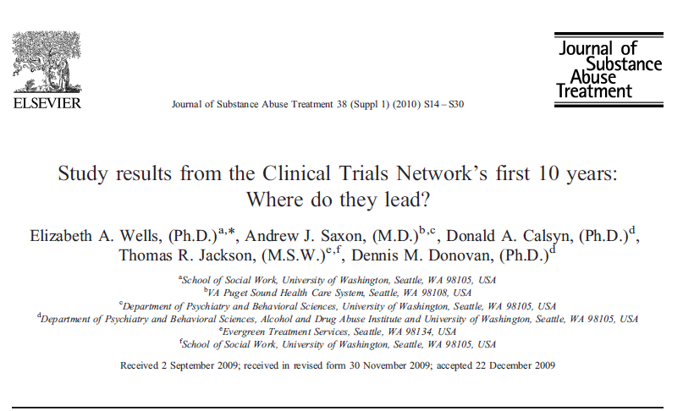
EBPs for SUD
Notes:
The CTN has completed and published results from a total of 21 intervention trials. We reviewed main findings from the first 15 of them in this article, published in 2010.
These have included 10 trials of behavioral/psychosocial interventions, 7 trials of medications or combined behavioral and med studies, and 2 trials of interventions to prevent HIV transmission or improve HIV care.

Slide 15
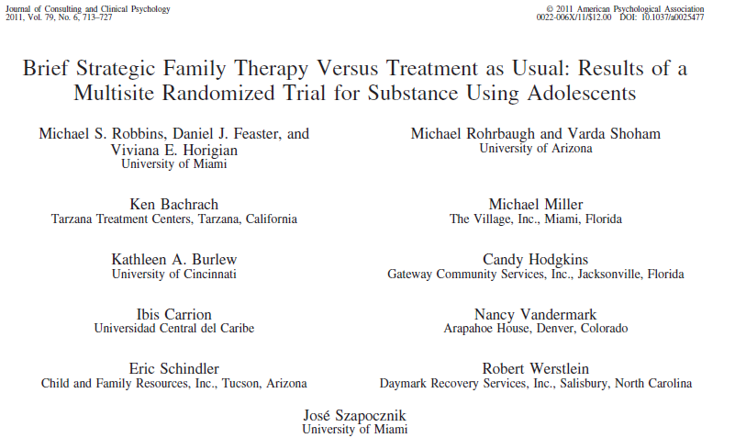
EBPs for Adolescents
Notes:
An area that could probably use greater attention in the CTN is adolescent treatment. To date, 3 adolescent protocols have been completed, including this trial of Brief Strategic Family Therapy, an investigation of use of buprenorphine to treat adolescent/young adult opiate dependence, and a study involving medication to treat ADHD in adolescent substance abusers..
We have fewer adolescent community treatment programs participating in the CTN, and it has also proven to take relatively longer to recruit adolescents at this smaller number of sites for these large trials.

Slide 16
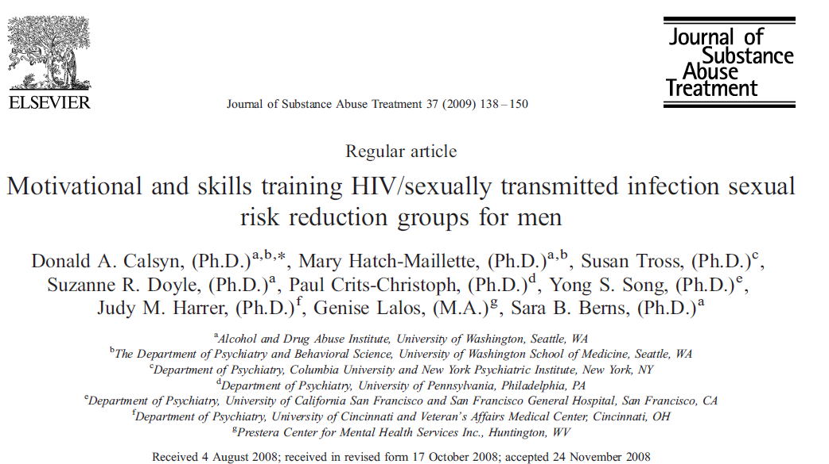
HIV Prevention
Notes:
HIV prevention and treatment is an NIH priority. CTN has an HIV SIG.
We’ve had 4 completed HIV –related trials and one trial underway to improve HIV care for substance users.
This trial of a safe sex intervention for men in SUD tx was successful in reducing unprotected sex – it was a parallel trial to the one Aimee will be presenting – as a result of these two trials both interventions have been designated “promising evidence” interventions by CDC.

Slide 17
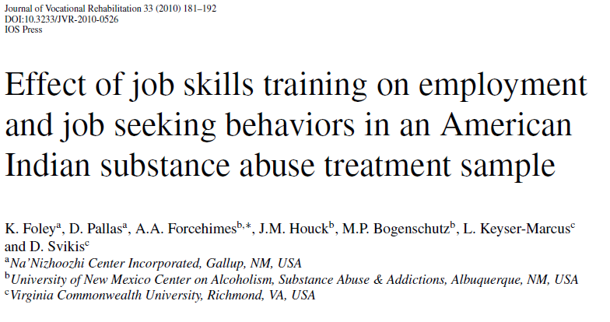
Evidence-Based for Marginalized Populations?
Notes:
The national and diverse nature of the network allows us to ask a set of questions that are consistently raised by social workers about EBPs.:
For whom is intervention X evidence-based?
The diverse sites participating in our multi-site trials sometimes allow us to analyze for effectiveness with different sub-populations. The men’s HIV intervention I just mentioned was less effective with African American & Latino men than with white men. That has led the lead investigator to follow-up with an ARRA grant to identify ways in which the intervention could be revised to be more meaningful and effective with these groups.
The CTN has sponsored a whole series of CBPR efforts with American Indian and Alaska Native communities to determine treatment needs related to substance use, and several protocols, such as this Job Seekers’ protocols have been specifically adapted and tested with AI groups.
There has been one Spanish language protocol , an investigation of Motivational Enhancement techniques.

Slide 18
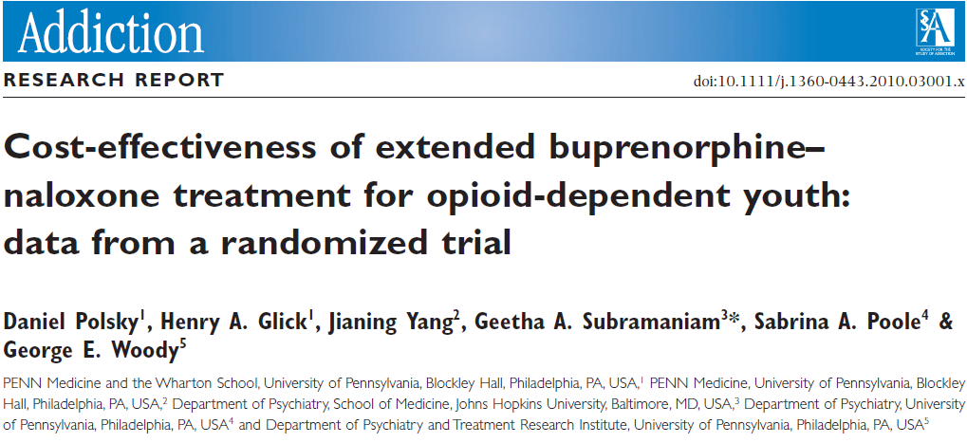
Cost-Benefit
Notes:
Of critical importance to Community Tx programs is whether the benefit of an intervention is worth the cost of implementing and sustaining the intervention. This is true for them in running their businesses as well as in working with state legislatures and single state agencies to fund tx.
Therefore, every CTN study should have an economic study attached to it; this has not been true, but there have been a number, and these provide valuable information to treatment decision-makers.

Slide 19
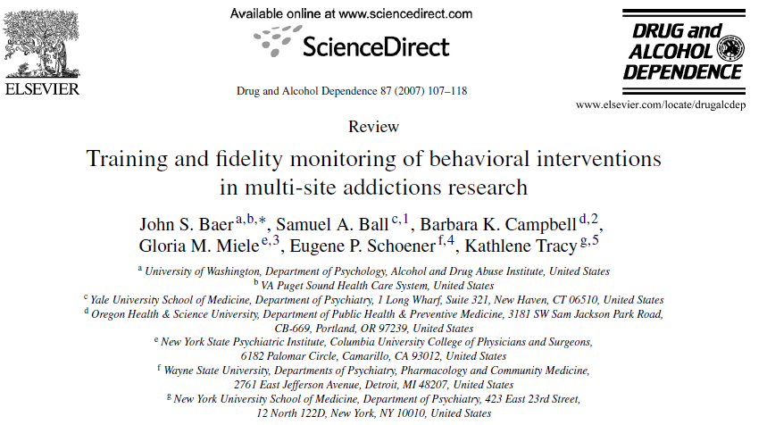
Training in EBPs
Notes:
The CTN has not itself done implementation research; that is not its mandate. However, the researchers and treatment providers in the network have a strong interest in implementation and sustainability. This paper examined what was required to train counselors in CTN interventions for CTN trials, and several platform studies have actually examined methods of training counselors.
A platform study is a study I might seek funding for, through an R01, separate from the CTN, but cooperating with CTN treatment sites to conduct the study.

Slide 20
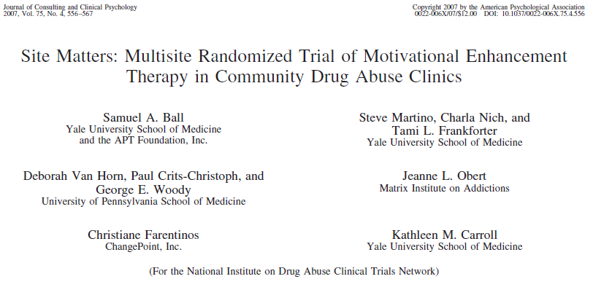
Treatment Sites

Slide 21
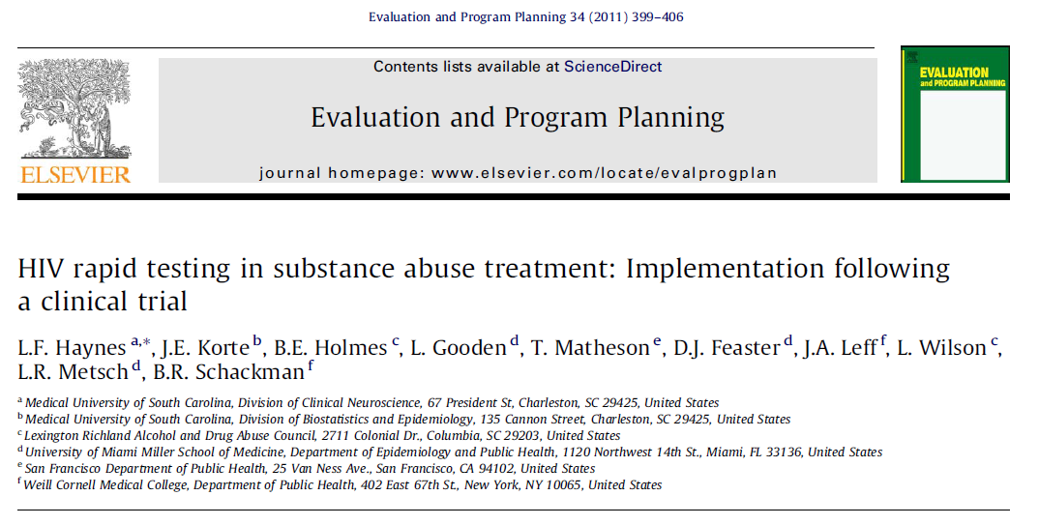
Sustainability of EBPs

Slide 22
Adoption of Buprenorphine over 4 year period in the CTN: Cross-sectional data
Paul M. Roman & Amanda J. Abraham, University of Georgia

Slide 23
Adoption of Motivational Incentives over
4 year period in the CTN: Cross-sectional data
Paul M. Roman & Amanda J. Abraham, University of Georgia

Slide 24
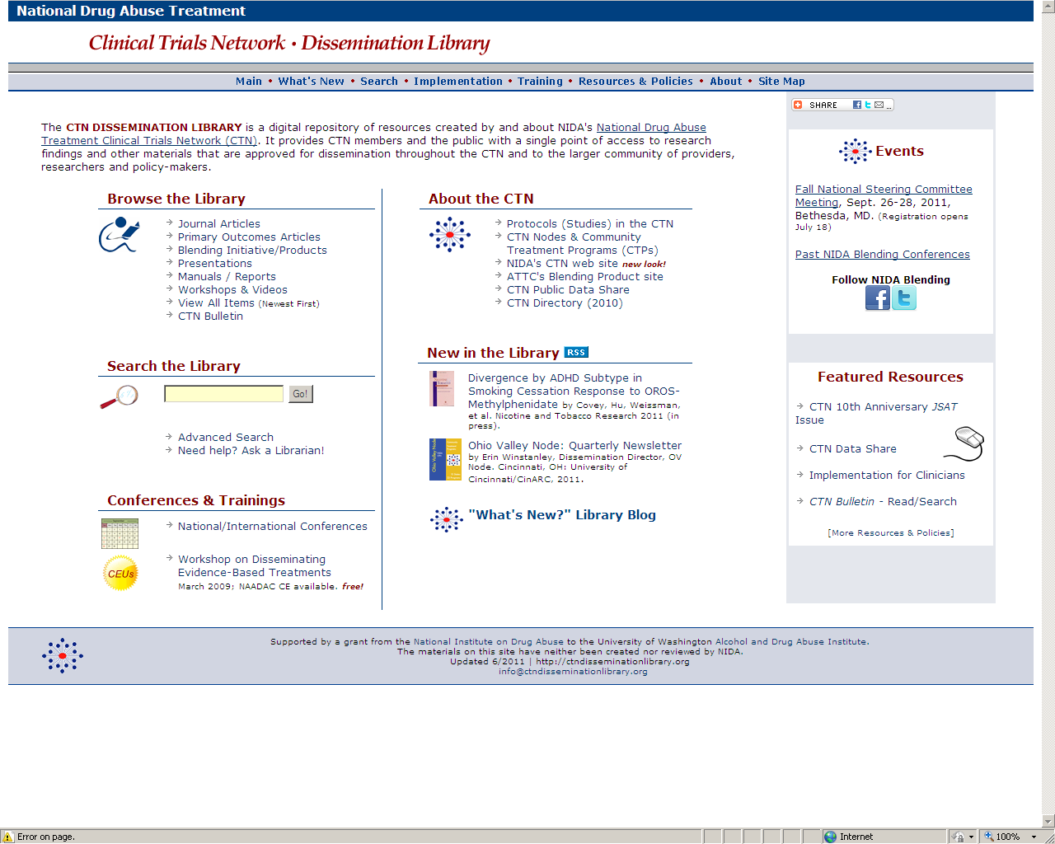
http://ctndisseminationlibrary.org
Notes:
If you write down only one thing in this session I would suggest writing down the URL to the Dissemination Library. It is a compendium of all info generated by CTN – articles, presentations (including ours today), monographs, manuals.
275 journal articles:
Primary outcome papers (23 of them)
Secondary outcome papers
Ancillary studies
Secondary data analyses
Platform studies – conducted within the network but not official CTN protocols
242 presentations
7 treatment manuals
And Dissemination products called Blending Products

Slide 25
http://www.ctndatashare.org/
Allows researchers to download de-identified data from completed CTN studies to conduct analyses that improve the quality of drug abuse treatment
Data available after primary outcome paper published
Data from 25 CTN studies currently available
Notes:
If you are interested in doing secondary analysis of data from SUD treatment samples, you might also want to write this down.
Data from each CTN study are shared at the conclusion of the study on this site.
There are currently 25 studies in the datashare. You can also access this through the CTN Dissemination Library.

Slide 26
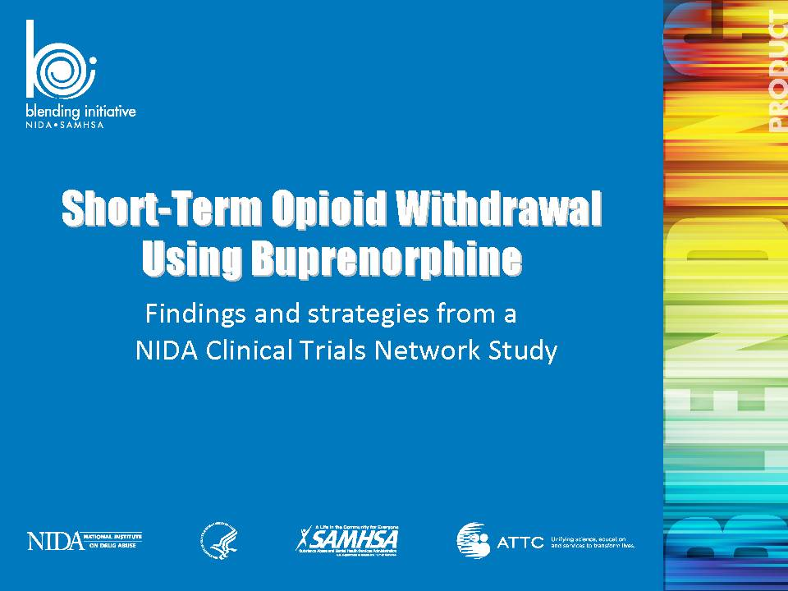

The NIDA/SAMHSA Blending Initiative
Three components:
Regional Blending Conferences
State Agency Partnerships
Blending Teams
Notes:
Historic collaboration between Substance Abuse and Mental Health Services Administration and NIDA – historic in that it involved an interagency agreement and money flowing between the two.
Blending = blending science and practice
Outgrowth of CTN
Included series Provider- oriented National/Regional Blending Conferences
NIDA and SAMSHA joined state agency directors at National Association of State Agency Directors.
Training products developed based on NIDA research and CTN studies.

Slide 27

Blending Teams
Use NIDA research findings to design user-friendly science-based tools for use in treatment settings soon after research results are published.
Teams include members from:
  SAMHSA-CSAT Addiction Technology Transfer Center (ATTC) Network,
  NIDA researchers, and
  Community treatment providers participating in the NIDA Drug Abuse Treatment Clinical Trials Network (CTN).

Slide 28
Blending Process
Selected CTN protocols
or other NIDA
Research
Hand-Off Meeting
Create the charge for Blending Team
Blending Team
Develop dissemination strategies and products.

Slide 29
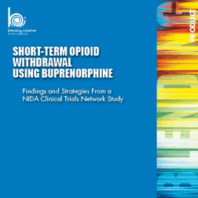
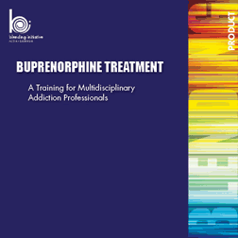
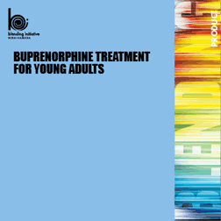


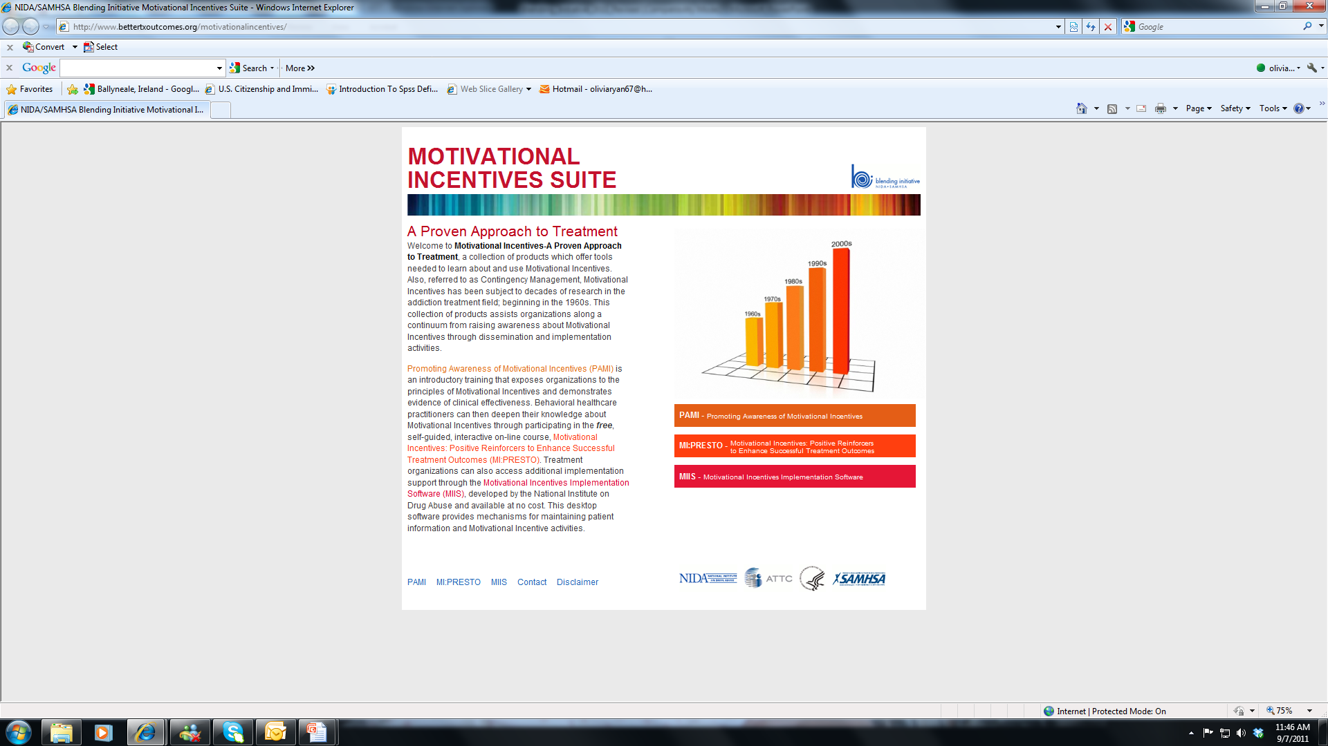
Current Blending Packages

Slide 30
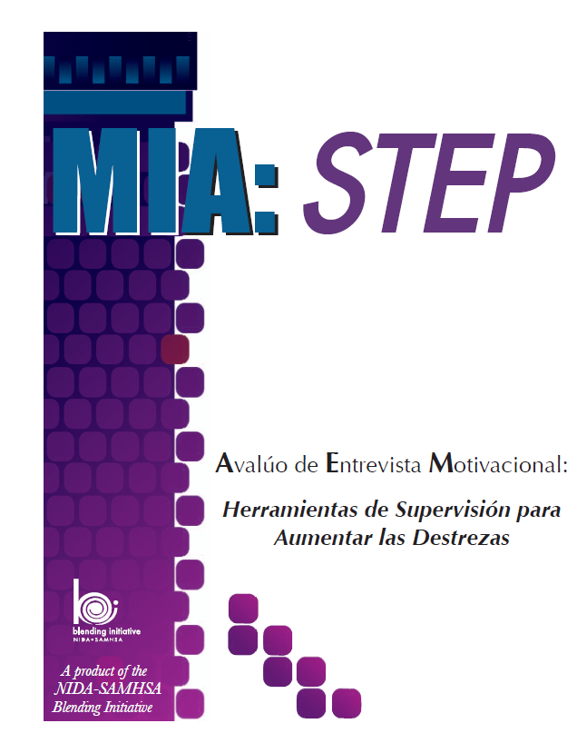
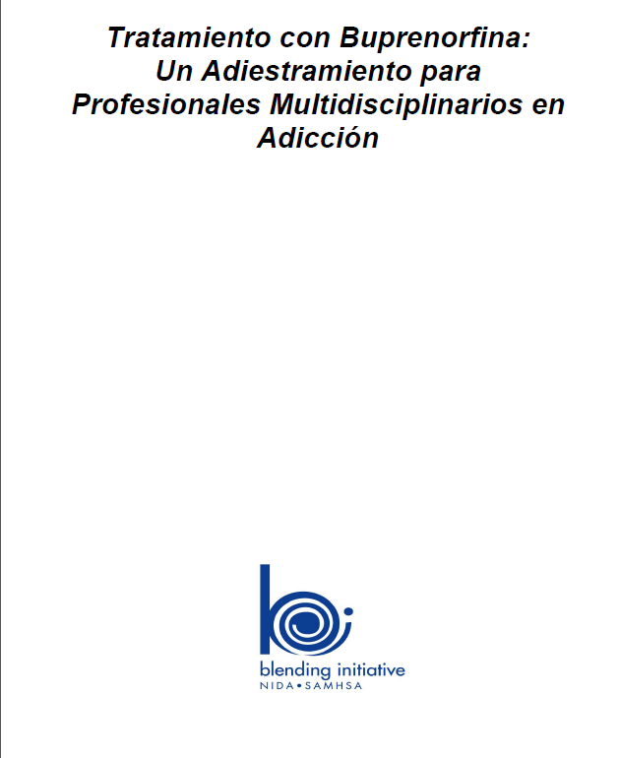
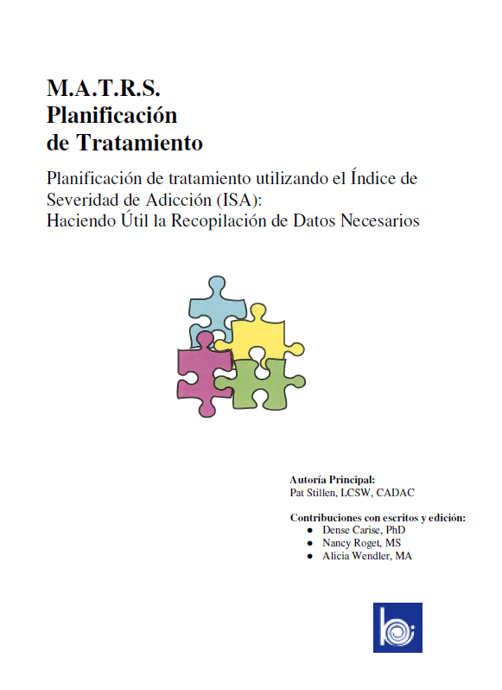
Blending Packages Available in Spanish
http://www.attcnetwork.org/explore/priorityareas/science/blendinginitiative/index.asp

Slide 31
Products Under Development
POATS (Prescription Opioid Addiction Treatment Study)
Onsite HIV Rapid Testing
Buprenorphine for Young Adults (Spanish version)

