Slide 1

NIDA
NATIONAL INSTITUTE ON DRUG ABUSE
National Drug Abuse Treatment
Clinical Trials Network
Stimulant Abuser Groups to Engage in 12-Step (STAGE-12):
Impact on Stimulant Use and 12-Step Engagement
Dennis M. Donovan, Ph.D.
University of Washington
Presented at 74th Annual Meeting of the College on Problems of Drug Dependence
La Quinta Resort and Club, Palm Springs, CA
June 12, 2012
Notes:
NIDA, NIH, DHHS

Slide 2
The present research was supported by grants from the National Institute on Drug Abuse and the NIDA Clinical Trials Network (5U10DA013714)
Dr. Donovan has no financial conflicts related to the topic of this presentation

Slide 3
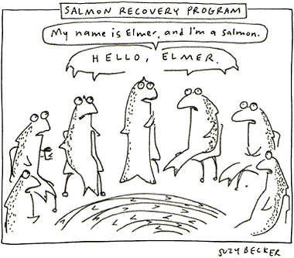
12-Step Salmon Recovery Program
http://www.grist.org/comments/ha/2002/02/04/becker-salmon/

Slide 4
Why Consider 12-Step Approaches?
12-step groups represent a readily available, no-cost recovery resource
An annual average of 5.0 million persons aged 12 or older in the U.S attended a self-help group in the past year because of their use of alcohol or illicit drugs
Consistent with community-based treatment program and counselor treatment philosophy
Applicable to a broad range of clients in different settings and can augment a wide range of standard treatments

Slide 5
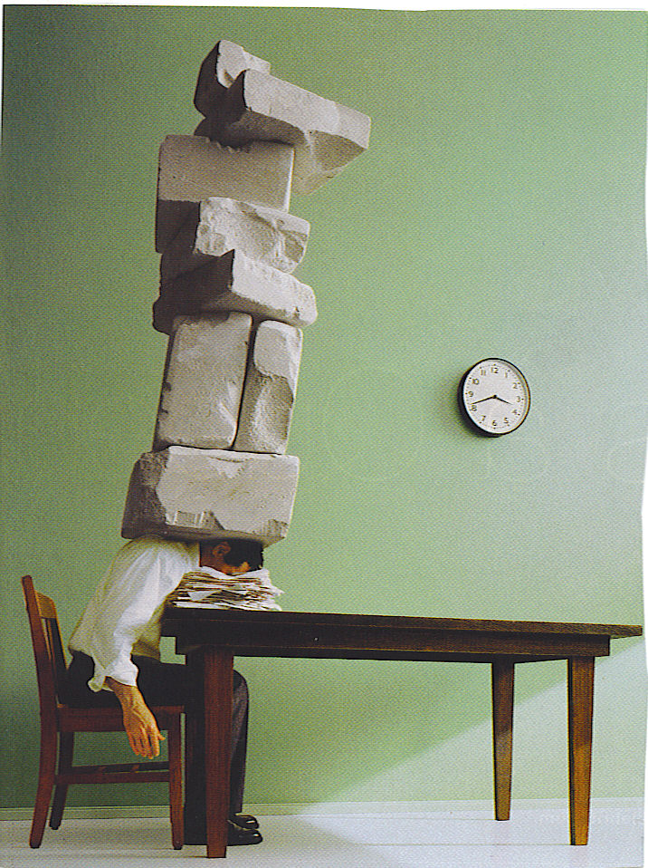
The Crushing Weight of the Data Support the Potential Positive Benefits of 12-Step Involvement

Slide 6
Findings from Previous Research on 12-Step Involvement
AA and NA participation is associated with greater likelihood of abstinence, improved psychosocial functioning, and greater self-efficacy
12-Step self-help groups significantly reduce health care utilization and costs
Combined 12-Step and formal treatment leads to better outcomes than found for either alone
Engaging in other 12-Step group activities seems more helpful than merely attending meetings

Slide 7
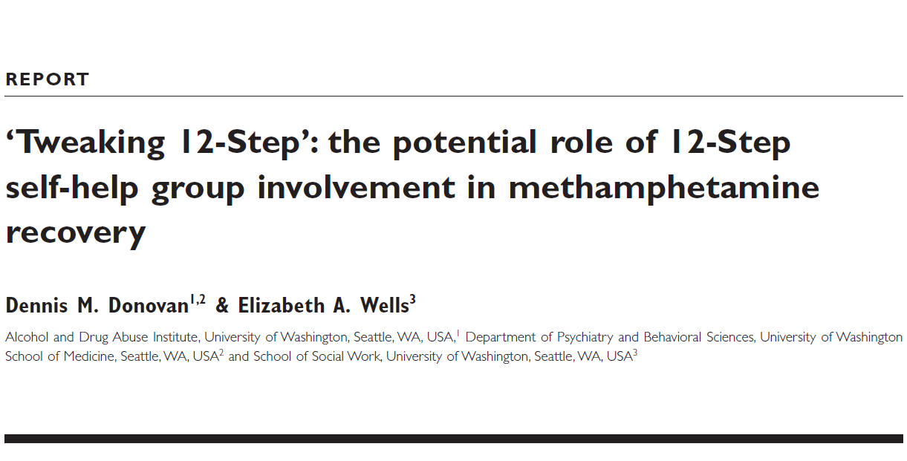
Background and Rationale for STAGE-12
Addiction, 102 (Supplement 1), 121-129, 2007

Slide 8
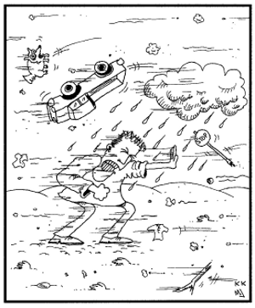
Jones would walk through a blizzard to score his dope.
The question remains: what will he do to get to a meeting?
Will he go?
Maybe,
but maybe not!!
http://recoveryjonescartoons.com/book_1.htm

Slide 9
“An increasingly rigorous body of evidence suggests consistent benefits of self-help group involvement. Dropout and nonattendance rates are high, despite clinical recommendations to attend.”
(emphasis added)
Kelly, 2003

Slide 10
Summary and Recommendations from William Miller on 12-Step Involvement
12-Step approaches cannot be ignored in understanding treatment outcomes.
Treatment is the time to initiate 12-Step attendance. If 12-Step attendance is not initiated during the period of treatment, it is quite unlikely to happen. Treatment, then, is a good time to encourage sampling of the program and meetings of 12-Step.
It is possible to facilitate 12-Step attendance. Without question, there are counseling procedures that significantly increase 12-Step attendance, at least during and often after treatment. TSF therapy clearly did this in Project MATCH. Systematic encouragement [intensive referral procedures] can significantly increase attendance.
Owen, Slaymaker et al. 2003

Slide 11
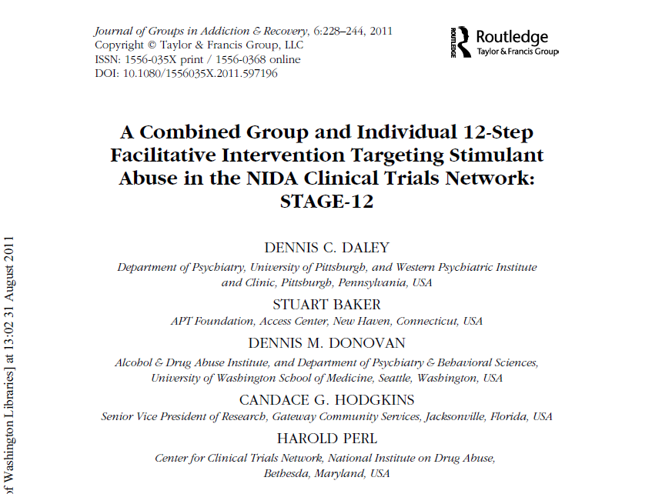
Elements of the STAGE-12 Intervention

Slide 12
STAGE-12 Therapy Manual
Based on and adapted from Twelve Step Facilitation Therapy for Drug Abuse and Dependence
Adapted for use in group delivery format from Brown, et al. 2002
Integrated with Intensive Referral procedures developed by Timko, et al., 2006, which actively attempts to get participants involved in 12-Step meetings

Slide 13
Basic Study Questions
Does STAGE-12 improve stimulant drug use outcomes in stimulant users compared to treatment-as-usual?
Substance Use Calendar
Urinalysis
Does STAGE-12 improve attendance and involvement in 12-step groups compared to treatment-as-usual ?
Substance Use Calendar
Self-Help Activities Questionnaire

Slide 14
Individual presents to CTP for Tx
Screen for study eligibility
Informed consent
Baseline assessment
Randomized to condition
Treatment as
Usual (TAU)
STAGE-12
Integrated into TAU
During Intervention
Assessment
End of Intervention
Assessment
3-, 6-Month Post-Randomization
Follow-ups

Slide 15
STAGE-12 Baseline Participant Demographic Information
Characteristics | TAU (N = 237) |  | STAGE-12 (N = 234) | Total (N = 471)
Gender
Female | 55.7% |  | 62.0% | 58.8%
Age
Mean (Std.) | 38.5 (9.4) |  | 38.2 (10.04) | 38.4 (9.7)
Ethnicity
Hispanic or Latino | 6.3% | 6.4% |  | 6.4%
Race
Caucasian | 49.0% | 46.2% |  | 47.6%
Black/African American | 35.0% | 37.6% |  | 36.3%
Marital Status
Married | 9.8% | 15. 5% |  | 12.6%
Widowed | 3.8% | 0.9% |  | 2.4%
Separated | 11.4% | 10.3% |  | 10.9%
Divorced | 22.9% | 24.0% |  | 23.5%
Never Married | 51.3% | 49.4% |  | 50.3%

Slide 16
STAGE-12 Baseline Participant Demographic Information
Characteristics | TAU (N = 237) | STAGE-12 (N = 234) | Total (N = 471)
Education
Mean (Std.) | 12.1 ( 1.6) | 12.2 (1.7) | 12.2 (1.6)
Usual Employment Pattern
Full Time | 37.1% | 35.5% | 36.3%
Part Time | 23.6% | 24.8% | 24.2%
Unemployed | 35.4% | 34.2% | 35.0%
Court Mandated
Yes | 20.7% | 22.2% | 21.4%

Slide 17
DSM-IV Dependence Diagnoses
Dependence | TAU (N = 237) | Stage-12 (N=234) | Total (N =471)
Cocaine | 70.9% | 72.7% | 71.8%
Methamphetamine | 38.4% | 33.8% | 36.1%
Amphetamine | 6.8% | 6.8% | 6.8%
Other Stimulants | 1.7% | 2.6% | 2.1%
Alcohol | 45.6% | 44.9% | 45.2%
Marijuana/Hashish | 18.6% | 21.4% | 20.0%
Opiates | 14.8% | 20.9% | 17.8%
Benzodiazepines | 7.2% | 8.1% | 7.6%

Slide 18
STAGE-12 Baseline Clinical and Trial-Related Characteristics
Characteristics | TAU (N = 237) | STAGE-12 (N = 234) | Total (N = 471)
ASI Composite Scores: Mean (Std.)
Alcohol | .162 (.21) | .159 (.20) | .161 (.21)
Drug | .157 (.09) | .155 (.09) | .156 (.09)
Psychiatric | .353 (.24) | .369 (.24) | .361 (.24)

Slide 19
Percent of Sample Endorsing Items from the Drug Section of the ASI
 | TAU | STAGE-12 | Total
How troubled by Drugs | (n=234) | (n=231) | (n=465)
Not at all | 17.1 | 16.5 | 16.8
Slightly | 10.7 | 12.6 | 12.6
Moderately | 20.5 | 16.5 | 16.5
Considerably | 20.9 | 22.5 | 22.5
Extremely | 30.8 | 32.0 | 32.0
Need Treatment for Drugs
Not at all | 17.9 | 19.0 | 18.5
Slightly | 1.7 | 3.5 | 2.6
Moderately | 3.8 | 3.9 | 3.9
Considerably | 8.1 | 10.8 | 9.5
Extremely | 68.4 | 62.8 | 65.6

Slide 20
Prior 12-Step Experience
 | TAU | STAGE-12 | Total
Ever involved in Self-Help groups for alcohol or drug problems in past | Yes = 59.4% | Yes = 62.9% | Yes = 61.1%
Median Total Meetings Attended and Number of People Having Attended [N]
Alcoholic Anonymous | 50.0 [112] | 35.0 [112] | 50.0 [224]
Narcotics Anonymous | 50.0 [112] | 30.0 [115] | 30.0 [227]
Cocaine Anonymous | 10.0 [43] | 10.0 [37] | 10.0 [80]
Crystal Meth Anonymous | 0.0 [6] | 1.5 [4] | 1.0 [10]

Slide 21
Stimulant Use Outcomes

Slide 22
Percent of Participants Entering Trial Stimulant-Free based on Baseline Self-Report and Urinalysis

Slide 23
Interpretation of Zero-Inflated Negative Binomial Models
Zero-inflated negative binomial random-effects model utilized allows for:
Missing data across time
Model-based predictions of the
probability of abstinence and
rate of stimulant substance use
within a 30-day window of assessment for all subjects at each time point, based on maximum-likelihood estimation procedures.

Slide 24
Interpretation of Zero-Inflated Negative Binomial Models
The logistic portion (abstinence) and the negative binomial (or count) portion are typically interpreted and described separately
Generally presented and interpreted in terms of odds ratios (logistic) and incidence rate ratios (negative binomial) with corresponding 95% confidence limits to assess statistical significance.

Slide 25
Interaction Odds Ratios and Incidence Rate Ratios: Days of Stimulant Substance Use within 30-day Window of Assessment
 | Logistic (Abstinence) |  | Negative Binomial (Count)
 | Odds Ratio | 95% CI for Odds Ratio | Rate Ratio | 95% CI for Rate Ratio
Mid-Treatment | 3.34* | 1.20, 9.28 | 1.66* | 1.05, 2.60
End-of-Treatment | 2.44* | 1.01, 5.86 | 1.50* | 1.01, 2.24
First Follow-up | 1.78 | 0.81, 3.90 | 1.36 | 0.93, 1.98
Second Follow-up | 1.30 | 0.60, 2.79 | 1.23 | 0.84, 1.79
Third Follow-up | 0.95 | 0.42, 2.15 | 1.11 | 0.74, 1.66
Last Follow-up | 0.69 | 0.27, 1.77 | 1.00 | 0.64, 1.57

Slide 26
Primary Outcome: Observed Percentage of Zero Days of Stimulant Use within 30-day Window

Slide 27
Primary Outcome: Observed Average Number of Stimulant Use Days within 30-day Window

Slide 28
Model-based Average Predicted Probabilities of Having a Positive Urine Screen for Stimulants

Slide 29
Percentage of Subjects with ASI Drug Composite Scores = 0 and Means for those with Scores > 0
Percent of Subjects with ASI Drug Composite Score = 0
Mean ASI Composite Score for Those
With Scores > 0

Slide 30
12-Step Related Outcomes

Slide 31
Secondary Outcome Measures on which Differences were Found between STAGE-12 and TAU
Number of days of AA, NA, CA or CMA meeting attendance during 30 day assessment windows at Baseline (RR = 1.21) and Mid-Treatment (RR = 1.18) (SHAQ)
Number of types of other recovery activities engaged in from Baseline through the 6-Month F-U (RRs ranged from 1.21 to 1.41 across time points) (SHAQ)
Maximum number of days of self-reported service at meetings within 30-day assessment windows at End-of-Treatment (RR = 1.61), 3-Month F-U (RR = 1.77), and the 6-Month F-U (RR = 2.38) (SHAQ)

Slide 32
Number of Other Self-Help Activities and Days of Doing Service at 12-Step Meetings (SHAQ)
* * * * *
Number of Days of Service at Self-Help
Meetings
Average Number of Other Self-Help Activities

Slide 33
Summary: STAGE-12 vs TAU
STAGE-12 increases the probability of abstinence from stimulants during and in the last 30 days of the active treatment phase
If abstinence is not achieved during this period, rates of use appear greater among STAGE-12 participants
STAGE-12 associated with significantly lower ASI Composite score at 3-month follow-up and greater change in this measure from baseline to 3-month follow-up
STAGE-12 associated with greater number of
days of 12-step self-help meeting attendance
types of other 12-step activities engaged in
maximum number of days of self-reported service activities at meetings at different periods during and following the active treatment phased

Slide 34
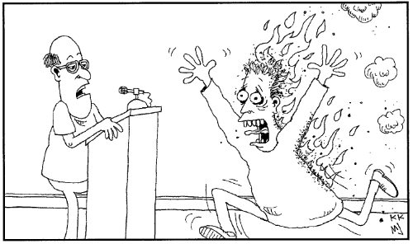
"Does anyone have a burning desire to share?"
http://recoveryjonescartoons.com/more_cartoons!.htm

