Slide 1
Evaluating A Culturally Adapted Version of Real Men Are Safe
Annual Scientific Meetings of the
College on Problems of Drug Dependence
Palm Springs, CA, June 11, 2012
Principle Investigator: Donald Calsyn, Ph.D.,
Co-Investigator: A. Kathy Burlew, Ph.D.
Project Manager: Mary Hatch-Maillette, Ph.D.
Graduate Assistant: Jerika Wilson, B.S.
Research Coordinator: Lynette Wright, M.S.W.
Statistician: Blair Beadnell, Ph.D.
Funding: NIDA grant 1RC1DA028245 (Donald Calsyn, PI)
No conflicts of interest to report
Notes:
I am pleased to be here today to talk with you about a research project in which we culturally adapted an evidence based HIV prevention project for men in substance abuse treatment, Real Men Are Safe, which is listed on the CDC’s website for evidence based practices. We believe our approach to cultural adaptation is one that could be utilized in culturally adapting other evidenced based practices.

Slide 2
Specific Aims
Revise the REMAS intervention shown to be effective in CTN0018 to be more culturally relevant to African American and Hispanic Men (Phase 1).
Conduct a pilot feasibility trial of the revised REMAS in four CTN CTPs in which there is a high percentage of African American or Hispanic clients (Phase 2).
Notes:
These findings led to us proposing a grant which was funded with ARRA $$. The specific aims were to
1) revise REMAS to make it more culturally relevant.
2) Pilot test revised version of REMAS

Slide 3

Study Design for Culturally Adapting REMAS
Recruit Expert Panel for Delphi Process
(3 Academic & 6 Community Based)
Prepare Delphi Process Round 1 Materials
(Literature Reviewed, REMAS Modules Grouped,
Culturally Tailored Modules Identified, Reviewed & Matched to REMAS)
Delphi Process Round 1
Prepare Delphi Process Round 2 Materials
(Round 1 Results, Suggested Changes to REMAS)
Delphi Process Round 2 – Review Revised Manual
REMAS-CA
Pilot Test at 4 Community Tx Programs
Conduct Patient Focus Groups &
Counselor Exit Interviews
Compare Pilot Ss to Hx Controls
Notes:
3
Here is the design for the project. We first identified a panel of experts to help us with the revision. Three were academics experienced in cultural adaptation, and six were community treatment providers experienced in working with either African American or Hispanic men in substance abuse treatment settings. Our plan was to use the Delphi Process in which each panel member would review and rate materials we sent them independent of other panel members. The Delphi Process is composed of a series of rounds where materials are reviewed and rated by panel members. This process limits the impact that a single panel member might have on swaying the opinion of other panel members. Where there is consensus among panel members revisions to the intervention materials are made and sent out for a second, and possible third, round of review and feedback until consensus is obtained. In the following slides I’ll provide more details of the process we utilized.
Once we had finalized the revised culturally adapted version of REMAS we planned to pilot test it in 4 community treatment programs and collect some qualitative data from patient focus groups and counselor exit interviews.

Slide 4
Culturally Tailored Interventions
Nia:
African American heterosexual men
d-up:
African American MSM
Many Men, Many Voices:
African American MSM
Cuídate:
Hispanic Adolescents
Notes:
To prepare for the first round of the Delphi Process we identified four articles on cultural adaptation that we felt would provide the panel members with direction in reviewing and rating the material we would be sending them. We next identified HIV prevention interventions that the CDC had identified as evidenced based that targeted either African Americans or Hispanics. None of these were designed for use in substance abuse treatment settings, which is one of the unique features of Real Men Are Safe. Nia targets heterosexual African American men, Many Men, Many Voices and d-up target AA MSM, while Cuídate targets Hispanic adolescents.

Slide 5
REMAS Modules: Sessions 1-2
Getting Started / Session Review
HIV/STD Information
Risk Self Assessment-Risk Reduction Motivation
Healthy Options
Condom Use Skills
Overcoming Barriers to Condom Use
Prevention Planning
Notes:
Next we identified which modules from these four interventions addressed concepts/issues similar to the modules from Real Men Are Safe. On this slide are the module topics from sessions 1 & 2 or Real Men Are Safe. I have highlighted “Overcoming Barriers to Condom Use” because I will be using this module as an example of the process in future slides.

Slide 6
REMAS Modules: Sessions 3-5
Sex without Drugs
Coping with Sexual Dysfunction
Relationships and Sexual Norms
Safe Sex Communications
Summary
Modules not included in REMAS
Making HIV Relevant to Participant
Ice Breakers
Notes:
On this slide are the module topics from sessions 3-5 for Real Men Are Safe plus a listing of modules in the culturally tailored interventions that do not have a REMAS counterpart. The “Sex without Drugs” is unique to REMAS.

Slide 7
Content Focus: - Overcoming Barriers to Condom Use
REMAS Module 6 - Barriers to Condom Use Brainstorming
2) Nia II.3 - Pros and Cons of Condom Use
Nia II.4 - Personal Feedback Report #3 (PFR-3):
Condom Attitudes
3) d-up You Can Do What With a Condom? (p65)
4) Cuídate Overcoming Barriers to Condom Use
(p. 5.10-5.15)
Notes:
The Overcoming Barriers to Condom Use topic was addressed in all the interventions. For the Delphi Process we chose to only send the panel members materials from three of the culturally relevant modules. On the next few slides I am going to show you what the panel members received from us for this one topic area. Remember there are 15 topic areas.

Slide 8
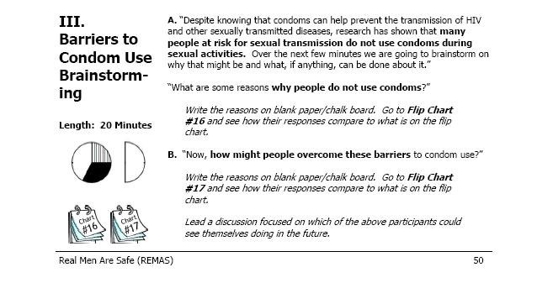
Real Men Are Safe: Overcoming Barriers to Condom Use
Notes:
This is the instructions from the REMAS Manual.

Slide 9
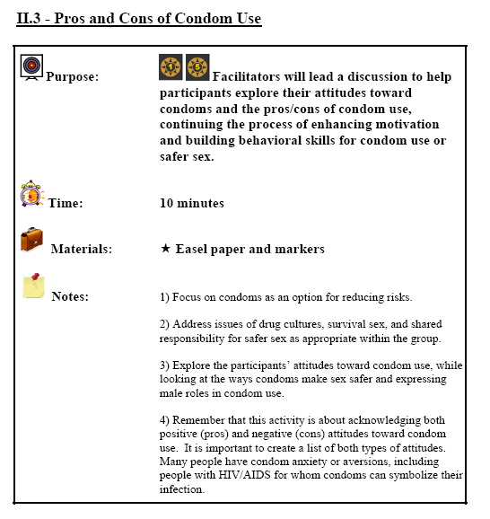
Nia: Pros & Cons of Condom Use
Notes:
This slide and the next are from the Nia manual.

Slide 10
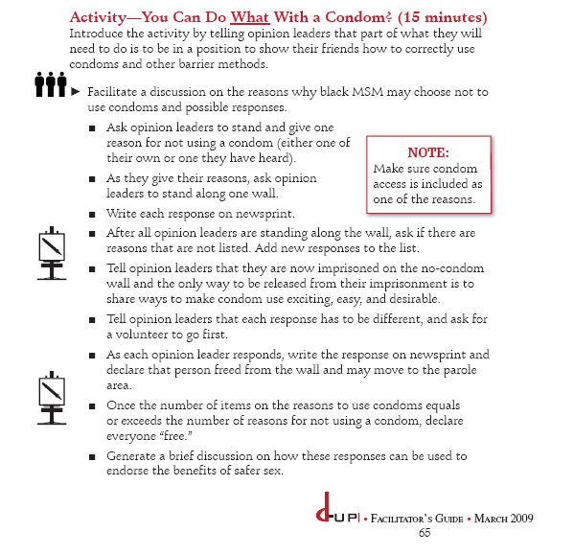
d-up: What Can You do with a Condom?
Notes:
Here are instructions from d-up.

Slide 11
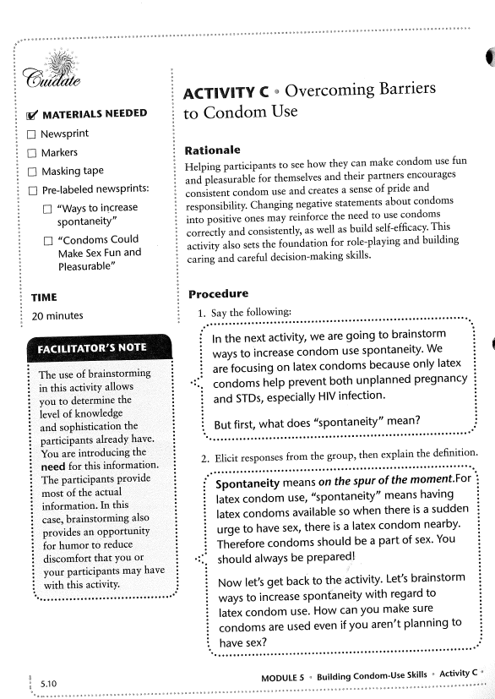
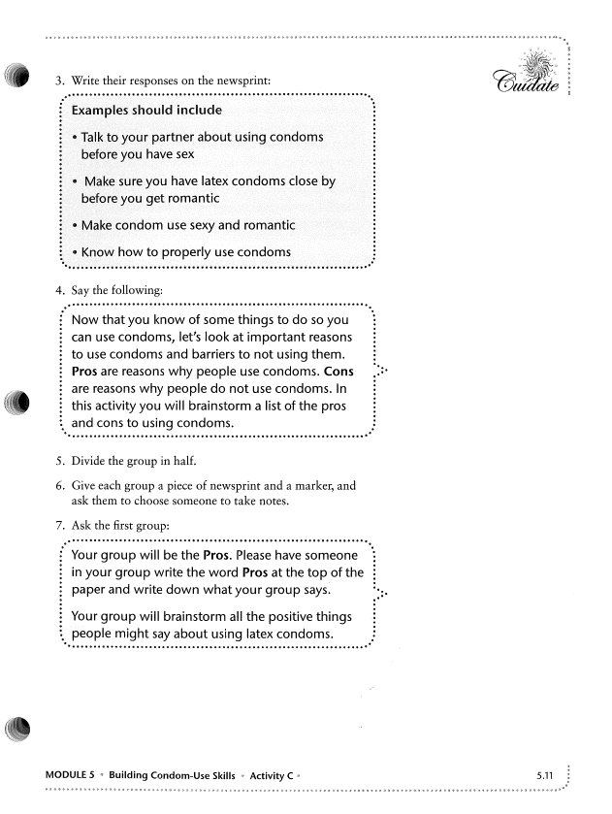
Cuídate: Overcoming Barriers to Condom Use
Notes:
And finally instructions from Cuídate are presented here and on the next 2 slides. I show you these only to give you a sense of the volume of material we were giving our panel members to review and rate. This is the material for one topic area, there were 17 all together.

Slide 12
1. Use of Language/Expressions of the Target Group
Module | Target Group | High use of unfamiliar language/expressions for target group (1) | Some use of unfamiliar language/expressions for target group (2) | Neutral on use of language/expressions of target group (3) | Some use of unique language/expressions for target group (4) | High use of unique language/expressions for target group (5)
 | African American
REMAS Barriers to Condom Use Brainstorming
Nia Pros/Cons of Condom Use & Personal Feedback Form #3
d-up What Can You Do w/ a Condom?
Cuídate: Overcoming Barriers to Condom Use
Notes:
The panel members received a rating form like this one for each topic area. We asked them to rate the modules on 4 dimensions. This first one is “Use of Language/Expressions of the Target Group.” They rated the module on a 1 – 5 scale for African Americans and Hispanics separately.

Slide 13
2. Activities that Enhance Ethnic Identity
3. Consistent with Norms, Knowledge,
Cultural Values of Target Group
4. Understands Social Context that Surrounds
the Behavior and Living Situation of
Target Population
Notes:
Here are the other three dimensions panel members had to rate each module.

Slide 14
Recommendations for the content area Barriers to Condom Use (check and complete all that apply. For any proposed additions, feel free to use your own ideas/language rather than be limited to existing modules):
____No change to the REMAS HIV Barriers to Condom Use module
____Revise the REMAS Barriers to Condom Use module by
Adding the following sections from ______________________________
Deleting the following sections __________________________________
and adding ___________________________________________________
Revising the following REMAS sections____________________________
with ___________________________________________________
_____ Replace the REMAS HIV Barriers to Condom Use module with ___
_______________________________________________________________
_____Delete this whole content area. It is not needed or relevant to the target groups.
Notes:
Finally we asked them whether they would change the REMAS module and if so how might they do that.

Slide 15
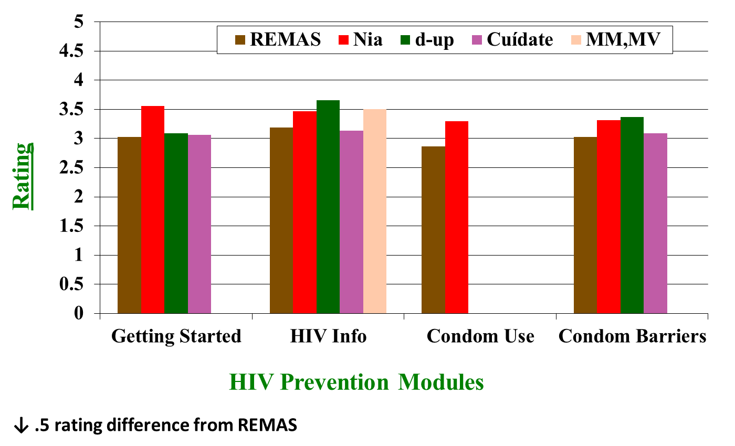
Mean Panel Member Ratings for African Americans I
↓
Notes:
For each of the 15 content areas we thus had ratings from 9 raters, on four questions for relevance to African American and Hispanic men separately. That is a lot of rating data. We summed across the four questions and across raters to come up with a mean rating for each content area for each intervention. We clearly do not have enough power to utilize inferential statistics. We decided to focus in on content areas where there was at least a .5 difference in the mean ratings between REMAS and one of the culturally tailored interventions. This slide shows the mean rating for 4 content areas for African Americans. For the getting started content area NIA was rated .5 higher than REMAS. Although the culturally tailored modules were often rated higher than REMAS, in none of the other three content areas presented here did the rating reach a .5 difference.

Slide 16
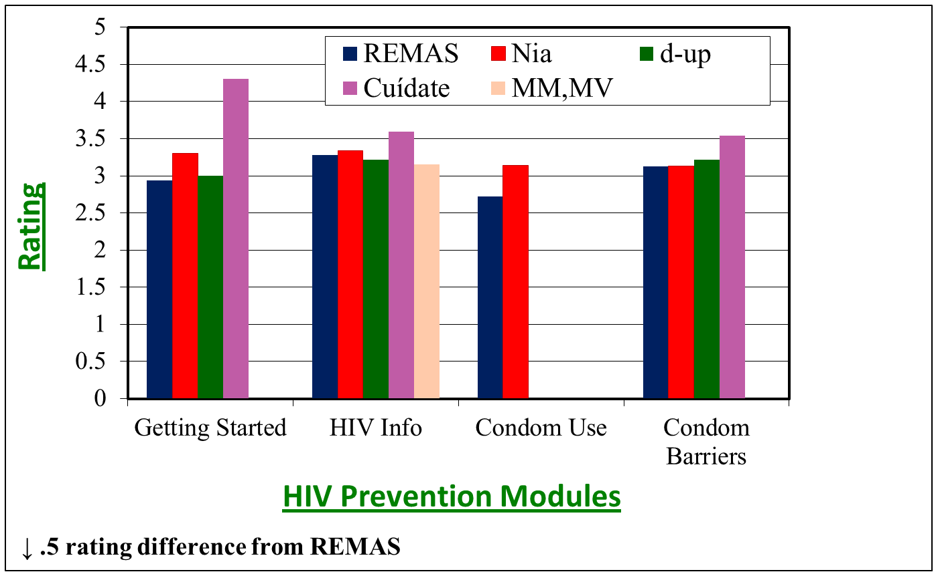
Mean Panel Member Ratings for Hispanics I
↓
Notes:
Here are the same content area ratings when asked to rate for relevance to Hispanics. As with African Americans the only rating difference >.5 is in the getting started module. However, for African Americans the difference had been for the Nia module targeted to AA heterosexual men, whereas for Hispanics the difference is for the Cuídate module which targets Hispanic youth.

Slide 17
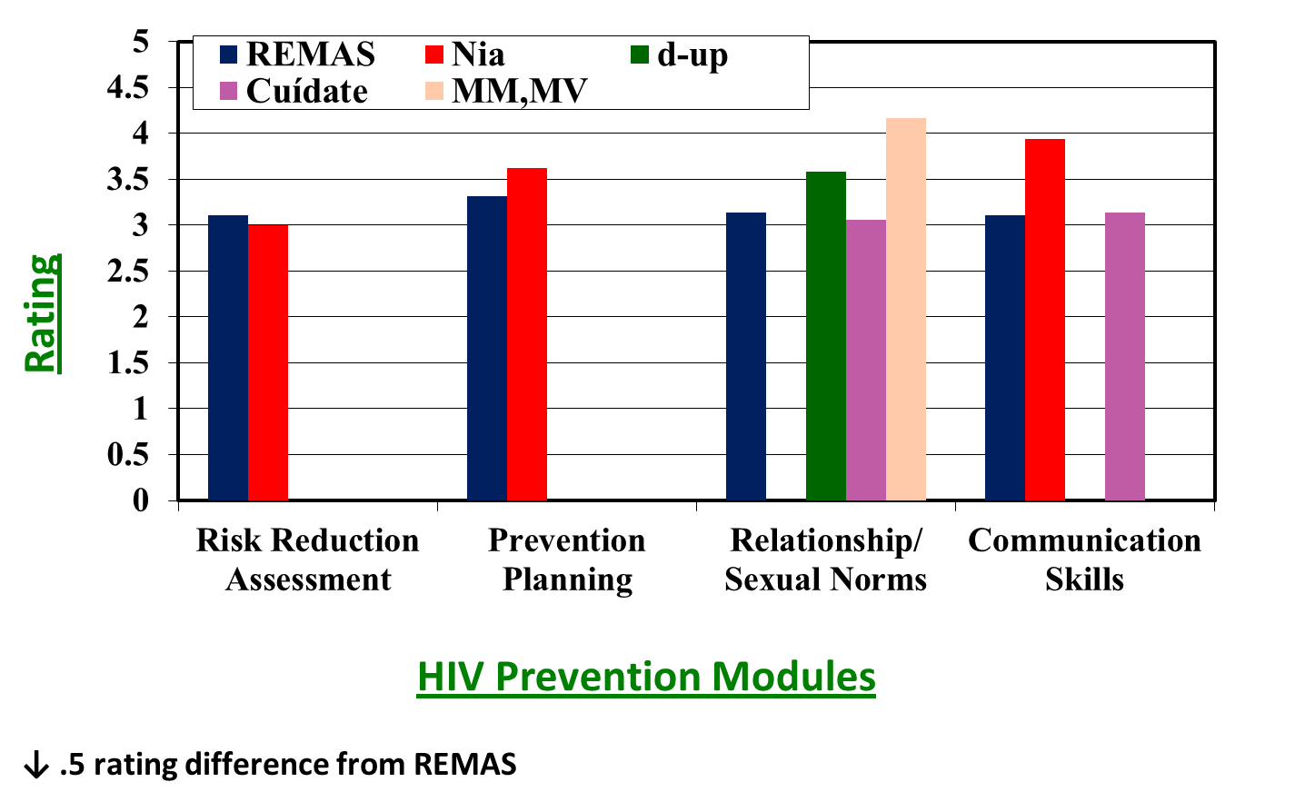
Mean Panel Member Ratings for African Americans II
↓
↓
Notes:
This slide shows the ratings for 4 additional content areas for relevance to African Americans. Here you can see that for the relationship/sexual norms and communication skills content areas the culturally tailored intervention are rated >.5 higher. Remember these ratings, we will come back to them later.

Slide 18
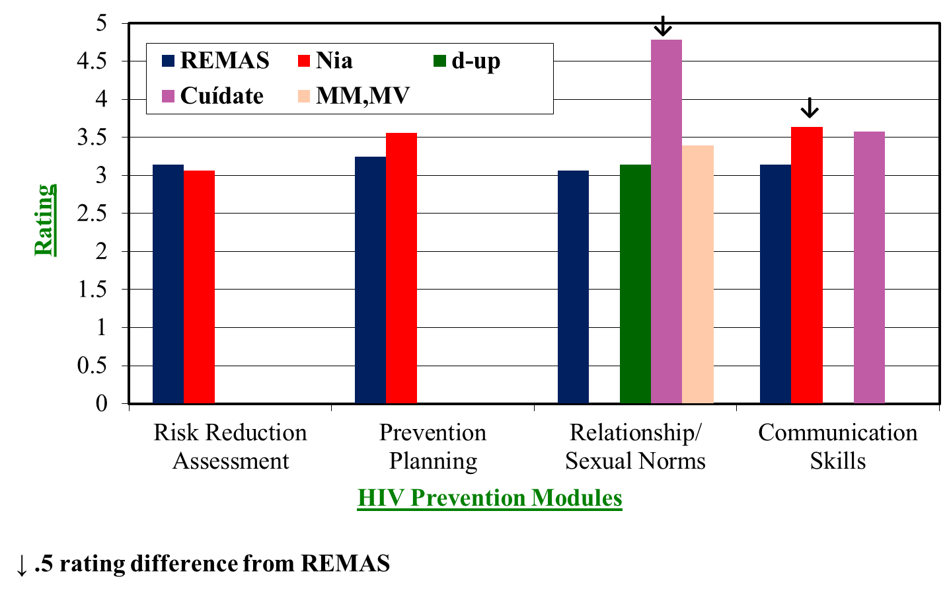
Mean Panel Member Ratings for Hispanics II
Notes:
Here are the same 4 content areas for relevance to Hispanic men. Again we have a >.5 difference in the relationship/sexual norms and communication skills content areas. As expected Cuídate is the module rated higher than REMAS for Relationship /Sexual Norms. However for communication skills only the Nia module meets our >.5 criteria.

Slide 19
Study Design for Culturally Adapting REMAS
Recruit Expert Panel for Delphi Process
(3 Academic & 6 Community Based)
Prepare Delphi Process Round 1 Materials
(Literature Reviewed, REMAS Modules Grouped,
Culturally Tailored Modules Identified, Reviewed & Matched to REMAS)
Delphi Process Round 1
Prepare Delphi Process Round 2 Materials
(Round 1 Results, Suggested Changes to REMAS)
Delphi Process Round 2 – Review Revised Manual
REMAS-CA
Pilot Test at 4 Community Tx Programs
Conduct Patient Focus Groups &
Counselor Exit Interviews
Compare Pilot Ss to Hx Controls
Notes:
19
Here again is the design for the project.
We are now ready to pilot test REMAS-CA in 4 community treatment programs and collect some qualitative data from patient focus groups and counselor at the end of the pilot.

Slide 20
REMAS-CA / REMAS Differences
A focus on how culture, social norms and upbringing affects our sexual behavior & relationships
More client input
Client engaged in more activities within the group, more doing, less watching
Notes:
Based on the feedback from our panel there were three broad areas in which REMAS was revised.

Slide 21
Phase 2 Study Design Progress
CTP Selection / UW IRB
Train All Counselors in Real Men Are Safe-CA
Train Research Coordinators
Recruit & Screen Participants
Complete Counselor
Certification
Baseline Assessment
Conduct REMAS-CA (x 3)
3 Month Assessment
Conduct Focus Group (Cohort 3, Post Intervention)
Notes:
21
Here is the design for the pilot study.

Slide 22
Client Inclusion / Exclusion Criteria
Inclusion Criteria:
1. Adult males admitted to treatment at a participating CTP in past 30 days.
Self report being sexually active in the past 3 months.
Willing to attend REMAS CA groups
4. Agreeable to completing assessments at baseline, 3 mo..
Exclusion Criteria:
1. Observable, gross mental status impairment – including
severe distractibility, incoherence or retardation
2. Observable psychotic symptoms or severe psychiatric
distress
3. Having a primary partner planning to become pregnant.
Notes:
Here are the inclusion/exclusion criteria. Participants need to be men 18 or older, in treatment at a participating program, self report being sexually active in prior 3 months, agreeable to attending an HIV prevention intervention, agreeable to the assessment schedule.
Exclusion criteria are gross mental impairment that would interfere with group participation as determined by the CTP clinician, having a primary sexual partner planning on getting pregnant during the study.
The HIV Risk Behavior Survey and a brief demographic form will be utilized to conduct the screening.

Slide 23
Client Measures
Screening
HIV Risk Behavior Scale
CTN Demographic Form
Baseline / Follow Up
Sexual Behavior Interview (ACASI)-shorten;
Condom Barriers Scale
HIV Knowledge
Condom Skills Demonstration
Notes:
Here are the baseline assessment measures. The primary outcome measure is obtained with the Sexual Behavior Inventory which is administered using Audio Computer Assisted Self Interviewing methodology where the participant sits at a computer station wearing headphones. The interview questions appear on the screen and are heard through the headphones. Responses are provided by keyboard or mouse. Several studies have demonstrated that participants are more likely to disclose high risk behavior using this method as compared to in person interview or paper & pencil assessment.

Slide 24
Participant Data Flowchart
Notes:
24
This slide displays our and our participants’ activity – throughout the course of the study.
113 men were screened for eligibility.
13 of these were excluded – mainly due to sexual abstinence
95 completed baseline assessment.
77 attended at least one session
66 of these completed the 3 month follow up assessment

Slide 25
Baseline Socio-demographic Characteristics*
n=54
n=63
Notes:
25
The data analysis reported here focuses 54 ethnic minorities from the pilot study and the 63 for original REMAS.

Slide 26
Session Attendance for Ethnic Minorities at REMAS & REMAS-CA
OR=2.1
Notes:
We had defined intervention completion as attending 3 or more sessions. Minorities in the pilot were more like to complete the intervention than those in the original REMAS.

Slide 27
Percent of Ethnic Minorities Having Casual Partners
REMAS-CA
Notes:
The percent of Minority men in the REMAS-CA pilot with casual sex partners decrease more than for original REMAS.

Slide 28
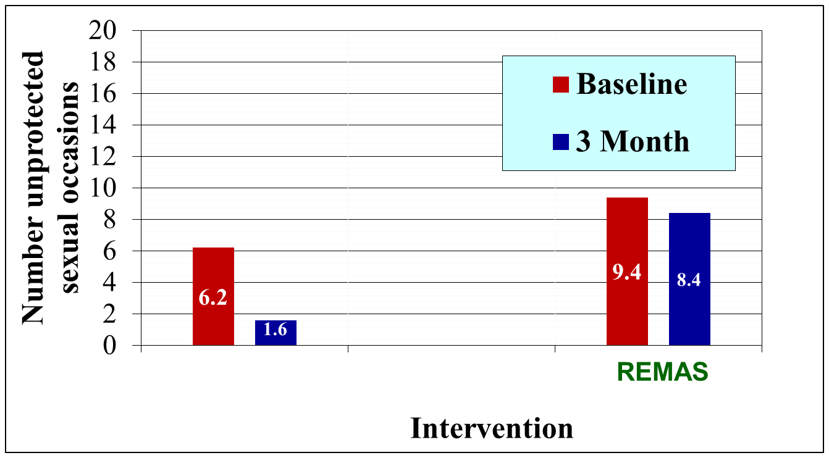
Number of Unprotected Sexual Occasions for Ethnic Minorities with Casual Partners
p < .04
RR=4.56
REMAS-CA
Notes:
Similarly there was similar greater decrease in number of unprotected sexual occasions with casual sex partners for Minority men in the REMAS-CA pilot than for original REMAS.

Slide 29
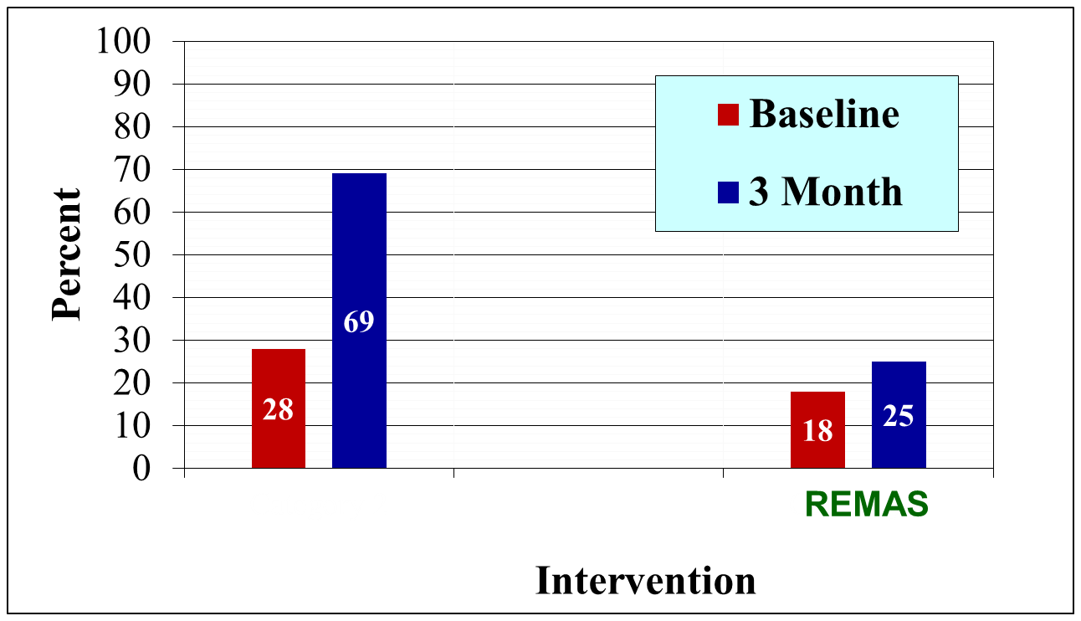
Percent of Ethnic Minorities Using Condoms >80% with Casual Partners
REMAS-CA
Notes:
Similarly there was similar greater increase in using condoms frequently with casual sex partners for Minority men in the REMAS-CA pilot than for original REMAS.

Slide 30
Feedback from Patient Focus Groups Following Pilot Testing of REMAS-CA
Likes
Getting basic information about STI statistics & safe sex options
Camaraderie of all men‘s group
Condom practice & ♀ condom info
Safe place to talk about sensitive issues
Able to get in touch with positive values from childhood years
Surprised at how similar values were across cultures/ethnicity
TALK tools helpful
Wanted more
Help with talking to partners about enhancing sex

Slide 31
Feedback from Counselor Exit Interviews Following Pilot Testing of REMAS-CA
Likes
Felt patients enjoyed and benefitted from sessions
Generational &ethnic diversity within the group helpful
Session 4 surprisingly very impactful
Co-therapy and use of a manual new & challenging, but rewarding
Improvement suggestions
Adjust movie clip use by spreading clips throughout sessions
More time to deal with sensitive issues that emerge in session 4
Focus more on disconnect between values and patient
behaviors in session 4
Treat TALK tools like a sales pitch
Add more myths with a cultural bias

Slide 32

Clinical Trials Network ∙ Dissemination Library
National Drug Abuse Treatment
Find it in the
CTN Dissemination Library!
http://ctndisseminationlibrary.org

Slide 33
REMAS-CA: Real Men are Safe Session 1
HIV/AIDS Update: Identifying Risks
I. Group Introductions. Goals and Guidelines 20 Min
II. HIV Risky Behaviors Exercise 15 Min
III. HIV/AIDS Update – Myths & Facts 25 Min
IV. Sexually Transmitted Infections 10 Min
V. Revisit Risky Behaviors Exercise 10 Min
VI. Talking Circle 10 Min
Notes:
On the next 5 slides I listed the changes to each of the REMAS sessions. In brown are modules with significant revision. In black are modules that are new or represent nearly full replacement of the original REMAS module. The Talking Circle was added to the end of each session as a way for each participant to indicate what he had gotten from the session. The other revisions all reflect the participant being more active than in the original REMAS.

Slide 34
REMAS - CA: Real Men are Safe Session 2
HIV/AIDS Update: Planning Prevention
I. Welcome, redo introductions 5 Min
II. Review Drug Use Practices & Safe Sex Hierarchies 10 Min
III. Male Condom Demonstration 20 Min
IV. Condom Practice 15 Min
V. Female Condom Demonstration 10 Min
VI. Barriers to Condom Use 20 Min
VI. Talking Circle 10 Min
Notes:
The change to the condom practice was that we eliminated practicing in pairs and conducting an assessment of the practice. The change in overcoming barriers to condom use has to do with participants needing to get up out of their seats as part of the module.

Slide 35
REMAS – CA: Real Men are Safe Session 3
Sex without drugs. Can it happen? Is it
Pleasurable?
I. Welcome, redo introductions 5 Min
II. Building Skills for Making Safer Sex Decisions:
Movie Clips 35 Min
III. Experience with combining sex & drugs
Enhancements/Impairments 25 Min
IV. Enhancing sex without drugs 20 Min
V. Talking Circle 10 Min
Notes:
Using clips from movies to help men explore safe sex decision making is totally new for REMAS and comes out of the Nia intervention. We did find new movie clips to use which we felt better met our goals.

Slide 36
REMAS - CA: Real Men are Safe Session 4
Intimate Relationships: Understanding the Origins of Attitudes, Beliefs, and Hopes
I. Welcome, redo introductions 5 Min
II. Who’s got the Power?
Who’s Showin’ the Love? 20 Min
III. Culture values & intimate relationships 20 Min
IV. Ideal man / ideal woman brainstorming 15 Min
Changing Social Norms 20 Min
VI. Talking Circle 10 Min
Notes:
As you can see, session 4 is almost all totally new. Although there is a focus on cultural issues in other parts of the intervention this session is where the cultural focus is the strongest. The biggest struggle we had was finding a way to address cultural issues with a culturally diverse group, which is a very common situation is substance abuse treatment programs.

Slide 37
REMAS-CA: Real Men are Safe Session 5
Beyond the Pick Up Line: Communicating About Safe Sex
I. Welcome, redo introductions 5 Min
II. Communicating About Safe Sex: Talk Tools 10Min
III. Practice Talk Tools: Responding to Excuses for
Not Using Condoms 15 Min
IV. Practice Talk Tools: Responding to come-ons for
sex under the influence 15 Min
V. Practicing TALK Tools: Role Plays 20 Min
VI. Personalizing Commitment to Sexual Safety 15 Min
VII. Talking Circle 10 Min
Notes:
Although the basic concept for using a clear, assertive communication strategy for discussing sexual issues is unchanged, how we get there has been tweaked a bit. For role plays we asked our expert panel members to write up new role scenarios since they thought the original ones were kind of lame. They did a nice job, but I think they found the task harder than they had imagined.

Slide 38
Q & A

