Slide 1


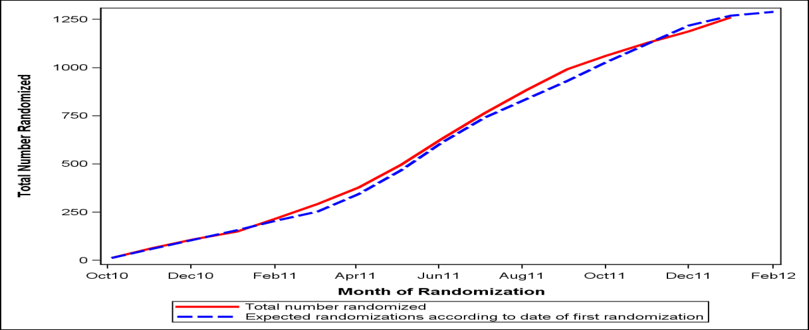
Recruitment and Retention Strategies in the NIDA National Drug Abuse Treatment Clinical Trials Network SMART-ED Study
L.M. Worth, A.A. Forcehimes , M.P. Bogenschutz , R.P. Chavez , H.L. Perl , R.N. Mandler
Center on Alcoholism, Substance Abuse, and Addictions (CASAA)
University of New Mexico
http://casaa.unm.edu
INTRODUCTION
Important Participant Characteristics (relevant inclusion and exclusion criteria)
Registered at the ED;
Access to a phone;
Not currently a prisoner or in police custody;
Not residing more than 50 miles from the location of the follow-up visit;
Able to provide sufficient contact information (including 2 locators).
Important Assessment Characteristics
Kept as brief as possible;
Web-based data entry using a tablet PC;
RAs emphasized confidentiality of information.
Important Trial Management Strategies
Thorough staff training occurred pre- and post-recruitment;
Use of recruitment scripts;
Weekly recruitment and retention calls with all sites.
RETENTION
Participants for this study were asked to take part in follow-up assessments at 3, 6, and 12-months following the baseline. The goal was to obtain an 85% retention rate across sites. The RAs that completed the follow-up assessments were different from those that completed the baseline assessment as the protocol required that follow-up staff be blind to participant treatment assignment. There was concern that since baseline staff was not responsible for conducting the follow-up for this study, they may be less motivated to collect thorough contact information.
Steps Taken to Maximize Retention
Routine monitoring of locator form by a national Tracking Coordinator;
Multiple contacts with participants between follow-up assessment visits;
Option to complete interviews over the phone or in the community;
Transportation to sites offered;
Participants compensated $75 for each follow-up complete;
Broad time windows for follow-up visits;
Use of multiple internet search engines, social media, email, and texting;
RAs received recognition and rewards for meeting or exceeding targets.
Recruitment and Retention Results
We obtained our recruitment goal of recruiting 1285 participants across sites on February 14, 2012, right on target with our projection. Follow-up is still ongoing for this trial.
Characteristics of the Recruited Sample:
Even in the most ideal of environments the inherent difficulties in recruitment and retention can lead to a drain on resources and threaten study success. Emergency Departments (EDs) present unique challenges in recruiting subjects for research including difficulty in locating patients in a chaotic environment, patient engagement with medical staff, patient refusal to participate because of feeling too ill or having too much pain to participate, staff attitudes, and privacy concerns. Further, recruiting individuals with drug use issues can be challenging since these individuals often hide their use given that it is a highly stigmatized behavior.
Screening, Motivational Assessment, Referral, and Treatment in Emergency Departments (SMART-ED) is a NIDA National Drug Abuse Treatment Clinical Trials Network protocol designed to test the impact a brief intervention has on individuals testing positive for problematic use of a non-alcohol non nicotine drug. A variety of recruitment and retention procedures are utilized in the SMART-ED trial that support obtaining the recruitment goal of 1285 participants and following up with a difficult to reach population.
SMART-ED Demographics
70% male
Mean age 36 + 12
50% White, 35% Black, 24% Hispanic
9% married
9 % college graduates
63% had household incomes under $15,000
19% had full-time jobs
42% unemployed
Drug Use by Primary Substance
Cannabis | 44%
Cocaine | 27%
Street Opioids | 17%
Rx Opioids | 5%
Methamphetamine | 4%
Sedative | 2%
Hallucinogens | 1%
Amphetamine | 0%
DISCUSSION
Key Elements to Recruitment Success:
Selecting appropriate ED sites;
Balanced eligibility criteria;
Staff training and monitoring;
Acceptance of research and recruitment staff by ED;
Use of technology.
Key Tracking Techniques Used:
Frequent letters and calls to participants and locators;
Use of technology (email, texting, web searches);
Interviewing flexibility (e.g. phone and community interviews);
Alternating trackers and times of tracking;
Weekly tracking and retention meetings.
The use of technology has proven to be a key element in both recruitment and retention success. Tablet PCs have allowed for easy and quick navigation in the busy ED environment and internet searches, texting and emailing improved tracking abilities. Use of a web based forms across sites saved time, translating into cost savings for the study, and facilitated easy data management from a central location.
Through weekly discussion with staff, we were able to brainstorm recruitment and retention ideas and share successful methods used at one site with all participating sites. It was important to explore a variety of methods as success not only varied by site but also by individual participant.
For future research we would recommend using internet cards rather than relying on wireless connections within the ED. Losing wireless connection became a point of frustration for RAs conducting interviews as they would sometimes lose data and have to redo parts of the baseline assessment. We would also recommend obtaining consent upfront for texting, emailing, and searching for participants through publically available data including social media networks. We did this midway through the study and some sites had difficulty in gaining permission from their IRBs to use these resources without participant consent. Sites that were able to obtain permission had a clear tracking advantage over sites that were not allowed without consent.
METHODS
Recruitment and the initial baseline assessment for this study took place at six different EDs in the United States. The population in this study are high-risk drug users with a sequelae of other issues including acute medical concerns, homelessness, legal troubles, and a host of other problems that make tracking and retention difficult. Participants were seen for follow-up at a separate location from the ED where they were initially recruited.
New Mexico UNMH ED/ UNM CASAA
Ohio
U. Cincinnati Dept. Emergency Medicine/ CINARC
Protocol Development, Recruitment & Retention Management, and Training Center
New Mexico
_____________________________
Data & Statistics Management , Protocol Implementation Support (NIDA CCTN)
Maryland
West Virginia
WVU ED/ WVU
Florida
Jackson Memorial/ U. of Miami
New York
Bellevue Hosp./ NYU
Massachusetts
Mass. Gen./ McLean Hosp.
RESULTS
RECRUITMENT
In consideration of the fast-paced and often chaotic environment inherent to an ED, multiple steps were taken prior to implementation to facilitate ease of recruitment and reduce refusal rates.
Important Characteristics of Participating ED Sites
Large volume of patients that use drugs;
Past research experience;
Available space to implement baseline assessments;
ED physician actively involved with the protocol to foster ED staff acceptance of the research;
Integration of recruitment staff into the workflow of the ED.
.
ACKNOWLEDGEMENTS
This research was supported by the NIDA National Drug Abuse Treatment Clinical Trials Network
Poster presented at the 2012 meeting of The College on Problems of Drug Dependence

