Slide 1
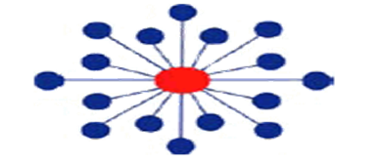
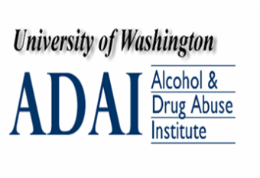
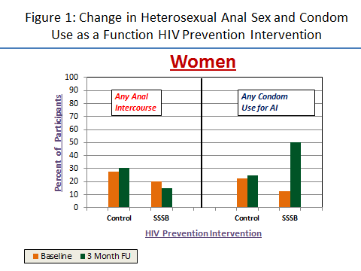
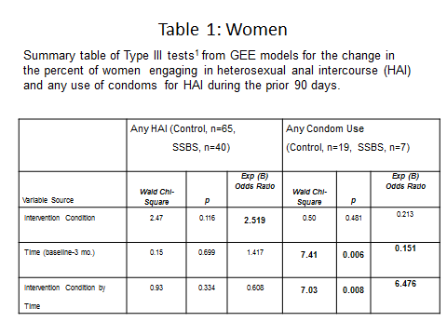
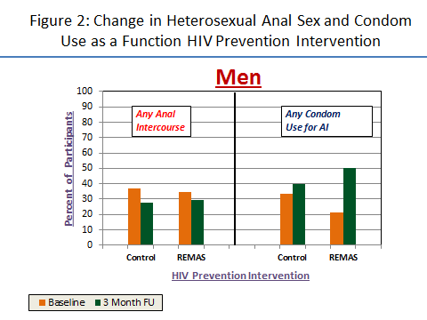
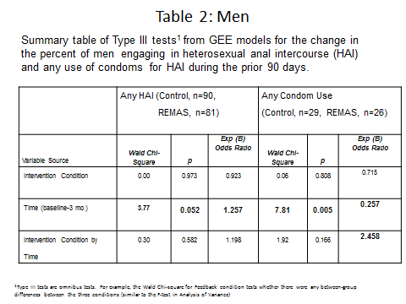

The effect of gender specific HIV prevention interventions on heterosexual
anal sex among men and women in substance abuse treatment
Donald A. Calsyn, Ph.D.^{1,2}, Aimee N.C. Campbell, Ph.D.³, Christina S. Meade, Ph.D.⁴,
Mary Hatch-Maillette, Ph.D.^{1,2}, Susan Tross, Ph.D.³
¹Alcohol & Drug Abuse Institute, ²Department of Psychiatry & Behavioral Sciences, University of Washington, Seattle, WA, USA, ³ Columbia University College of Physicians & Surgeons, New York, NY, USA, ⁴Duke University, Durham, NC, USA
Background
Substance abusers are at risk for HIV and other STIs.
Heterosexual anal intercourse (HAI) is riskier than vaginal intercourse. HAI is riskier for women than men because they are always the receptive partner.
Previously our group reported more women and men in substance abuse treatment engaged in HAI than in general population samples. (Calsyn et al., 2012).
More men engaged in HAI than women, and men were more likely to engage in HAI with their casual sex partners than women.
Condom use for HAI was infrequent.
Younger age, bisexual behavior, being White and having more sex partners (men) were associated with engaging in HAI.
Objective
Evaluate the effectiveness of the five session NIDA Clinical Trials Network gender specific HIV prevention interventions, Real Men Are Safe (REMAS) and Safer Sex Skill Building (SSSB) for Women (vs. single session information only control), on decreasing heterosexual anal intercourse (HAI) and increasing condom use for HAI
Methods
Participants: Men (n=171) and women (n=105) enrolled in the NIDA Clinical Trials Network (CTN) “Real Men Are Safe” and “Safe Sex Skill Building for Women” trials who reported heterosexual activity at baseline, attended SSBS/REMAS or control condition sessions, and completed the 3 month follow up were included in the current analysis.
Measures: Sexual Experiences and Risk Behavior Assessment Schedule and Sexual Behavior Inventory administered via ACASI at baseline and 3 month follow up.
Variables. 1) Frequency of anal intercourse
2) Frequency of condom used for anal intercourse
(Due to the bimodal distribution of the variables
they were dichotomized to: yes/no).
Data Analysis
Generalized Estimating Equations (GEE) was used to evaluate change in the percent engaging in HAI between baseline and 3 month follow up assessments.
Intervention condition (SSBS/REMAS vs. Control) and assessment period were entered into GEE repeated measure models as independent variables, as was an interaction term for intervention by assessment period.
GEE Models were generated separately for women and men.
Results: Women
The percent of women engaging
in HAI did not change from
baseline to 3 month follow up
assessment. (Table 1, Figure 1).
The percent of women engaging
in HAI and reporting any condom
use for HAI increased between
baseline and 3 month follow up
assessment and increased more
for SSBS attenders than control
group attenders. (Table 1, Figure 1).
Results: Men
The percent of men engaging in HAI decreased from baseline to 3 month follow up assessment,
but did not differ as a function of intervention condition. (Table 2, Figure 2).
The percent of men engaging in
HAI and reporting any condom
use for HAI increased between
baseline and 3 month follow up
assessment . Although not
reaching statistical significance
the change from no condom use
to condom use for HAI was 2.5
times more likely by REMAS
attenders than control group
attenders. (Table 2, Figure 2).
Conclusions
The percent of men, but not women, engaging in HAI decreased from baseline to 3 month follow up.
The decrease for men was similar for REMAS and control condition participants.
Although condom use for HAI remained infrequent, the percent of both women and men reporting any use
of condoms for HAI increased between baseline and follow up.
Women attending SSBS were more likely to change from no condom use to some condom use than women attending the control intervention. A similar non-significant trend was noted for men attending REMAS.
Acknowledgements
This study was supported by National Institute on Drug Abuse (NIDA) grants U10 DA13714 (Dennis Donovan , PI), U10 DA 13035 (Edward Nunes & John Rotrosen, Co-PIs), U10 DA 013727 (Kathleen Brady, PI).
The authors wish to thank the CTN 0018 lead node team, the 23 RRTC and site PIs, the 15 site coordinators, the 21 research assistants, the 15 therapy supervisors, and the 29 therapists who worked on this project.
References
Calsyn, DA, Hatch-Maillette, MA, Meade, CS, Tross, Campbell, ANC.
Gender differences of heterosexual anal sex among men and women in substance abuse treatment. Poster presented at the Annual Scientific Meeting of the College on Problems of Drug Dependence, Palm Springs, CA, June 12, 2012.
Find it in the Clinical Trials Network ∙ Dissemination Library
http://ctndisseminationlibrary.org

