Slide 1



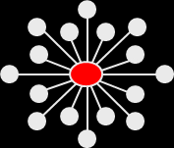

STAGE-12:
A combined group/individual TSF intervention to treat stimulant abuse
Harold I Perl, PhD
National Institute on Drug Abuse
APA 120th Annual Convention
August 3, 2012

Slide 2
Acknowledgements
STAGE-12 Executive Committee
  Dennis Donovan, Dennis Daley, Greg Brigham, Candace Hodgkins, Sharon Garrett, Anthony Floyd
  Data and Statistics Center – Duke Clinical Research
  Clinical Coordinating Center – EMMES Corp
Staff at 10 Community Treatment Programs
And most of all …
471 Participants in the STAGE-12 study

Slide 3
Why Consider 12-Step Approaches?
12-step orientation/philosophy is predominant approach found in U.S. substance abuse treatment
12-step groups represent readily available, no-cost recovery resource
Growing evidence of benefit for clients from 12-step involvement
Consistent with treatment philosophy of many programs and counselors
Applicable to broad range of clients in different settings and can augment wide range of treatments

Slide 4
Don’t We Already Do 12-Step Facilitation?
“Making the case that treatment programs should prioritize self-help group involvement can be difficult because many treatment providers believe they ‘do this already’; indeed, that every program does.”
“In practice, however, what this often means is that at some point during treatment a counselor gives the patient a list of local self-help groups and suggests that the patient attend a meeting, which is a minimally effective clinical practice.”
“We therefore encourage treatment providers to use the more intensive methods of promoting self-help group involvement empirically demonstrated to be effective …such efforts will maximize the maintenance of treatment gains.”
Humphreys & Moos, 2007

Slide 5
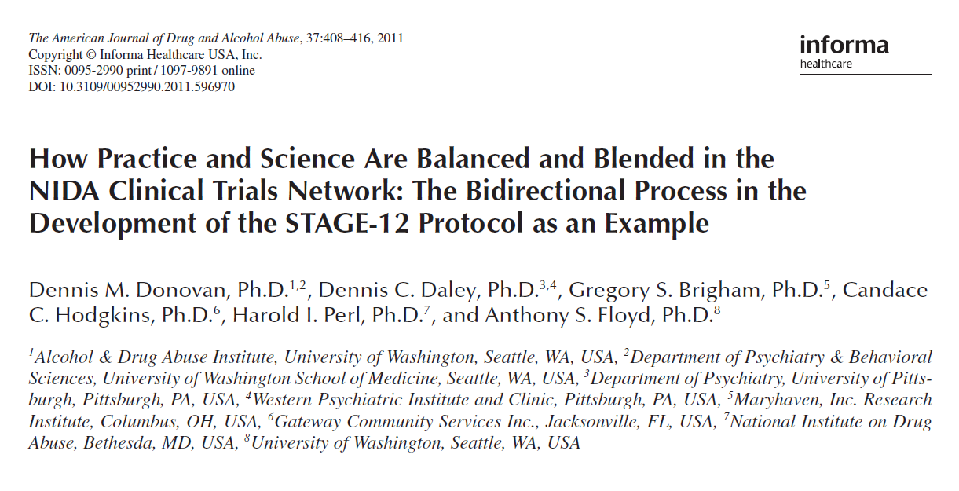
Stimulant Abuser Groups to Engage in 12-Step
Bidirectional Protocol Development Process
Collaborations between clinicians and investigators
We wanted to conduct research that would be most useful to the clinicians

Slide 6
CTP Survey Results
Which of the following formats would work best for integrating 12-Step facilitation at your CTP so that you could continue using the intervention after the study has ended?
1.6% -- Individual therapy
39.1% -- Group therapy
59.4% -- Group therapy plus
some individual counseling

Slide 7
CTP Survey Results
If you were to deliver some or all of a 12-Step
intervention in a group format, which type of
group would you most likely use
4.6% -- “Closed admission group”
95.4% -- “Open-ended or rolling admission group”

Slide 8
10 STAGE-12 Sites

Slide 9
What Is STAGE-12?
Combined group- and individual-based intervention
  3 individual sessions
  5 group sessions
Combines elements of Twelve-Step Facilitation Therapy and Intensive Referral
Introduces participants to concepts and principles involved in 12-Step groups
Actively attempts to get participants involved in 12-Step meetings

Slide 10
Rationale for Combining Intensive Referral with Twelve Step Facilitation
Interventions that increase attendance may be insufficient to ensure active involvement.
Early attrition from attending meetings may be due to individuals’ inability to embrace or utilize other aspects of the 12-step program
Individuals who are having difficulty embracing key aspects of the program may need professional assistance that focuses more on 12-step practices and tenets and less on meeting attendance
Caldwell & Cutter,1998

Slide 11
Basic Study Questions
Does STAGE-12 improve substance use outcomes in stimulant users compared to treatment-as-usual?
  Substance Use Calendar
  Urinalysis
Does STAGE-12 improve attendance and involvement in 12-step groups compared to treatment-as-usual ?
  Substance Use Calendar
  Self-Help Activities Questionnaire

Slide 12
Individual in treatment at CTP
Screen for study eligibility
Informed consent
Baseline assessment
Randomized to condition
Treatment as
Usual (TAU)
STAGE-12
Integrated into TAU
During Intervention
Assessment
End of Intervention
Assessment
3-, 6-Month Post-Baseline
Follow-ups

Slide 13
STAGE-12 Baseline Participant Demographic Information
Characteristics | TAU (N = 237) | STAGE-12 (N = 234) | Total (N = 471)
Gender
Female | 55.70% | 61.97% | 58.81%
Age
Mean (Std.) | 38.45 (9.40) | 38.24 (10.04) | 38.35 (9.71)
Ethnicity
Hispanic or Latino | 6.33% | 6.41% | 6.37%
Race
Caucasian | 48.95% | 46.15% | 47.56%
Black/African American | 35.02% | 37.61% | 36.31%
Marital Status
Married | 9.75% | 15.45% | 12.58%
Widowed | 3.81% | 0.86% | 2.35%
Separated | 11.44% | 10.30% | 10.87%
Divorced | 22.88% | 24.03% | 23.45%
Never Married | 51.27% | 49.36% | 50.32%

Slide 14
STAGE-12 Baseline Participant Demographic Information
Characteristics | TAU (N = 237) | STAGE-12 (N = 234) | Total (N = 471)
Education
Mean (Std.) | 12.07 ( 1.64) | 12.24 (1.65) | 12.15 (1.64)
Usual Employment Pattern
Full Time | 37.13% | 35.47% | 36.31%
Part Time, Regular | 10.13% | 8.55% | 9.34%
Part Time, Irregular | 13.50% | 16.24% | 14.86%
Student | 1.27% | 0.43% | 0.85%
Retired, Disability | 1.69% | 2.99% | 2.34%
Unemployed | 35.44% | 34.62% | 35.03%
Court Mandated
Yes | 20.68% | 22.22% | 21.44%

Slide 15
DSM-IV Dependence and Abuse Diagnoses
Dependence | TAU (N = 237) | Stage-12 (N=234) | Total (N =471)
Amphetamine | 6.75% | 6.84% | 6.79%
Methamphetamine | 38.40% | 33.76% | 36.09%
Cocaine | 70.89% | 72.65% | 71.76%
Other Stimulants | 1.69% | 2.56% | 2.12%
Alcohol | 45.57% | 44.87% | 45.22%
Marijuana/Hashish | 18.57% | 21.37% | 19.96%
Opiates | 14.77% | 20.94% | 17.83%
Benzodiazepines | 7.17% | 8.12% | 7.64%
Abuse
Amphetamine | 7.17% | 7.69% | 7.43%
Methamphetamine | 37.97% | 35.90% | 36.94%
Cocaine | 71.31% | 74.79% | 73.04%
Other Stimulants | 1.69% | 2.99% | 2.34%
Alcohol | 63.71% | 61.97% | 62.85%
Marijuana/Hashish | 34.18% | 39.74% | 36.94%
Opiates | 18.14% | 21.37% | 19.75%
Benzodiazepines | 10.13% | 12.39% | 11.25%

Slide 16
Interaction Odds Ratios and Incidence Rate Ratios:
Days of Stimulant Substance Use within 30-day Window of Assessment
 | Logistic (Abstinence) |  | Negative Binomial (Count)
 | Odds Ratio | 95% CI for Odds Ratio | Rate Ratio | 95% CI for Rate Ratio
Mid-Treatment | 3.34 | 1.20, 9.28 | 1.66 | 1.05, 2.60
End-of-Treatment | 2.44 | 1.01, 5.86 | 1.50 | 1.01, 2.24
First Follow-up | 1.78 | 0.81, 3.90 | 1.36 | 0.93, 1.98
Second Follow-up | 1.30 | 0.60, 2.79 | 1.23 | 0.84, 1.79
Third Follow-up | 0.95 | 0.42, 2.15 | 1.11 | 0.74, 1.66
Last Follow-up | 0.69 | 0.27, 1.77 | 1.00 | 0.64, 1.57

Slide 17
Primary Outcome: Observed Percentage of Zero Days of Stimulant Use within 30-day Window

Slide 18
Number of Other Self-Help Activities and
Days of Doing Duties at 12-Step Meetings (SHAQ)
* * * * *
Number of days of Duties at Self-Help
Meetings
Average Number of Other Self-Help Activities

Slide 19
STAGE-12 vs TAU: Mixed Findings
STAGE-12 increases the probability of abstinence from stimulants during and in the last 30 days of the active treatment phase
If abstinence is not achieved during this period, rates of use appears greater among STAGE-12 participants
STAGE-12 associated with greater number of
  days of 12-step self-help meeting attendance
  types of other 12-step activities engaged in
  days of performing duties at meetings at different periods during and following active treatment phase

Slide 20

There’s gotta be a pony in here somewhere

Slide 21
Comparison of STAGE-12 Completers vs Non-Completers
Completion of STAGE-12 was defined
a priori as the completion of
2 or more individual sessions and
3 or more group sessions

Slide 22
Odds Ratios and Incidence Rate Ratios
STAGE-12 Completion Status: Days of Stimulant Substance Use within 30-day Window of Assessment
 | Logistic (Abstinence) |  | Negative Binomial (Count)
 | Odds Ratio | 95% CI for Odds Ratio | Rate Ratio | 95% CI for Rate Ratio
Mid-Treatment | 41.31 | 6.55, 260.46 | 0.42 | 0.22, 0.81
End-of-Treatment | 20.38 | 4.07, 102.05 | 0.51 | 0.28, 0.93
First Follow-up | 10.05 | 2.32, 43.54 | 0.63 | 0.36, 1.10
Second Follow-up | 4.96 | 1.18, 20.76 | 0.76 | 0.43, 1.34
Third Follow-up | 2.45 | 0.54, 11.15 | 0.93 | 0.51, 1.70
Last Follow-up | 1.21 | 0.22, 6.63 | 1.14 | 0.58, 2.23

Slide 23
STAGE-12 Completers vs Non-completers: Observed Percentage of Zero Days of Stimulant Use within 30-day Window

Slide 24
STAGE-12 Completers vs Non-completers:
Observed Average Number of Stimulant Use Days within 30-day Window

Slide 25
Average Predicted Probabilities of Having a Positive Urine Screen for Stimulants
Stage-12 Completers versus Non-completers

Slide 26
Average Predicted Probability of Not Attending and the Number of Days of Attending Self Help Meetings for STAGE-12 Completers vs Non-Completers
* * * * * *
Predicted Probability of NOT Attending
Self-Help Meetings
Average Number of Days of Attending
Self-Help Meetings

Slide 27
STAGE-12 Completers vs Non-Completers
Compared to Non-Completers, STAGE-12 Completers have:
Higher odds of abstinence from and lower rates of stimulant drug use
Lower probabilities of stimulant positive urines
Higher odds of abstinence from and lower rates of non-stimulant drug use
Lower odds of not attending and higher rates (days) of attending 12-step self-help groups
Number of types of other activities engaged in during 30 day assessment windows
Maximum number of days of self-reported duties at meetings

Slide 28
STAGE-12 Adoption
Many anecdotal reports that clinicians and clients liked this intervention
Has been some uptake at many of the study sites
  Program level
  Clinician level
Expressed interest in getting a formal manualized intervention and supporting materials

Slide 29
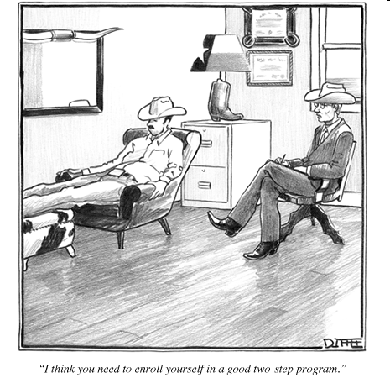
Beware of Overzealous Adaptations!
“I think you need to enroll yourself in a good two-step program”

