Slide 1
Screening, Enrollment, and Assessment in the SMART-ED study
Robert Lindblad, MD
Ro Shauna S. Rothwell, PhD
Notes:
Click to add notes

Slide 2
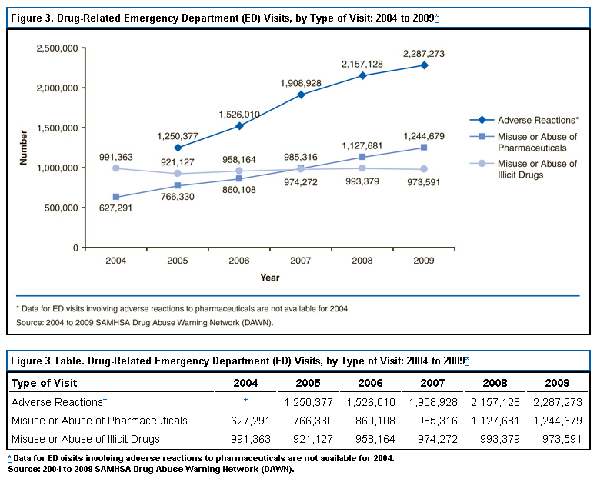
Need for SMART-ED:
Drug Related ED visits are on the rise

Slide 3
Study Set Up
Emergency Department (ED) selection
Integration into the ED - communication
Flexibility
Recruitment
Study flow
Results

Slide 4
SMART ED
Emergency Department Selection
Emergency Department Issues
  Chaotic environment providing clinical care to a geographically limited population, SBIRT part of practice, research naive
  Large study with potential for many screen failures
  Limited staff to perform research assessments

Slide 5
SMART ED Emergency
Department Selection, continued
Study solutions
  No current routine use of the SBIRT model for drug users
  Research experience
  Large volume of patients who use drugs
  Ability to present a convincing plan for patient flow and space utilization
  Have or are able to hire appropriate research staff to conduct the study (in conjunction with the NIDA CTN)
  Have sufficient referral network for patients needing specialty addiction treatment
  Population representative of US population (in aggregate)

Slide 6
Integration of SMART-ED into
Emergency Departments
Principal Investigator had to be a ED Physician
Hire staff to conduct research
All EDs that participated had a communication plan
Study Staff timed intervention to minimize interference with medical treatment
Depending on level of acuity, some participants were approached prior to the initial evaluation by a physician, and some after
Research assistant/interventionist worked closely with ED staff to identify potential participants, determine eligibility and to determine acuity

Slide 7

Integration of SMART-ED into Emergency Departments
Data Collection
  The HP-EliteBook 2730P was the Tablet PC used for the study
  Benefits
    facilitate rapid screening
    electronic data capture
    mobility within the busy ED setting
Web based data entry with no data residing on the tablet
  None of the SMART-ED tablet PCs were stolen or misplaced
    Sites kept tablet logs
To maximize confidentiality, the screening Tobacco Alcohol and Drug assessment (TAD) was completed by the participants unless the participant was not comfortable with this technology

Slide 8

Flexibility:
One size does not fit all
Emergency Department Logistics Issues
  Variable recruitment hours and procedures
  Variable ED logistics
  Variable handling of medical and psychiatric events
Study Solution
  Each site developed site specific SOPs to address specific needs
    All were reviewed centrally
  SMART-ED Study was initiated in two waves (2 sites followed by 4 sites)
  Issues discovered during wave 1 implementation were addressed during wave 2 training
SMART-ED
Emergency Departments

Slide 9
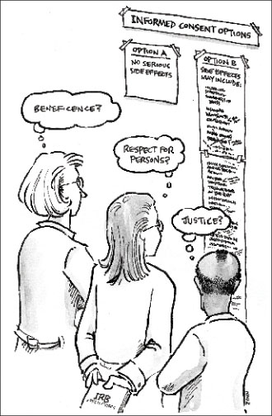
Flexibility: Consenting Process
Issue
  Consent process had to be brief
Solution
  Participants provided verbal consent for the anonymous collection of screening data, using a brief IRB-approved script
  Refusals and inability to participate were recorded on the BIT
  After completing two screening forms (TAD and SSF) the participant received written informed consent

Slide 10
Recruitment
ISSUE: Needed to ensure that the each site had a sampling procedure to ensure that the patients screened are broadly representative of the ED population
Solution:
Most RA Interventionist assessed triage level by Patient Chart and/or consultation with ED staff such as a charge nurse or physician
Next, the RA consulted various electronic systems to complete the Brief Intervention Tool assessment

Slide 11
Recruitment, continued
Site | Initial Sampling Procedure
West Virginia University Emergency Department | Electronic medical record system (MERLIN)
University of New Mexico Emergency Department | University Hospital patient tracking system "FirstNet."
Massachusetts General Health Emergency Department | Hospital ED Information System (EDIS)
Jackson Memorial ED | Access Corner/Powerchart
University of Cincinnati Emergency Department | LastWord
Bellevue Emergency Department | Electronic Whiteboard

Slide 12
Synopsis of the Pre-Screening and Screening Process
Sampling Procedure
Brief Intervention Tool (BIT)
Verbal Consent
Tobacco Alcohol and Drug (TAD)
Secondary Screening Form (SSF)
Once the participant consented, the SMART-ED
Screening Form was completed

Slide 13

Synopsis of the Pre-Screening and Screening Process
Sampling Procedure
    Date, Age, Gender,
    Presenting complaint,
    Triage level
Brief Intervention Tool (BIT)
Verbal Consent
Tobacco Alcohol and Drug (TAD)
Secondary Screening Form (SSF)
Once the participant consented, the SMART-ED
Screening Form was completed

Slide 14
Synopsis of the Pre-Screening and Screening Process
Sampling Procedure
Brief Intervention Tool (BIT)
Verbal Consent
    Heavy Smoking Index
    The AUDIT C
    DAST 10
Tobacco Alcohol and Drug (TAD)
Secondary Screening Form (SSF)
Once the participant consented, the SMART-ED
screening Form was completed
If the DAST score is ≥ 3, follow-up questions identified the primary drug of abuse (patient report)
and the number of days of use of this substance in the past 30 days.

Slide 15
Synopsis of the Pre-Screening and Screening Process
Sampling Procedure
Brief Intervention Tool (BIT)
Verbal Consent
      In addiction treatment
      Resides more than 50 miles
      At least two locators
      Access to a phone
      Status as a prisoner
Tobacco Alcohol and Drug (TAD)
Secondary Screening Form (SSF)
Once the participant consented, the SMART-ED
Screening Form was completed

Slide 16
Synopsis of the Pre-Screening and Screening Process
Sampling Procedure
Brief Intervention Tool (BIT)
Verbal Consent
Tobacco Alcohol and Drug (TAD)
Secondary Screening Form (SSF)
Once the participant consented, the SMART-ED
Screening Form was completed

Slide 17
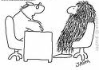
SMART-ED Biological Measure of Substance Abuse: Drug Hair Analysis
No sir, I don’t think we’ll have any difficulty gathering a sufficient sample.
Clearly, I have no hair to spare!
  Cocaine
  Opiates
  PCP
  Amphetamines
  Marijuana
  Hair grows 1.3 cm/month
  4 cm – 3 mo detection

Slide 18

The Results of Selection, Integration and Flexibility in the SMART-ED Study
Success!
Who
How

Slide 19
SMART-ED Participant Demographics and Socioeconomics (Who)
Age
50% 25-45 Years old
Mean Age was 36+/-
Race
50% White
34% Black
4% Mixed Race
5% Other
Ethnicity
76% Not Hispanic/Latino
24% Hispanic or Latino
Employment Past 30 Days
Income
63% earned <15,000
14% earned <30,000
12% Declined to Answer
42% Unemployed
19% Full time employment
15% Retired
6% Part time regular hours
9% Part time irregular hours
Education

Slide 20
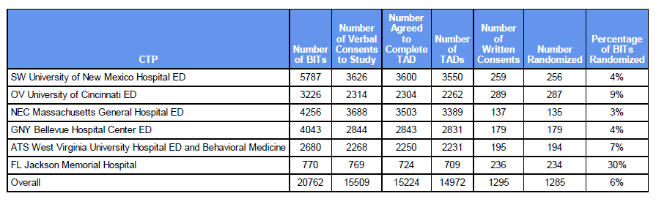
BITs, TADs and Randomizations
(HOW)
Site 1
Site 2
Site 3
Site 4
Site 5
Site 6*
Total
* Hospital uses a research consent for all patients that are admitted.
By signing this consent, the future SMART-ED participant agreed to research prior to consenting to a particular study.
This process decreases the rate of screen fails thus increasing the percentage of BITs randomized compared to other sites.
Sampling Procedure
Brief Intervention Tool (BIT)
Verbal Consent
Tobacco Alcohol and Drug (TAD)
Secondary Screening Form (SSF)
Once the participant consented, the SMART-ED Screening Form was completed

Slide 21
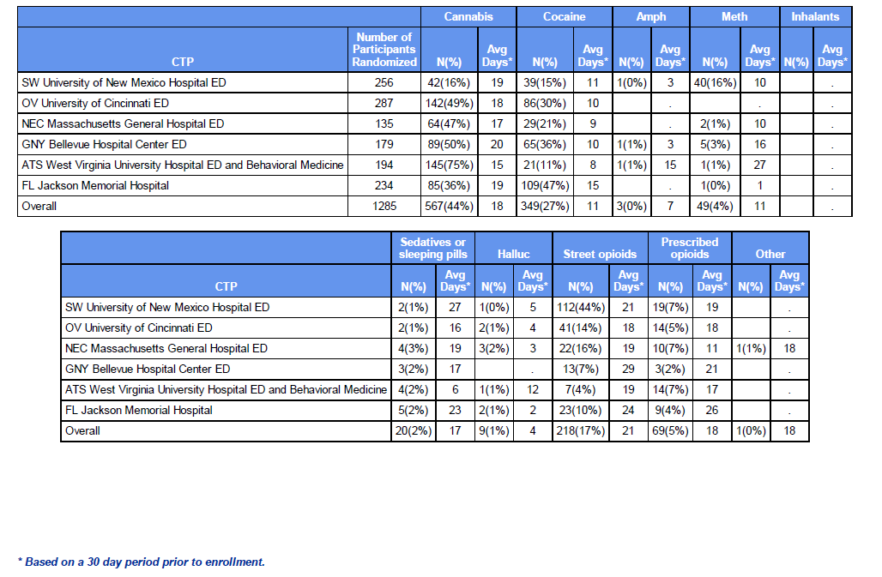
Summary of TAD
Results of Randomized Participants
Site 1
Site 2
Site 3
Site 4
Site 5
Site 6
Total
Site 1
Site 2
Site 3
Site 4
Site 5
Site 6
Total

Slide 22
Conclusions
Implementing a study in different Emergency Departments requires flexibility, constant communication and time efficiency
Sample was diverse with respect to substance of abuse and ethnicity, used drugs frequently and had a very low socioeconomic status

Slide 23

Acknowledgements
NIDA Clinical Coordinating Center (CCC)
Data and Statistics Center 2
Alex Borbely
Neal Oden
Gaurav Sharma
Colleen Allen
Confidential - For Internal Use Only
Contract # HHSN201201000024C/N01DA-10-2221

