Slide 1

Intervention Training, Supervision and Fidelity Monitoring in NIDA CTN 0047: SMART-ED
A. Forcehimes
K. Wilson
T. Moyers
J. Tillman
C. Dunn
C. Lizarraga
C. Ripp

Slide 2
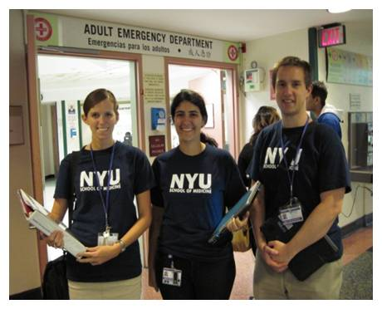
The Interventionists

Slide 3
Prior to Training
Hiring decisions
  Emphasized selecting empathic individuals
Interventionists provided informed consent and completed questionnaires including
  Demographic information
  Training and experience
  Knowledge of MI and other counseling approaches
  Short Understanding of Substance Abuse Scale (SUS, Humphreys, et al., 1996)
Notes:
SUSS: Theoretical model for understanding addiction

Slide 4
Who were the Interventionists?
Thirty-three counselors received training across the two waves of the study
  64% female
  82% Caucasian
  32.45 + 7.93 years old
    Wave 1 interventionists were significantly older than Wave 2 interventionists
  Little counseling experience (1.58 + 2.50 years)
  Less than a quarter licensed as a counselor (21%)
  Understanding of substance use
    Most strongly influenced by psychosocial model
    Very low scores on disease model
Notes:
10 interventionists in wave 1; 20 in wave 2
Understanding of substance abuse
Comparing subscale norms for counselors (addiction therapists, social workers) 329 treatment staff working in addiction treatment (Humphreys et al., 1996)
19.1 disease model (this sample: (9.69 + 6.04)
12.3 psychosocial learning (this sample: 13.79 + 2.93) social learning theory based
12.1 eclectic (this sample: 10.70 + 3.55)

Slide 5
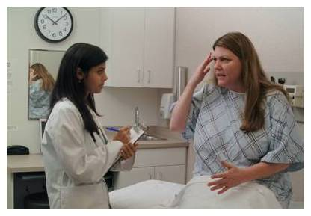
Training and Certification

Slide 6
Two-Stage Training and Certification
MI skills 2-day local training
Protocol specific SBIRT training at national training
Standardized Patient Walkthroughs
Pilot sessions
Certification
Post-training webinars
Notes:
*Interventionists received a 2-day training in basic motivational interviewing skills, conducted locally
*Followed 1 month later by a 2-day training in the specific intervention used in this trial, conducted as part of the national protocol start-up meeting
*MITI yields 4 summary scores as well as several calculated scores based on coding of utterances during the rated tape
*Audio files of these sessions were reviewed by an expert rater, using the Motivational Interviewing Treatment Integrity scale and content checklists. The MITI yields 4 summary scores as well as several calculated scores based on coding of utterances during the rated tape.
*To become certified, interventionists had to score at least 4.0 (“competent”) on the 5-point Global Clinician Rating from the MITI and 80% on content checklists, for 2 consecutive sessions for Brief Interventionists and 4 consecutive sessions for Booster Interventionists
* Interventionists also participated in two post-training webinars (incorporating feedback from coding team--themes that needed additional work (e.g., reflecting change talk)

Slide 7
Motivational Interviewing Treatment Integrity (MITI)
Ratings of First Two Training Cases
  Global Clinician Ratings averaged 4.45 + .51 on a scale of 1-5
    Well above the threshold for competency (4.0)
    higher than scores typically recorded after a two-day training
Notes:
Norms available for “beginning proficiency” and “competency”
Computed Scores
Significant differences were found between Wave 1 and 2 on Percent Open Questions computed score, with higher scores for Wave 2.
Wave 1 scores were in the 50% is “Beginning Proficiency” range (50%)
Wave 2 scores were in the “Competency” range (70%)

Slide 8
Correlates of Treatment Fidelity (Pearson’s r)
To explore interventionist chars that might account for variance in treatment fidelity
  Age
    Significantly related to performance in training cases
  Psychosocial Model subscale score of the SUSS
    Sample question:
      A person's environment plays an important role in determining whether he or she develops alcoholism or drug addiction.
        Scores were significantly (and negatively) related to Global Clinical Ratings, MI Spirit, Direction, and Percent MI-Adherent
Notes:
Prior experience
No significant differences between self-reported use of MI approach, self-reported MI understanding, or years of experience

Slide 9

Supervision and Ongoing Fidelity Monitoring

Slide 10
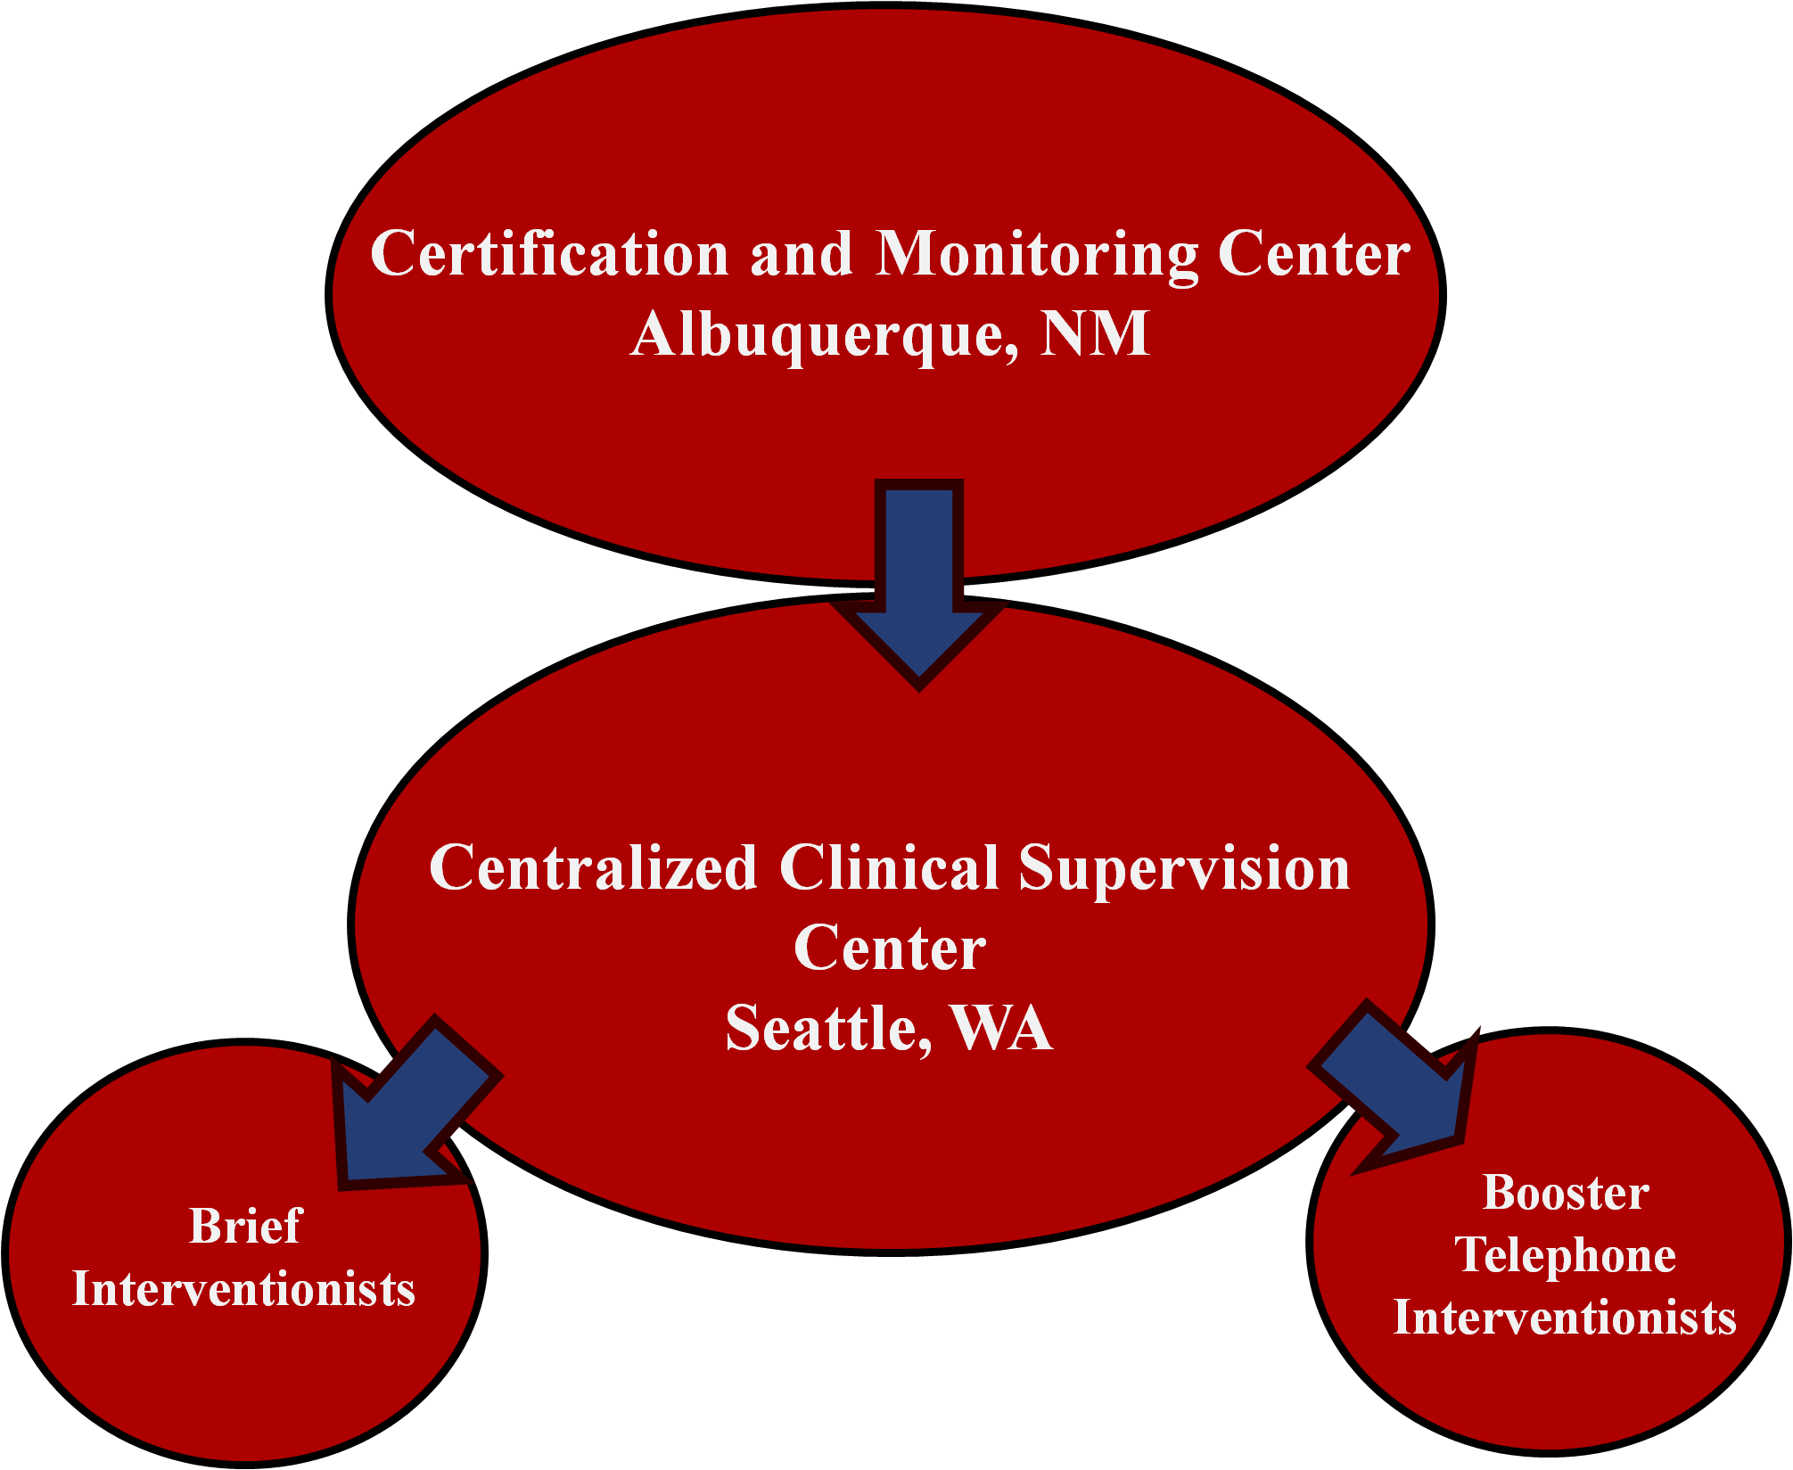
Roles and Interaction Between the Fidelity Monitoring Center and Supervision Center
Notes:
Telephone supervision
Bi-weekly calls between the Centralized Clinical Supervisor (CCS) and interventionist
The CCS listened to one session per interventionist per week
Bi-weekly coaching continued throughout the trial
Interventionists found these sessions useful in maintaining their skills.
Centralized Session Monitoring
The Centralized Monitoring Center (CMC) coded approximately 12% of the interventionists sessions during active trial phase
A MITI and checklist was completed for each session
CCS received automated notification when these were completed
The CCS had access to these scores to use as part of their ongoing supervision

Slide 11
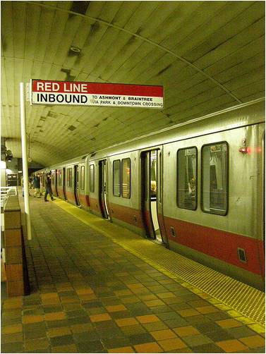
Red-Lines and Red-Line Warnings
Red-Line Warning
  Minor drift, but enough to be of concern
  Three interventionists received a warning
Red-Line
  Failure to meet predefined standards of fidelity
  Stopped delivering interventions
  Given a performance improvement plan
  Only one interventionist received a Red-Line
  Fidelity monitoring during the trial successfully prevented drift
Notes:
Warning: Increased supervision outlined by CMC.
At supervisor’s discretion whether interventionist could
continue seeing pts.
clinical supervisors immediately carried out increased coaching with them to prevent an official Red-Line
one of the 3 warnings resulted in a Red-Line
Red-Line: Continued bi-weekly supervision with CCS to monitor progress
Re-certified by delivering two brief interventions/booster sessions with two additional pilot/training participants.
unable to recertify due to timing of the ending of the recruitment phase of Wave 1

Slide 12

Post-trial Fidelity Monitoring

Slide 13
Post-trial fidelity monitoring
20% of the interventionist sessions (n=161)were randomly selected and coded for overall trial fidelity.
Completed coding of all baseline sessions
  an additional 237 sessions
    Will allow for the examination of therapist effects across 33 interventionists
Results from fidelity monitoring indicate above average performance on MITI scores.

Slide 14
Summary
The two-stage interventionist training, bi-weekly supervision, and ongoing monitoring produced excellent results and prevented drift
This model may bestow an advantage for learning and implementing brief interventions based on a MI approach

