Slide 1

Qualitative Reports of Interventionists in the SMART-ED Study:
Challenges and Themes
Dennis Donovan¹, Melissa Phares¹, Ernie McGarry¹, Julie Taborsky¹,
Alyssa Forcehimes², Courtney Fitzgerald²,
Mary Hatch-Maillette¹, and K. Michelle Peavy¹
¹University of Washington, Seattle, WA, USA
²University of New Mexico, Albuquerque, NM, USA
Presented at the 9th Conference of INEBRIA
International Network on Brief Interventions for Alcohol & Other Drugs
Barcelona, Spain
September 27, 2012

Slide 2
Background
Interventionists involved in the NIDA Clinical Trials Network (CTN) Screening, Motivational Assessment, Referral and Treatment (SMART-ED) protocol conducted 30-minute motivational enhancement therapy sessions with patients presenting to medical EDs who screened positive for problematic substance use.
Interventionists, working from a centralized call center, attempted to complete two 20-minute telephone “booster” sessions within a week following a patient’s ED discharge.

Slide 3
Objective
As part of their final supervision session and in discussions with the research team following completion of the treatment phase of the study, brief and booster interventionists reported the unique challenges and lessons learned.
We present brief interventionists' and booster interventionists’ perspectives on the unique challenges, lessons learned, and themes that emerged in providing brief interventions in medical ED settings and booster sessions over the phone.

Slide 4

Perspectives of ED Brief Interventionists

Slide 5
Themes and Challenges:
Conducting Screening, Motivational Assessment, Referral and Treatment in the ED
The inherent nature of the emergency department
  Patient flow through and variable wait times in the ED
  Availability of space allowing adequate privacy
  Frequent interruptions, with medical care taking priority
  Patient concerns about confidentiality and the possible impact of disclosure of substance use on their medical care
  Patient acuity that precludes ability to provide informed consent and participation
Notes:
The ED is an extremely busy, hectic, and at times chaotic environment. Many times there is limited space to conduct assessments or interventions in a private and confidential manner. There are frequent interruptions, since medical needs and demands take priority.
Many individuals come to the ED for reasons that in their perception may seem quite unrelated to alcohol or drug use. Although they may screen positive for a substance use disorder and be enrolled in the intervention, these individuals may regard their substance use as of lower priority and less of an immediate concern than the medical and/or psychosocial issues that are more immediate and emergent.
One of the features of the study, in large part because of staffing and budgetary considerations, was that all of the research assistants were trained in motivational interviewing, and they served as both the screener/assessors and as the motivational interventionists (although not for the same person). Once one has been trained in the use of MI and has a MI “style” it is difficult not to slip into conducting a MI-like intervention while serving as the assessor.

Slide 6
Themes and Challenges:
Conducting Screening, Motivational Assessment, Referral and Treatment in the ED
Maintaining focus on addictions in the face of multiple competing priorities
  Patients desire to discuss medical reasons for ED visit
  Psychosocial/mental health needs that might require attention
  Temptation of interventionists to address basic needs such as housing, employment
Issues inherent in “dual roles” for research assistants, all of whom have been trained in motivational interviewing
  Using MI techniques appropriately during intervention, and not using them during screening and assessment.

Slide 7
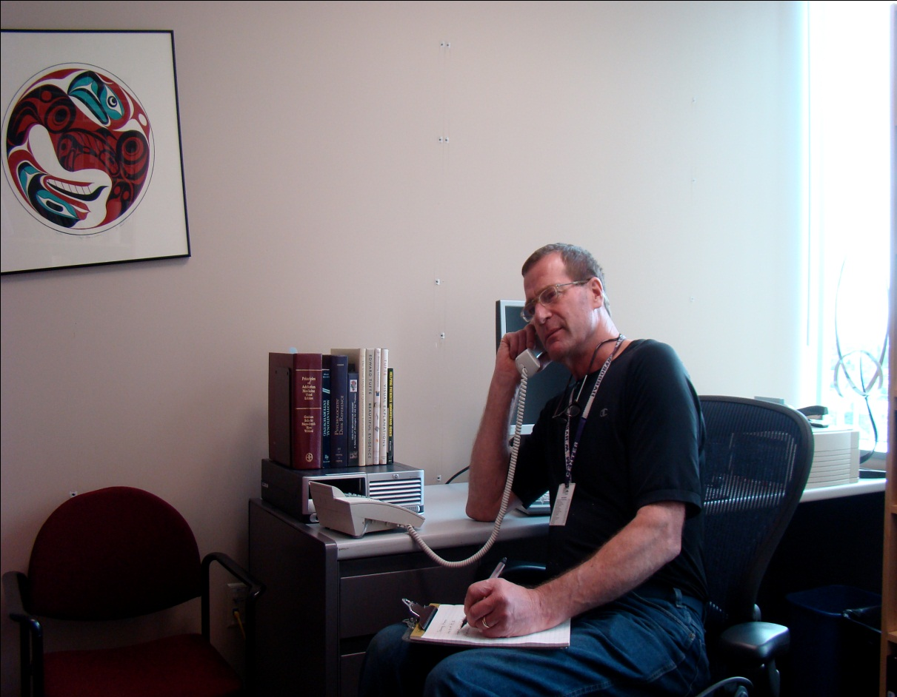
Booster Phone Sessions Following ED Visit

Slide 8
Rationale:
Why Include Booster Sessions
Brief motivational interventions appear to have more limited effectiveness with drug abusers than with alcohol-involved individuals
While the initial brief intervention may get individuals to focus on changing risk-related behaviors, it may be insufficient to motivate them to develop and implement a change plan
The “teachable moment” thought to be associated with care in the ED may not actually occur given the challenges outlined above and may fade rapidly if it does occur, leading to the recommendation that “booster sessions” be provided, either in person or via phone

Slide 9

Rationale:
Why Include Booster Sessions
“A booster session or referral for follow-up sessions outside the confines of a busy ED may be needed in addition to a 10-minute intervention in the course of clinical care.”
Bernstein and Bernstein (2008, p. 752)

Slide 10
Mechanics of Booster Sessions
Booster calls were made from a centralized, study-wide intervention booster call center, by interventionists who received standardized training and supervision and who had electronic access to necessary information from baseline visit and initial ED intervention
Participants received up to 2 phone “booster” sessions, ideally completed at 3 and 7 days following the ED visit, but with further attempts to engage participants for up to one month post-discharge from the ED
Each booster call was to be approximately 20 minutes long, consisting of motivational interviewing focused on substance use issues
The purpose of the booster sessions was to check whether participants had engaged in treatment, review and reinforce change plans, address barriers to treatment engagement, seek a commitment for behavior change, and support continuing efforts.

Slide 11

Perspectives of Booster Session Interventionists

Slide 12
Themes and Challenges:
Conducting Booster Counseling Calls following the ED
Difficulties reaching participants following their ED visits.
  Wrong phone number or contact information, despite completed locator forms in ED
  Lack of minutes on patients’ cell phones
  Lack of financial incentive as provided for follow-up assessments
  Lack of privacy to take calls (e.g., on bus, in noisy location, others around whom they did not want to have hear conversation)
  Failure of participant to return calls despite saying that they would
  Differences in time zones between call center and patients’ locations
  Hesitancy to accept call from unfamiliar area code

Slide 13
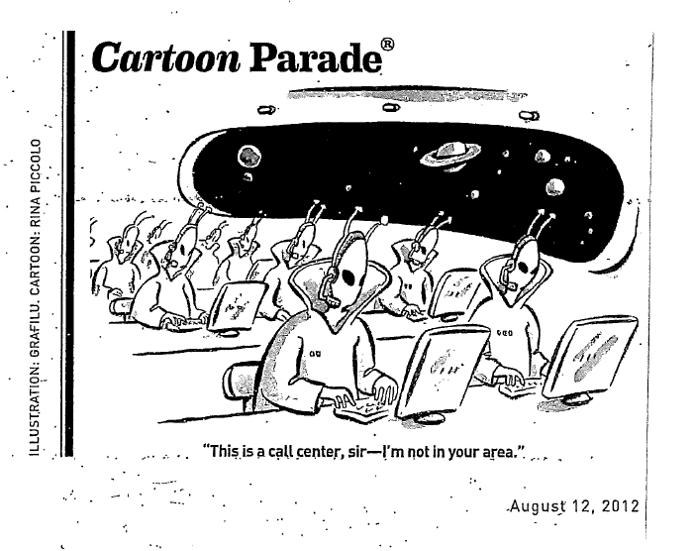

Slide 14
Themes and Challenges:
Conducting Booster Counseling Calls following the ED
Difficulties engaging some patients once contacted
  Lack of awareness of the call or its purpose despite attempts of ED interventionists to provide “warm handoffs” and informing participants that they would be receiving follow-up calls
  “Cold call” on part of booster counselor who is different from the interventionist seen by patient in the ED
  Differences in engaging individuals who viewed their ED visits as related or not to their drug use
Differences in the perceived need and willingness to change behavior between those whose primary drug is marijuana, which was viewed as much less problematic, versus other classes of drugs.

Slide 15
Summary
While potentially effective in impacting substance use, there are many complexities involved in providing brief addiction intervention in the ED setting.
While augmenting an initial intervention delivered in the ED with subsequent booster sessions shortly after the ED visit has been recommended and may contribute incrementally to outcomes, there are also complexities in implementing such booster sessions.
Being aware of, understanding, and preparing for such challenges is critical to the successful implementation of addiction treatment programs or research aiming to implement brief interventions in the ED environment.

