Slide 1

Recruitment & Retention
SMART-ED, NIDA CTN 0047
C. Crandall
R. Mandler
M. Bogenschutz
D.Donovan
L. Worth
R. Lindblad

Slide 2
SMART-ED
Screening, Motivational Assessment, Referral and Treatment in Emergency Departments
  Designed to assess the efficacy of a brief intervention on ED patients who endorse problematic non-alcohol, non-nicotine drug use
  Recruitment, initial assessment and brief intervention occurred in the ED
  Follow up and retention efforts occurred at the follow up location
  Multi-site design for efficiency and diversity
    6 sites, N=1,285 subjects
Notes:
The SMART-ED trial, as stated in the overview, is a multi-site study designed to assess the efficacy of a BI on ED patients who endorse problematic, non-alcohol, non-nicotine drug use.

Slide 3

R&R
Recruitment
  Identify potential subjects who might benefit
  from a substance use intervention
Retention
  Identify potential subjects with a high probability of returning for follow up
Balance of considerations
  Numerous trade0ffs/considerations balancing R&R
Notes:
I am covering the R&R portion of our talks—that is, the recruitment and retention efforts. Subjects were identified among ED patients to identify potential subjects who might benefit from a substance use intervention. The recruitment efforts also need to identify potential subjects we could retain. That is, we needed to have a high probability of returning for follow up. There were different considerations for each component and the research staff had to balance these considerations.

Slide 4

SMART-ED Site Selection
  17 sites applied, 6 sites selected to participate
    CTN node sites with affiliated academic EDs
    EDs needed
      available space, staff, research experience
      sufficient drug using patient population
      could not currently have an SBIRT model in place
      onsite ED physician had to take part in the study to both ensure proper implementation and ED staff acceptance of the research.
      Research staff collaboration with medical/nursing staff
Notes:
The first recruiting task was to identify the sites that were selected for the trial overall. 17 different sites applied and 6 sites were selected to participate. In order to apply, the site had to be affiliated with NIDA’s Clinical Trials Network (CTN). The EDs needed to have space, staff and research experience. They had to have a patient population with a high enough prevalence of drug use to make enrollment efficient. We excluded sites if they already had an SBIRT model in place for drug use. We also required that an ED physician be involved in order to troubleshoot issues in the ED. We also required that the research staff have a history of being able to collaborate with the ED medlcal and nursing staff.

Slide 5
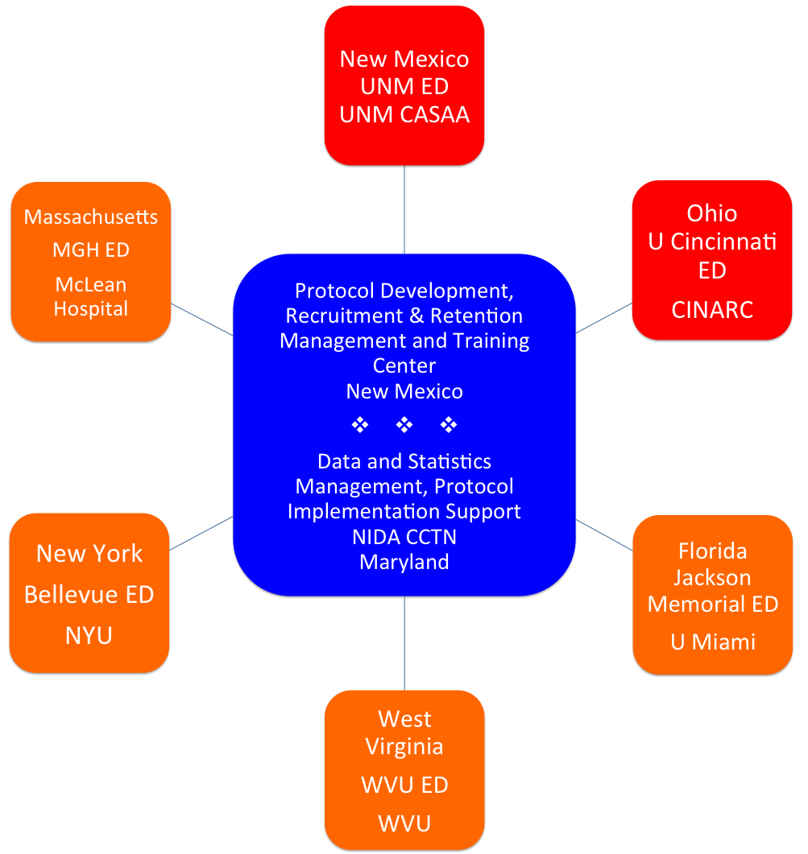
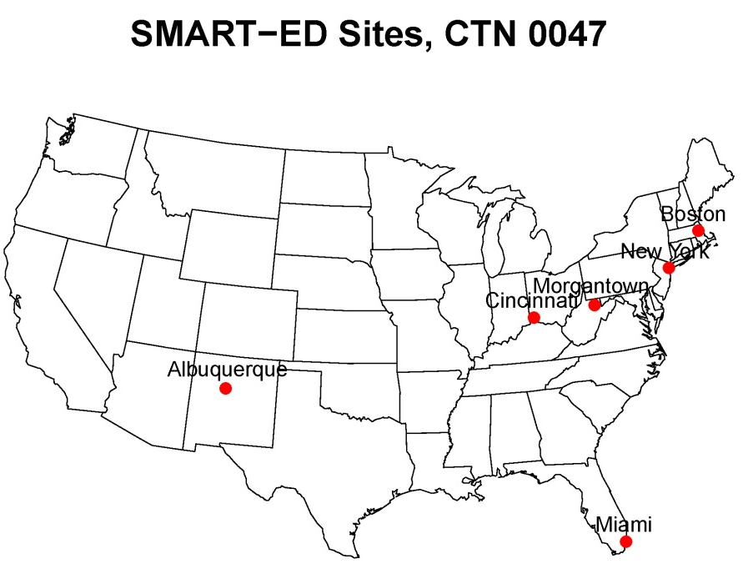
SMART-ED Sites
Notes:
Ultimately, six sites were selected. The University of New Mexico was the lead site and was responsible for protocol development, R&R management and overall training. EMMES in Maryland was the data coordinating center and was also responsible for coordinating implementation support. The six sites rolled out in 2 waves. The first wave (in red) included the University of New Mexico site in Albuquerque and the University of Cincinnati in Cincinnati, Ohio. The wave 2 sites (in orange) started about six months later an included MGH/McLean hospital in Boston, Mass, Bellevue/NYU in NYC, WVU in Morgantown, WV and Jackson Memorial Hospital / University of Miami in Florida.

Slide 6
ED Study Phases…
Two stage screening process
  Discussed in detail in the next session
Formal subject recruitment
  Inclusion/exclusion criteria
  Informed consent
Multistage randomization reveal / Assessment
  MSO
  SAR vs BI-B
Initial visit wrap up
  Appointment made for follow up in ED
Covered in this presentation
Notes:
Several study steps occurred in the ED. These steps included an initial 2 stage screening process, formal subject recruitment, a multistage randomization procedure with associated assessment procedures and finally an initial visit wrap up. I will cover only the first 2 steps in this presentation. The other panelists will cover the other material.

Slide 7

Subject Inclusion Criteria
Registered as a patient in the ED
Access to a phone
Reside within 50 miles (80 km) of the follow up site
Provide sufficient locator information for self and 2 or more locators
Not currently a prisoner or in police custody
Notes:
Subject had to have been registered as a patient in the ED (family members and friends often volunteered to be a subject when they found out they would be paid). Since part of the intervention included up to two telephone booster sessions, we required access to a phone. Subjects had to live within 50 miles / 80 km of the follow up site. Potential subjects had to be able to provide sufficient locator information for themselves and 2 others to assist with tracking and retention. You could be homeless and still be enrolled. We excluded those who were prisoners or in police custody while in the ED.

Slide 8
Recruiting Challenges
Recruitment plans tailored to site characteristics
  Patient length of stay
  Assessment location (in the ED)
EDs are inherently chaotic
  Patients often have undifferentiated illness
  Angry, irritable, in pain
  Many have waited to be seen for hours (days?)
  Confidentiality
Integrating processes into triage and medical screening protocols
  EMTALA
  Medical staff / patient flow
Patients who were too ill or “altered” to participate
  Medical illness
  Intoxication
  Acutely psychotic or suicidal patients
Notes:
The ED is a challenging environment to enroll subjects and each site had very different characteristics. We permitted each site to tailor their procedures to their own environment. Each ED could figure out where best to screen and do assessments. This often depended upon the patient’s length of stay in the ED.
EDs are inherently chaotic and many patients were angry, irritable and in pain. Many waited hours (and occasionally days) to be seen. Furthermore, the ED is a challenging environment to provide private and confidential services. Research staff had to integrate the recruiting into existing triage and medical screening protocols. In many instances, potential subjects were too ill or altered to participate, including those too ill for acute medical illness, intoxication on alochol or durgs and the acutely psychotic or suicidal patient.

Slide 9
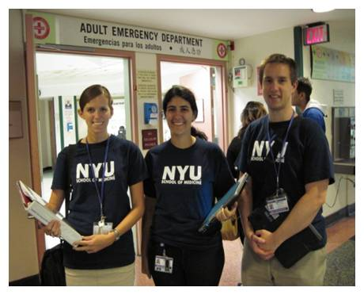
The Recruiters
Computer based screening
Notes:
Here are 3 of the research assistants at Bellevue Hospital in New York City.
Notice the tablet computer. The study tried to eliminate paper whenever possible.

Slide 10


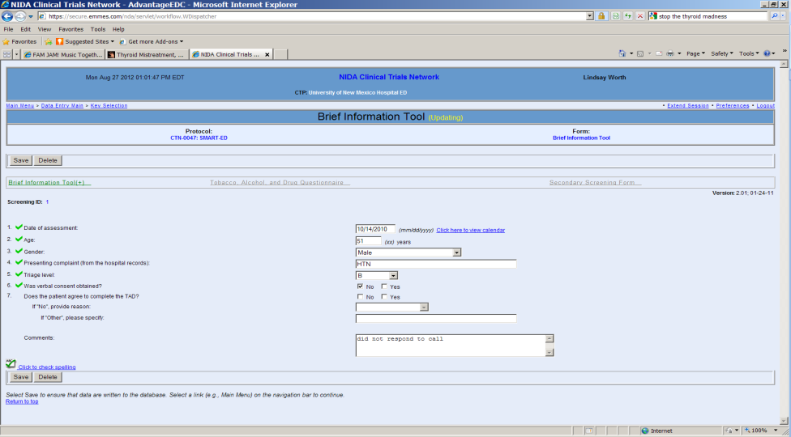
Computer based Screening
Very little paper used (consent forms)
Provided for mobility, electronic data capture
Stylus driven, PC based system cumbersome
Challenging for ED patients to use

Slide 11
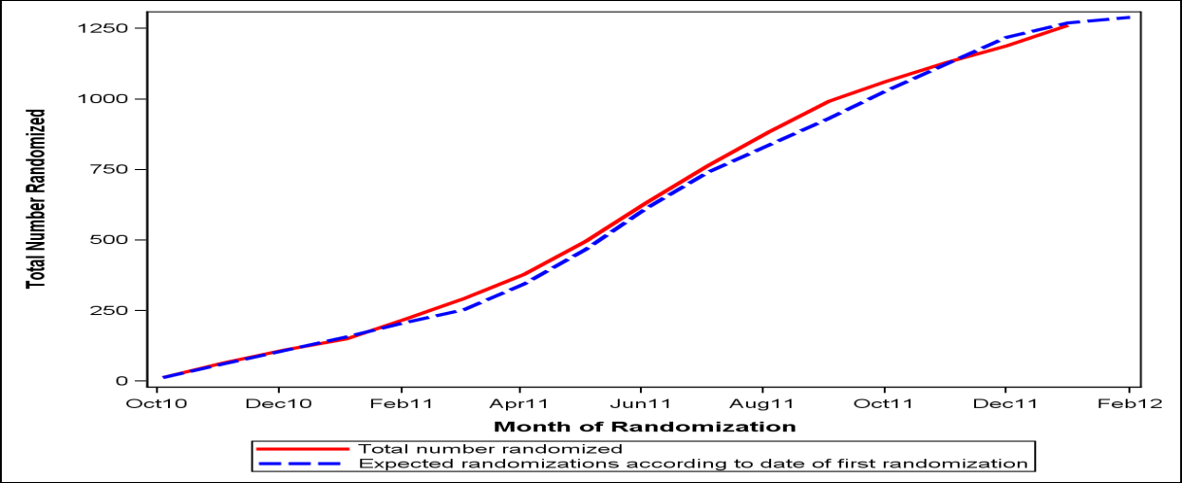
Recruitment Rate
20,762 pre-screened
15,509 gave initial verbal consent
15,224 completed anonymous screening
  Computer assessed eligibility to continue
  Additional screening questions reviewed inclusion/exclusion criteria
  ~8% recruited
Informed consent
About 21 participants recruited per week
Screening process about 5-10 minutes

Slide 12
Characteristics of the Recruited Sample
Demographics
  70% male
  Mean age 36 years ±12
  50% White, 35% Black, 24% Hispanic
  9% married
  9% college graduates
  63% household income under $15,000
  42% unemployed
  19% full-time employment

Slide 13
Retention
Participants asked to follow up…
  3 months
  6 months
  12 months
To make it even more challenging…
  Different location than the ED
  Different research staff
Target retention rate
  85% at 3 months
  !!

Slide 14

Tracking Strategies
Phone and mail current locator information
Old phone numbers and old addresses
Email and text / SMS
Community searches (‘haunts’)
Call jails and medical examiner
Search jails and prisons online
  (e.g., local websites and www.vinelink.com)
Web searches
Check participant’s medical record for updated information
Use different staff members
  Different voice and different strategies
Vary times of contact (weekends and evenings)
Call the Lead Node Tracking & Retention Coordinator for web searching assistance
Send certified letters to confirm receipt
Use “Forwarding Address” stamp
Confirm / refute deaths

Slide 15

Strategies for Overdue Participants
National Tracking Coordinator routinely monitored overdue participants
For participants resistant to completing a follow-up:
  Maintain frequent, multiple contacts with participants between follow-up assessment visits
  Offer a phone interview as an alternative
  Offer to meet participants in the community
  Remind them that they will be compensated $75 for each completed follow-up
  Offer transportation to the follow-up site
  Call & conduct assessments with participants on weekends & evenings
  Broad time windows for follow up visits

Slide 16
Key Elements of Success
Recruitment
  Select appropriate ED sites
  Balance eligibility requirements
  Staff training and monitoring
  Assure acceptance of research and recruitment staff by ED staff
  Technology
Retention
  Frequent letters and calls to participants and locators
  Technology
    Email, SMS, web searches
  Interviewing flexibility
    Telephone and community-based interviews
  Alternating trackers and times of tracking
  Weekly tracking and retention meetings

Slide 17
Questions?

