Slide 1



Community Perspective on Pain Management
and Prescription Opioid Overdose Prevention
Fred Wells Brason II
www.projectlazarus.org
Dr. Mike Lancaster
www.communitycarenc.org

Slide 2


Slide 3
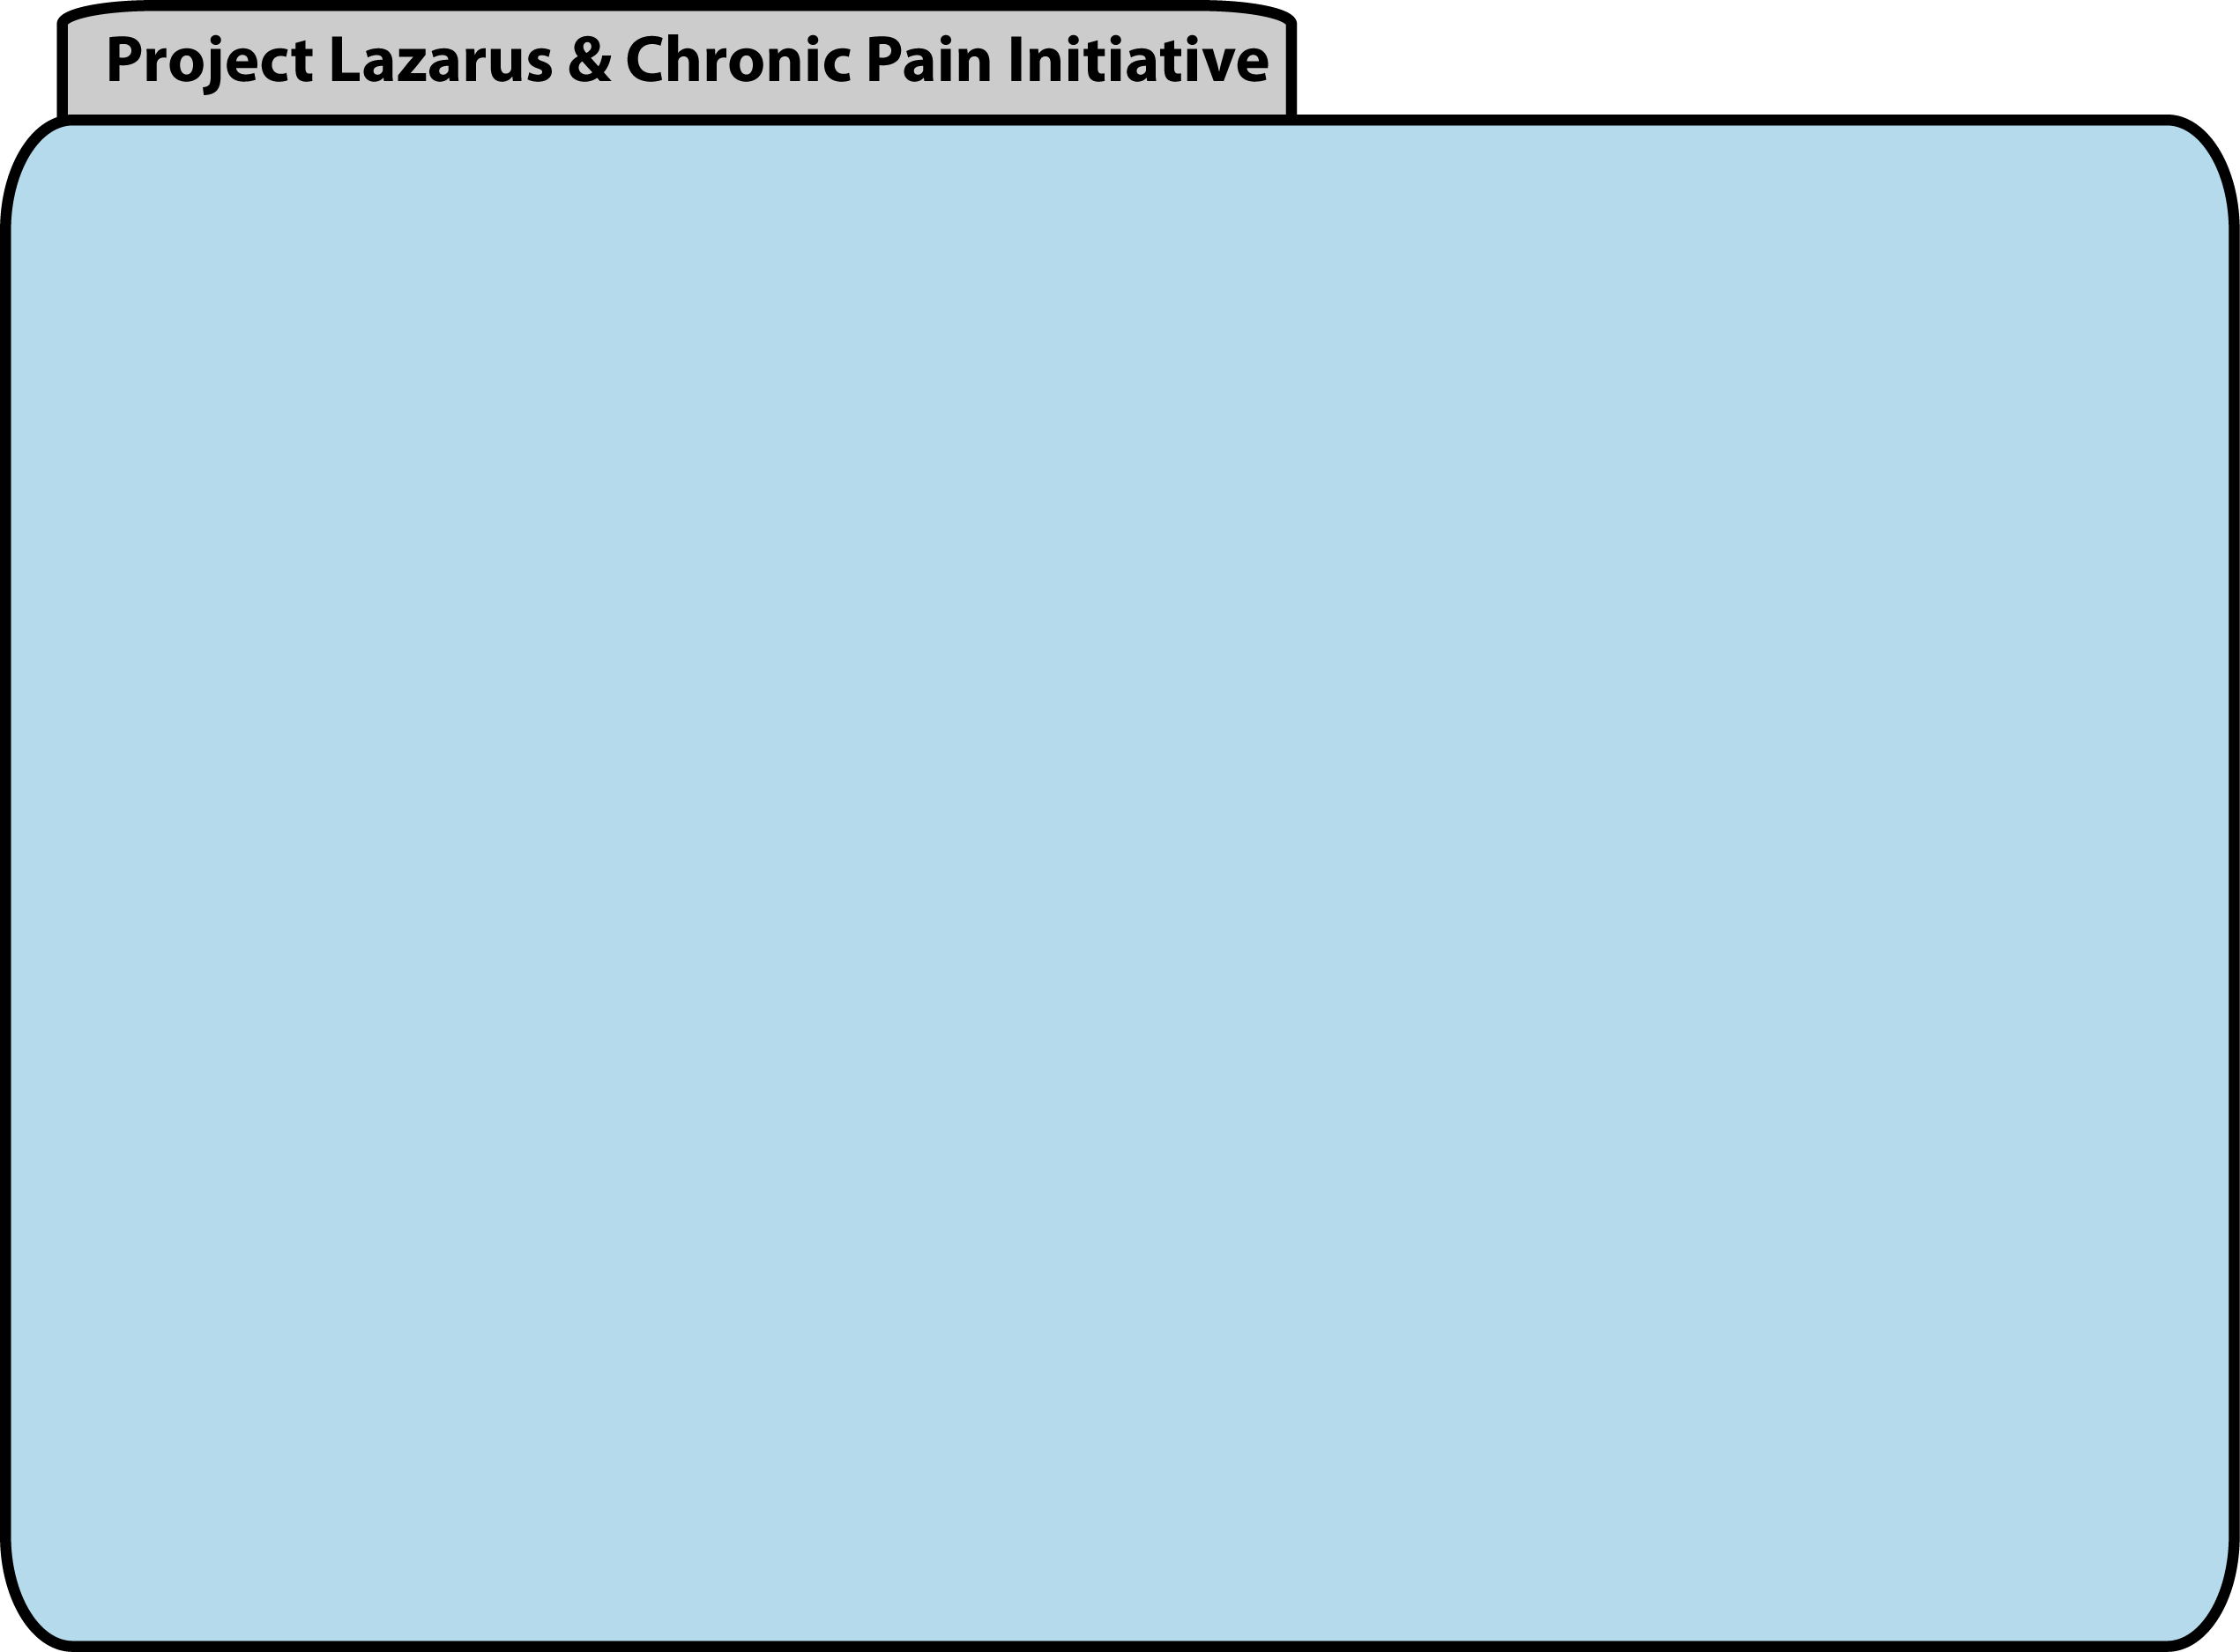
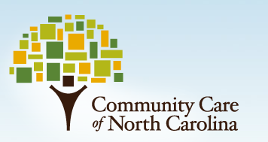
Who We Are
Project Lazarus believes that communities are ultimately responsible for their own health and that every drug overdose is preventable. We are a secular, non-profit organization that provides technical assistance to community groups and clinicians throughout North Carolina and beyond. Using experience, data, and compassion we empower communities and individuals to prevent drug overdoses and meet the needs of those living with chronic pain.
North Carolina’s non-profit public-private partnership that oversees care to 1.1 million Medicaid beneficiaries. Focused on cost reduction and improvements in quality, CCNC is administered through 14 multi-county regional networks. The statewide Chronic Pain Initiative was created in conjunction with Project Lazarus to provide medical education to prescribers. It’s goals are to reduce the demand for, supply and diversion of, and harms resulting from prescription opioids; optimize the treatment of chronic pain, and manage substance abuse associated with opioid misuse.

Slide 4
Who We Are
“A PUBLIC HEALTH APPROACH TO OVERDOSE PREVENTION” AUGUST 23, 2012
STATEMENT OF R. GIL KERLIKOWSKE DIRECTOR OFFICE OF NATIONAL DRUG CONTROL POLICY EXECUTIVE OFFICE OF THE PRESIDENT
“Project Lazarus is an exceptional organization—not only because it saves lives in Wilkes County, but also because it sets a pioneering example in community-based public health for the rest of the country.”
“This Administration understands that substance dependence is a health issue—not necessarily a criminal justice issue—and we support innovative ways to bring treatment to people who need it most………….
……….. Project Lazarus is a striking example of this kind of innovation.”
“My office remains steadfast in its support of a health and science-based approach to this Nation’s drug problem. We’re pleased to partner with groups on the forefront of drug policy like Project Lazarus to build a safer, healthier America.”

Slide 5

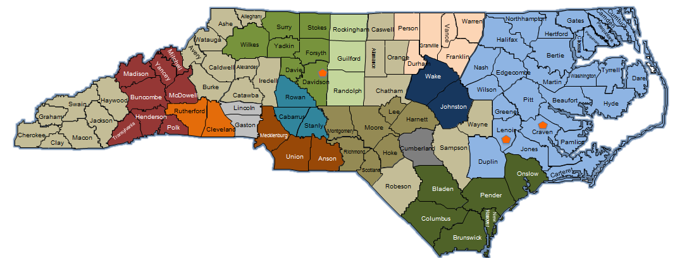
Results
NC Medical Board
NC Medical Society
NC College of Emergency Physicians
Carolinas Poison Center
Dental Society
SBI
Source: CCNC 2011

Slide 6
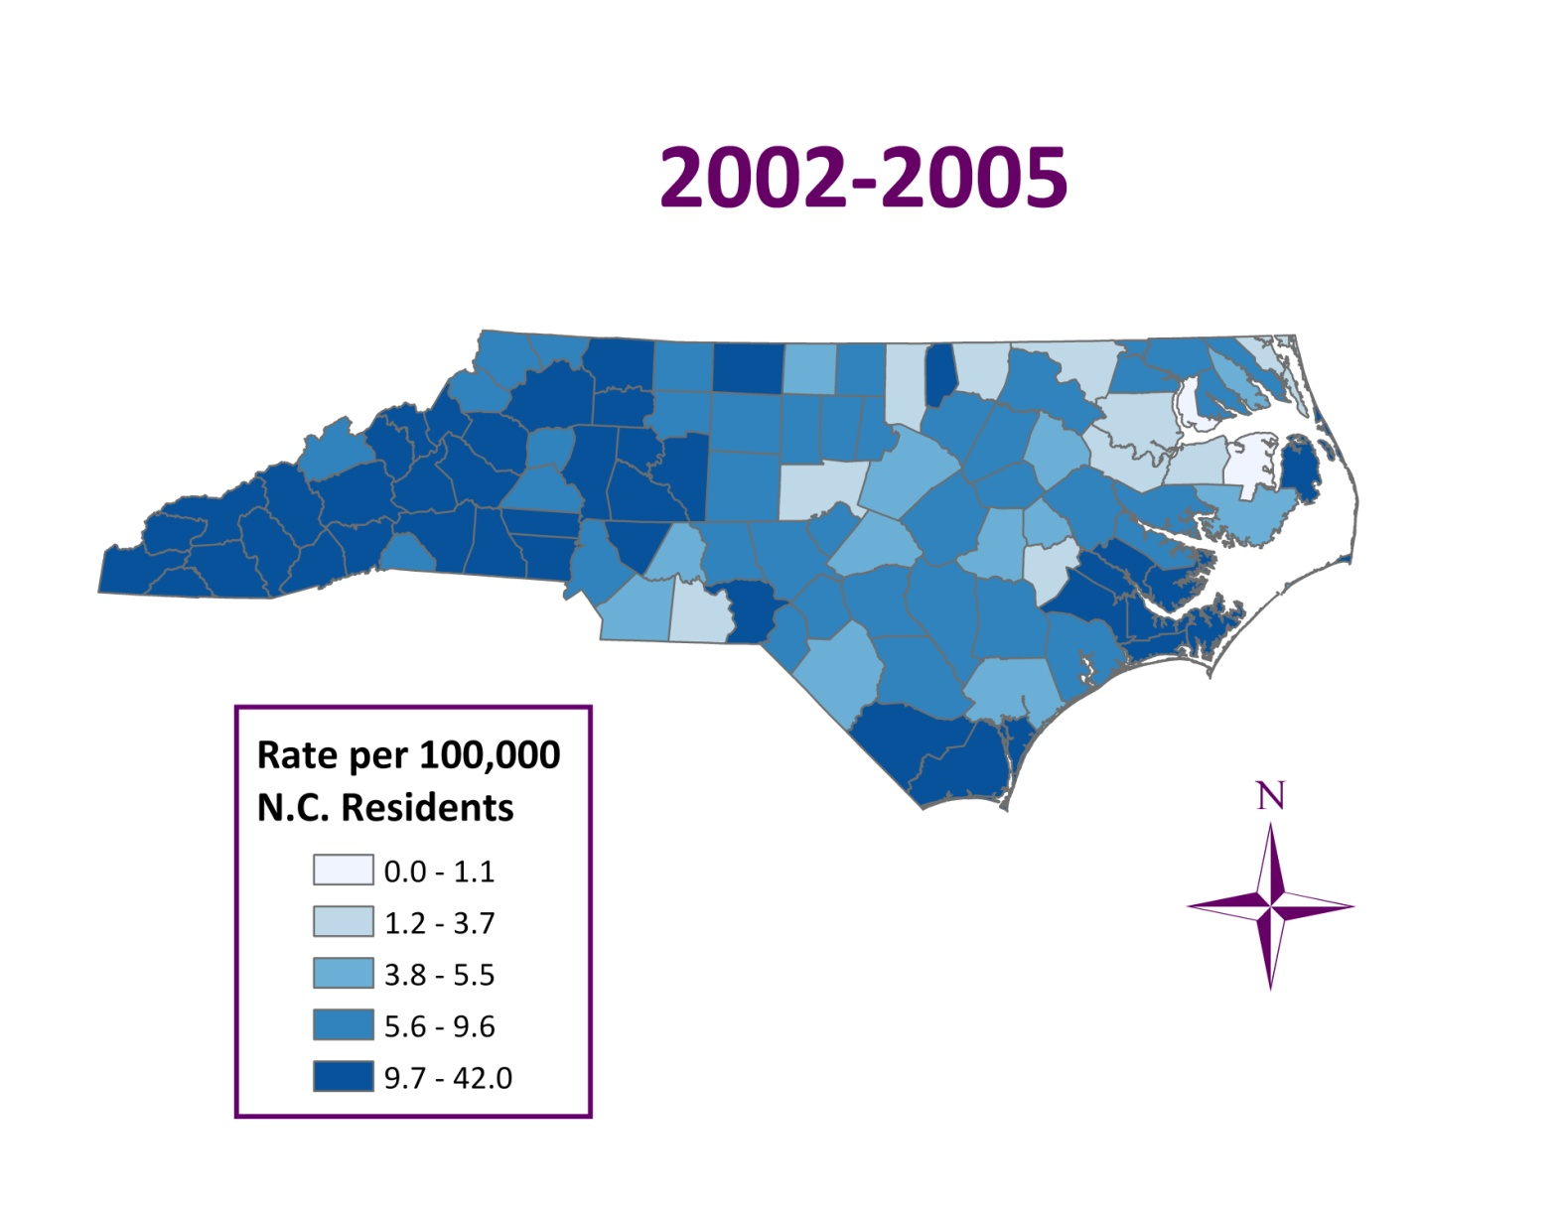
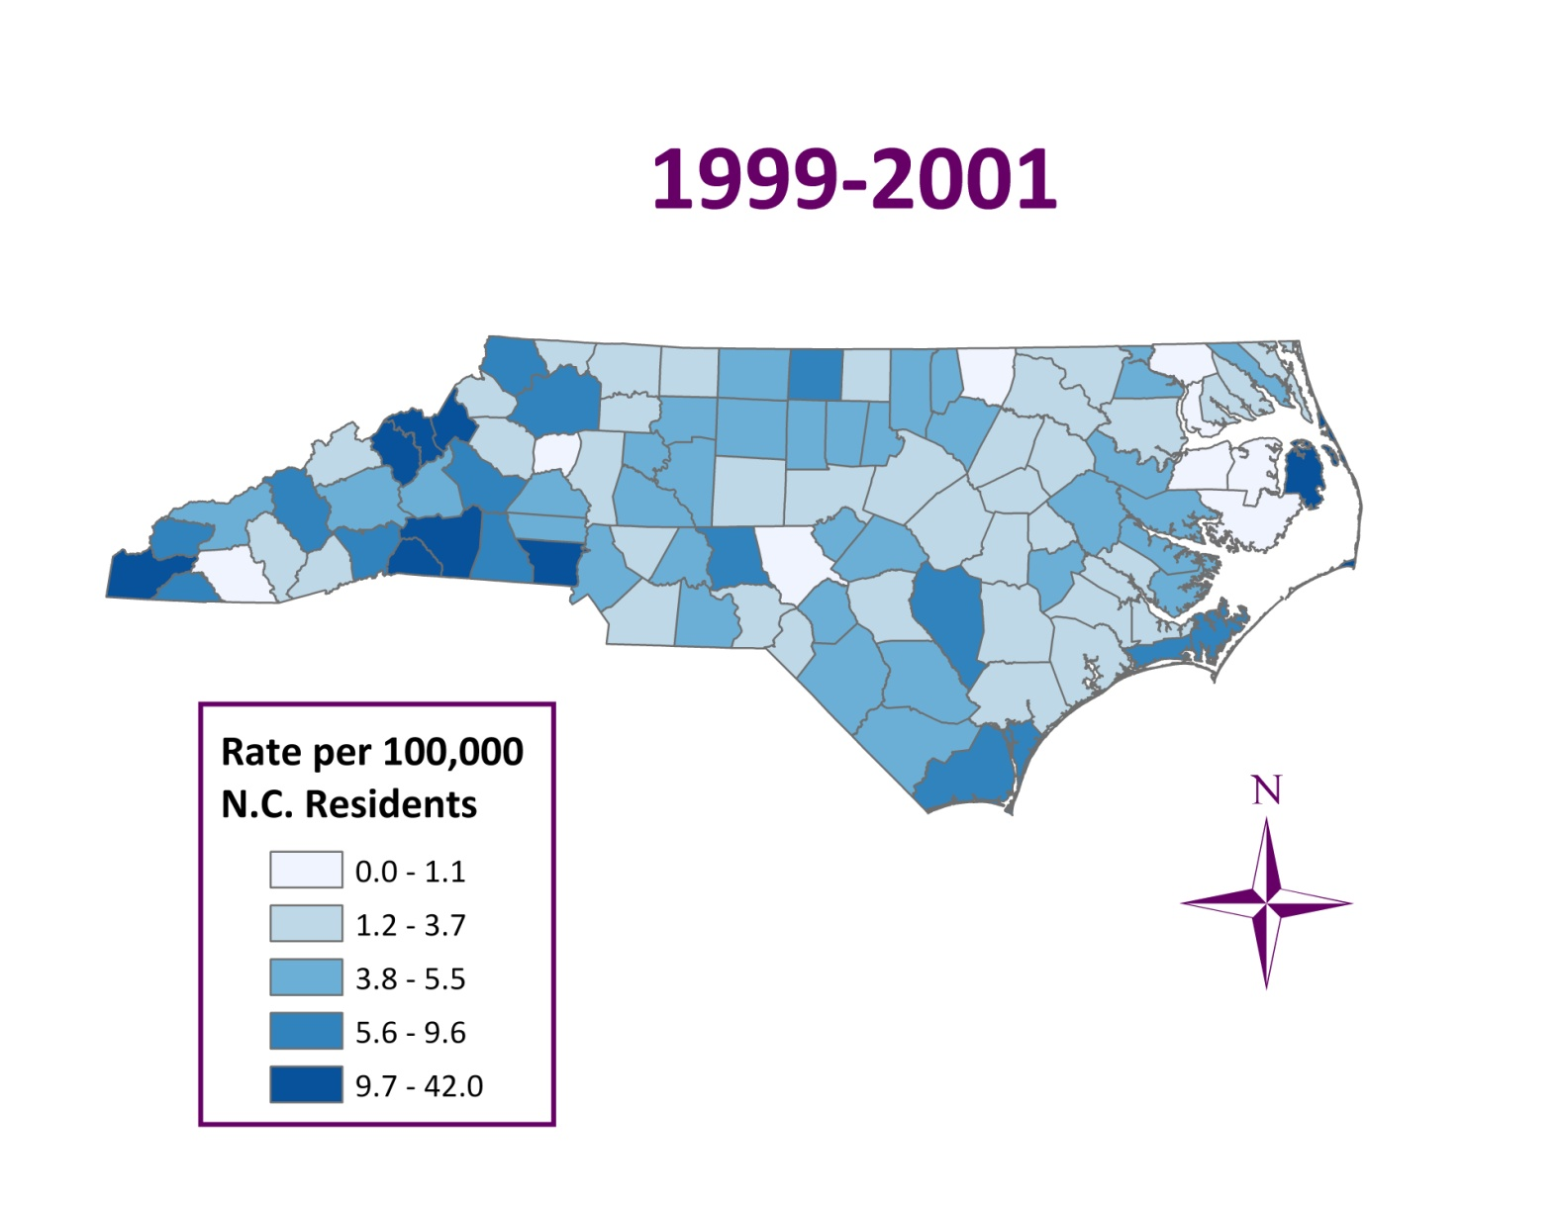
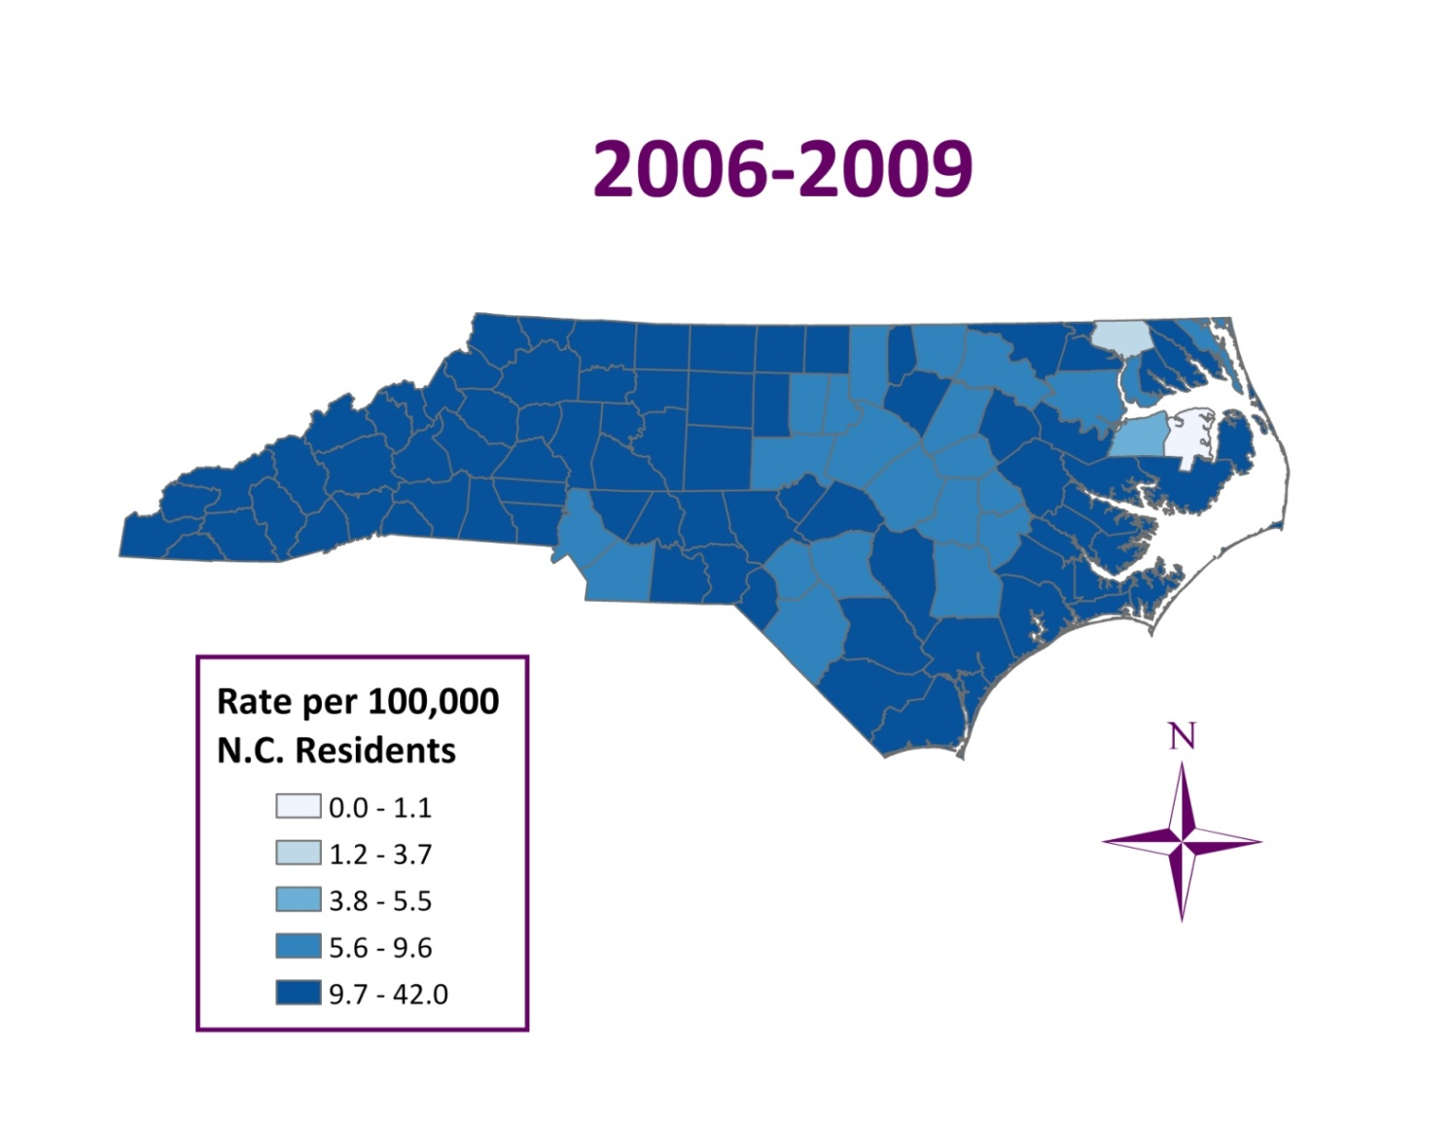
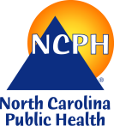
Unintentional Poisoning Deaths by County: N.C., 1999-2009
Source: N.C. State Center for Health Statistics, Vital Statistics-Deaths, 1999-2009 Analysis by Injury Epidemiology and Surveillance Unit

Slide 7
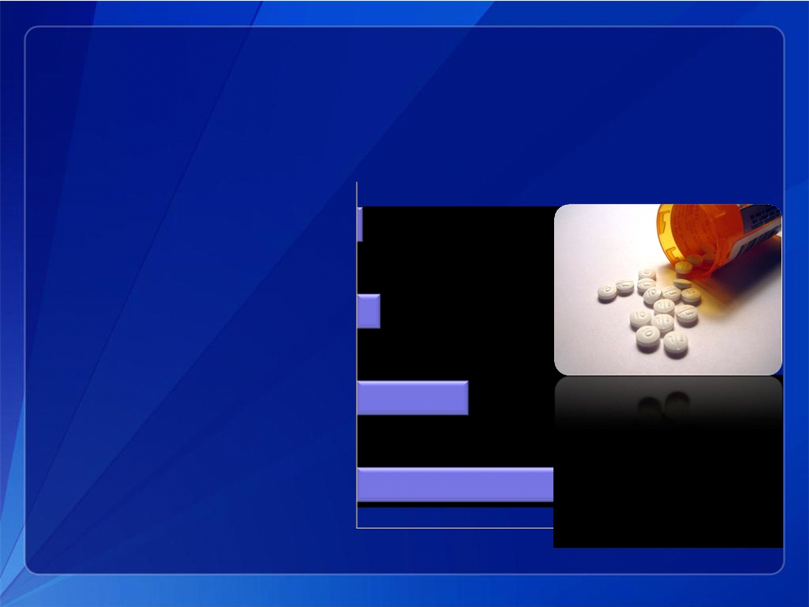
Public Health Impact of Opioid Analgesic Use
For every 1 overdose death there are
Abuse treatment admissions
9
ED visits for misuse or abuse
35
People with abuse/dependence
161
Nonmedical users
461
Treatment admissions are for primary use of opioids from Treatment Exposure Data set
Emergency department (ED) visits are from DAWN,Drug Abuse Warning Network, https://dawninfo.samhsa.gov/default.asp Abuse/dependence and nonmedical use in the past month are from the National Survey on Drug Use and Health
7

Slide 8
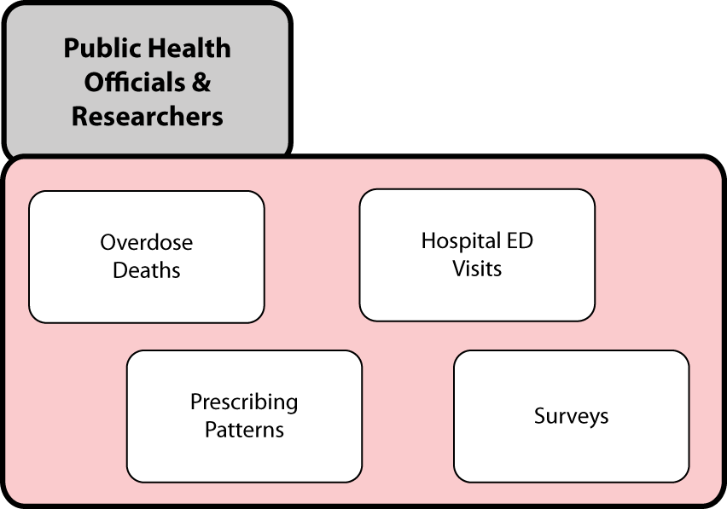

Slide 9
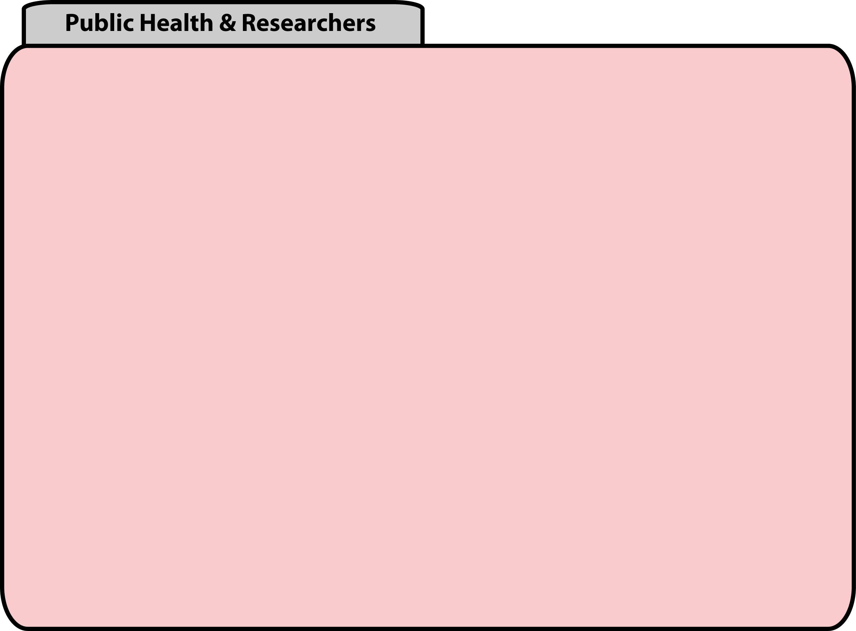
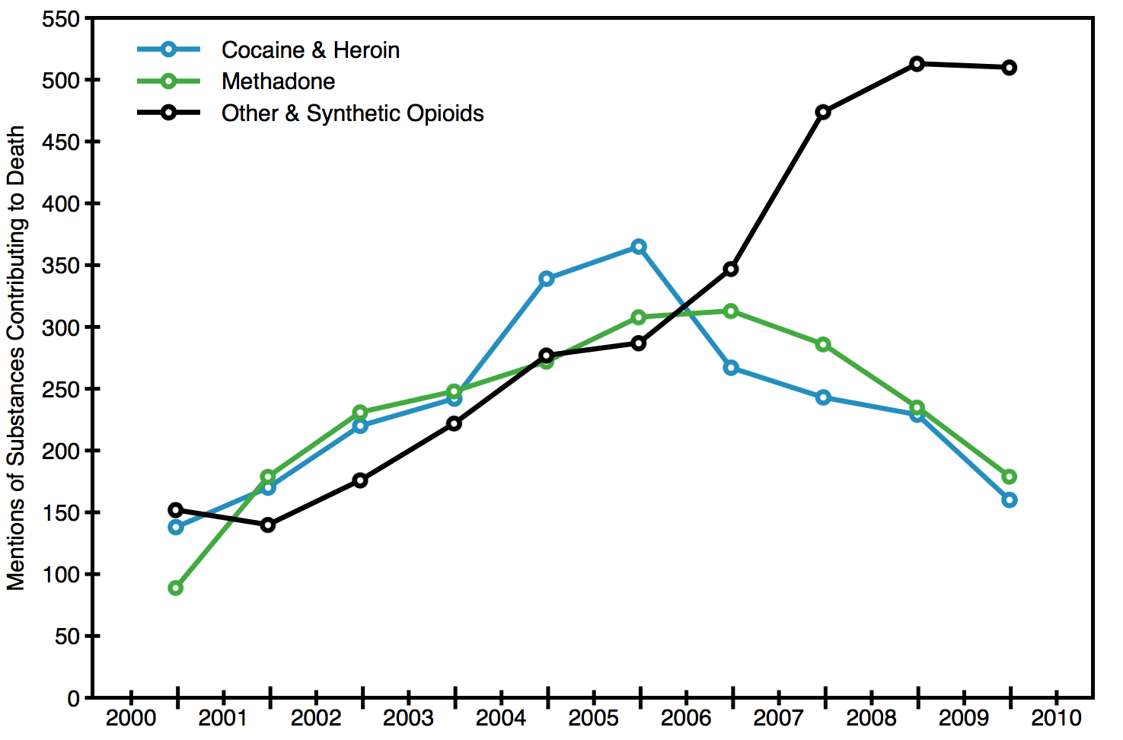
Overdose Deaths
Deaths from prescription opioid overdoses increased in NC over the last decade. Methadone deaths peaked in 2006.
Source: NC SCHS. North Carolina, 2010. Underlying COD X40-49.0 and Y10.-Y19.9; Contributing COD T40

Slide 10

Overdose Deaths
A decade of fatal unintentional poisonings*: mortality rates of NC residents, 2001-2011**
Deaths per 100,000 population
*Source: NC State Center for Health Statistics; annually prepared reports on fatal unintentional (X40-X44) and undetermined intent (Y10-Y19) poisonings; 2001-2009 mortality rates based on bridged population estimates; 2010-2011 rates based on US Census data. ^ Data for 2011 are preliminary and may be an underestimate of the true mortality rate..

Slide 11
Prescribing Data from PMP
Cost of Hospitalizations for Unintentional Poisonings: NC, 2008
Average cost of inpatient hospitalizations
for an opioid poisoning*: $16,970.
Number of hospitalizations for unintentional
and undetermined intent poisonings**: 5,833
Estimated costs in 2008: $98,986,010
Does not include costs for hospitalized substance abuse
*Agency for Healthcare Research and Quality
** NC State Center for Health Statistics, data analyzed and prepared by K. Harmon, Injury and Violence Prevention Branch, DPH, 01_19_2011
Source: NC CSRS

Slide 12
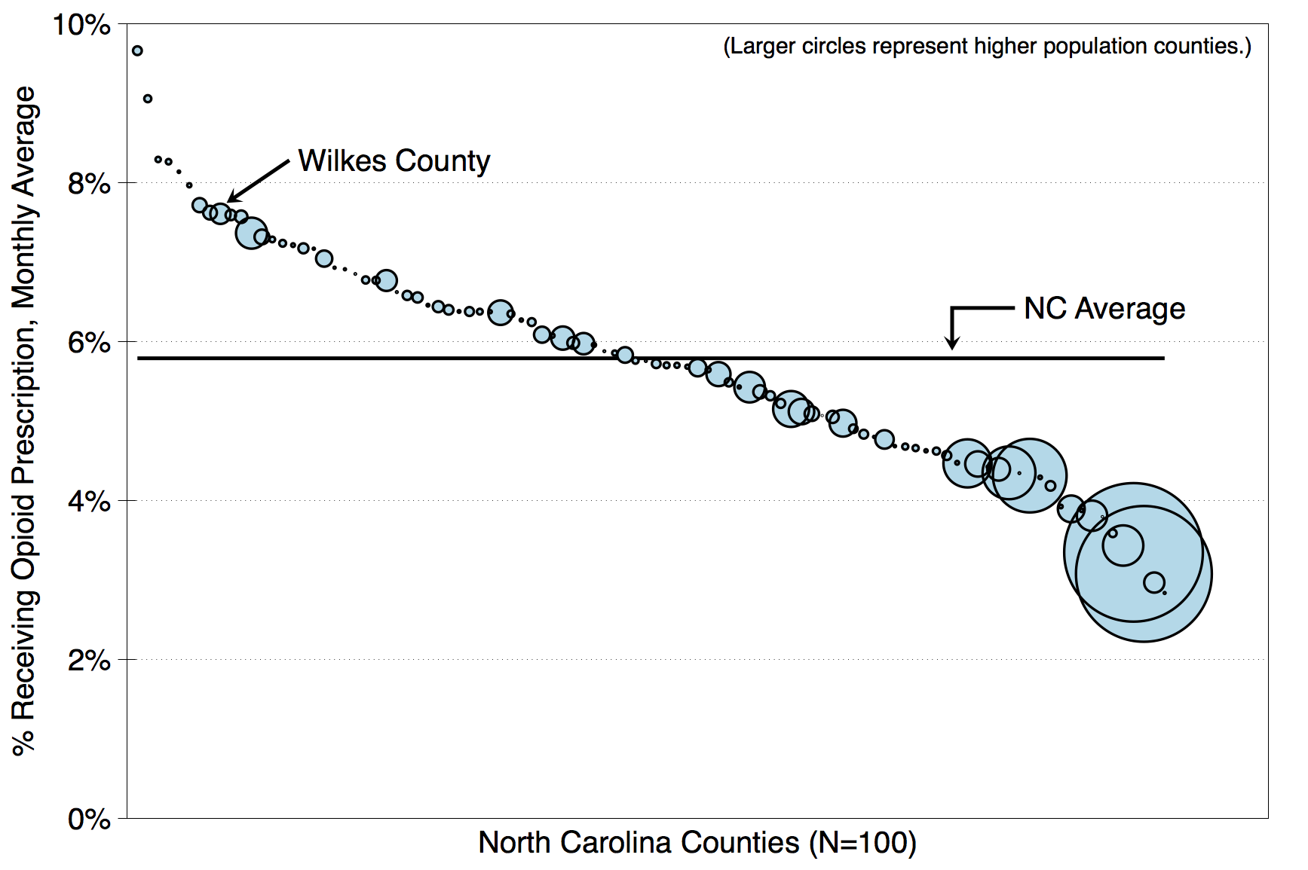
Prescribing Data from PMP
Differences in opioid availability suggest complex phenomena that are independent of pharmacology. Large cities have relatively fewer people receiving opioids than small counties. Areas with the highest opioid prescribing also have the highest poverty.
Source: NC CSRS and US Census

Slide 13
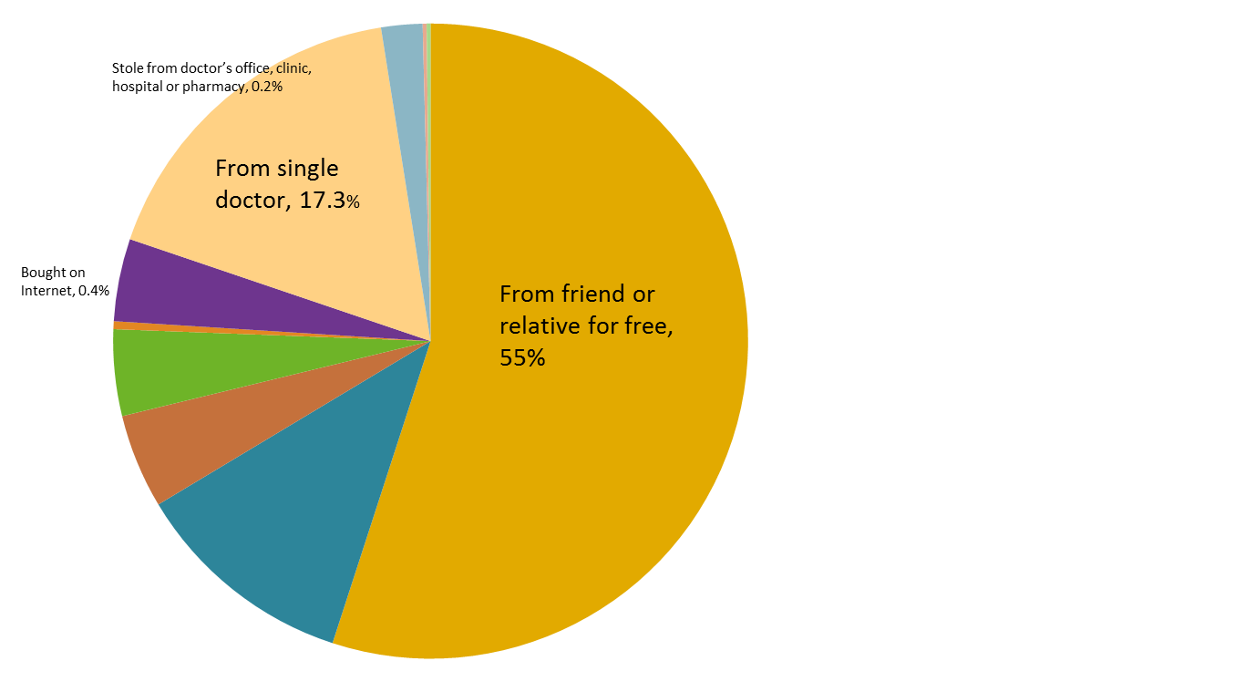
Prescription Source
Source of illicit drugs in Americans age 12 or older: 2010*
From multiple doctors, 2.1%
Wrote fake prescription, 0.2%
2010 NATIONAL SURVEY ON DRUG USE AND HEALTH SHOWS RISE IN ILLICIT DRUG USE.
In 2010, 22.6 million Americans, age 12 or older, (8.9% of the population) reported having used an illicit drug in the past 12 months.
The percentage of youths, ages 18 to 25, who reported using drugs for non-medical reasons increased from 19.6% in 2008 to 21.5% in 2010.
In 2010, 23.1 million Americans, age 12 or older, needed treatment for substance abuse but only 2.6 million (11.2 %) received treatment.
Some other way, 4.2%
Bought from drug dealer or other stranger, 4.4%
Took from friend or relative, 4.8%
Bought from friend or relative, 11.4%
*Source: 2010 National Survey on Drug Use and Health. SAMHSA http://www.samhsa.gov/samhsaNewsletter/Volume_19_Number_3/surveyshows.aspx
Source: NC CSRS

Slide 14
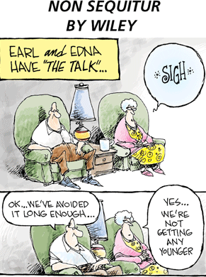
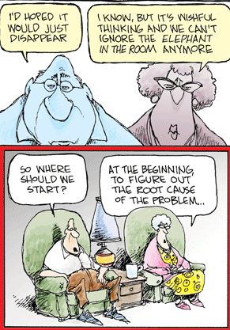
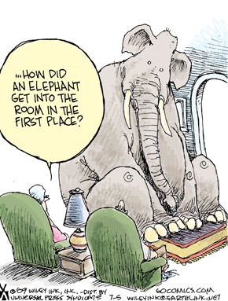

Slide 15
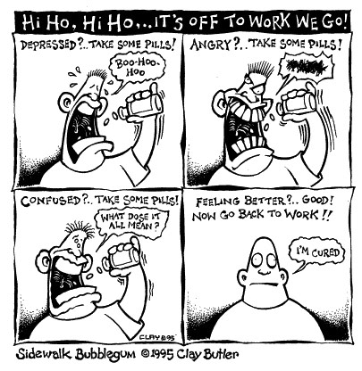
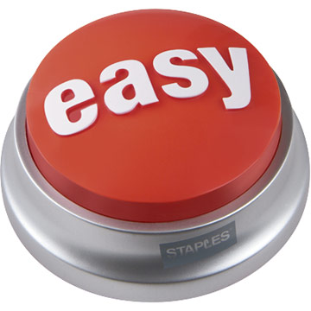
“EASY BUTTON” to life problems
“What is being done”
Source: NC CSRS

Slide 16
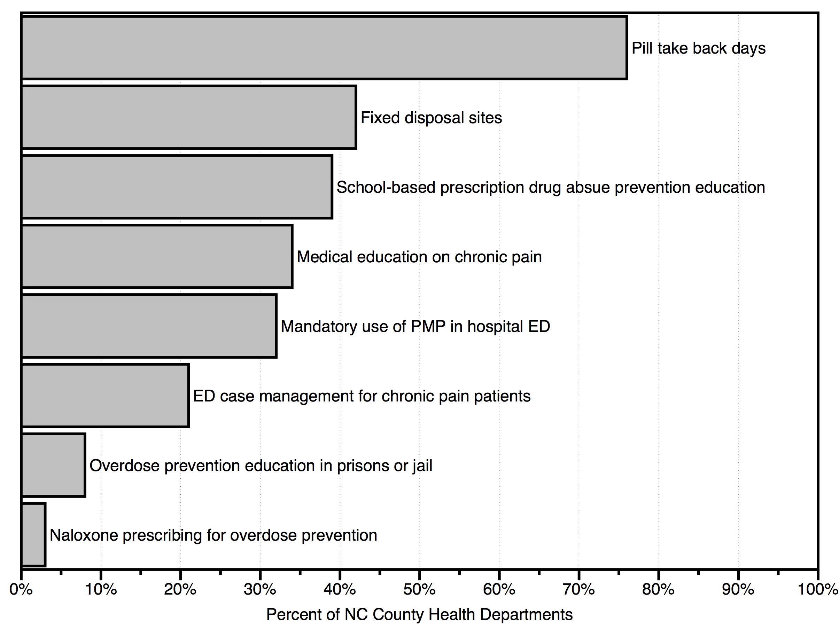
Survey: County Health Directors
Traditional interventions intended to prevent drug abuse have not been able to stop overdose deaths in North Carolina.
Source: Project Lazarus, December 2011

Slide 17
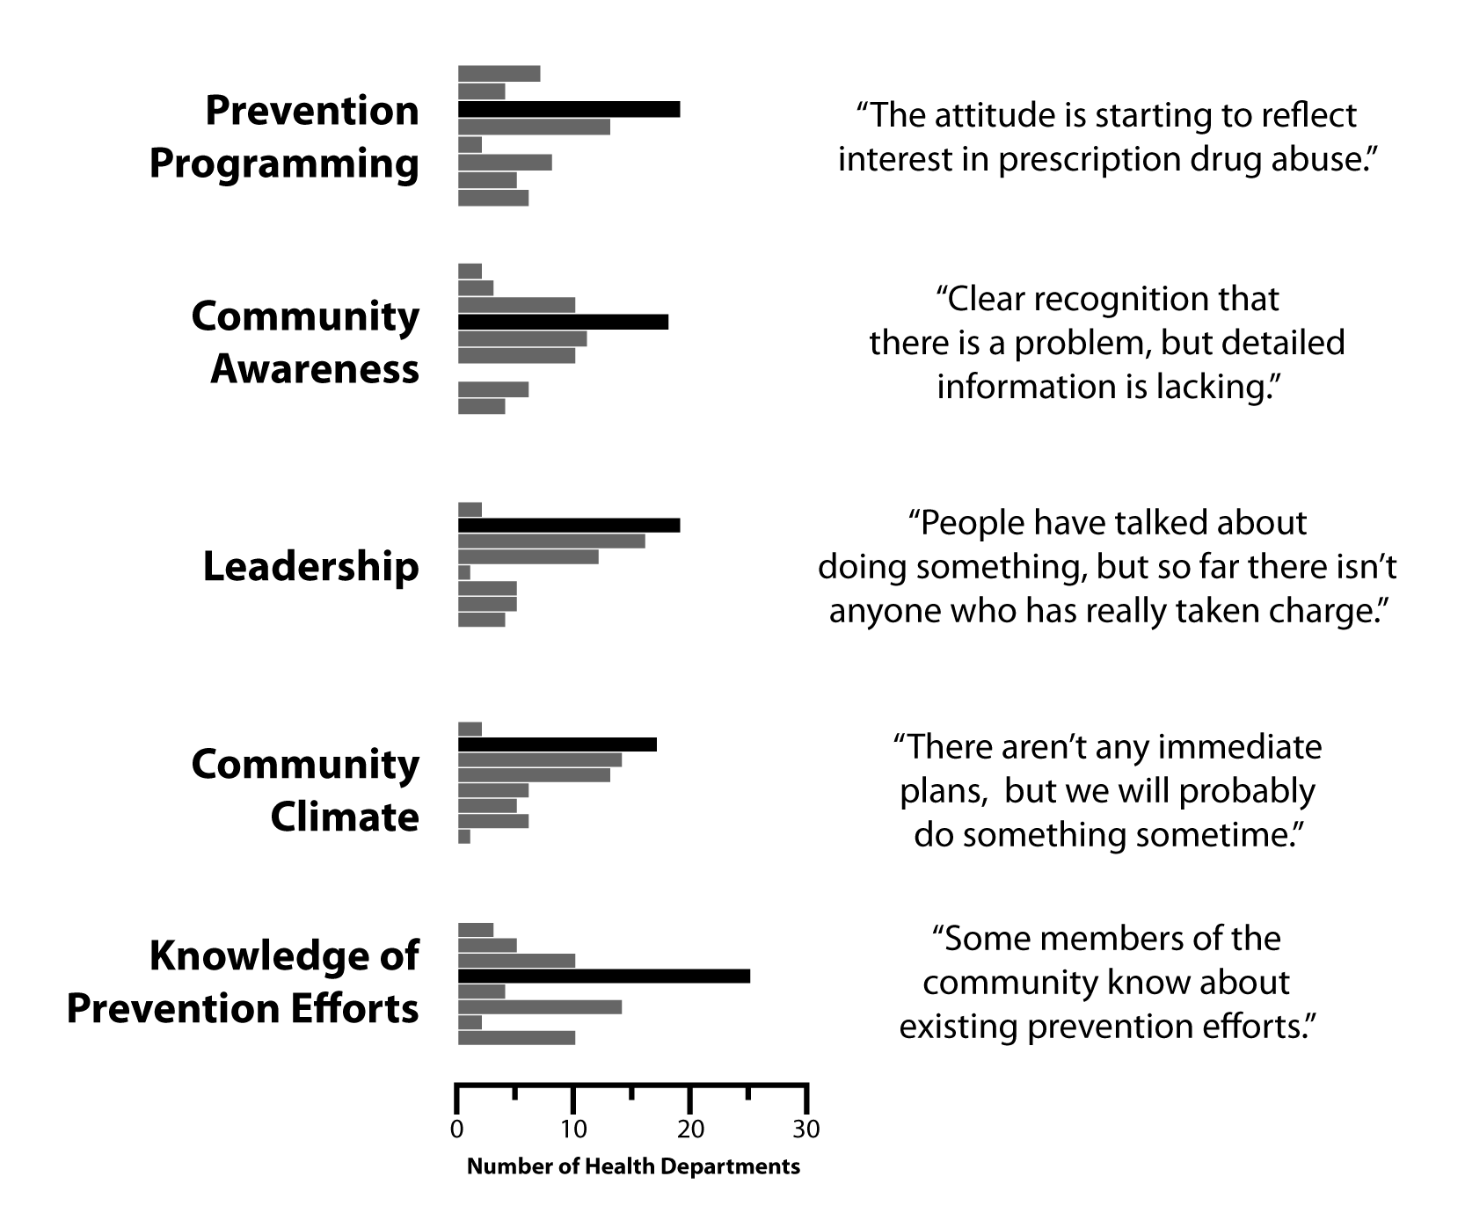
Survey: County Health Directors
Communities lack of information, tools and leadership to prevent ODs.
Source: 2011 Project Lazarus Health Director Survey

Slide 18
Prescribing Data from PMP
Controlled Substance Reporting System nccsrs.org
The stated purpose of the program (NC GS §90-113.71) is to “improve the State’s ability to identify controlled substance abusers or misusers and refer them for treatment, and to identify and stop diversion of prescription drugs in an efficient and cost effective manner that will not impede the appropriate medical utilization of licit controlled substances.”
www.ncdhhs.nc.gov/mhddsas/controlledsubstance
Source: NC CSRS

Slide 19
Prescribing Data from PMP
 | Total Pharmacists |  | Practitioners Registered | Total Practitioners |  | Percent
 | Registered 8/23/12 |  | 8/23/12 | As of March 2012 |  | Registered
Wilkes | 11 |  | 89 | 138 |  | 64.5%
NC | 1961 |  | 10378 | 37839 |  | 27.4%
Source: NC CSRS

Slide 20
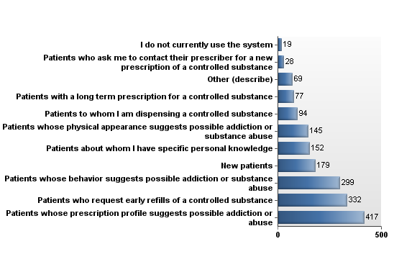
Survey: PMP Utilization
Prescribers use the PMP mostly for patients they are suspicious about, not following universal precautions. CME has limited ability to change physician behavior.
Source: UNC Injury Prevention Research Center

Slide 21
Prescribing Data from PMP
Pharmacists:
When do you use the CSRS? I access patient records for...
Source: NC CSRS

Slide 22
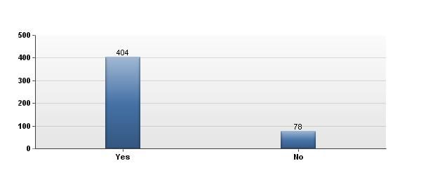
Prescribing Data from PMP
Have you ever used information from the CSRS when you called
a prescriber with concerns about a patient's prescription?
UNC IPRC SURVEY MARCH 2012
Source: NC CSRS

Slide 23
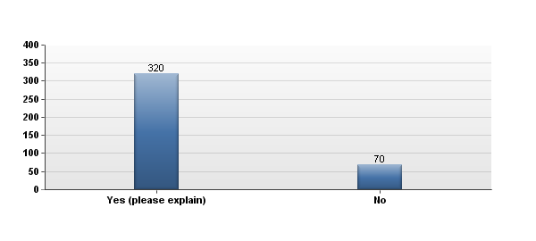
Prescribing Data from PMP
Did the prescriber change the prescription?
UNC IPRC SURVEY MARCH 2012
Source: NC CSRS

Slide 24
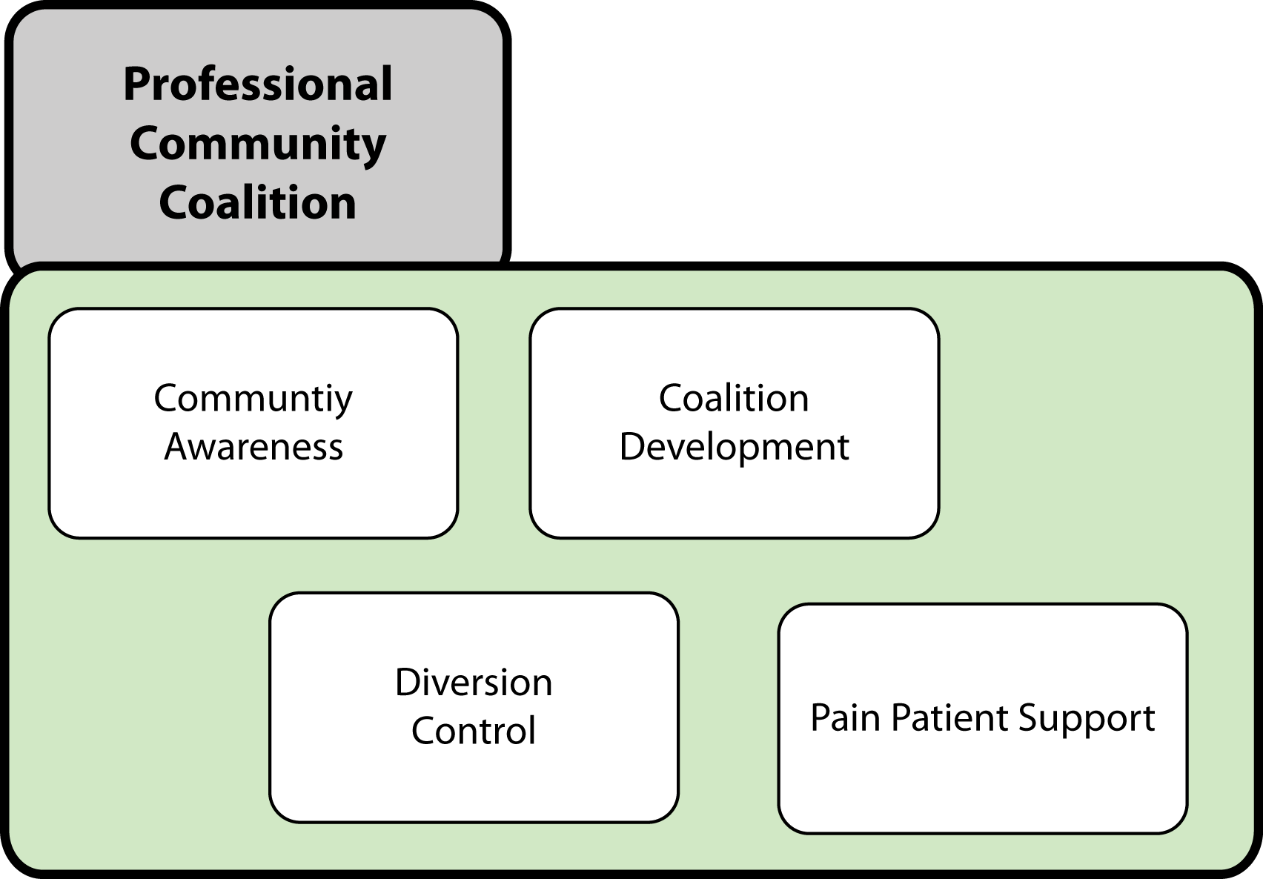

Slide 25
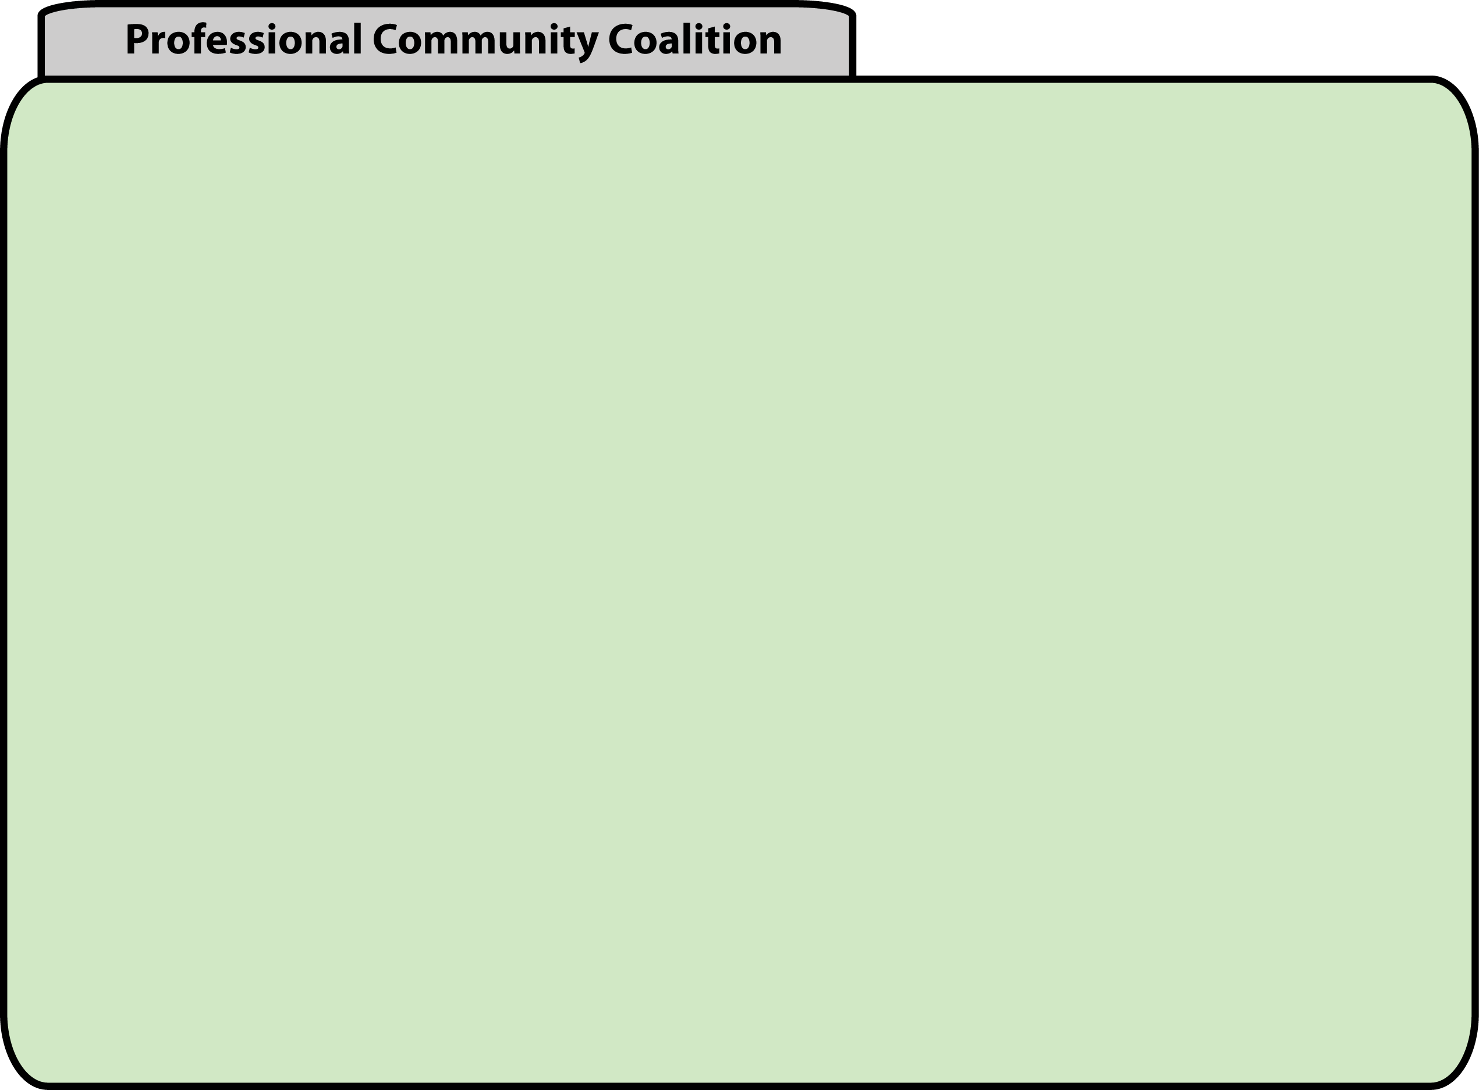
Community Awareness
Society
Environmental
Situation
Medical
Local Gov’t
Economic
Conditions
Social
Structures
School
Peers
Individual
Physical
Psychological
Social
Spiritual
Youth
Military
Faith
Community
Community
Prejudices
Employment
Opportunities
Civic
Human Service
Family
Treatment
LOCUS OF COMMUNITY INTERVENTIONS*

Slide 26
Community Awareness
Stakeholders
Stakeholders
Stakeholders
Stakeholders
Community Forum
Community Sectors
Steering Committee
Community Sector Workshops
Sector Committees – Objectives, Strategies, Tactics, Action Plans, Implementation, Evaluation

Slide 27
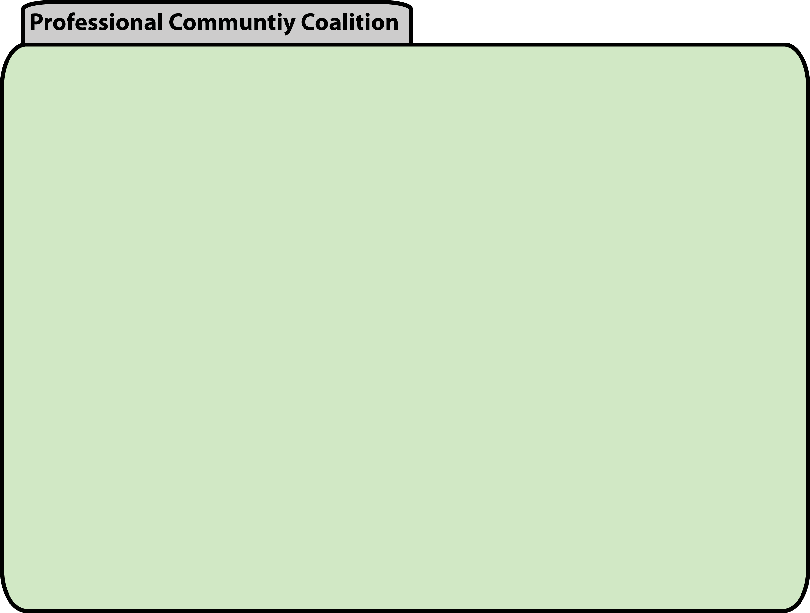
Can coalitions help reduce Rx drug abuse?
Counties with coalitions had 6.2% lower rate of ED visits for substance abuse than counties with no coalitions (but this could be due to random chance)
However, counties with a coalition where the health department was ^{the} ^{lead} agency had a statistically significant 23% lower rate of ED visits (X2=2.15, p=0.03) than other counties
In counties with coalitions 1.7% more residents received opioids than in counties without a coalition.
Coalitions may be useful in reducing the harms of Rx drug abuse while improving access to pain medications at the same time.
More professional coalitions may have a greater impact on reducing Rx drug harms.
Data Sources: NC Health Directors Survey, NC DETECT (2010), CSRS (2008-2010)

Slide 28
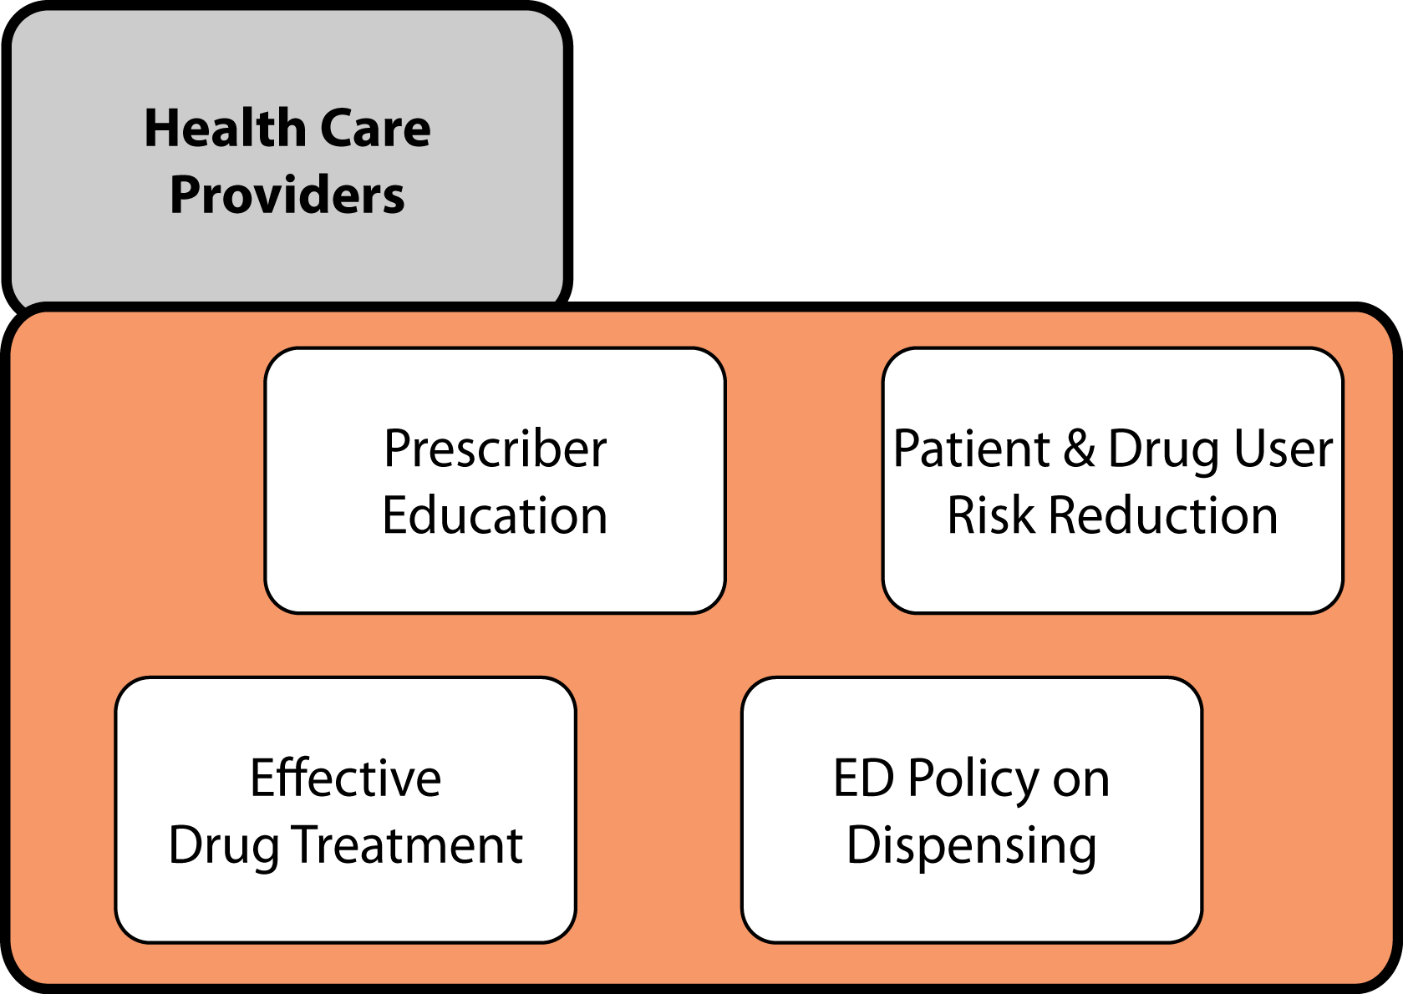

Slide 29
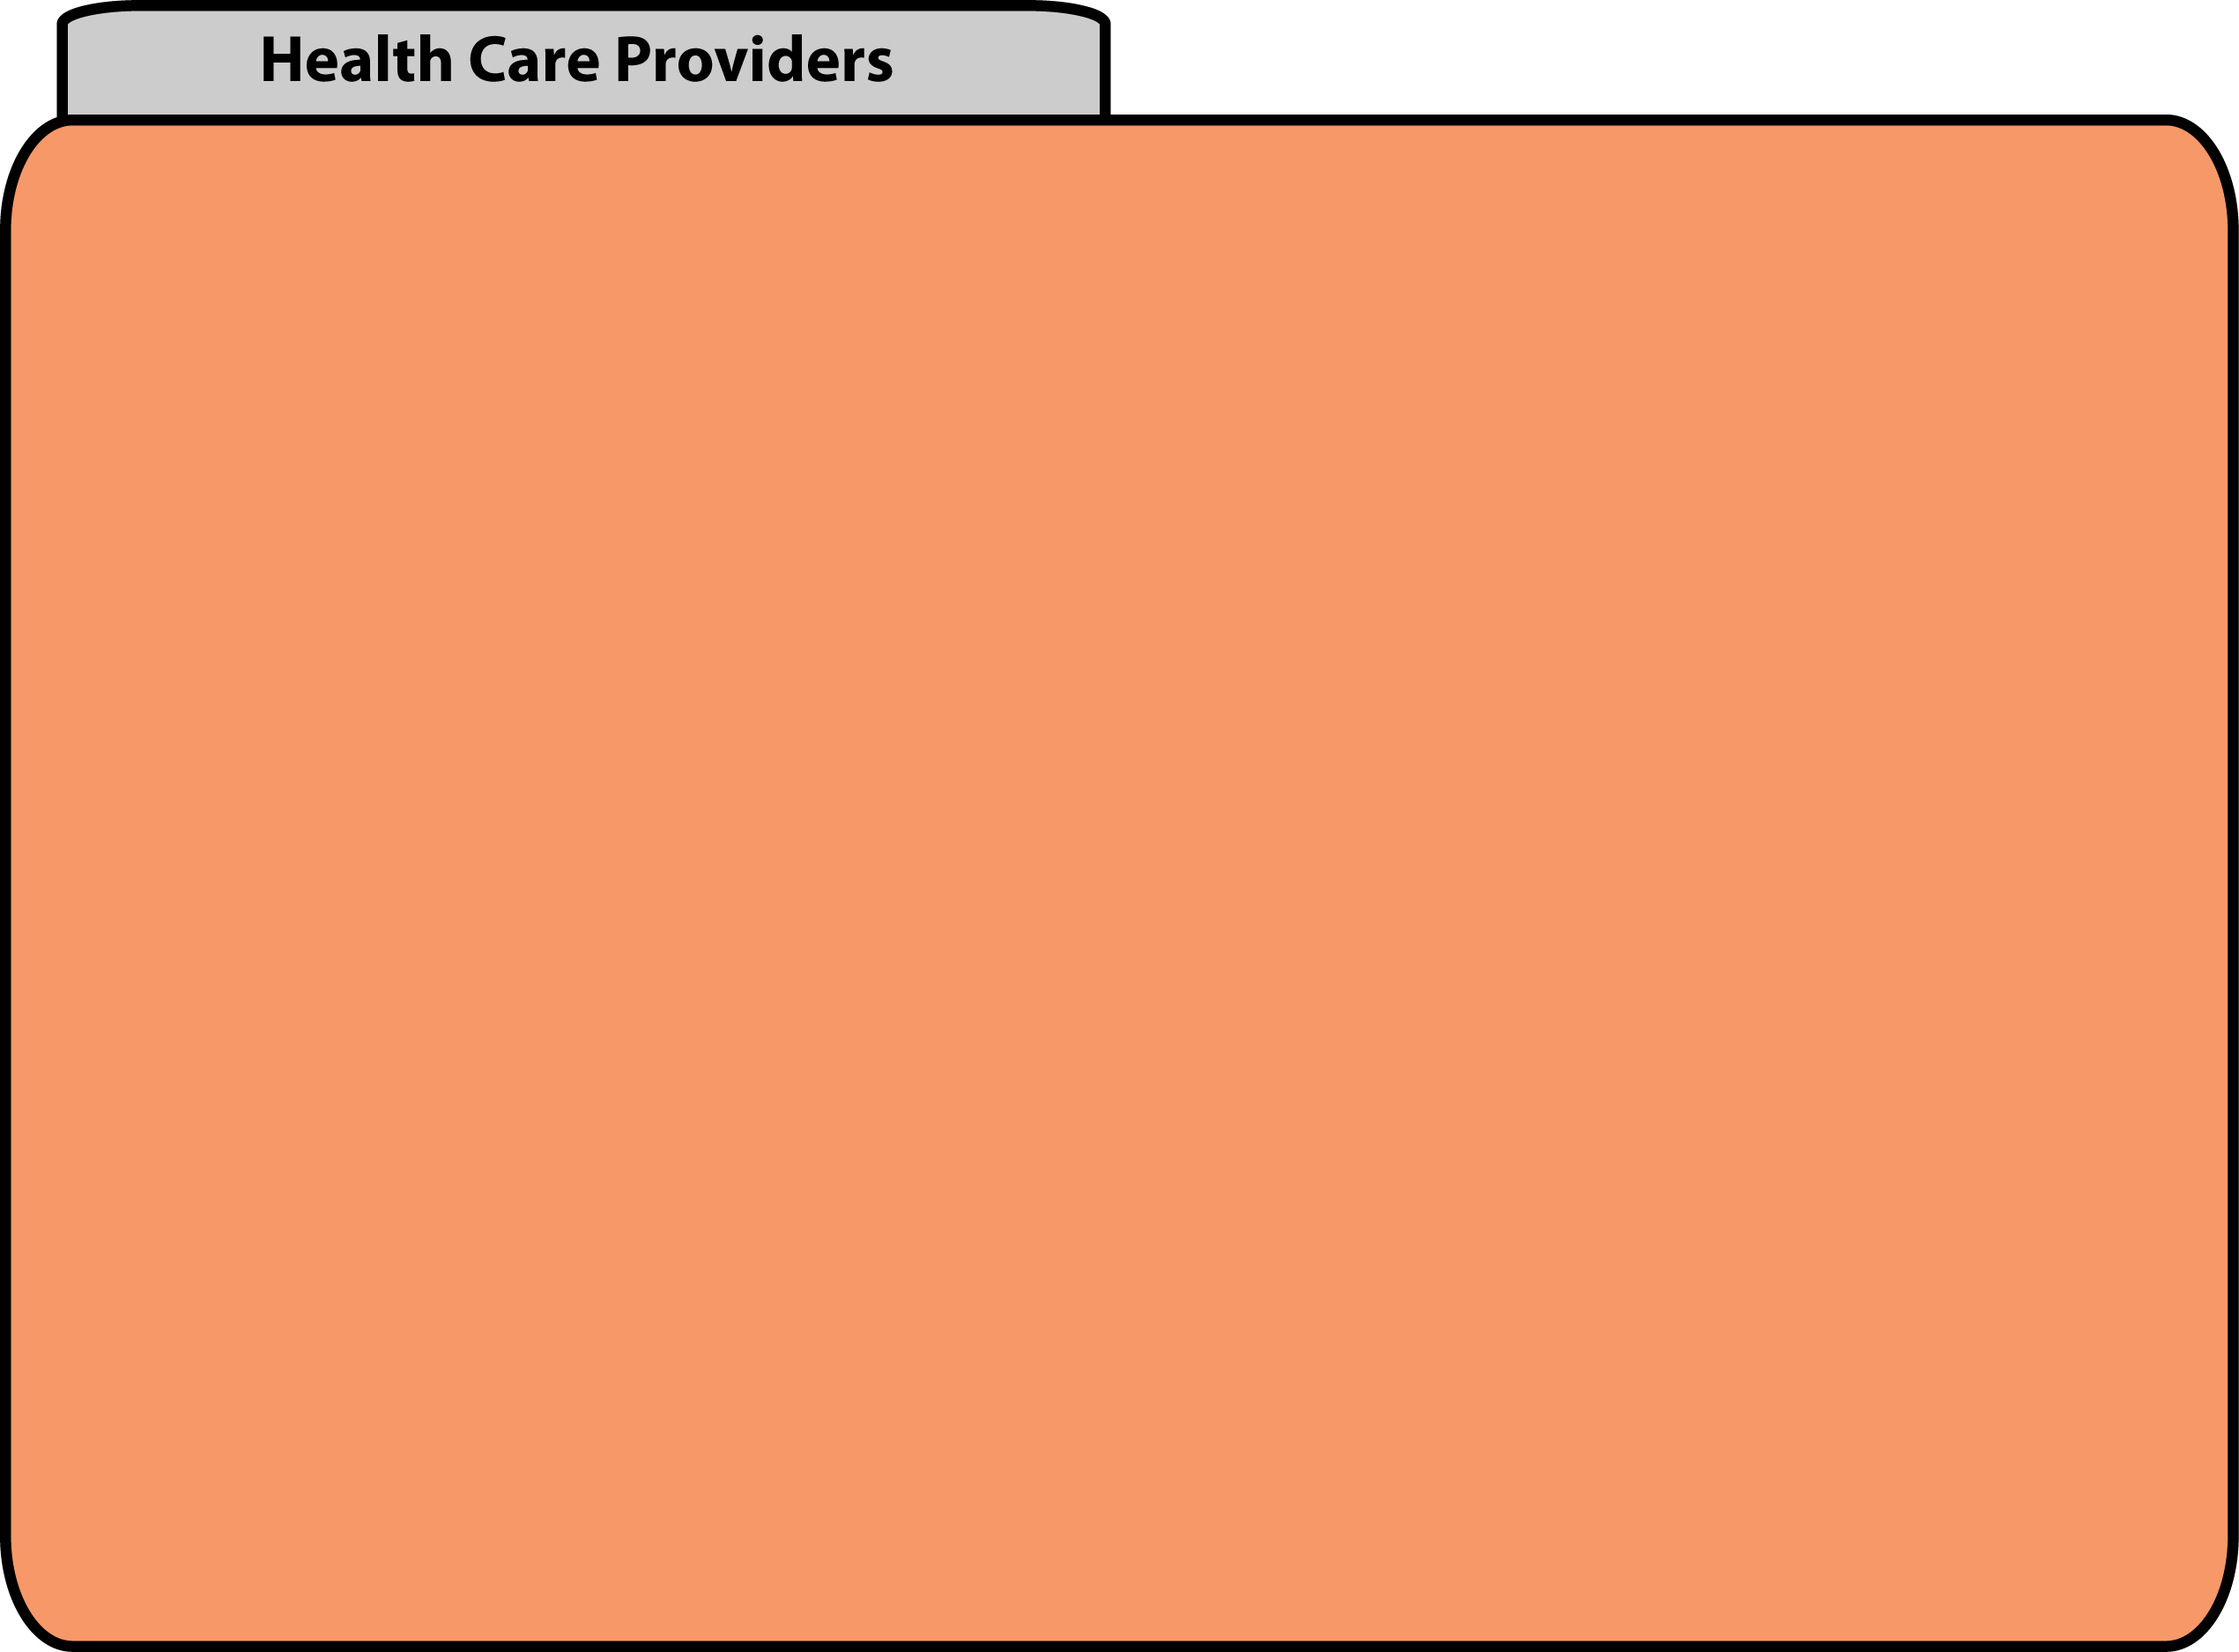
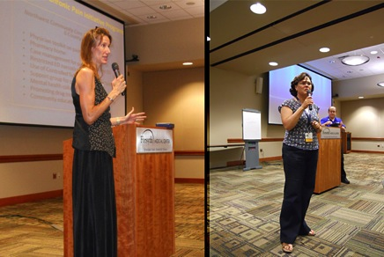
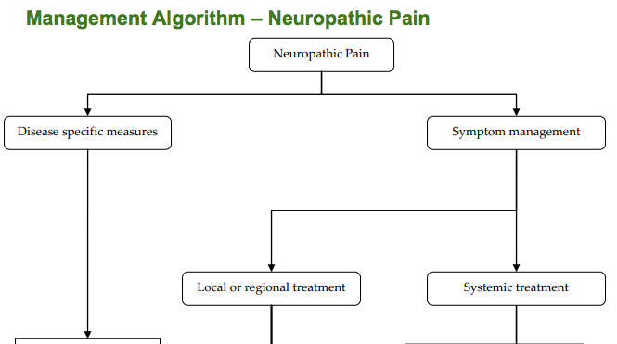
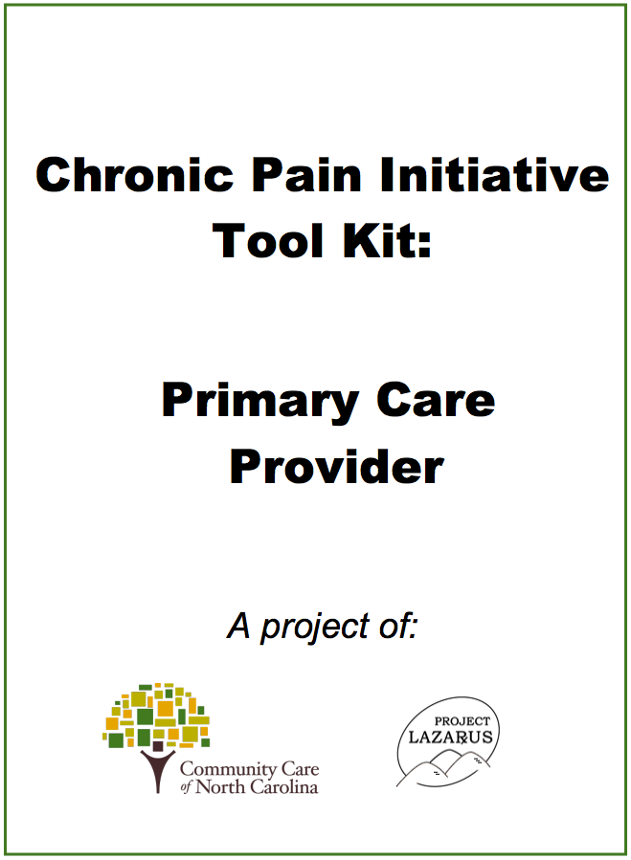
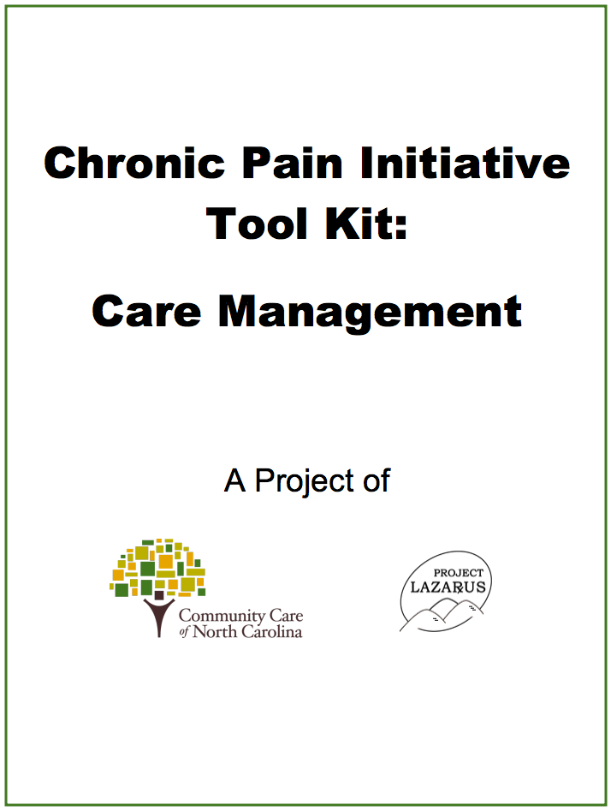
Prescriber Education: Chronic Pain Initiative
Pain management education is being conducted statewide through Medicaid.
Locally-designed toolkits created by community coalitions have more legitimacy than those produced at a national level.
Registered to Use the PMP
Wilkes: 70%
NC Average: 28%

Slide 30
Prescriber Education: Chronic Pain Initiative
Introduction
Section I. Opioids in the Management of Chronic Pain
Opioids in the Management of Chronic Pain: An Overview
Section II. Assessment and Management Algorithms
Universal Precautions for Pain Medicine Prescribing
Assessment Algorithm
Management Algorithm
Management Algorithm ––Neuropathic Pain
Section III. Patient Treatment Records
Pain Management Agreement
Chronic Pain Management Progress Note
Section IV. Opioid Overdose Prevention
How to Prevent an Opioid Overdose
How to Recognize and Reverse and Opiod Overdose
How to Make an Overdose Plan
Section V. Prescriber and Patient Education Materials and Resources
Chronic Pain Overview
Resource Links
Section VI. Screening Forms and Brief Intervention
Annual Screening Questionnaire
SBIRT Audit Form
SBIRT DAST-10 Form
Template for Scoring the SBIRT-Audit Form/ DAST-10
The CRAFFT Screening Interview
Narcotics Utilization Report/Explanation
Interpreting Urine Toxicology Screens
Section VII. Controlled Substance Reporting System (CSRS) and Medicaid Pharmacy Lock-In Program
Controlled Substance Reporting System
DMA Lock-in Program
Lock-in Referral Form

Slide 31
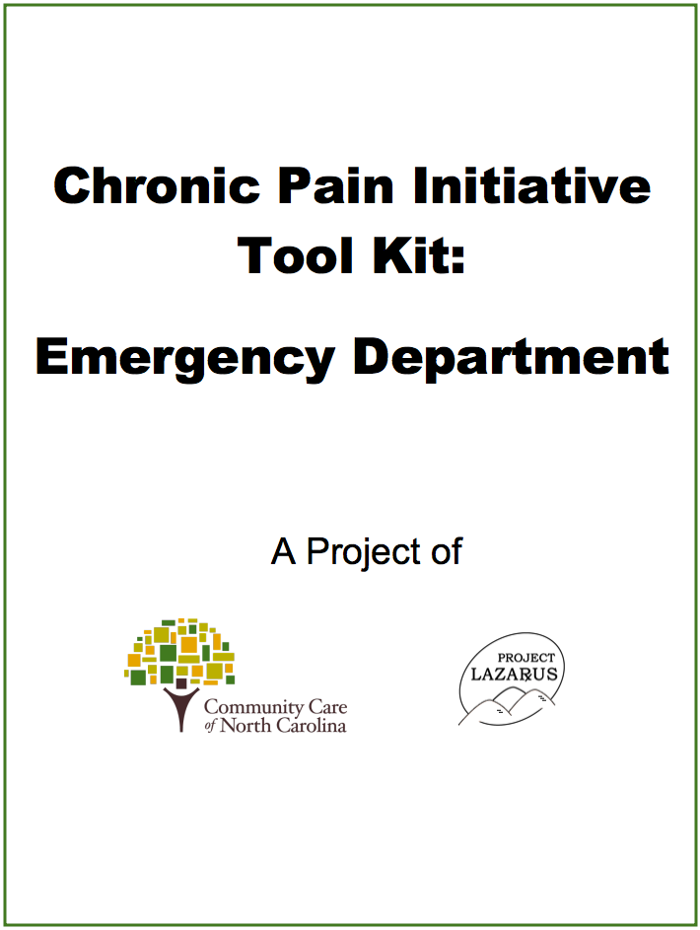
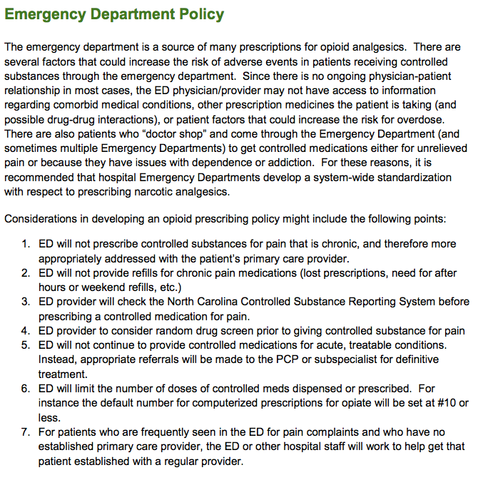
Hospital ED Dispensing Policy
Managing chronic pain patients in the ED can be supported with tight policies and case management.

Slide 32
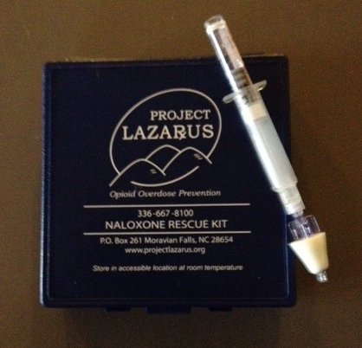
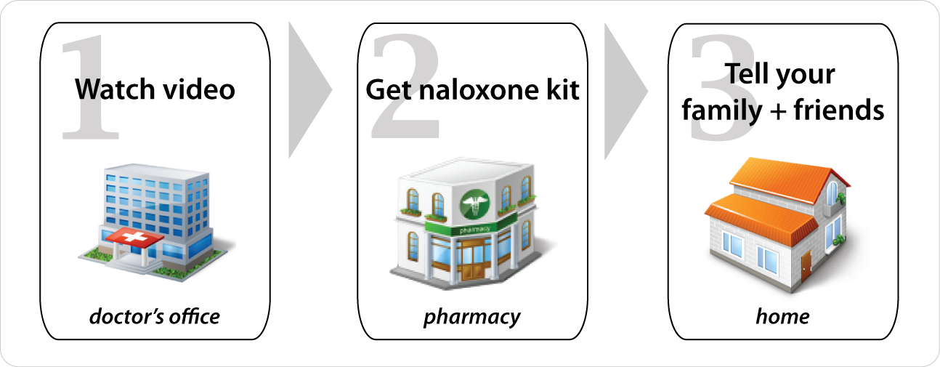
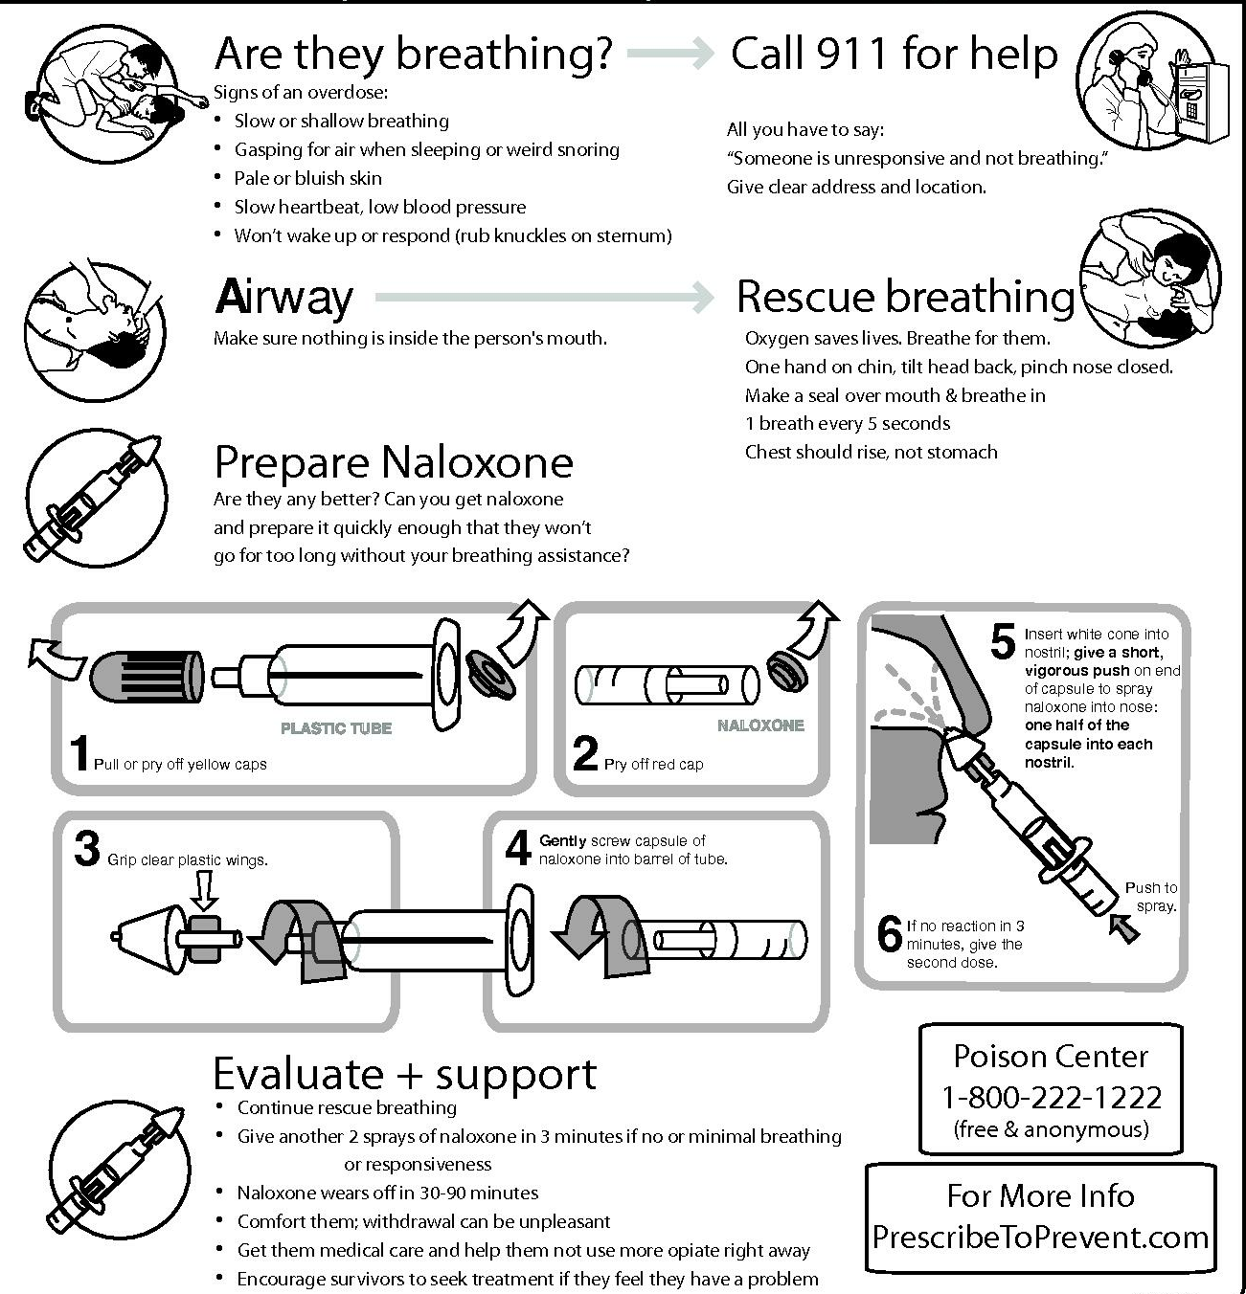
Risk Reduction
“The [NC Medical] Board encourages its licensees to abide by the protocols employed by Project Lazarus and to cooperate with the program’s efforts to make naloxone available to persons at risk of suffering drug overdose.”
August 2008 (ncmedboard.org)
“Educating both physicians and patients about the availability of naloxone and supporting the accessibility of this lifesaving drug will help to prevent unnecessary deaths. AMA, June 19, 2012
A script gives patients specific language that they can use with their family to talk about overdose and develop an action plan, similar to a fire evacuation plan.

Slide 33
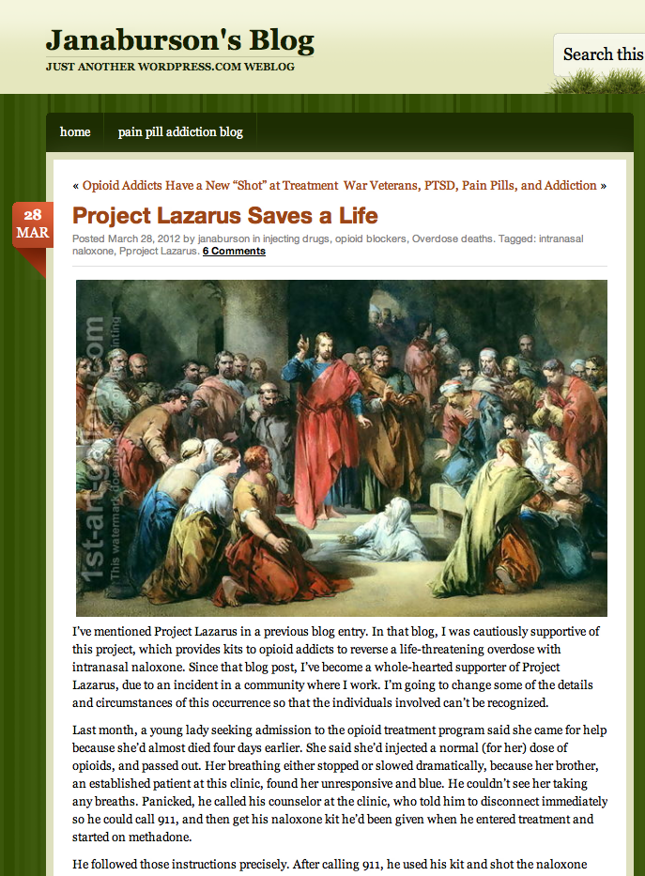
Rescue Medication
Addiction medicine doctors count lives saved with take-home naloxone.
“I’m not ready to die. I’m only 26 years old. I always thought people who died from drugs didn’t know how to do them right and took too much. But I took the same amount I’m used to taking. I don’t know why I overdosed that time. It made me see I’ve got to do something different if I want to stay alive. My brother was a worse addict than me, and I’ve seen him change his life since he’s been on methadone. I want that too.”

Slide 34

Rescue Medication – US Army
Operation OpioidSAFE
Operation OpioidSAFE is a novel provider, patient and community education program with the added advantage of lay person diagnosis and reversal of opioid overdose.
Lt Colonel Anthony Dragovich MD
Medical Director, Pain Medicine
Ft. Bragg, NC

Slide 35
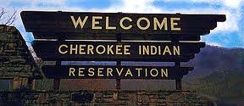
Rescue Medication
Qualla Boundary
Eastern Band of the Cherokee Indians
NC Medicaid
Emergency Departments
NC Opioid Treatment Programs (OTP)
Law Enforcement – NADDI –
Quincy, MA & Suffolk Cty, NY
Jails
First Responders
NM, OH, ME, NY, MA, CA, etc.

Slide 36
Rescue Medication
NADDI supports nasal naloxone
The National Association of Drug Diversion Investigators (NADDI) has taken a position to encourage law enforcement agencies to adopt policies that would allow officers to carry nasal naloxone with them to administer to individuals involved in a an opioid overdose. Proper training and certification by the proper authority of each state helps to ensure proper use of nasal naloxone on those in distress due to a drug overdose.
It is the opinion of the NADDI Executive Board that the ready availability of this product will ultimately save many lives, as police officers are oftentimes the first responders where delays of only a few seconds can mean the difference between life and death. www.naddi.org

Slide 37
Prescribing Data from PMP
Substance Abuse
Mental Health
Pain
TBI
PTSD
Source: NC CSRS

Slide 38
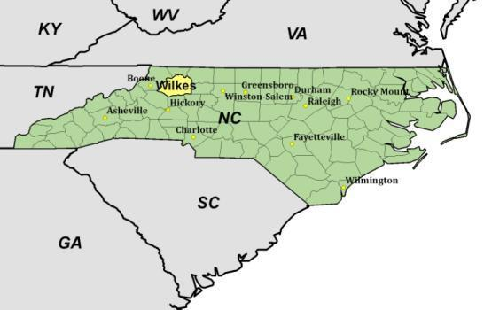
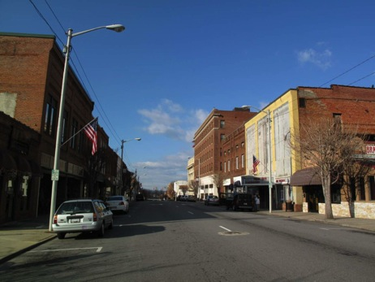
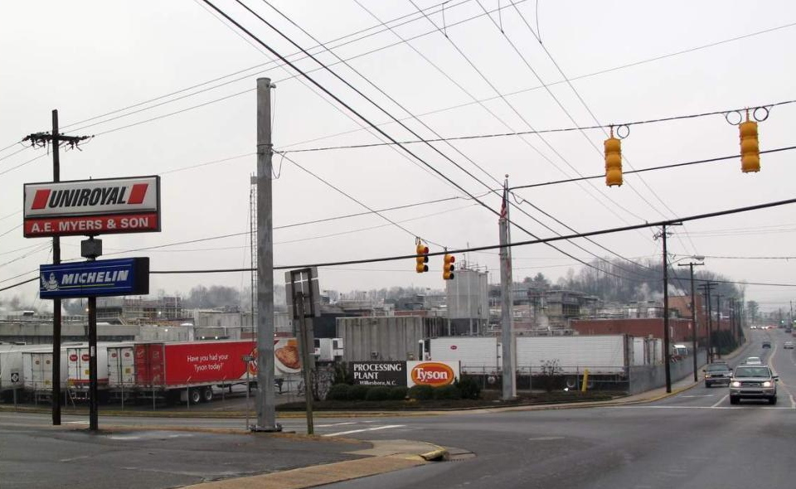
Pilot Project Setting
Wilkes County had the 3rd highest overdose death rate in the nation in 2007, due exclusively to prescription opioid pain relievers.
Manual labor dominates employment options in this county of 68,000.

Slide 39
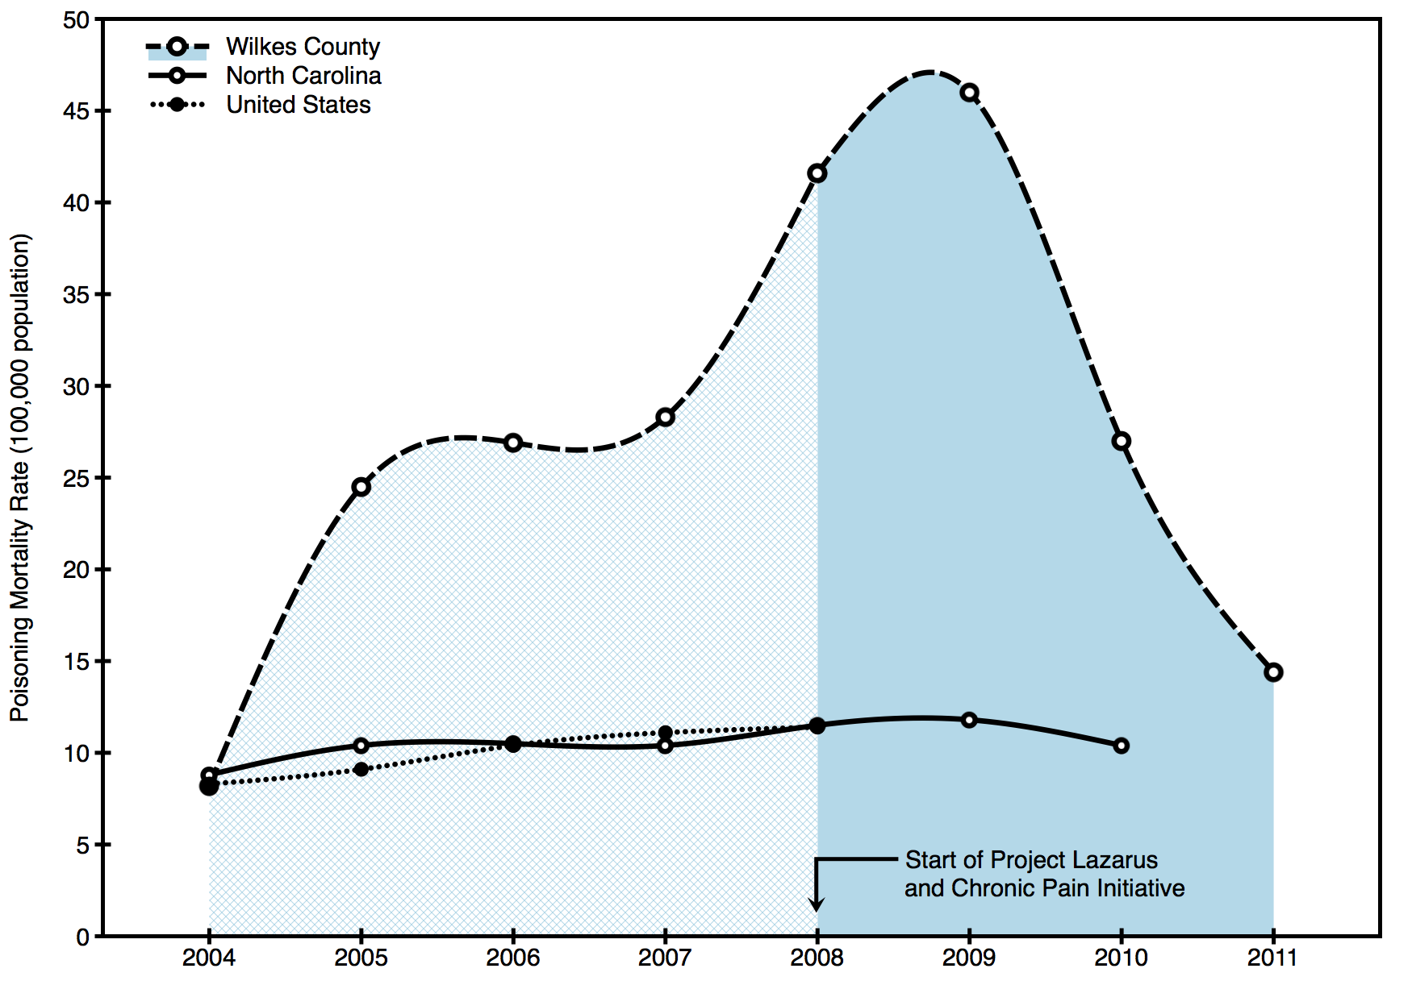
Results: Opioid Prescribing
The overdose death rate dropped 71% in two years after the start of Project Lazarus and the Chronic Pain Initiative.
Source: Wilkes Co. Health Department; NC SCHS; CDC Wonder

Slide 40
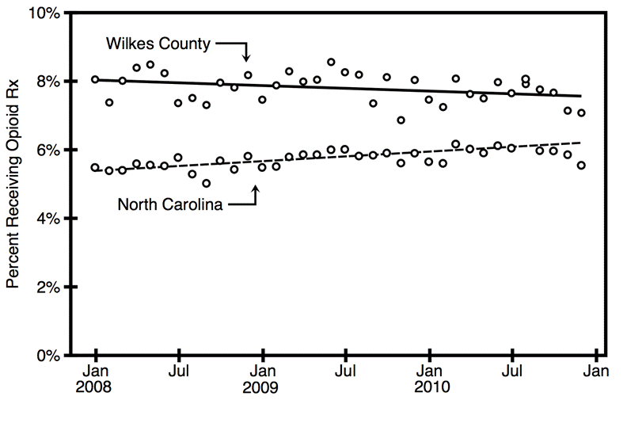
Results: Opioid Prescribing
Wilkes County had higher than state average opioid dispensing during the implementation of Project Lazarus and the Chronic Pain Initiative. Access to prescription opioids was not dramatically decreased.
Source: NC CSRS

Slide 41
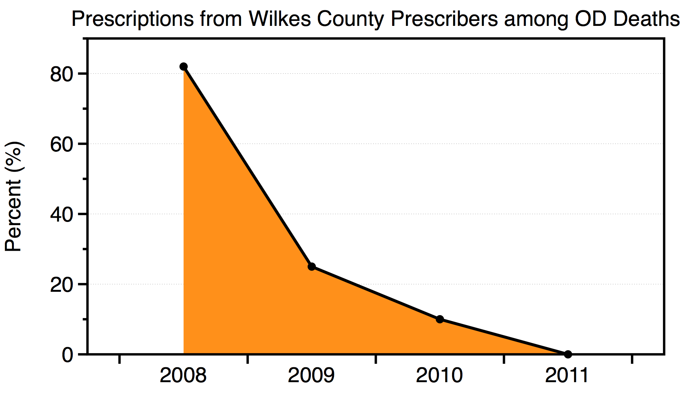
Results
In 2011, not a single OD decedent had an opioid prescription from a Wilkes County prescriber. The fundamental risk:benefit ratio for opioids can be altered for the better through a community-wide approach.
Source: Wilkes Co. Health Department

Slide 42
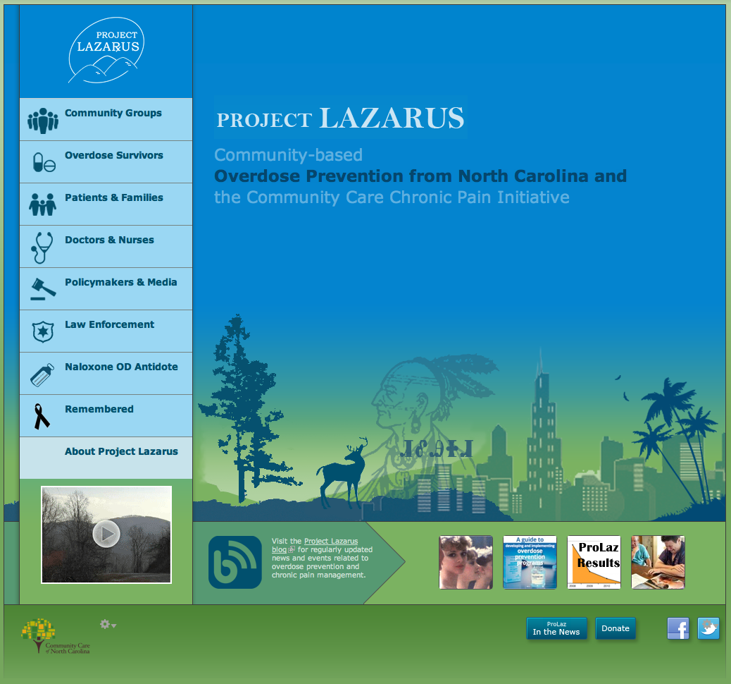
projectlazarus.org communitycarewnc.org

