Slide 1
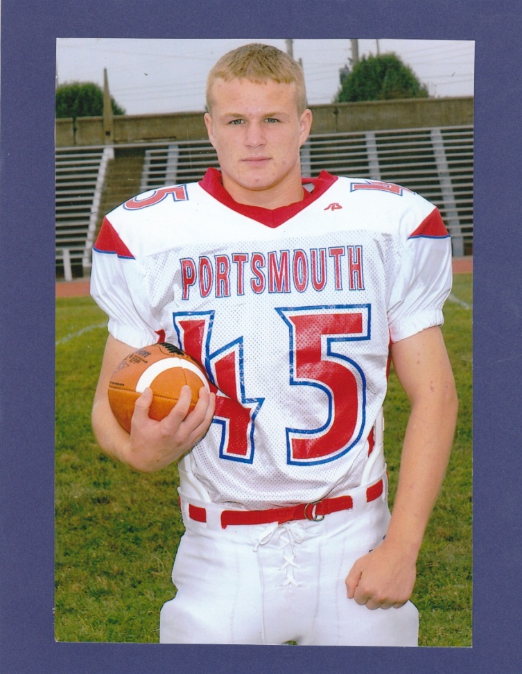
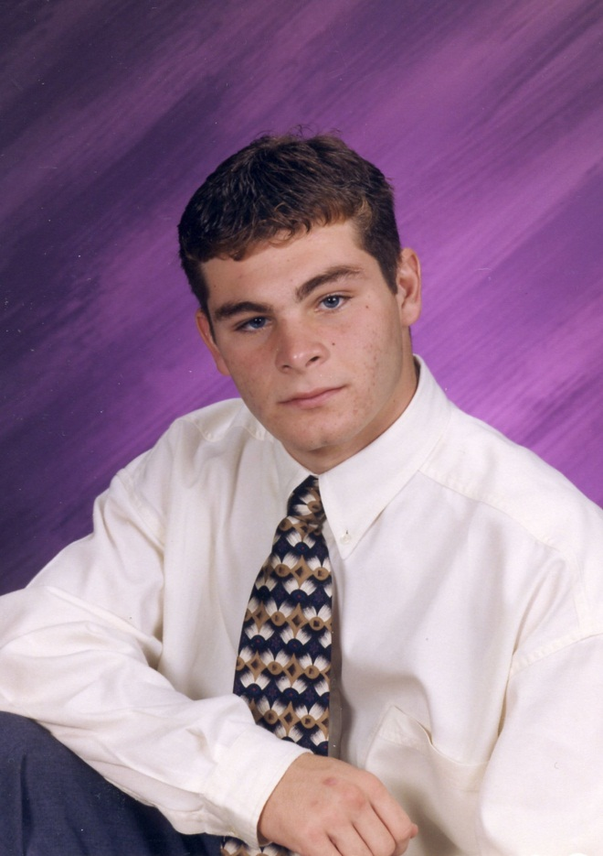
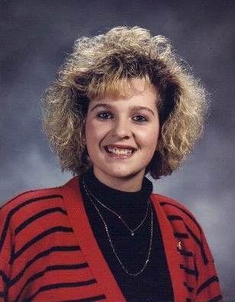
Wes Workman Kent Piatt Leslie Cooper 10/31/89 – 4/22/08 7/20/80 – 8/28/00 10/20/74 – 10/3/09

Slide 2
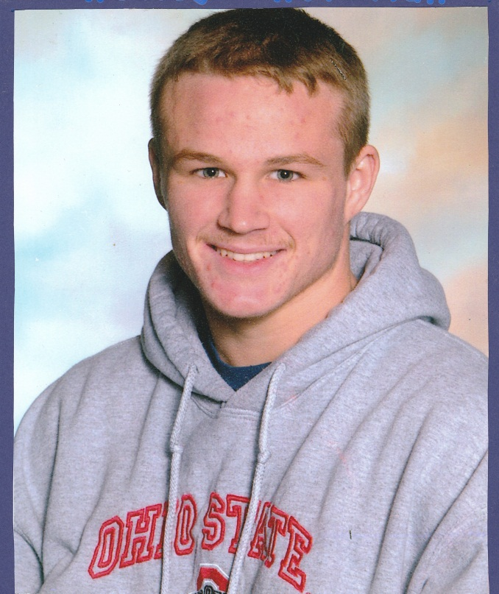
SOLACE founded on April 20, 2010
Solace – to seek comfort
Surviving Our Loss And Continuing Everyday
Presenter:
Jo Anna Krohn, Executive Director
& Statewide Chair for SOLACE Expansion
In memory of Wes Workman
Oct. 31, 1989 – April 22, 2008
DISCLOSURES: None

Slide 3
Scioto County Rankings 2010: the cold hard facts
3rd highest fatal overdose rate from Rx drugs
Highest Hepatitis C and B rate
Highest homicide rate (Rx crime driven)
10 pain clinics (pill mills) in Scioto County (50% owned by convicted drug felons)
9.7 pain pills dispensed (enough for 123 doses per person)
Home to the #1 prescriber of Oxycontin in the nation.

Slide 4
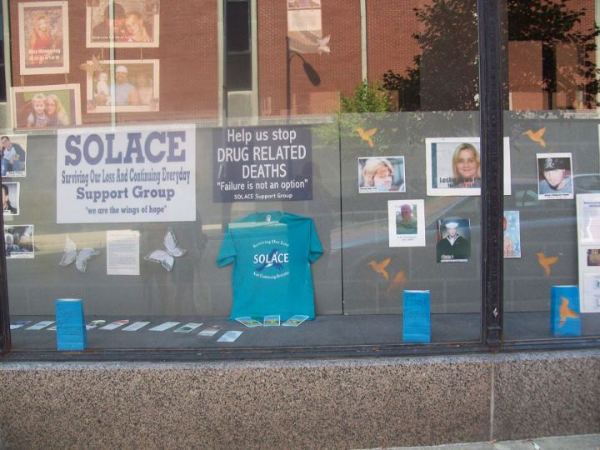
SOLACE puts a “face” to the drug epidemic

Slide 5
“Taking Action”
COALITION BUILDING:
Scioto Co. Health Commissioner declared Public Health Emergency & formed the Scioto County Rx Drug Action Team
ENGAGING THE COMMUNITY:
Pill Mill Protests (Farewell Tour 2010)
“Be the Wall Against Drugs” campaign and SOLACE (Surviving Our Loss And Continuing Everyday) is born!
Ignited a community revolt against occupation by criminal enterprises in the form of pill mills

Slide 6
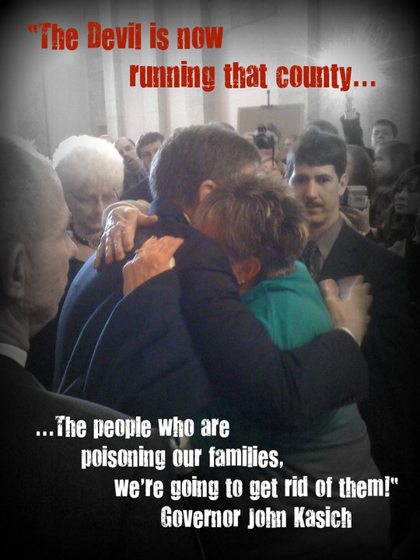
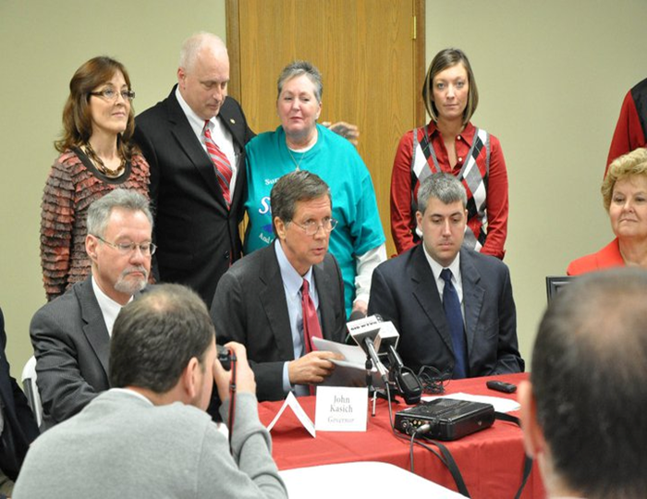
March 2011 Scioto County is made “Ground Zero”

Slide 7
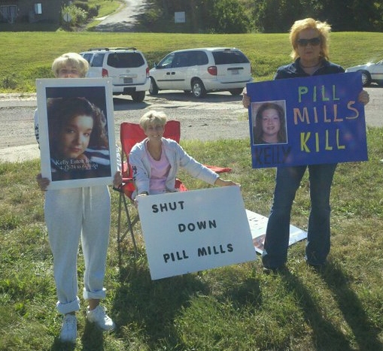
Farewell Tour 2010

Slide 8
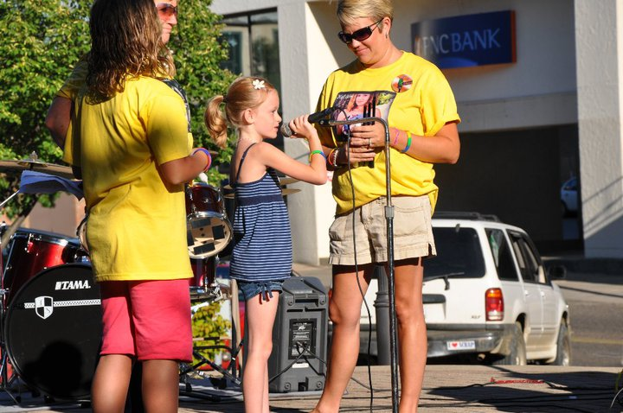
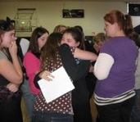
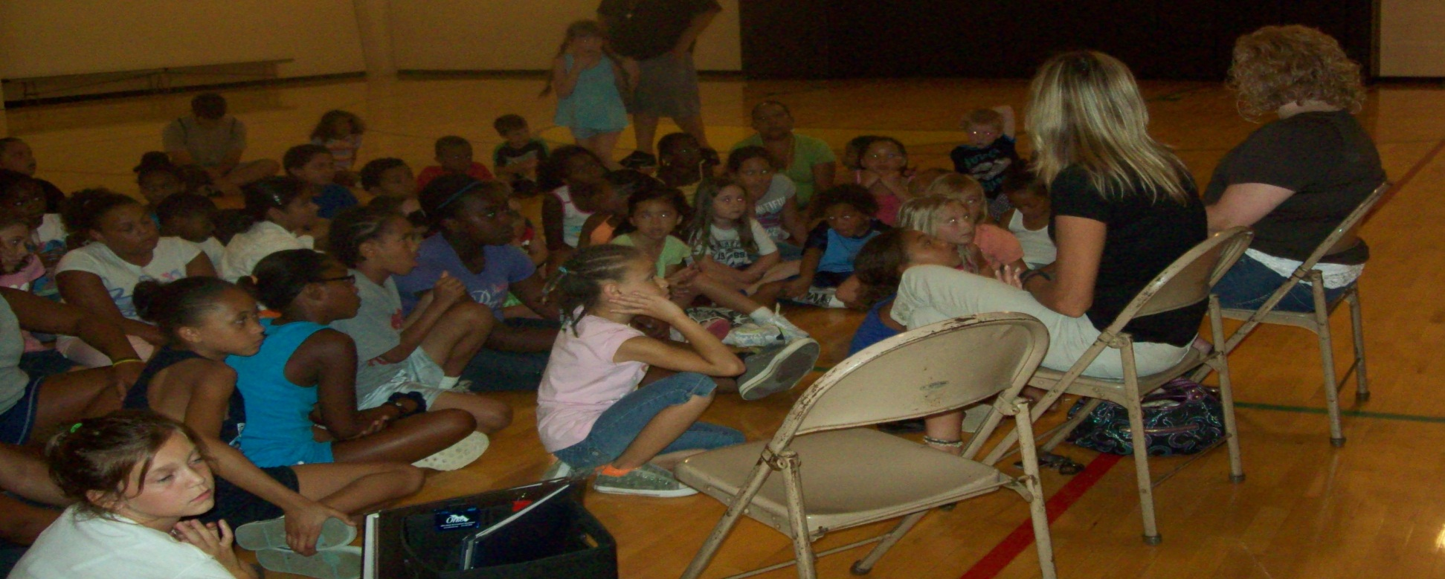
Engaging & Educating Our Youth

Slide 9
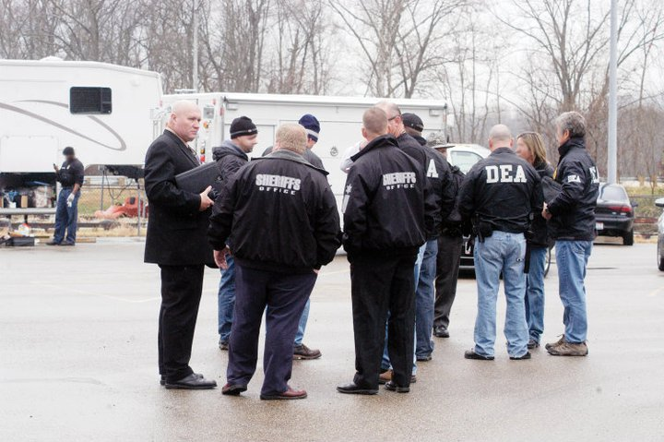
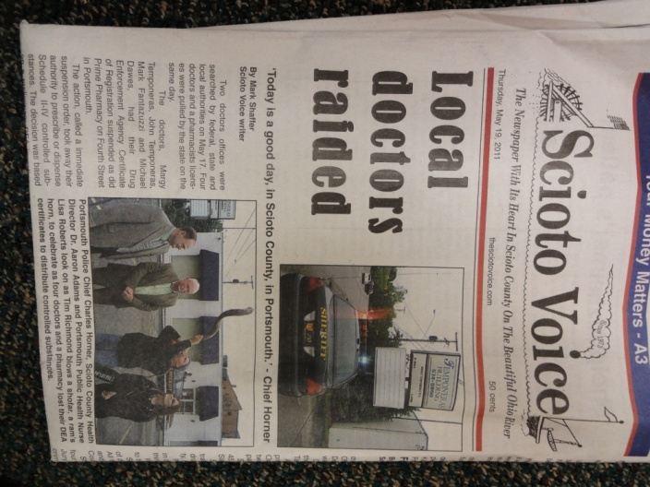
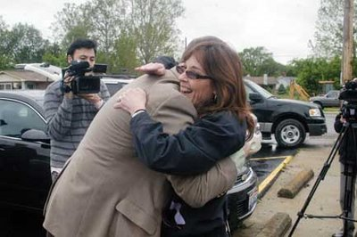
USDOJ-Operation Deliverance “Independence Day” May 17, 2011
Five physicians suspended, one pharmacist suspended
One physician convicted 2011
Three clinic owners indicted 2011
90% reduction in Pill Mills achieved
by combined efforts

Slide 10
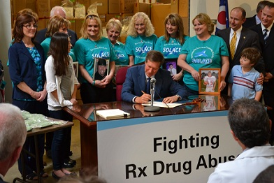
Success!
May 20, 2011-HB93 signed

Slide 11
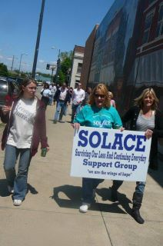
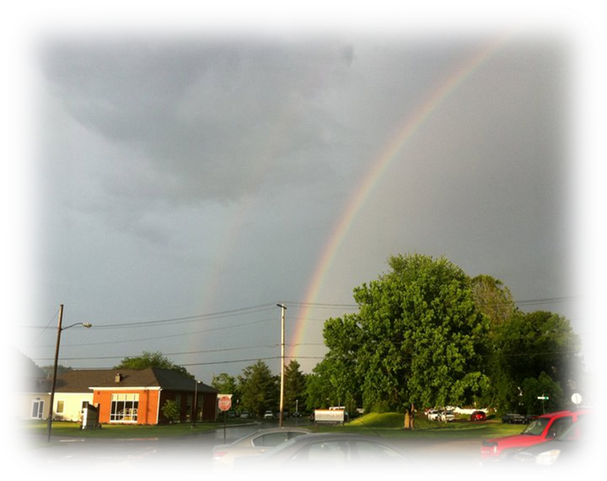
Faith Based
“7 Marches in 7 Weeks”
The end of the 7th March – God blessed us with a double rainbow!

Slide 12
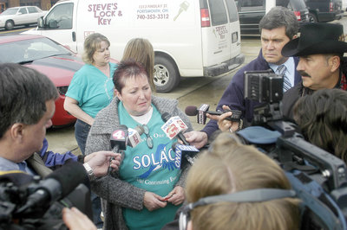
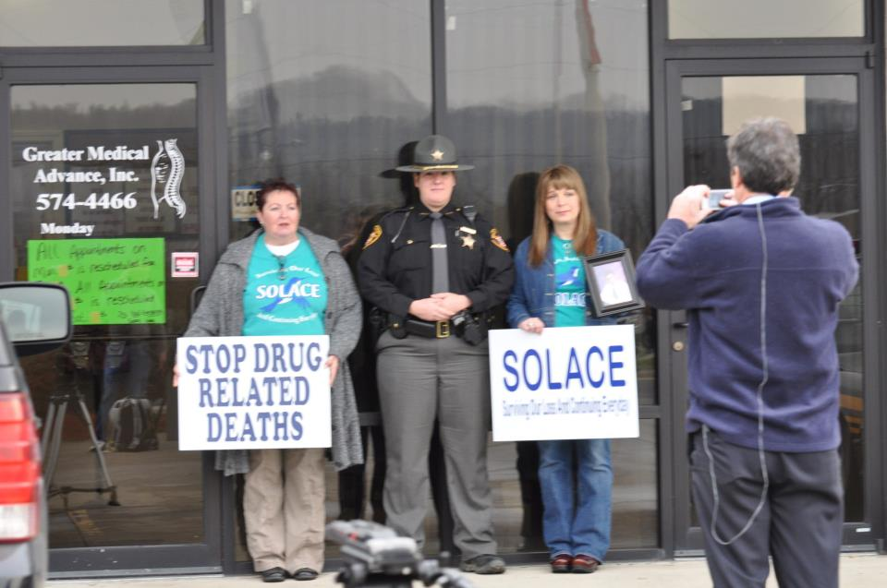
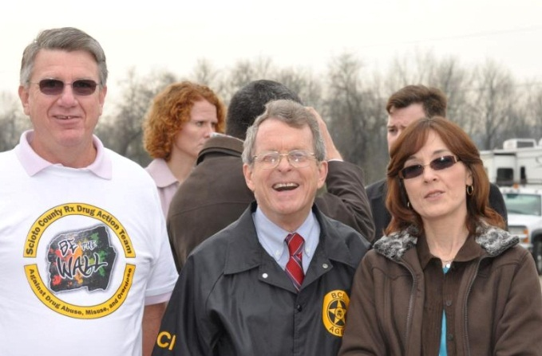
Scioto County celebrates Last Pain Clinic CLOSED! Corporative effort between state and local law enforcement
Barbara Howard speaks about her daughter Leslie Cooper. Leslie had obtained a prescription at this clinic the day before she died.

Slide 13
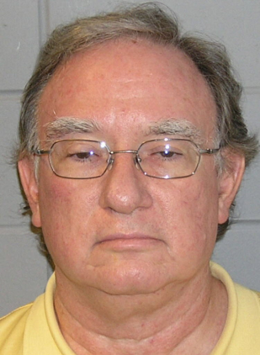
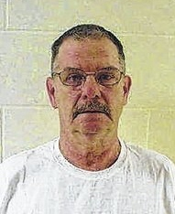
New precedent set in the state of Ohio If you do the crime you will do the time
Pill Mill Dr. Paul Volkman, Gets 4 Life Terms In Drug Overdose Case Pain Clinic Owner Marshall Adkins was sentenced to 10 yrs. for engaging in a pattern of corrupt activity, permitting drug abuse, aggravated trafficking in drugs & forgery.

Slide 14
Scioto County: Cold Hard Facts 2011 Shows Improvement!
By the end of December ALL pain clinics were closed (from 10 – 0).
There were 1.5 million fewer pills prescribed in our county than the previous year.
Our number one prescriber has lost her license.
12 fewer people died from drug related deaths in Scioto County in 2011!

Slide 15
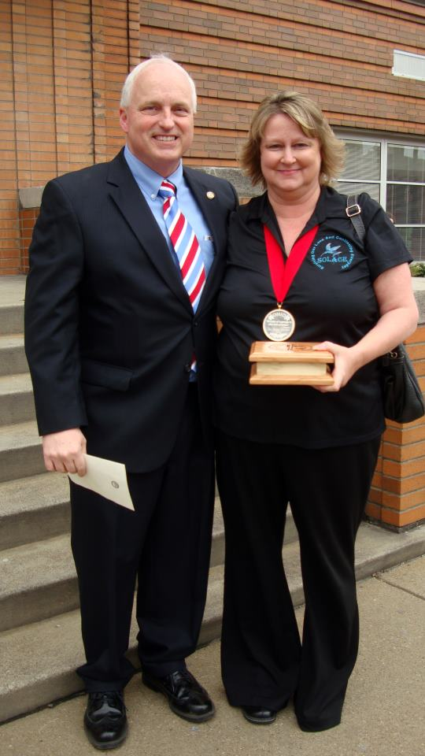
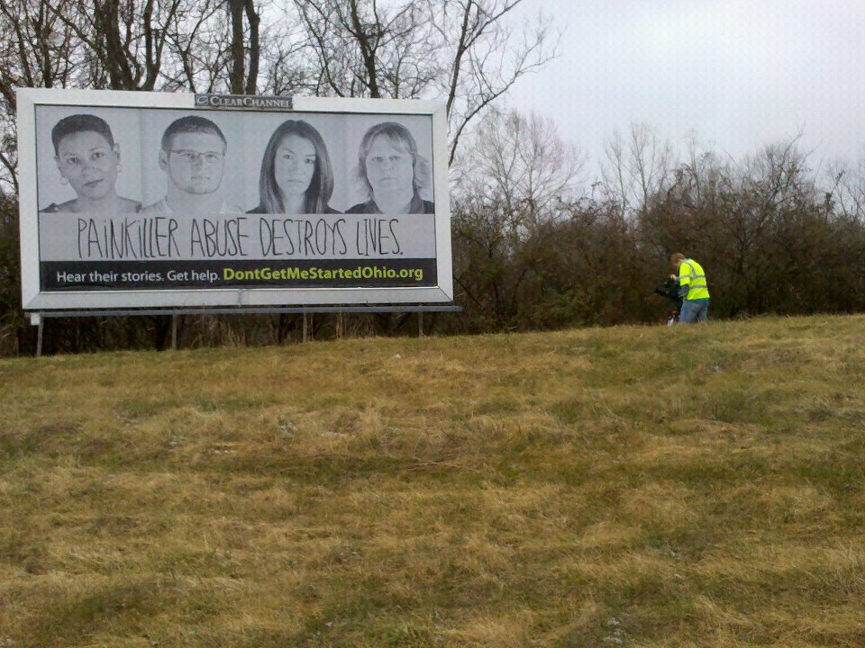
Don’t Get Me Started
Campaign
State Rep. Dr. Terry Johnson with Jo Anna Krohn after Gov. Kasich presented Jo Anna with the first Medal of Courage.

Slide 16


SOLACE Statewide Expansion A priority of
In partnership with SOLACE of Portsmouth and

