Slide 1
Drug Abuse 101
Presented by: Gloria M. Miele, Ph.D.
Training Director
Greater New York Node

Slide 2
Training Outline & Goal
Review of drugs of abuse
Intoxication syndromes of various drug classes
Withdrawal syndromes of various drug classes
DSM-IV substance abuse criteria
DSM-IV substance dependence criteria
Commonly used methods and procedures to evaluate substance use, abuse and dependence measures
Notes:
Lesson descriptions should be brief.

Slide 3
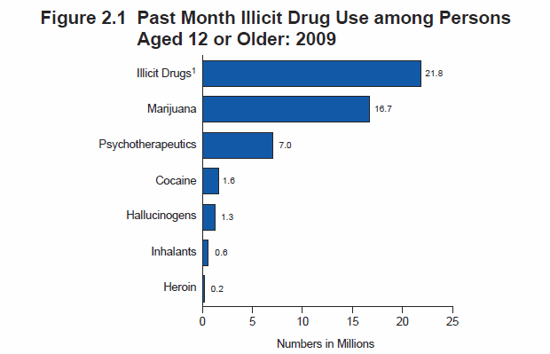
http://oas.samhsa.gov/NSDUH/2k9NSDUH/2k9ResultsP.pdf

Slide 4



Drugs of Abuse
Alcohol and other Sedatives
  Benzodiazepines – Valium, Ativan, Xanax, downers
  Barbiturates – Phenobarbital, Seconal, reds, yellows
  Rohypnol – Date rape drug, roofies
  Other sedatives – GHB, Qaaludes

Slide 5

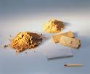

Drugs of Abuse
Heroin and other Opiates
  Heroin – Dope, smack, H, horse
  Opiates – Oxycodone HCL, Codeine, Morphine, Dilaudid, Vicodin, Percocet, Hydrocodone, Fentanyl, methadone, suboxone (Buprenorphine)

Slide 6

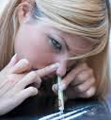

Drugs of Abuse
Cocaine and other Stimulants
  Cocaine - Blow, coke, crack, rock, toot
  Methamphetamine - Crank, crystal, ice, meth

Slide 7

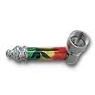
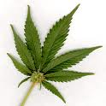
Drugs of Abuse
Cannabinoids
  Marijuana (Cannabis) – blunt, dope, ganja, grass, herb, joints, pot, reefer, weed, hash
  Synthetic formulations – Spice, K2

Slide 8



Drugs of Abuse
Psychedelics
  Hallucinogens - LSD, Mescaline, peyote, Psilocybin, shrooms
  Dissociative drugs - Ketamine, Special K, PCP, angel dust
  MDMA - ecstasy
      Psychedelic and Stimulant

Slide 9
Substance
Intoxication and Withdrawal

Slide 10
Intoxication
Substance specific syndrome due to recent ingestion of a substance
Clinically significant, maladaptive behavioral or psychological changes
Symptoms not due to general medical condition or another mental disorder

Slide 11
Withdrawal
Substance-specific syndrome due to stopping or cutting down on heavy and prolonged substance use
Causes clinically significant impairment or distress
Not due to general medical condition or another mental disorder

Slide 12
Alcohol Intoxication
Inappropriate sexual or aggressive behavior
Mood lability
Impaired judgment
Impaired social/occupational functioning

Slide 13
Alcohol & Sedative Intoxication & Withdrawal Syndromes
Alcohol & Sedative | Intoxication (1 or more) | Withdrawal (2 or more)
 | Slurred speech | Autonomic hyperactivity
 | Incoordination | Increased hand tremor
 | Unsteady gait | Psychomotor agitation
 | Nystagmus | Nausea and vomiting
 | Impairment in attention and memory | Hallucination or illusions
 | Stupor or coma | Insomnia
 |  | Anxiety
 |  | Grand mal seizure

Slide 14
Heroin/Opiate Intoxication
Initial euphoria followed by apathy
Dysphoria
Psychomotor agitation or retardation
Impaired judgment
Impaired social or occupational functioning

Slide 15
Heroin & other Opiates Intoxication & Withdrawal Syndromes
Heroin & other Opiates | Intoxication (2 or more) | Withdrawal (3 or more)
 | Constricted pupils | Dilated pupils, sweating, piloerection
 | Drowsiness or coma | Insomnia
 | Slurred speech | Dysphoric mood
 | Impairment in attention or memory | Nausea or vomiting
 |  | Muscle aches
 |  | Water eyes, runny nose
 |  | Diarrhea
 |  | Yawning
 |  | Fever

Slide 16
Cocaine/Stimulant Intoxication
Euphoria or affective blunting
Changes in sociability
Hypervigilance
Interpersonal sensitivity
Anxiety, tension or anger
Impaired judgment
Impaired social or occupational functioning

Slide 17
Cocaine/Other Stimulant Intoxication & Withdrawal Syndromes
Cocaine & other Stimulants | Intoxication (2 or more) | Withdrawal (* plus 2)
 | Heart racing | Dysphoric mood*
 | Dilated pupils | Fatigue
 | Elevated/lowered blood pressure | Vivid unpleasant dreams
 | Perspiration or chills | Trouble sleeping
 | Nausea or vomiting | Increased appetite
 | Evidence of weight loss
 | Psychomotor agitation or retardation | Psychomotor retardation or agitation
 | Muscle weakness, cardiovascular effects
 | Confusion, seizures, coma

Slide 18
Cannabis Intoxication
Impaired motor coordination
Euphoria
Anxiety
Sensation of slowed time
Impaired judgment
Social withdrawal

Slide 19
Cannabis Intoxication & Withdrawal Syndromes
Cannabis | Intoxication (2 or more) | Withdrawal (proposed for DSM-5)
 | Red eye | Irritability, anger or aggression
 | Increased appetite | Nervousness or anxiety
 | Dry mouth | Sleep difficulty (insomnia)
 | Heart racing (tachycardia) | Decreased appetite or weight loss
 |  | Restlessness
 |  | Depressed mood
 |  | At least on of the following physical symptoms causing significant discomfort: stomach pain, shakiness/tremors, sweating, fever, chills, headache
Notes:
6.
7.

Slide 20
Hallucinogen Intoxication
Marked anxiety or depression
Ideas of reference
Fear of losing one’s mind
Paranoid ideation
Impaired judgment
Impaired social or occupational functioning

Slide 21
Hallucinogen Intoxication & Withdrawal Syndromes
Hallucinogens | Intoxication (2 or more) | Withdrawal
 | Dilated pupils
 | Tachycardia
 | Sweating
 | Palpitations
 | Blurred vision
 | Tremors
 | Incoordination

Slide 22
Hallucinogen Persisting Perception Disorder
Perceptual flashbacks
  Flashes of color
  Image trails
  Halos around objects
  Other false perceptions

Slide 23



Inhalant Intoxication
Belligerence
Assaultiveness
Apathy
Impaired judgment
Impaired social or occupational functioning

Slide 24
Inhalant Intoxication & Withdrawal Syndromes
Inhalants | Intoxication (2 or more) | Withdrawal
 | Dizziness, incoordination, or unsteady gait
 | Nystagmus
 | Lethargy
 | Psychomotor retardation (Depressed reflexes)
 | Tremor
 | Generalized muscle weakness
 | Blurred vision or diplopia
 | Stupor or coma
 | Euphoria

Slide 25
Nicotine Intoxication & Withdrawal Syndromes
Nicotine | Intoxication | Withdrawal (4 or more)
 |  | Irritability, frustration or anger
 |  | Dysphoric or depressed mood
 |  | Insomnia
 |  | Anxiety
 |  | Difficulty concentrating
 |  | Restlessness
 |  | Decreased heart rate
 |  | Increased appetite or weight gain

Slide 26
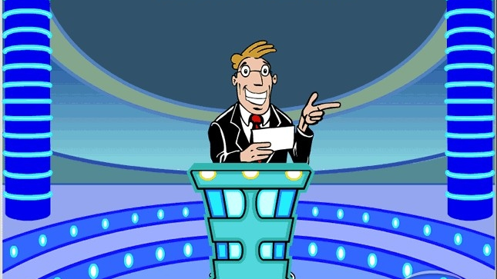
Name that High

Slide 27

Information
http://www.nida.nih.gov

Slide 28
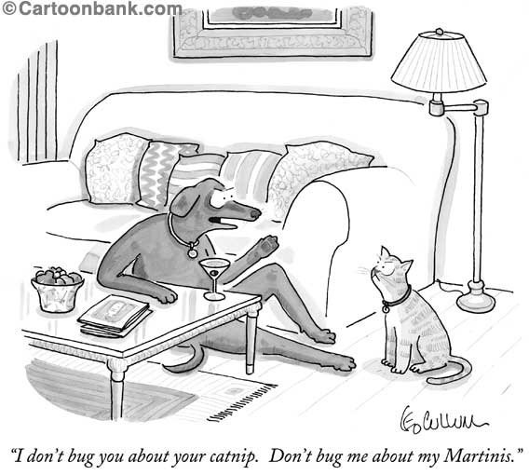
Substance Abuse
vs.
Substance Dependence

Slide 29
Substance Abuse vs. Substance Dependence
Abuse – consequences related to use
Dependence
  Physiological symptoms
  Loss of Control

Slide 30
DSM-IV substance abuse criteria
A) A maladaptive pattern of substance use leading to clinically significant impairment or distress, as manifested by one (or more) of the following, occurring within a 12-month period:

Slide 31
Failure to Fulfill Major Role Obligations
Recurrent substance use resulting in a failure to fulfill major role obligations at work, school, or home (e.g., repeated absences or poor work performance related to substance use; substance-related absences, suspensions, or expulsions from school; neglect of children or household)

Slide 32
Substance Use in Dangerous Situations
Recurrent substance use in situations in which it is physically hazardous (e.g., driving an automobile or operating a machine when impaired by substance use)

Slide 33
Legal Problems
Recurrent substance-related legal problems (e.g., arrests for substance-related disorderly conduct)

Slide 34
Continued Use Despite Social Problems
Continued substance use despite having persistent or recurrent social or interpersonal problems caused or exacerbated by the effects of the substance (e.g., arguments with spouse about consequences of intoxication, physical fights)

Slide 35
DSM-IV substance abuse criteria
AND…
B) The symptoms have never met the criteria for Substance Dependence for this class of substance.

Slide 36
DSM-IV Substance Dependence
A maladaptive pattern of substance use, leading to clinically significant impairment or distress, as manifested by three (or more) of the following, occurring at any time in the same 12-month period:

Slide 37
Tolerance, as defined by either of the following:
A need for markedly increased amounts of the substance to achieve intoxication or desired effect
OR
Markedly diminished effect with continued use of the same amount of the substance

Slide 38
Withdrawal, as manifested by either of the following:
The characteristic withdrawal syndrome for the substance
OR
The same (or a closely related) substance is taken to relieve or avoid withdrawal symptoms

Slide 39
Larger or Longer
The substance is often taken in larger amounts or over a longer period than was intended

Slide 40
Persistent desire or unsuccessful efforts to cut down or control use

Slide 41
Time Spent
A great deal of time is spent in activities necessary to obtain the substance (e.g., visiting multiple doctors or driving long distances), use the substance (e.g., chain-smoking), or recover from its effects

Slide 42
Important social, occupational, or recreational activities are given up or reduced because of substance use

Slide 43
Continued Use Despite Physical or Psychological Problem
Continued despite knowledge of having a persistent or recurrent physical or psychological problem
Problem likely to have been caused or exacerbated by the substance
Notes:
(e.g., current cocaine use despite recognition of cocaine-induced depression, or continued drinking despite recognition that an ulcer was made worse by alcohol consumption

Slide 44
What’s in store for DSM-V?
New Category: Addiction and Related Disorders
No distinction between abuse and dependence
Withdrawal and tolerance become indicators of physiological dependence
Will include substance and non-substance related disorders
  Gambling, Internet addiction

Slide 45
What’s in store for DSM-V?
2 or more to meet diagnosis
Added craving or strong desire or urge to use
Severity specifiers
  2-3 = moderate
  4 or more = severe

Slide 46
Procedures to Evaluate Substance Use, Abuse & Dependence
Objective measures
  Urine and breath tests
  Hair
Assessments
  ASI
  TLFB
  CIDI
  SCID
  DSM-IV Checklist

Slide 47
Clinical Trials Network ∙ Dissemination Library
National Drug Abuse Treatment
A copy of this presentation will be available electronically after the meeting from:
CTN Dissemination Library
http://ctndisseminationlibrary.org
and
NIDA Livelink
https://livelink.nida.nih.gov

