Slide 1
HELPING PATIENTS WITH
SUBSTANCE USE DISORDERS AND PAIN
Presented on December 19, 2012 by:
Jennifer Sharpe Potter, PhD, MPH
Roger D. Weiss, MD

Slide 2
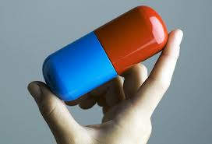
Chronic pain and the prescription opioid problem in the united states

Slide 3
Outline:
Basic education on pain complaints common in substance use treatment patient populations
Guidelines for basic pain assessment
Strategies for engaging pain specialists as part of the treatment team
Recommendations for incorporating pain-related issues as part of substance use treatment
Pharmacotherapy considerations

Slide 4
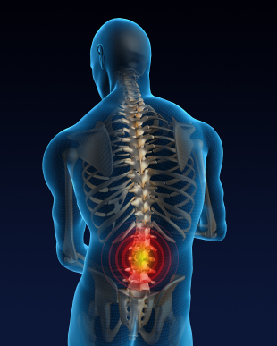
What is pain?
Physical pain: An unpleasant sensory and emotional experience associated with actual or potential tissue damage, or described in terms of such damage (IASP, 1994)
Chronic pain: Continuous or recurrent pain that persists for three months or more
  heterogeneous set of pain phenomena with multiple etiologies

Slide 5
Physical pain is a common complaint
Potter et al., 2008

Slide 6
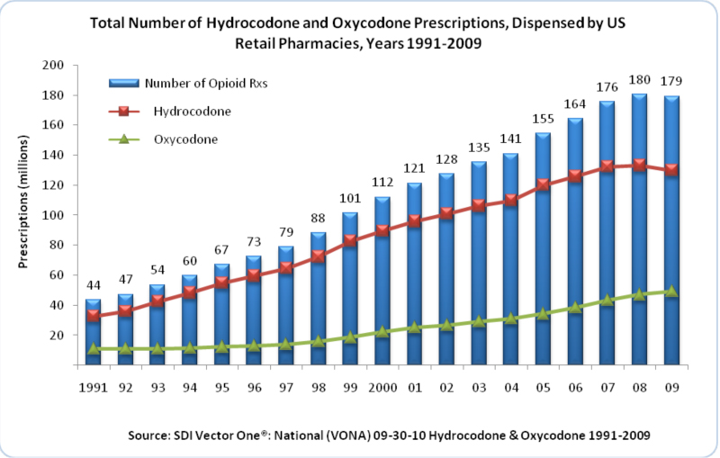

Slide 7
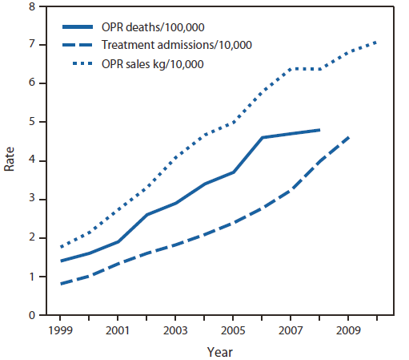
Related Opioid Trends

Slide 8
Opioid Analgesic Misuse:
Scope of the Problem
Currently, opioid analgesics is the most misused drug class in the United States, and among all drugs of abuse is second only to marijuana
In 2011, the second highest rate of past year dependence or abuse of illicit drugs was seen in opioid analgesic users with 1.8 million meeting diagnostic criteria
In 2011, there were 4.5 million non-medical users of opioid analgesics

Slide 9
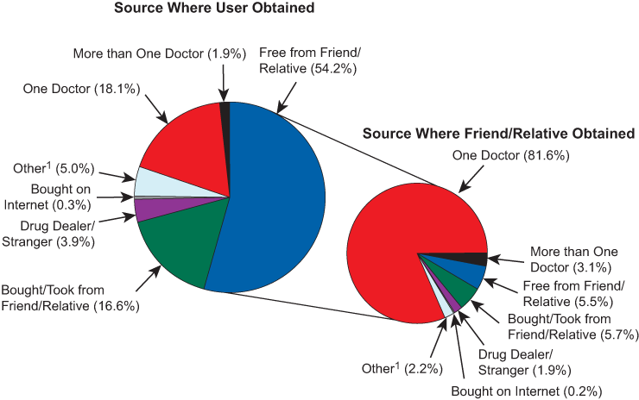
Source of Pain Relievers for most recent nonmedical use among past year users 12yo or older: 2010-2011
National Survey on Drug Use and Health 2011

Slide 10
The Prescription drug epidemic is unique
Prescription drugs are not inherently bad
When used appropriately, they are safe and necessary
Threat comes from abuse and diversion
Just because prescription drugs are legal and are prescribed by an MD, they are not necessarily safer than illicit substances.
SOURCE: ATTC National Office, CONNECT to Fight Prescription Drug Abuse.
10
Notes:
Unlike illicit drugs like heroin, cocaine, and methamphetamine, prescription medications are not illegal or inherently harmful. There has been an increase in legitimate commercial production and distribution of pharmaceuticals, as well as an increase in marketing to physicians and public regarding the availability of opioid pain medications. Some physicians have become more willing to prescribe medications, especially for pain management.
Additional Information for the Trainer(s):
In the terminology of the United States Drug Enforcement Administration (DEA), diversion is the use of prescription drugs for recreational purposes. The term comes from the “diverting” of the drugs from their original purposes. The DEA employs Diversion Investigators to address these problems.

Slide 11

Prescription Opioid Addiction Treatment Study
The NIDA CTN Clinical Trial
R. Weiss, MD
Principal Investigator
New England Consortium
Weiss, et al. (2011). Adjunctive counseling during brief and extended buprenorphine-naloxone treatment for prescription opioid dependence: A 2-phase randomized controlled trial. Archives of General Psychiatry, 68(12), 1238-46.
Weiss, et al. (2010). A multi-site, two-phase, Prescription Opioid Addiction Treatment Study (POATS): Rationale, design, and methodology. Contemporary Clinical Trials, 31(2), 189-99.
11
Notes:
The next series of slides will present information on the NIDA CTN clinical trial conducted by Dr. Roger Weiss and colleagues of adjunctive counseling during brief and extended buprenorphine-naloxone treatment for prescription opioid dependence.
References:
Weiss, et al. (2011). Adjunctive counseling during brief and extended buprenorphine-naloxone treatment for prescription opioid dependence: A 2-phase randomized controlled trial. Archives of General Psychiatry, 68(12), 1238-46.
Weiss, et al. (2010). A multi-site, two-phase, Prescription Opioid Addiction Treatment Study (POATS): Rationale, design, and methodology. Contemporary Clinical Trials, 31(2), 189-99.

Slide 12
The Prescription Opioid Addiction Treatment Study (POATS)
Largest study ever conducted for prescription opioid dependence – 653 participants enrolled
Compared treatments for prescription opioid dependence, using buprenorphine-naloxone and counseling
Conducted as part of NIDA Clinical Trials Network (CTN) at 10 participating sites across U.S.
Examined detoxification as initial treatment strategy, and for those who were unsuccessful, how well buprenorphine stabilization worked
Patients randomized to standard medical management alone or SMM plus drug counseling
12
Notes:
The primary objective of POATS was to determine whether the addition of individual drug counseling to the prescription of buprenorphine-naloxone along with Standard Medical Management (SMM) for subjects dependent on prescription opioids improves outcome both during (a) an initial four-week treatment with taper and (b) a 12-week stabilization treatment for those who do not respond successfully to the initial treatment with taper.
Subjects underwent an initial four-week buprenorphine-naloxone outpatient treatment with taper, and were randomized to SMM or SMM+ODC, which consisted of SMM plus twice weekly individual outpatient drug counseling.
After the initial treatment with taper, participants who were thus far successful were followed for eight weeks to assess success or failure. Initial treatment failures were eligible for treatment in phase 2. Phase 2 consisted of a 12-week outpatient stabilization treatment with buprenorphine-naloxone, plus random assignment to SMM or SMM+ODC, followed by a four-week taper and eight weeks of follow-up.

Slide 13
POATS: Study design
Subjects who succeed in Phase 1 (1-month taper plus 2-month follow-up) are successfully finished with the study
Subjects who relapse may go into Phase 2:
  Re-randomized to SMM or SMM + ODC in
  Phase 2
  3 months of BUP-NX stabilization,
  1- month taper off BUP-NX,
  2 months of follow-up
13
Notes:
POATS was a multi-site, randomized clinical trial that used a 2-phase adaptive treatment research design. Brief treatment (phase 1) included 2-week buprenorphine-naloxone stabilization, 2-week taper, and 8-week post-medication follow-up. Subjects with successful opioid use outcomes exited the study; unsuccessful subjects entered phase 2: extended (12-week) buprenorphine-naloxone treatment, 4-week taper, and 8-week post-medication follow-up.
The study compared outcomes for individuals receiving standard medical management (SMM) and those receiving manual-based opioid dependence counseling. The SMM visits encompassed strategies such as assessing cravings and recommending abstinence and self-help group participation. The more extensive opioid dependence counseling from behavioral health professionals employed relapse prevention and 12-step strategies.
Standard medical management (SMM) in the study was considered by the investigators to be “pretty good counseling.” Doctors in the community usually see patients only once a month. In POATS, doctors saw patients for 15-20 minutes each week.

Slide 14
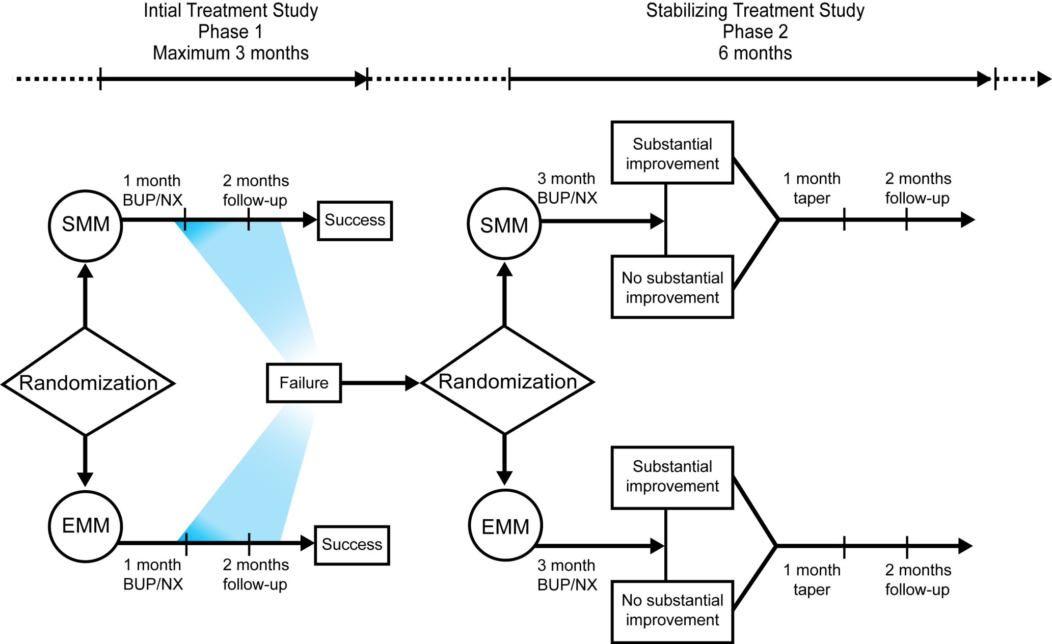
POATS: Study schema

Slide 15
POATS: Study locations
WA: Providence Behavioral Health Svc
OR: ADAPT, Inc.
CA: SF General Hospital
CA: UCLA ISAP
SC: Behavioral Health Services of Pickens Co
IN: East Indiana Treatment Center
WV: Chestnut Ridge Hospital
NY: Bellevue Hospital Center
NY: St. Luke's Roosevelt Hospital Center
MA: McLean Hospital
15
Notes:
Move forward and site locations will appear one at a time.
This slide shows the sites that participated in the clinical trial. There were a total of 10 sites across the United States.
Additional Information for the Trainer(s):
The CTN works to ensure diversity among participating sites (geography, client demographics, etc.) to maximize generalizability. CTN Nodes self-select community treatment programs for participation in a protocol based on interest in the protocol and the ability to recruit appropriate participants into the study (i.e., clients served by the agency are representative of the target population for the study).
15

Slide 16
Key Eligibility Criteria
DSM-IV opioid dependence
≥ 20 days opioid use in past 30
Additional SUDs eligible if not requiring immediate medical treatment
Non-psychotic, psychiatrically stable
Notes:
The two-phase outpatient study included males and females 18 years of age or older, seeking detoxification from prescription opioid dependence in the absence of chronic pain severe enough to require ongoing opioid therapy or an acute pain event within the past six months. For subjects receiving opioids for pain, the study medical clinician consulted with the subject’s prescribing physician to ensure that the subject was medically stable enough to enter the trial (e.g., the subject does not have a malignant tumor causing the pain). Subjects who used prescription opioids by injection were included as long as they had never injected heroin. Subjects had to meet the DSM-IV criteria for current dependence on prescription opioids. While physiologic features are essential, DSM-IV dependence requires more than just tolerance and withdrawal to be present; must have behavioral symptoms, as well. Physical dependence was not sufficient for study participation. Subjects were excluded if they required ongoing opioid therapy for pain.

Slide 17
Factors in Defining a Study Population of Subjects with Prescription Opioid Dependence
Heroin use
Chronic pain
17
Notes:
Heroin use and chronic pain were used as stratification variables on the phase 1 primary end points, so secondary analyses could be performed on the phase 1 outcomes to see if there was a relationship between the outcomes and the one or both of the stratification factors.
Additional Information for the Trainer(s):
For phase I, the randomization was stratified by whether or not the subject had ever used heroin, and whether or not the subject had current chronic pain. Whereas for phase 2, it was stratified by the treatment received in phase I (SMM+ODC or SMM). To keep the sequencing of treatment assignment confidential, block size was not revealed to the investigators.

Slide 18
Heroin-Related Exclusion Criteria
>4 days of heroin use in past 30 days
Ever met criteria for opioid dependence as a result of heroin use alone
Ever injected heroin
SOURCE: Potter et al. (2010).
18
Notes:
Potential study participants were excluded if they used heroin more than 4 days in the past month; had a lifetime opioid dependence diagnosis due to heroin alone; and had ever injected heroin.

Slide 19
Chronic Pain
Many, but not all, subjects with POD have been prescribed opioids for pain
“Prescription” use ≠ pain
Some people with pain obtain opioids illicitly
19
Notes:
The presence of “chronic pain” was operationalized by a ‘yes’ answer to the first question of the Brief Pain Inventory (whether you have pain beyond usual aches and pains) AND a duration of pain of at least three months.
Additional Information for the Trainer(s):
Chronic pain is widely believed to represent disease itself. It can be made worse by environmental and psychological factors. Chronic pain persists over a longer period of time than acute pain, and is resistant to most medical treatments. It can, and often does, cause severe problems for patients. A person may have two or more co-existing chronic pain conditions at any given time.
A dilemma exists with regards to pain management. It is critical to accurately assess and diagnose acute and chronic pain, and provide the necessary and effective analgesia, if needed. There is a need to accurately diagnose disease and provide effective pain management. Some illnesses have no clearly explainable pathophysiology, but are frequently cited as reasons for pain syndromes needing medication treatment(s), including: headache; low back pain; pelvic pain; arthritis; Fibromyalgia; and Chronic Fatigue Syndrome. A misunderstanding and mismanagement of pain may contribute to abuse of pain medications.
Pain Control and Addiction:
“Pseudoaddiction”
Presence of drug-seeking behavior in context of inadequate pain control
Behavior stops with adequate pain relief
Physical dependence
with continued use, withdrawal syndrome produced by rapid dose reduction; occurs via neuroadaptation
Not synonymous with addiction
With regards to diagnosing addiction in opioid-maintained pain patients, there are no validated diagnostic criteria for addiction in pain patients; only “at risk” behaviors, including: lack of control; compulsive use; continued use despite harm; increased craving; and psychiatric symptoms.
To identify “at risk” patients, a clinician might use: patient’s history; screening instruments; behavioral checklists; and therapeutic interactions.
With regards to early intervention for prescription drug abuse, health care providers should: (1) screen patients w/ abuse symptoms; (2) be aware of increases in medication amount needed; and (3) frequent, unscheduled refill requests.
Pharmacists can: (1) provide clear information about proper medication use, effects and danger of drug interactions; and (2) prevent prescription fraud by looking for false prescription forms.
Patients can: (1) provide complete medical history; (2) describe reason for the visit to ensure proper medication; (3) avoid increasing or decreasing doses or abruptly discontinuing prescription use without permission from a physician.

Slide 20
Pain-Related
Inclusion/Exclusion Criteria
Subjects prescribed opioids for pain were included only if approved by prescribing physician
Cancer pain excluded
No traumatic or major pain event within past 6 months
Subjects expressed interest in stopping opioids
20
Notes:
Potential study participants were excluded if they had experienced a major pain event in the past six months; had cancer-related pain; and were prescribed methadone (>40mg/day) for pain. Potential participants needed to express an interest in stopping prescription opioid use to be enrolled in POATS.

Slide 21
POATS Study Questions
Does adding individual drug counseling to buprenorphine-naloxone (BUP-NX) + standard medical management (SMM) improve outcome?
  May be a proxy for drug abuse treatment program vs. office-based opioid treatment
Is initial detox strategy successful for subjects?
21
Notes:
The primary research question for the study was: What benefit does SMM+ODC offer over SMM in (a) a short-term treatment paradigm (a four-week buprenorphine-naloxone treatment with taper) and (b) a longer-term treatment paradigm (12 weeks of a stabilization dose of buprenorphine-naloxone) for subjects who have not responded successfully to the initial short-term buprenorphine-naloxone treatment with taper?

Slide 22
POATS Study Questions (cont.)
For those who fail the initial phase, does adding individual drug counseling to buprenorphine-naloxone (BUP-NX) + standard medical management (SMM) improve outcome when administered over a longer stabilization period?
Do answers vary according to (1) presence of current chronic pain, or
(2) a lifetime history of any heroin use?
22
Notes:
Secondary research questions included: (1) For those who failed phase 1, did the addition of individual opioid drug counseling to buprenorphine-naloxone and SMM improve outcome when administered over a longer stabilization period (phase 2)?; and (2) Were there subject characteristics that predict the likelihood of success in Phase 1, such as heroin use or chronic pain?

Slide 23
Study Treatments
23
Notes:
23
The next set of slides describes, in more detail, the study treatments, including buprenorphine-naloxone, standard medical management, and individual opioid drug counseling.
23

Slide 24
Buprenorphine
Partial Opioid Agonist
  Has effects of typical opioid agonists at lower doses
  Produces a ceiling effect at higher doses
  Binds to opioid receptors and is long-acting
Safe and effective therapy for opioid maintenance and detoxification in adults
Slow to dissociate from receptors so effects last even if one daily dose is missed.
FDA approved for use with opioid dependent persons aged 16 and older
Notes:
24
24
Buprenorphine is a partial opioid agonist. It has been shown to be safe and effective for the treatment of opioid addiction both as a maintenance agent and for use during withdrawal from opioids.
Buprenorphine binds to the receptors very strongly and comes off very slowly. This makes it a very long-lasting medication that continues to be effective even if a dose is missed.
Buprenorphine's abuse potential is relatively low when compared with the abuse potential of full agonist mu opioids. Low doses of injected buprenorphine (such as 1 mg or less) produce minimal effects and are primarily identified as placebo-like in opioid dependent patients
Clinical trials have established the effectiveness of buprenorphine for the treatment of heroin addiction.
Additional Information for the Trainer(s):
Safety: Because of its ceiling effect and poor bioavailability, buprenorphine is safer in overdose than opioid full agonists. The maximal effects of buprenorphine appear to occur in the 16-32 mg dose range for sublingual tablets. Higher doses are unlikely to produce greater effects.
Respiratory depression from buprenorphine (or buprenorphine-naloxone) overdose is less likely than from other opioids. There is no evidence of organ damage with chronic use of buprenorphine, but increases in liver enzymes are sometimes seen. There is no evidence of significant disruption of cognitive or psychomotor performance with buprenorphine maintenance dosing.
Side Effects: Side effects of buprenorphine are similar to those of other opioids and include nausea, vomiting, and constipation. Buprenorphine and buprenorphine/naloxone can precipitate the opioid withdrawal syndrome. Additionally, the withdrawal syndrome can be precipitated in individuals maintained on buprenorphine.

Slide 25
Standard Medical Management
Manualized treatment*
Weekly visits with buprenorphine-certified physician
Initial visit: 45-60 min; f/u visits 15-20 min
Assess substance use, craving, medication response
Recommend abstinence, self-help
*SOURCE: Fiellin et al. (1999).
25
Notes:
Manual-based Standard Medical Management (SMM), which has previously demonstrated efficacy, was provided to all the subjects by physicians certified to prescribe buprenorphine. During the initial session in each phase (45-60 minutes in phase 1 and 30-60 minutes in phase 2), the physician reviewed the patient’s medical, psychiatric, and substance use problems; recommended abstinence; and referred the subject to self-help groups. In subsequent 15- to 20-minute visits, the physician assessed substance use, craving, and buprenorphine-naloxone response; recommended abstinence and self-help participation; and prescribed buprenorphine-naloxone.
SMM represents a higher level of care than is routinely provided to patients receiving medical services for opioid addiction.

Slide 26
Individual Opioid Drug Counseling
Provide education about addiction and recovery
Recommend abstinence
Recommend self-help
Provide skills-based interactive exercises and take-home assignments
Address relapse prevention issues including: high-risk situations, managing emotions, and dealing with relationships
SOURCE: Pantalon et al. (1999).
26
Notes:
Counselors educated subjects about addiction and recovery, recommended self-help groups, and emphasized lifestyle change. Using a skills-based format with interactive exercise and take-home assignments, the counseling covered a wider range of relapse prevention issues in greater depth than did SMM, including coping with high-risk situations, managing emotions, and dealing with relationships.

Slide 27
Description of the Study Population
(N=653 in Phase 1)
27

Slide 28
Baseline Stratification Factors
Lifetime heroin use | 23.0%
Current chronic pain | 42.0%
Chronic pain defined as self-report of non-withdrawal pain, beyond the usual aches and pains for > 3 months.

Slide 29
Baseline Sociodemographic Characteristics
Female | 40.0%
Caucasian | 91.4%
Hispanic | 4.7%
Age (mean, SD) | 32.7 (10.2)
No observable significant differences between SMM and SMM + ODC across baseline characteristics.

Slide 30
Baseline Stratification Factors and Sociodemographic Characteristics
Mean Age = 32.7 years
Mean Years Education = 13 years
Notes:
30
The sociodemographic and clinical characteristics of the subjects enrolled did not differ between treatment groups. About one in four (23%) of all subjects reported lifetime heroin use and about four in 10 (42%) reported current chronic pain. Forty percent of the subjects were female, and approximately 90% were Caucasian. Less than 5% were Hispanic.
30

Slide 31
Participant Demographics
Notes:
31
The POATS sample was well employed, with nearly two-thirds reporting current full-time employment. About half of the sample was never married.
31

Slide 32
Days of Use - Past 30 Days
Mean (SD)
Opioid analgesics | 28.2 (3.5)
Cannabis | 4.9 (9.4)
Sedatives/hypnotics (not barbiturates) | 3.8 (7.9)
Alcohol | 3.0 (6.0)
Amphetamine | 0.5 (3.3)
Cocaine | 0.5 (2.0)
Barbiturates | 0.2 (2.0)
Heroin | 0.1 (0.6)
32
Notes:
Overall, subjects tended to use prescription opioids almost daily, but not much else. The use of cannabis, sedatives/hypnotics, and alcohol was reportedly used in a range of 3-5 days in the past month.
32

Slide 33
Other
Baseline Substance Use Characteristics
Mean years opioid use | 4.5
Current cigarette smoker | 70.6%

Slide 34
Most Frequently Used Opioids in Past 30 Days
Oxycodone (sustained) | 35%
Hydrocodone | 32%
Oxycodone (immediate) | 19%
Methadone | 6%
Other | 8%

Slide 35
Opioid Use Disorder Treatment Histories
Any treatment* |  |  | 210 (30%)
 | Self-help |  | 124 (59%)
 | Inpatient/residential |  | 88 (42%)
 | Outpatient counseling |  | 84 (40%)
 | Methadone maintenance |  | 64 (31%)
 | Buprenorphine maintenance |  | 46 (22%)
 | Intensive outpatient |  | 33 (16%)
 | Naltrexone |  | 7 (3%)
 | Other medications |  | 11 (5%)
*Participants could endorse >1

Slide 36
Maximum Buprenorphine Dose Prescribed
Phase 1
8 mg | 11%
12 mg | 23%
16 mg | 44%
20 mg | 4%
24 mg | 11%
32 mg | 3%
Other | 3%
Phase 2
8 mg | 9%
12 mg | 20%
16 mg | 38%
20 mg | 11%
24 mg | 10%
32 mg | 5%
Other | 8%

Slide 37
Results
37

Slide 38
Study Question 1:
Does adding drug counseling to bup-nx + Standard Medical Management improve outcome?
38

Slide 39
Phase 1 Successful Outcome
(N=653)
SMM+ | SMM | p
ODC
6% | 7% | 0.45
Phase 1 Successful Outcome Criteria
≤ 4 days opioid use per month
No positive urine screens for opioids on 2 consecutive weeks
No other formal substance abuse treatment
No injection of opioids
39

Slide 40
Phase 2 Successful Outcome
(n=360)
 | SMM+ | SMM | p
 | ODC
Week 12 (end of stabilization) | 52% | 47% | 0.3
Phase 2 Successful outcome criteria
Abstinent for > 3 of final 4 weeks (including final week) of bup-nx stabilization (urine-confirmed self-report)
40

Slide 41
Phase 2: Successful Outcome at End of Taper & at Follow-up
 | SMM+ | SMM | Overall | p
 | ODC
Week 16 (end of taper) | 28% | 24% | 26% | 0.4
Week 24 (8 wks post-taper) | 10% | 7% | 9% | 0.2
41

Slide 42
Study Question 2:
How does length of bup-nx treatment affect outcomes in pts with prescription opioid dependence?
42

Slide 43
Successful Outcomes at 3 Time Points
 |  | Success
Phase 1 | 4-week taper + 8 weeks f/u | 7%
Phase 2 | Week 12 - End of stabilization | 49%
 | Week 24 - 8 weeks post-taper | 9%
Ph1 vs Ph2 Wk12 | <.001
Ph1 vs Ph2 Wk24 | 0.21
Ph2 Wk12 vs Ph2 Wk24 | <.001
43

Slide 44
Predictors of Outcome
44

Slide 45
Phase 2 Week 12 Outcome Predictors
 |  | Success | p
Gender | Male | 47% | 0.48
 | Female | 52%
Race | White | 49% | 0.56
 | Not White | 53%
Ethnicity | Hispanic | 72% | *
 | Not Hispanic | 48%
Smoking Status | Smokers | 47% | 0.23
 | Non-smokers | 56%
*Not tested because of small sample with Spanish origin (5%).

Slide 46
Phase 2 Outcome Predictors:
Lifetime Heroin Use
Heroin use |  | Success | p
Week 12 end of stabilization | Yes | 37% | 0.003
 | No | 54%
Week 24 8 weeks post-taper | Yes | 5% | 0.13
 | No | 10%

Slide 47
Chronic Pain Participant Outcomes

Slide 48
Chronic Pain (CP) vs no CP: Sociodemographics
 | CP (n=274) | No CP (n=379)
Female | 42.3% | 38.3%
Age (years)** | 35.4 (10.3) | 30.8 (9.7)
Caucasian (vs not) | 91.2% | 93.1%
Years of education | 12.9(2.3) | 13.1 (2.1)

Slide 49
CP vs no CP: Substance Use Histories
 | CP (n=274) | No CP (n=379)
Years using opioids (other than short term treatment) | 4.6 (1.5) | 4.4 (1.3)
ASI Alcohol Composite | 0.04 (0.1) | 0.05 (0.1)
ASI Drug Composite | 0.33 (0.1) | 0.34 (0.1)
Ever used heroin | 20.1% | 25.1%
Ever in opioid SUD treatment | 29.9% | 33.8%

Slide 50
Chronic pain participants (n=274)
 |  | M (SD) or %
Pain severity (0-10) |  | 4.4 (2.17)
Pain interference (0-10) |  | 4.2 (2.67)
Course | Constant | 43.1%
 | Intermittent | 54.7%
Duration | > 1 year | 81.4%
 | > four years | 54.7%

Slide 51
Chronic pain location
Head/face | 16.1%
Chest/abdomen | 5.5%
Upper extremities | 29.6%
Cervical | 27.0%
Thoracic | 26.3%
Lumbar/sacral | 65.0%
Lower extremities | 52.9%
Multiple spinal areas | 36.1%

Slide 52
Primary Reason for Use: Past and Present
Major reason for first use among CP patients
pain | 83.2%
get high | 13.1%
Major reason for current use among CP patients whose first reason was pain
pain | 22.6%
get high | 13.9%
avoid withdrawal | 56.5%

Slide 53
Important Reasons for Using Opioids
PAST 6 MOS | CP |  | No CP
 | Mean | (SD) | Mean | (SD) | p
Ill or in pain from wanting OAs | 7.8 | (2.7) | 8.1 | (2.6)
Non-withdrawal pain | 5.7 | (3.6) | 2.9 | (3.2) | 0.00
Angry/frustrated with self | 3.5 | (3.2) | 3.8 | (3.2)
Felt bored | 2.8 | (3.1) | 3.8 | (3.2) | 0.00
Felt anxious | 4.9 | (3.3) | 5.2 | (3.2)
Saw OAs and had to give in | 4.8 | (3.6) | 5.7 | (3.6) | 0.00
Felt sad | 3.8 | (3.5) | 3.8 | (3.3)
Good mood and wanted to get high | 3.8 | (3.4) | 5.0 | (3.4) | 0.00
Wanted to see what would happen | 1.1 | (2.3) | 1.3 | (2.3)
Tempted out of the blue | 1.9 | (2.9) | 2.5 | (3.1) | 0.02
Someone offered OAs | 3.5 | (3.6) | 4.6 | (3.7) | 0.00
Angry/frustrated due to relationship | 3.1 | (3.5) | 3.4 | (3.5)
With others having a good time | 2.8 | (3.3) | 4.1 | (3.6) | 0.00
Worried about a relationship | 2.9 | (3.4) | 3.3 | (3.4)
Felt others were being critical | 2.0 | (2.9) | 1.9 | (2.8)
Saw others using | 2.3 | (3.2) | 3.0 | (3.3) | 0.01

Slide 54
Important Reasons for Using Opioids
PAST 6 MOS | CP |  | No CP
 | Mean | (SD) | Mean | (SD) | p
Ill or in pain from wanting OAs | 7.8 | (2.7) | 8.1 | (2.6) | ns
Non-withdrawal pain | 5.7 | (3.6) | 2.9 | (3.2) | 0.00

Slide 55
Chronic pain patients were…
No more likely to drop-out or terminate from Phase 1
Equally likely to enter Phase 2
No more likely to have SAE/AE

Slide 56
Chronic pain and Outcome
 |  | Improved | P
Phase 2 Week 12 (end of stabilization) | Chronic Pain | 53.0% | 0.22
 | No | 46.5%
Phase 2 Week 24 (8 weeks post-taper) | Chronic Pain | 9.4% | 0.60
 | No | 8.1%

Slide 57
% of CP Participants with Clinically Meaningful Reductions in Pain
Reduction at Ph2 wk 12 from baseline | Minimal (>10% Δ) | Moderate (>30% Δ) | Substantial (>50% Δ)
BPI Intensity Scale | 69% | 51% | 35%
Worst pain | 66% | 51% | 34%
Average pain | 67% | 55% | 43%
BPI – (0-10) worst, least, average, and “right now”
Results presented for overall sample; no difference between treatment groups
n=121 (149 Phase 2 CP participants)
(IMMPACT recommendations, Dworkin et al, Pain, 2008)

Slide 58
Clinically Meaningful
Reductions in Pain Interference
Reduction at Ph2 wk 12 from baseline | Minimal (>1 point Δ) | Moderate (>2 point Δ)
BPI Interference | 59.5% | 43.0%
Results presented for overall sample; no difference between treatment groups
n=121 (149 Phase 2 CP participants)

Slide 59
POATS: Conclusions & Caveats
Patients with chronic pain did as well as those without chronic pain
No significant safety concerns observed
Many had significant pain improvement
Treatment-seeking for a substance use problem not pain
Heterogeneity of chronic pain
Pain improvement - no control group

Slide 60
chronic pain Care: Assessment and treatment

Slide 61


IOM Pain Care Principles
Effective pain management a moral imperative
Chronic pain a disease in itself
Often requires comprehensive approaches to prevention and management
Interdisciplinary assessment and treatment
Need for public health and
community-based approach
Coordinated NIH focus
Challenge of opioid Rx
Relieving Pain in America electronic publication
Living Well with Chronic Illness

Slide 62
SUD versus physical dependence
Addiction/Substance Use Disorder
Physical Dependence
Physical dependence alone and tolerance to prescribed drugs is not sufficient evidence of a substance use disorder. They are normal responses that often occur with the persistent use of certain medications.
DSM-V

Slide 63
Assessment of Pain
Pain is a subjective experience (Haller)
  Patients experience and “interpret” it differently
  No test for pain (only for unpleasantness)
Pain tolerance varies from person-to-person (Haller)
  Genetic and cultural differences
  “Significance” of pain plays a role
Requires comprehensive clinical evaluation (Haller)
  Doctors don’t like patients with pain
  Few are taught how to diagnose and treat
  Failure to treat/under-treatment common
Physicians nearly twice as likely to underestimate pain in black vs white patients (Staton LJ, Natl Med Assoc, 2007)

Slide 64
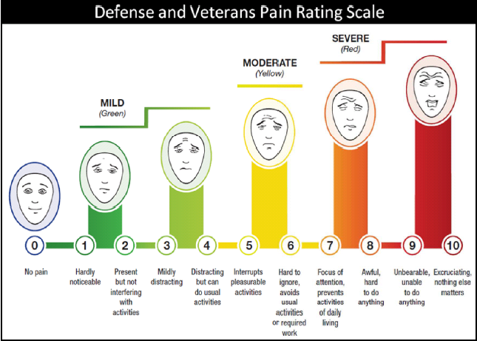
New Pain Scale from DOD - VA

Slide 65
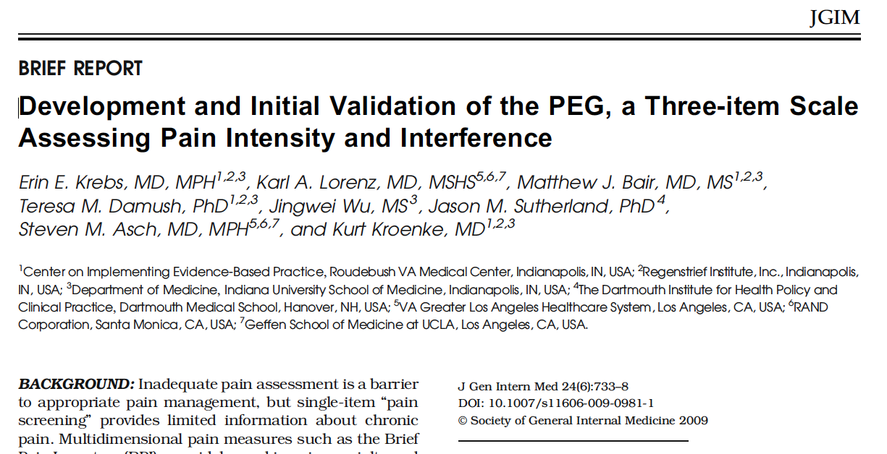
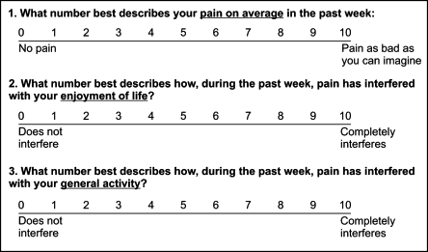

Slide 66
What do we Know about Treating Pain in Patients with SUD?
  Limited evidence base to inform clinical care
  Chronic pain treatment: primary care pain management program effective regardless of SUD history (Chelminski et al., 2005).
  Two CBT studies that addressed pain and relapse prevention helped reduce pain, improve function, and reduce relapse risk
  (Currie et al., 2003; Ilgen et al., 2011).
Morasco et al. (2011). PAIN, 152, 488-497.

Slide 67
CTN-0030 MANUAL Opioid Drug Counseling: Chronic pain participants
Awareness of how pain relates to drug use and may impact outcome.
Session goal was to help the patient to
  understand the connection between pain symptoms and drug use
  identify times when pain symptoms pose a risk for relapse
  identify and utilize specific strategies to cope with pain.

Slide 68
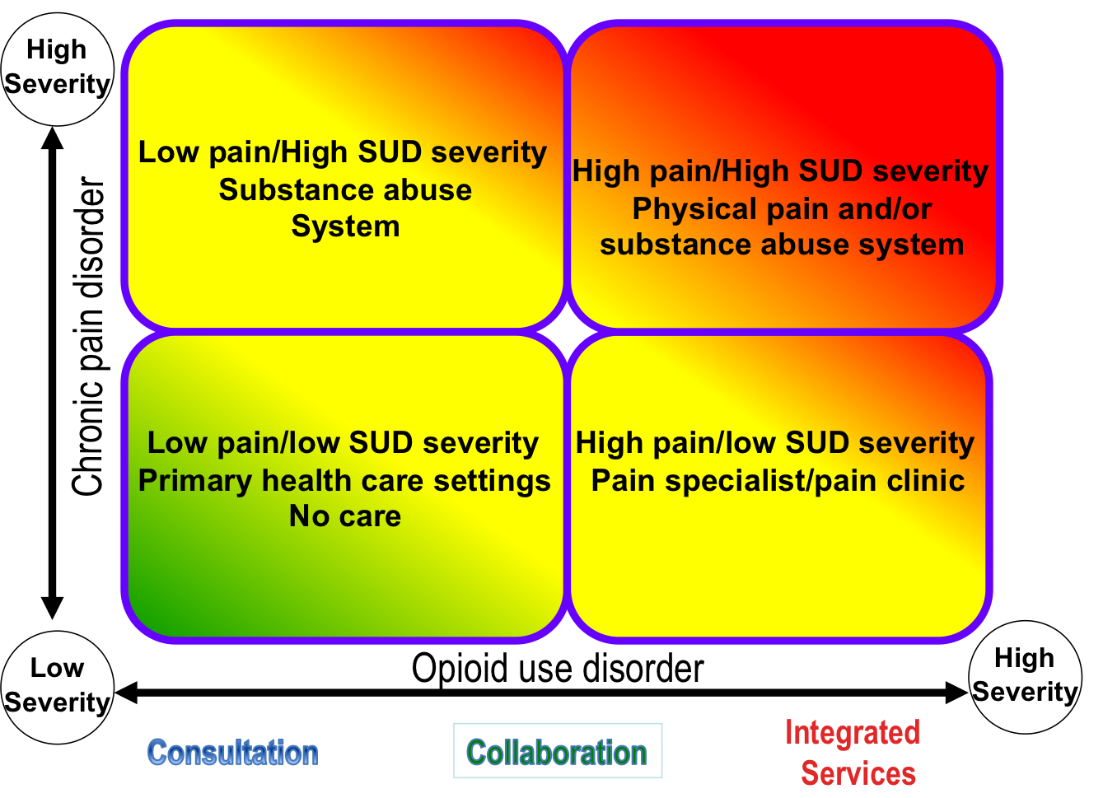
Integrated approach to co-occurring CP & SUD

Slide 69
Recommendations
Do not ignore pain
Routinely monitor and, if present, chart pain intensity and interference
Ask about pain treatment history, including current prescriptions
Consider the interrelationship between pain and substance use, even non-opioid substance use
Incorporate pain in to your treatment planning

Slide 70
Managing patients with SUD history receiving opioids for chronic pain
Frequent visits and small quantities
Long-acting drugs with no rescue doses
Use of one pharmacy, pill bottles, no replacements or early scripts
Use of urine toxicologies
Coordination with sponsor, program, addiction medicine specialist, psychotherapist, others
Avoid prn dosing
Notes:
In some cases, a patient engaged in aberrant drug-related behavior should discontinue therapy. Pain can be treated in other ways, or the patient can be appropriately referred. In some cases, referral for addiction treatment is appropriate. If the decision is made to continue opioid therapy, the behaviors should be controlled using one or more strategies. These strategies may include frequent visits, small refills, checking of pill bottles, the use of long-acting drugs without rescue doses, the requirement that only one pharmacy be used, the use of spot urine toxicologies (to determine whether other drugs of abuse are being taken), and the requirement for visits with a sponsor or mental health care provider. In some cases, the use of a written “contract” is a useful intervention. It should stipulate guidelines for therapy and also indicate the consequences of further aberrant drug-related behavior.

Slide 71
Goal-Directed Opioid Agreement
Goal-directed: no change after a specified period of increasing dosage of opioids, consider stopping
Multi-modality management, part of the agreement
Agreement needs to define:
  use/refill guidelines;
  follow-up guidelines;
  single prescriber/pharmacy;
  no illicit drugs or diversion;
  safe storage;
  UDS;
  prescription monitoring program
Hariharan J et al JGIM 2007;22:485–490
Von Korff M, Clin J Pain 2008;24:521–527

Slide 72

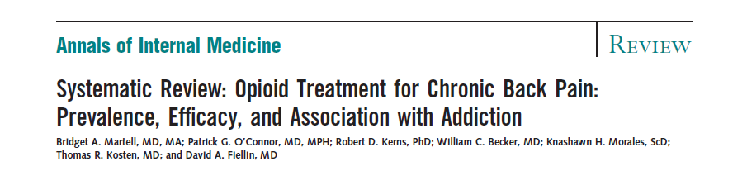
Evidence for Efficacy of Long-Term Opioid Therapy for Chronic Pain?
Few RCTs, most <4 mos. duration
Selected populations, high rates of attrition
Heterogeneous opioid regimens
Unclear efficacy of long-term opioid therapy for low back pain or other CNCP

Slide 73
Diagnostic issues
Pseudo addiction
  Aberrant drug-related behaviors driven by uncontrolled pain (increasing the dose, doctor-shopping)
  Reduced by improved pain control
  How aberrant can behavior be before it is inconsistent with pseudoaddiction?
  Can addiction and pseudoaddiction coexist?
Undertreatment vs SUD
  False positives (e.g., patients with tolerance, withdrawal, persistent desire to cut down)
  Difficulties distinguishing “drug seeking” from inadequate treatment

Slide 74
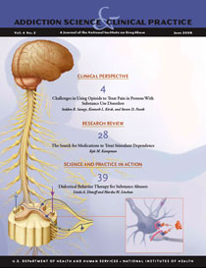
Recommended resources
Challenges in Using Opioids to Treat Pain in Persons With Substance Use Disorders,
Seddon R. Savage, MD, M.S., Kenneth L. Kirsh, PhD, & Steven D. Passik, PhD
  http://www.nida.nih.gov/PDF/ascp/vol4no2/Challenges.pdf

Slide 75

Recommended resources
Abuse, Addiction, and Pain Relief: Time for Change, Herbert D. Kleber, MD, Rollin M. Gallagher, MD, MPH, & Eugene R. Viscusi, MD
  http://www.cpdd.vcu.edu/Pages/NewsletterFINAL080108.pdf
Opioid Therapy for Chronic Pain, Jane C. Ballantyne, MD, and Jianren Mao, MD, PhD.Pain Center, Department of Anesthesia and Critical Care, Massachusetts General Hospital and Harvard Medical School
N Engl J Med 2003;349:1943-53

Slide 77
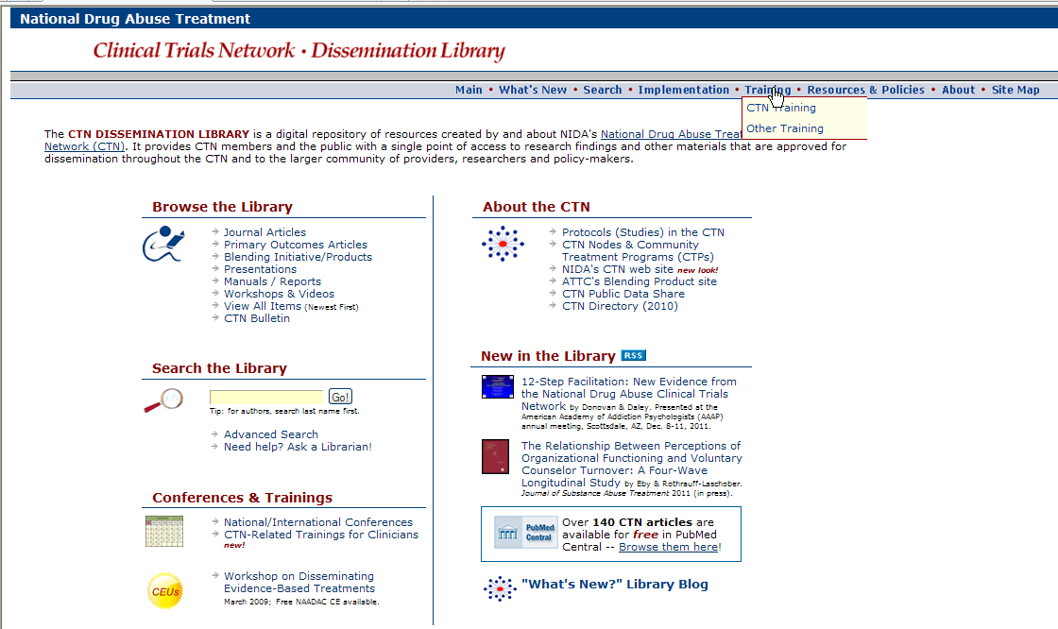
A copy of this presentation will be available electronically after the meeting
http://ctndisseminationlibrary.org

Slide 78

Survey Reminder
The CCC encourages all to complete the survey issued to participants directly following the webinar session, as this is the primary collective tool for rating your experience with this and other webinars, and communicating the interests and needs of CTN members and associates.

Slide 79

Thank you all for your support of the
2012 CTN Web Seminar Series.
See you in
2013
From The NIDA Clinical Coordinating Center

