Slide 1

IRB and Regulatory Documentation
Presented by:
Emily Dorer, BS and
Ro Shauna Rothwell, PhD, CCRP
Wednesday, April 24, 2013

Slide 2
Objectives
Identify critical aspects of Institutional Review Board (IRB) oversight and compliance.
Determine appropriate regulatory documentation practices.
Explain roles and responsibilities involved in reporting progress to regulatory bodies.

Slide 3
Good Clinical
Practices (GCP)
Reviewing the Fundamentals

Slide 4
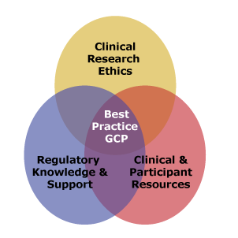
Foundations for the Ethical Conduct of Clinical Research
Major Milestones in Clinical Research
Nuremberg Code (1947)
Declaration of Helsinki (1964)
Belmont Report (1979)
International Conference on Harmonisation (ICH-GCP)
International Standards Organization 14155
Code of Federal Regulations

Slide 5
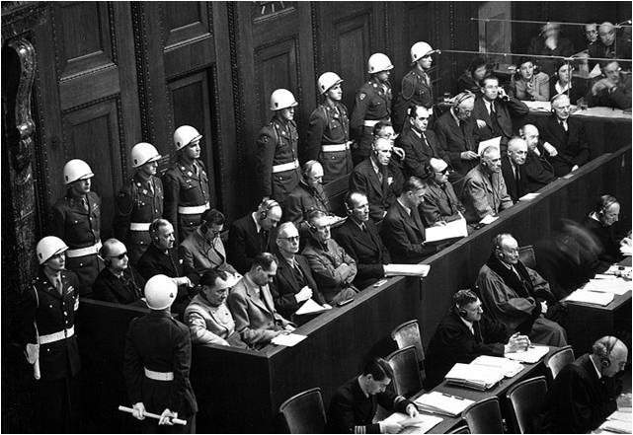
GCP – A Historical Perspective
Nuremberg Code (1947)
  Voluntary participation
  Informed Consent
  Minimization of risk

Slide 6

GCP – A Historical Perspective
Declaration of Helsinki (1964)
  Well being of the participant takes precedence
  Respect for Persons
  Protection of subjects health and rights
  Special protection for vulnerable populations

Slide 7

GCP – A Historical Perspective
Belmont Report Ethical Principles (1979)
  Respect for Persons
    Informed Consent
    Protection of vulnerable populations
  Beneficence
    Non-maleficence
  Justice
    Fairness

Slide 8
Institutional Review Board (IRB)

Slide 9

IRB Function
Code of Federal Regulations 21 CFR 56
Function:
  The overarching goal of the
  IRB is to protect human subjects
    Risk/Benefit analysis
    Ensure that the selection of
    participants is equitable
    Ensure the following principles
    in research studies
      Respect for Persons
      Beneficence
      Justice
  Additional safeguards for vulnerable populations

Slide 10

IRB Composition
At least 5 members
All members should not be the same gender
Varying professions
At least one member whose primary concern is scientific
At least one member who is not affiliated with the institution or part of the immediate family of a person affiliated with the institution
Other members may include: clergy, lawyers, ethicist…
Collectively, the IRB is expected to have the qualifications and experience to evaluate all aspects of the proposed research.

Slide 11

Institutional Review Board
When is IRB Review
required?
  Investigational Drug or Device ( 21 CFR parts 312, 812, and 813)
  Intervention or interaction with human subjects
  Collection of identifiable private data on living individuals and/or data analysis of identifiable private information on living individuals (21 CFR 56.103)

Slide 12

Institutional Review Board
When is IRB Review
NOT required?
  Taste and food quality evaluations; consumer acceptance (21 CFR 56.104)

Slide 13
Institutional Review Board
When is IRB Review
NOT required?
  If the investigator and independent physician agree (before using the test article) that all of the following apply
    Life Threatening situation
    Informed Consent cannot be obtained due to inability to communicate with the participant
    Insufficient time to obtain consent from participant’s legal representative
    No alternative options available that have an equal or greater likelihood of saving the life of the participant

Slide 14
Institutional Review Board
  If the investigator deems it necessary for immediate treatment with test article to preserve the life of the participant and time is not sufficient for prior consultation
    Documentation of the investigator’s certification and the written explanation of a independent physician must be submitted to the IRB within 5 working days after the use of the test article
    Subsequent use of the test article is subject to IRB review
    Your IRB may impose more stringent requirements(e.g., they might not allow exceptions).

Slide 15
IRB Review – Required Documents
Type of IRB Reviews
IRB Required Documents
Initial Review
Amendments
Continuing Review
Protocol
Informed Consent Forms (Main, Ancillary Study)
Recruitment materials and advertisements
Participant handouts or counseling materials
Notification of Study Closure

Slide 16

IRB Review and Reporting
Considerations
for Review
  Is the study being conducted in compliance with the protocol?
  Is investigator complying with IRB requirements?
    Adverse event reporting
    Status reports
  Randomization procedures and masking

Slide 17
Regulatory Documentation Practices
Sponsor-Related Responsibilities

Slide 18

Regulatory Reporting Responsibilities of NIDA CTN
Sponsor ( 21 CFR 312.3 (b))
  A person who takes responsibility
  for and initiates a clinical investigation
Responsibilities
  Ensure proper monitoring of the investigation
  Ensure that the FDA and all participating investigators are promptly informed of significant adverse events
  Select qualified monitors to monitor the study
  Maintain and retain adequate records and reports
  “ The sponsor is essentially responsible for all operational aspects of the clinical trials it sponsors.”

Slide 19
NIDA CTN Required Regulatory Documents
Study Documents
  Protocol
  Informed Consent Template
  Certificate of Confidentiality (CoC)
  Package Insert/Investigator Brochure
  Endorsement Forms (fully executed by Lead Node, CCC, DSC, and NIDA CCTN)

Slide 20
NIDA CTN Required Regulatory Documents
Central or Local Laboratories that are clinical in nature
  CAP Certificate
  CLIA Certificate
  Lab Reference Ranges

Slide 21
NIDA CTN Required Regulatory Documents
Site Documents
  Drug Enforcement Administration (DEA) Registration – Institution and Individual
  Federalwide Assurance (FWA) number
  IRB Approvals (Consents and Protocol)
  IRB Roster
  OHRP Approval for Special Populations
  Protocol Signature Page (signed by PIs and Sub-Is)
  Site Staff Signature & Delegation Logs

Slide 22
NIDA CTN Required Regulatory Documents
Site Staff Documents
  Curriculum Vitae (CV) for Investigators
  Financial Disclosure Certification (IND studies)
  Financial Disclosure Tracking Form (non-IND studies)
  Form FDA 1572 (IND studies)
  Investigator Agreement (IA for non-IND studies)
  Evidence of GCP Training
  Evidence of HSP Training
  DEA Registration for Practitioners
  License/State Issued
  Training Documentation Form

Slide 23

NIDA CTN Policies and
Procedures – IRB Reporting
All sites must obtain approval from the appropriate IRB(s) prior to study start.
  The IRB must review and approve the following:
    Protocol
    Informed Consent
    Recruitment materials
    Other necessary documents

Slide 24
NIDA CTN Policies and Procedures – Requirements for Lead Investigators
Lead Investigator Responsibilities
  Follow and comply with all applicable protections for human subjects and clinical research regulations (local, state, and federal)
  Obtain IRB approval for their respective protocol and maintain it throughout the conduct of the clinical trial

Slide 25
NIDA CTN Policies and Procedures – General Regulatory Requirements
Maintain regulatory documents
  Copies of these documents should be provided to the sponsor by submission to the CCC via upload into the CCC Regulatory Tracking System (RTS)
Each NIDA CTN CTP should be aware of their regulatory responsibilities
Each research site obtains a Federalwide Assurance (FWA) from OHRP prior to enrollment of study participants at that site

Slide 26

Regulatory Documentation Practices – Lead Node & Local Site
Lead Node
  Special requirements for leading a multi-site trial
Local Site
  Will regulatory binder be electronic or paper?
  Will node or site staff be responsible for updates?
  Who will submit documents to the RTS?

Slide 27
Reference Tool –
Regulatory Binder Checklist
1.0 | Table of Contents | 6.0 | Informed Consent Documents
2.0 | Protocol |  | 6.1 Current Informed Consent
 | 2.1 Current IRB Approved Protocol |  | 6.2 Current Other PPT Agreements
 | 2.2 Current Protocol Sig. Page |  | 6.3 Obsolete Informed Consents
 | 2.3 Obsolete IRB Approved Protocols |  | 6.4 Obsolete Other Agreements
 | 2.4 Obsolete Protocol Sig. Pages |  | 6.5 Informed Consent Change Logs
 | 2.5 Protocol Change Log | 7.0 | Sponsor/Inv Authority Agreements
3.0 | Pharmacotherapy |  | 7.1 Form 1572/IA
 | 3.1 DEA Registrations |  | 7.2 Certificates of Confidentiality
 | 3.2 Package Insert (PI)/Inv. Brochure |  | 7.3 Other Regulatory Approvals
 | 3.3 PI/Inv Brochure Amendments | 8.0 | Institutional Review Board (IRB)
 | 3.4 Study Drug Accountability Logs |  | 8.1 IRB Correspondence
 | 3.5 Study Drug Recall Notifications |  | 8.2 Initial IRB Submission/Approval
 | 3.6 Study Drug Shipment Records |  | 8.3 Additional Submissions/Approvals
 | 3.7 Study Product Labels |  | 8.4 FWA and IRB Contact Information
4.0 | Clinical Laboratory | 9.0 | Safety Notifications
 | 4.1 Lab Reference Ranges |  | 9.1 Expedited Safety Reports
 | 4.2 Lab Certs/Accreditations |  | 9.2 DSMB Notifications
 | 4.3 Lab Correspondence | 10.0 | Quality Assurance (QA)
5.0 | Research Personnel |  | 10.1 Data/Safety Monitoring Plan
 | 5.1 Staff Signature Delegation Log |  | 10.2 QA Monitoring Plan
 | 5.2 Personnel |  | 10.3 Endorsement Form
 | 5.3 Financial Disclosures |  | 10.4 Local QA Monitor Report
 | 5.4 Protocol Training Plan |  | 10.5 Sponsor Monitor Reports
 |  |  | 10.6 Audit Certificate
 |  |  | 10.7 Site Visit Log
 |  | 11.0 | Study Correspondence

Slide 28

Roles and Responsibilities

Slide 29
Roles & Responsibilities in Reporting Process
Lead Node
  Oversee the study at all sites
  Communicate with:
    Clinical Coordinating Center
    Sites
  Apply for Certificate of Confidentiality
  Register trial with ClinicalTrials.gov

Slide 30
Roles & Responsibilities in Reporting Process
Local Node
  Oversee study at one or more participating site(s)
  Communicate with:
    Lead Node
    Site IRB
Participating Site
  Communicate with:
    Local Node
    Lead Node
    Site Administration

Slide 31
Role of an IRB and Expectations
Who can serve as a Principal Investigator?
What is the IRB’s attitude toward amendments?
  More vs. Less
Requirements if lead of a multi-site trial
Submission timelines

Slide 32
Submit Regulatory Documents Accurately
Lead Node
  Submit first, then send to sites after approval
  Best Practice! Have all study documents available when presented to sites:
    CRF Manual
    Operations Manual
    Protocol
    Informed Consent Template
    Site Monitoring and Quality Assurance Plan
  Reporting requirements
    Site approvals or submissions
    Safety reports
    Site information at time of continuing review

Slide 33

Submit Regulatory Documents Accurately
Local Node
  Know what your IRB requires and convey this to the lead team as early as possible in the
  pre-implementation process
    Are draft versions acceptable or must they be final?
  Submission timelines
    Can you have more than one review ongoing at the same time?
      Amendment and Continuing Review

Slide 34

Internal vs. External Regulatory Reporting
Internal Reporting
External Reporting
NIDA CTN
PRB/DSMB
CCC
DSC
IRB
DEA
FDA

Slide 35

RTS – Regulatory tracking system
Reviewing Upload Procedures

Slide 36
Document Upload Process
REGULATORY TRACKING SYSTEM (RTS)
Document Upload Process
1. Scan and name document according to convention guide
2. Follow URL to enter site and study specific username and password
3. Select document type
4. Browse and attach document for uploading
5. Complete fields as prompted & click update. Date format is mm/dd/yyyy.
Document rejected with
explanation and instruction
6. CCC Document review and approval
7. E-mail status
notification or confirmation
Document approved
8. Document released
for system storage

Slide 37
Getting Started
Step 1
  Name document according to the Naming Convention Guide
  Ex. CV – LingCVDateSigned (LingCV04-12-11)
  Licenses, DEA – SaxonDEAExpiredate (SaxonDEA11-12-11)
  Please PDF your document before uploading.
  MS Word files (.doc, .docx) are not acceptable.
  Confirm document size of the PDF to upload does not exceed 6 MB.
  Sites using electronic binders should also use the CCC’s naming conventions for standardization.

Slide 38
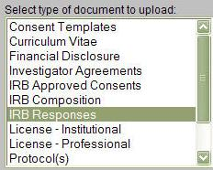
Sample Upload Process
Step 2
  Begin the document uploading process by selecting the type of regulatory document you want to upload.
  For this demonstration we will upload an IRB approval, which is located under IRB responses.

Slide 39
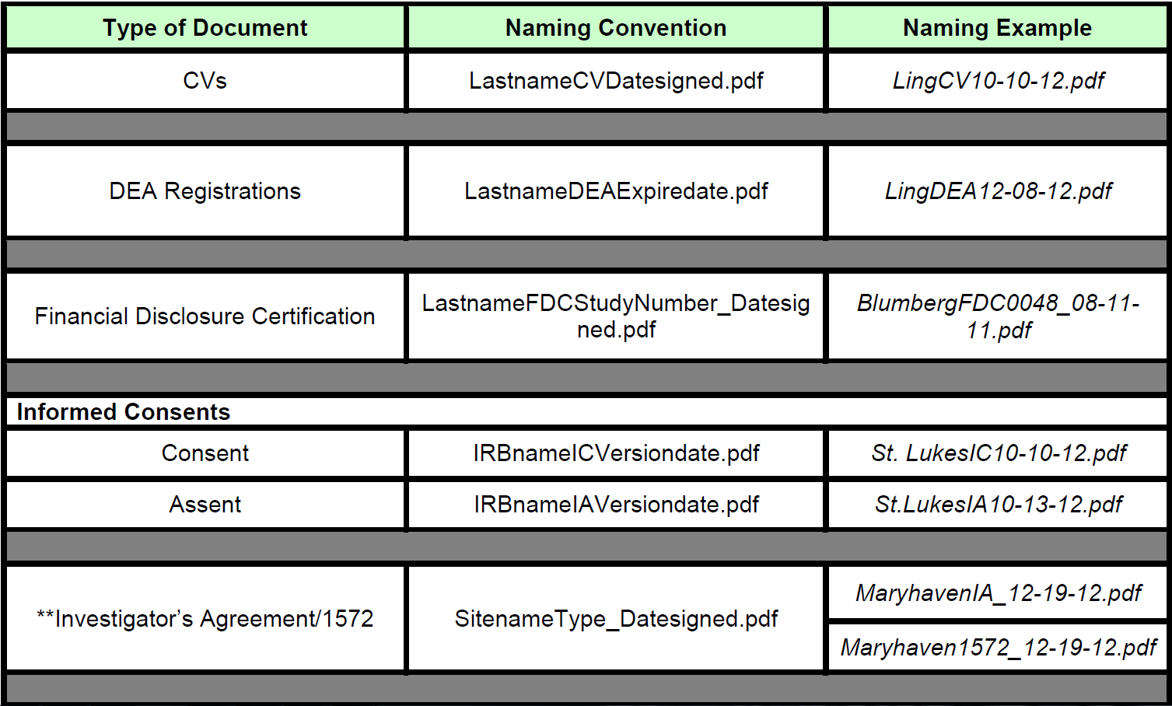
NIDA CTN RTS Document
Naming Convention Guidelines

Slide 40
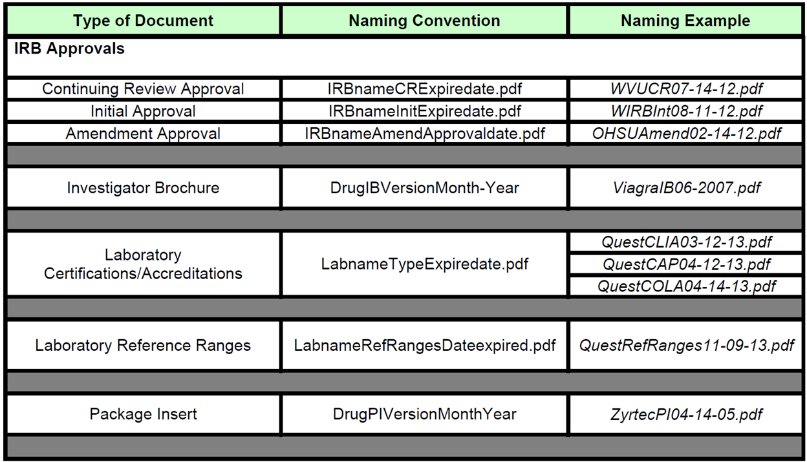
NIDA CTN RTS Document
Naming Convention Guidelines

Slide 41
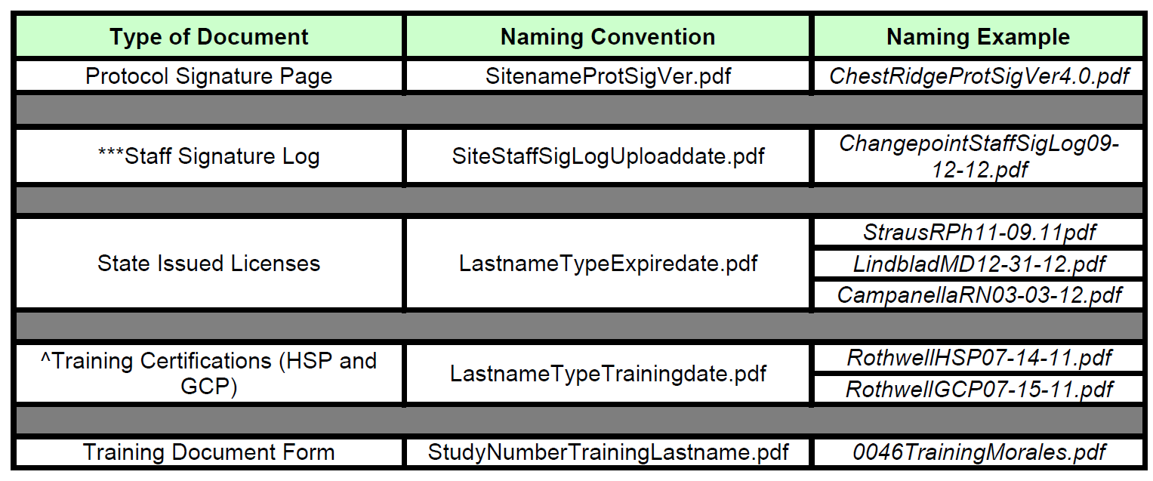
NIDA CTN RTS Document
Naming Convention Guidelines

Slide 42
NIDA CTN RTS Document
Naming Convention Guidelines
Documents must be converted to PDF format and then uploaded into RTS. All other formats (i.e., JPEG, DOC, etc.) will be rejected.
The original signed (wet) copy of 1572 and/or Investigator Agreement (IA) documents must be sent to the CCC. The original signed copy should be converted to PDF format and uploaded to the RTS database.
Staff Signature Logs should be uploaded to the RTS within 90 days from the date of original signature and then re-submitted per study needs.
RCR, CITI and Institutional training may be acceptable to satisfy the Human Subjects Protection and/or Good Clinical Practice training requirement. If CITI or RCR are to be used, they must be approved by the CCC prior to uploading it to RTS.

Slide 43
Let’s review

Slide 44
Recap / Highlights
What are some critical aspects of Institutional Review Board (IRB) oversight and compliance?
What are the required documents for IRB review?
What are some appropriate regulatory documentation practices?

Slide 45

Q&A – Questions / Comments
Alternatively, questions can be directed to the presenter by sending an email to CTNtraining@emmes.com.

Slide 46
Survey Reminder
The NIDA CCC encourages all to complete the survey issued to participants directly following this webinar session, as this is the primary collective tool for rating your experience with this and other webinars, and for communicating the interests and needs of CTN members and associates.
Upcoming Webinar
Site Management and Performance
Wednesday, May 29, 2013
1:00 pm ET to 2:30 pm ET

Slide 47
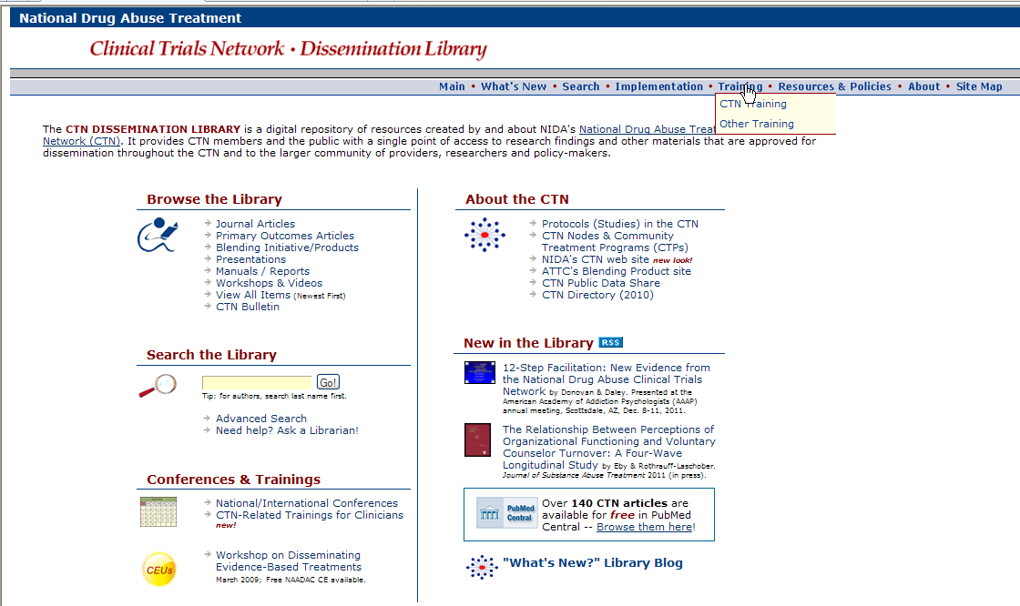
A copy of this presentation will be available electronically after this session.
http://ctndisseminationlibrary.org

Slide 48
Thank you for your participation

