Slide 1
QUALITY ASSURANCE AND RISK BASED/STRATEGIC MONITORING
Presented by:
Elizabeth Alonso, PhD, CCRA
Maria Campanella, BSN, RN, CCRA
Robert Lindblad, MD
Thursday, September 19, 2013

Slide 2
Objectives:
Define risk based and strategic monitoring
Identify factors to consider when determining how and how often to monitor
Identify types of monitoring models
  Identify a model that will work for you

Slide 3

New FDA Guidance Document A RiSk-based approach

Slide 4
New FDA Guidance Document
“Oversight of Clinical Investigations – A Risk-Based Approach to Monitoring”
Current guidance issued in August 2013
Overarching goal:
“to enhance human subject protection
and the quality of clinical trial data by focusing sponsor oversight on the most important aspects of study conduct
and reporting.”

Slide 5
Observations from CTTI Survey of Monitoring Practices
Perception that FDA requires that on-site visits occur every 4-8 weeks
Perception that appropriate monitoring means a 100 % review of 100% of data

Slide 6
New FDA Guidance Document
Suggests that varied approaches to monitoring that include risk assessment and strategic planning are more likely to ensure subject protection and overall study quality than routine on-site visits to all clinical sites and 100% data verification

Slide 7
New FDA Guidance Document
Advises sponsors to incorporate alternative monitoring approaches and on-site monitoring to improve the quality and efficiency of trial oversight
The FDA recognizes that both quality and efficiency can be improved

Slide 8
New FDA Guidance Document
Rationale:
  Improve efficiencies and effectiveness of monitoring by “focusing on the most critical data elements”
  Detect data anomalies in various modes of monitoring to “ensure the quality and integrity of clinical trial data”
  Maximize opportunities to monitor remotely using the available technology, “electronic data capture (EDC) systems”
    centralized monitoring by monitors, data managers and statisticians

Slide 9
New FDA Guidance Document
Does not suggest a need for less oversight or vigilance
Advises focused efforts on identifying, preventing, or mitigating important and likely risks to data quality and processes
Stresses findings should help determine if/when additional actions are needed to ensure human subject protection and data quality across sites

Slide 10
SPONSOR Monitoring within the NIDA CTN
The path from Conventional to Risk-Based Monitoring

Slide 11
NIDA Clinical Trials Network (CTN)
A platform for conducting multi-site clinical trials targeting substance abuse treatment
Network Composed of
  Academic Regional Research Training Center(s) (RRTC), also referred to as “nodes” (currently 13)
  Approximately 240 clinical sites, all US sites
  Sites are affiliated with nodes for IRB oversight, site management, training support and QA

Slide 12
NIDA Clinical Trials Network(CTN)
  Clinical Coordinating Center (CCC):
  Quality assurance monitoring, safety monitoring, protocol document development, collection and maintenance of regulatory documents
  Data and Statistical Center (DSC):
  Data collection in EDC system, protocol document development, data quality assurance, statistical analysis
  The EMMES Corporation, a CRO, has been contracted by the sponsor to conduct the activities of the CCC and DSC.

Slide 13
The scope of the CTN from 2007 – Present
2007– 2010
  4 active trials (300-1200/trial)
  36 sites requiring monitoring
2011 - present
  2 active trials (as of Sep 2013)
  4 trials in closeout: 3 trials in Q1-Q2; 1 trial in Q3
  40+ sites requiring closeout and monitoring activities, some on multiple protocols
  4 trials under development – est. 11-15 additional sites (at least half naïve to CTN research practices)

Slide 14
The Conventional Approach
Clinical Trial A

Slide 15
7 Years Ago – The Reality
Clinical Trial A
  n = 1200 (original n of 400 changed to1200, during the trial)
  Primary endpoint → changes in liver enzymes
  Nine sites, various geographic locations
  Substance Use Disorder population
  Large number of assessments per participant
  Large amount of paper CRFs requiring SDV
  Ancillary pharmacogenetics study requiring additional consent form review

Slide 16
The Conventional Approach
  Visits to each site conducted quarterly
  100% review of eligibility criteria
  100% review of informed consent process
  100% review of primary endpoint data
  100% review of reported SAEs
  100% review of all data, including progress notes for 10% of randomized participants

Slide 17
The Monitoring “Burden”
Clinical Trial A
 | Number of Visits
Year | Q1 | Q2 | Q3 | Q4 | Total
2006 |  | 8 | 8 | 7 | 23
2007 | 10 | 9 | 11 | 9 | 39
2008 | 6 | 10 | 7 | 12 | 35
2009 | 10 | 11 | 8 | 15 | 44
2010 | 19 | 23 | 12 |  | 54
Total | 45 | 61 | 46 | 43 | 195
Number of visits conducted
2010 – 28% of study visits in 17% of study time

Slide 18
Analysis of the Conventional Plan
Relevance
  In 2010 - most of these visits were “catch up” visits reviewing “old” data
Cost
  Of these same visits in Q1-Q2 of the last year of the study, 28 of 42 (67%) visits were co-monitored (2 or more monitors sent to the same site at the same time-doubling cost of the visit)
Value
  Discrepancies noted in data were not critical
  to either primary endpoint or safety

Slide 19
Analysis of the Monitoring Impact
Change in number of subjects enrolled and the duration of the study resulted in a significant increase in cost associated with monitoring
Inability to adequately monitor other simultaneously conducted trials due to a lack of resources
Increased site staff burden with increased number of multiple day visits combined with continuous findings
Decreased staff morale, monitor burnout, and high turnover

Slide 20
Lessons Learned
The Conventional Monitoring Plan did not work for this study
Data errors noted were not timely nor were they critical to primary endpoint or safety
Failure to identify problem trends early on, in particular those related to processes, resulted in repetitive site staff errors
“Catch up” visits were expensive and not a good value

Slide 21
The Beginnings of Change
Clinical Trial B

Slide 22
A Risk-Based Approach
Evaluated and categorized retrospectively the monitored trials :
  the number of site monitoring visits conducted
  the amount of resources utilized
  the associated costs and impact of monitoring practices across all trials
  Process problems and data errors noted
Developed an algorithm to determine a hierarchy of ‘monitoring risk’ for each of these trials in order to
better develop a monitoring plan for future
trials with similar characteristics

Slide 23
3 years ago – The Challenge
Create a Risk-Based Monitoring Plan that takes the following into consideration:
  Identify potential ‘risks’ associated with trial
  Data collection factors (source document vs. direct data entry)
  Plan for adaptation of the plan during study based on specific site performance – number of randomizations, number of protocol departures, incidence of adverse events, screen failure rate, frequent changes in staffing at sites
  Actively participate in National Team and Operational calls to address study issues across all sites in a timely manner

Slide 24
Created Algorithm to Assess Trial Risk and Monitoring Complexity
Assess complexity of protocol design
  Trial Risk
    Study population
    Safety profile of investigational product
    Critical study procedures
    Novel outcome or adherence measures

Slide 25
Created Algorithm to Assess Trial Risk and Monitoring Complexity
Assess complexity of protocol design
  Monitoring Complexity
    Participant assessment frequency and length
    Number and complexity of assessments
    Number of primary endpoints
    Number of participants enrolled
    Number of sites and research experience of each
    Expected rate of enrollment and length of participant involvement
    Complexity of regulatory components (DEA, OHRP, IND)
    Volume of available source documents vs. direct data entry

Slide 26
Created Algorithm to Assess Trial Risk and Monitoring Complexity
Sophistication of EDC system and Data Management
Focus on processes and consistency
  Use errors as a window into process

Slide 27
Moderate “Risks” to Consider
Multi-site trials, high need for consistency
Vulnerable population, high need for confidentiality
Varying levels of Investigator and site staff experience in research
Heavy assessment burden for primary outcome
Pharmacologic therapy
Occasional novel approaches to primary outcome measures

Slide 28
Low “Risks” to Consider
Behavioral interventions (unless novel)
Safety profile of pharmacologic agents well known
Low to Moderate risk for related, unexpected serious adverse events
Centralized data collection in EDC

Slide 29
A Different Kind of Trial
Clinical Trial B
  n = 500
  Primary endpoint →measure of abstinence from all drugs and heavy drinking days
  Ten sites
  Large number of assessments conducted per participant
  Large amount of paper CRFs requiring SDV

Slide 30
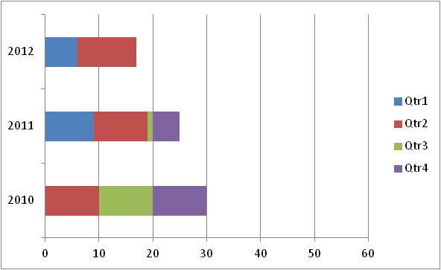
3 Years Ago – Monitoring Data
Clinical Trial B
 | Number of Visits
Year | Q1 | Q2 | Q3 | Q4 | Total
2010 |  | 10 | 10 | 10 | 30
2011 | 9 | 10 | 1 | 5 | 25
2012 | 6 | 11 |  |  | 17
Total | 15 | 31 | 11 | 15 | 72
Number of visits conducted

Slide 31
The Transitional Monitoring Plan
Started monitoring trial using conventional plan
  Quarterly visits, etc.
Relatively low risk trial: no pharmacotherapy, no invasive procedures/assessments, etc.
On-site monitoring had identified no significant issues related to data quality
Decision made to tailor Monitoring Plan to apply a new Risk-based approach
Monitoring resources were re-allocated
based on risk

Slide 32
Comparison of Monitoring Visits
Clinical Trial A –
7 years ago – 3 years ago
Clinical Trial B –
3 years ago – 1 year ago
Number of visits conducted
Number of visits conducted

Slide 33
Analysis of the new Monitoring Approach
Limited ongoing monitoring efforts to:
  100% review of informed consent processes, eligibility criteria, safety events and primary endpoint data
Compulsory quarterly visits changed to visits based on site specific triggers
No change in error rate noted after frequency of visits was decreased during the last third of the trial
Trial database locked on time
Conclusion – New strategy maintained trial
integrity, safety, timely monitoring and
morale of both monitors and clinical site staff

Slide 34
The Risk-based Plan
Clinical Trial C

Slide 35
Last Year– A Tailored Approach
Clinical Trial C
  n= 300
  11 sites
  Primary endpoint → number of cocaine use days as measured by self-report and corroborated by thrice-weekly urine drug screens
  Started with a plan tailored to the identified clinical trial risk
  High risk trial: Substance Use Disorder population, novel treatment combination, Schedule II medications, moderate level of safety risk, increased direct data entry, low amount of SDV required

Slide 36
Last Year– A Tailored Approach
Monitoring Plan:
  100% review of informed consent processes, eligibility criteria, a sample of randomly selected participants for 100% data review and a random selection of other critical primary endpoint data
  Review reported SAEs and protocol departures remotely in real time
  Review a percentage of data within a site and across all sites, leveraging the EDC system to identify trends in reporting

Slide 37
Leveraging Experience and Technology
Incorporated data quality features into a comprehensive monitoring plan
  Worked with the Data and Statistical Center to continue to leverage web based data capture
    Real-time range validations
    Skip logic within the data system
    Data integrity checks
    Protocol violation review system built within
    the data system to immediately address corrective action plans

Slide 38
The Present – Monitoring Data
Clinical Trial C
Year | Number of Visits
 | Q1 | Q2 | Q3 | Q4 | Total
2011 |  |  | 5 | 8 | 13
2012 | 8 | 10 | 22 | 7 | 47
2013 | 22 | 9 |  |  | 31
Total | 30 | 19 | 27 | 15 | 91
Number of visits conducted

Slide 39
The Present – Monitoring Data
Clinical Trial C – Modes of Monitoring/Phase
Year | Initiation-On Site | Interim-On Site | Interim-Remote (TLFB) | Closeout-Remote | Total
2011 | 11 | 2 |  |  | 13
2012 | 1 | 32 | 14 |  | 47
2013 |  | 9 | 11 | 11 | 31
Total | 12 | 43 | 25 | 11 | 91
Number of visits conducted
Notes:
Percentage of visits held by type of monitoring mode and phase of the study
On-Site Remote Total
Initiation 13% 13%
Interim 47% 27% 75%
Closeout 12% 12%
100%

Slide 40
Clinical Trial C - Conclusions
Appropriate to tailor the sampling rate and type of visits conducted (on-site vs. remote) according to the phase of the trial (actively enrolling vs. active and follow up phases)
Rate of site visits appears appropriate for the clinical trial
  Based on identified issues, study conduct, error rates, etc.
  Continued to be assessed throughout the trial

Slide 41
Clinical Trial C - Conclusions Cont.
Analysis of Proactive Approach
Recommending additional data quality checks based upon real-time monitoring findings
Reviewing and assessing reported PVs remotely in real time provided window into process
Allowed opportunity to address issues quickly, provide retraining and reduce the rates of recurring violations

Slide 42
Looking Ahead
An Adaptive Risk-Based Monitoring Plan

Slide 43
Targeted and Random Data Sampling
Use the same criteria applied to Clinical Trial C
Determine critical variables associated with participant safety, primary outcome and overall trial integrity
Identify critical elements of the trial that are at risk for error in interpretation or completion (e.g., informed consent, study assessments, medication dispensing)

Slide 44
Enhancing The Plan
On-site visit soon after first participant is randomized
More frequent visits in earlier stage of implementation, then reassess on a site-by-site basis
Adapt overall plan with every protocol amendment, as necessary
Adapt plan per site, as necessary

Slide 45
Risk Based Monitoring Benefits
Adaptive and Tailored Monitoring Plans are allowing us to better utilize monitoring resources
Review of ongoing trials have not identified problems with data quality or monitoring frequency
Proactive approaches are identifying trends in data earlier and allowing for early corrective action
  Focus on timely visits and site process improvement

Slide 46
Some Potential Risks
Adjustments are to be expected
  Check and re-check assumptions about a trial and associated risk levels for suitability
  Need for prompt analysis of trends, re-evaluation, and adjustment to the plan
Protocol specific training requirements
  Fewer visits requires properly trained study teams
  Lapse in sufficient and timely training can be disastrous
High reliance on effective site management
  Sufficient oversight is critical
  Consider contingency management plans for staff turnover
  Document procedures in SOPs
  Maintain up-to-date Manual of Procedures
Notes:
Risk-based monitoring plans must be re-evaluated periodically and adjusted as needed in response to findings and trends.

Slide 47





monitorinG MODELS

Slide 48
ICH E6 and ISO Guidelines
Both ICH E6 and ISO advise sponsors to assess and consider the objective, design, complexity, size, and endpoints in order to determine the extent and nature of monitoring for a given trial

Slide 49
Choosing the right model
Number of sites
Number of participants
Length of trial
Experience of research staff
Complexity and number of interventions
Complexity and number of assessments
Vulnerability of study population

Slide 50
Centralized vs. On-Site
Recent retrospective review of on-site monitoring findings from a multi-center international trial suggests that centralized monitoring activities could have identified more than 90% of the findings identified during on-site monitoring

Slide 51
Centralized vs. On-Site
Centralized
On-site
Efficient
Cost effective
Allows for Targeted and Random selection of data
Automated data integrity queries
Ability to see and compare trends both within sites and across sites
A window into processes
Verification of PI oversight, level of staffing and site logistics
Reassurance that someone is “personally” watching the site
Staff compliance with site SOPs

Slide 52
Centralized AND On-site
Take advantage of the option to do both
Identify those things that have to be done on-site (e.g., ICF reviews, IP accountability)
Identify other things that can be done remotely (e.g., lengthy and repetitive assessments, internal audit trail checks)

Slide 53

Leveraging The Role of the monitor within the CTN

Slide 54
The CTN Model
Comprised of four distinct entities that ‘monitor’ trial integrity and site performance
  CCC (Sponsor Monitors)
  Node (Local Monitors)
  DSC
  Site

Slide 55
Managing Risk Through Monitoring
Sponsor (CCC) Monitors
Local (Node) Monitors
On-site visits to all sites
Overview of protocol implementation
practices across sites
Experience with CTN trials
Can implement cross protocol risk-based and adaptive monitoring and centralized reviews
Extensive experience with CTN trials
Knowledgeable about local site practices (e.g.,SOPs, state laws, IRB)
Established relationship with and proximity to sites

Slide 56

Completing the picture
Site management and a view into process

Slide 57
The Local Monitor/Protocol Manager
Works on behalf of Node Study PI & Site PI
Works closely with the study site→ unique perspective
  Often serves as liaison between Node/University and study site team
  More frequent visits/contacts than CCC/EMMES
    Some visits may be remote
  May be responsible for regulatory submissions (correspondence with Local IRB)
  Familiarity with local personnel and procedures
Notes:
EMMES/CCC works on behalf of the Sponsor
Node and Site PI’s share the responsibility for regulatory and protocol compliance and protection of HS
Local Monitor/PM has a key role in helping the Node meet this responsibility

Slide 58

The Local Monitor/ Protocol Manager
Can help to fill in the gaps with close monitoring/support focused on local processes and procedures

Slide 59
Local Monitor/ Protocol Manager: Areas of site support
Training & re-training of staff
  Addressing staff turnover
  Training site team in protocol & MOP changes
  Documentation of staff responsibilities, qualifications & training
Local SOPs
  SOP development & revisions
  Streamlining procedures for greater efficiency
  Allocation of site personnel/resources

Slide 60
Local Monitor/ Protocol Manager: Areas of site support
Protocol deviations
  Ensuring proper documentation and reporting
  Corrective and preventive action plans (CAPAs)
  Identification of trends
Safety events
  Identification, tracking, documentation, and follow-up

Slide 61
Local Monitor/ Protocol Manager: Areas of site support
Regulatory compliance
  Prompt review of Reg. Binder updates
  Ensuring protocol departures & safety events are reported to Local IRB, as appropriate
  Support in preparing IRB submissions: initial, amendments, and continuation reports
Data review
  Review data reports to ensure prompt resolution of queries or missing data
  Greater focus on forms/processes not reviewed by CCC/EMMES
  Review of Checklist/Progress Notes & Contact Logs
  Intervention documentation
  Service utilization data

Slide 62

Internal Quality assurance
Where it all begins

Slide 63

Internal Quality Assurance
Quality Assurance begins with internal monitoring and the expectation of a high standard of data quality and regulatory and GCP compliance.
A ‘culture’ of Quality is the
foundation of a successful
site.

Slide 64
Internal Quality Assurance: Strategies
Informed Consent Documentation
  Real-time review of completed Informed Consent documents for completeness and accuracy
    Allows for prompt corrections by staff and/or participant
  Q: “Are all printed names, signatures, dates, and in/out responses present and correct?”
  Can be cross-checked by another staff member (if available)

Slide 65
Internal Quality Assurance: Strategies
Accuracy of data entry/abstractions
  Cross-check or double-check
Regular review of data reports to ensure prompt resolution of data issues
  Missing Forms, Missing Values, Integrity Data Queries & others

Slide 66

Internal Quality Assurance: Strategies
Proactive approach to minimizing errors:
Identification of likely or common errors
Implementation of targeted strategies to increase accuracy
  Examples:
    Use of stylus pen in conjunction with a tablet
    Distinguishing ICF versions with different colored paper
    Use of checklists for complex or multi-step processes
    Reference or guidance documents displayed in key locations (e.g., steps for processing a urine test displayed in lab area)

Slide 67

Factors to trigger monitoring actions

Slide 68
Factors Determining Monitoring
Complexity/length of a trial
Implementation (soon after first participant randomized)
Volume of source to data verification
Sites naïve to research or the CTN
Performance indicators
Error rates from remote monitoring
Due Diligence

Slide 69

Q&A Session
Alternatively, questions can be directed to the presenter by sending an email to CTNtraining@emmes.com.

Slide 70
Survey Reminder
The NIDA CCC encourages all to complete the survey issued to participants directly following this webinar session, as this is the primary collective tool for rating your experience with this and other webinars, and for communicating the interests and needs of CTN members and associates.
Upcoming Webinar
ADAPTIVE RESEARCH DESIGN
FOR SUBSTANCE ABUSE
CLINICAL TRIALS
Wednesday, October 23, 2013
1:00 pm to 2:00 pm ET

Slide 71
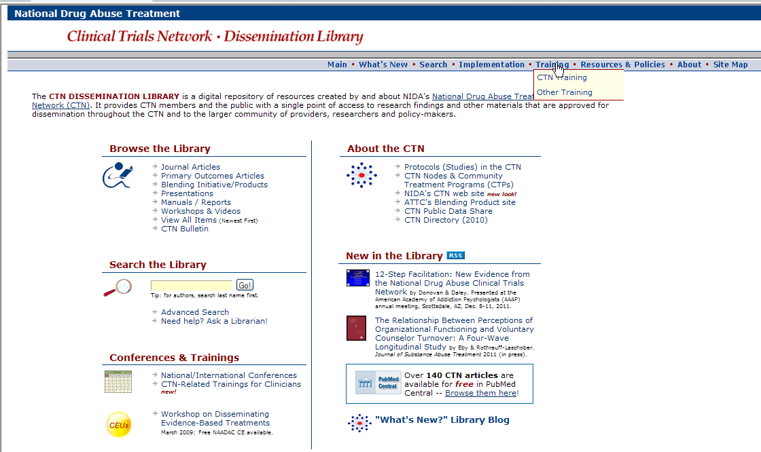
A copy of this presentation will be available electronically after this session.
http://ctndisseminationlibrary.org

Slide 72
Thank you for participating.
NIDA CTN Web Seminar Series

