Slide 1
SITE CLOSEOUT – AN OVERVIEW
Presented by:
Maria Campanella, BSN, RN, CCRA
March 20, 2013

Slide 2
Objectives:
Explain aspects of closing out sites
Describe a smooth closeout process
Define closeout preparation related activities to occur even before site endorsement

Slide 3

Aspects of closing out a research site

Slide 4
Components of Site Closeout
Monitoring Visits
Study Personnel
Supplies & Equipment
Safety & Regulatory
Data Cleaning Activities
Storage & Records

Slide 5
Monitoring Visits
Closeout visits conducted once all ICFs, eligibility, medication accountability and primary outcome data reviews have been completed
May be conducted on-site or remotely depending upon the study
Intended to wrap up loose ends
Very focused on status of regulatory documents, safety and protocol violation reviews, and resolution of outstanding data discrepancy queries
Not typically a time of data review

Slide 6


Monitoring Visits
Guided by the monitor’s site
visit preparation and the
site closeout checklist
Intended to communicate the
expectations of the sponsor,
with regards to site and study
closeout, to the site PI
May provide site staff the opportunity to ask questions and clarify these expectations prior to trial database lock

Slide 7
Study Personnel
Site staff is expected to dwindle as the study activities become less demanding
Ensure collection of all related staff documentation prior to their departure
Someone who knows the study and has access to the various data and document collection systems must be available to the CCC/DSC and LI through database lock.

Slide 8

Study Personnel
Staff Signature and Delegation of Responsibilities Log
  Prior to staff departure ensure evidence of all training and qualifications is current according to study role and responsibilities
  Complete a study participation “End Date” on the log as appropriate
  Notify the CCC/DSC and sponsor of the staff departure via submission of an updated CTN Research Staff Information form
  Notify the IRB as appropriate

Slide 9
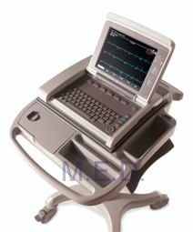
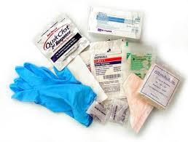
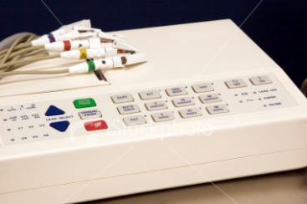
Supplies and Equipment
Work with CCC to maintain as low a supply inventory as possible
Consider who provisioned the supplies and equipment, namely who ‘owns’ it, then ask when is it returned and how?
Return study equipment to vendors promptly as instructed by the CCC/DSC or LI
as appropriate, keep all associated
shipping records

Slide 10
Supplies and Equipment
If donating unused supplies, list inventory by lot # and expiration date before donating
If returning study Investigational Product to the study central pharmacy, follow directions from pharmacy and CCC and maintain all shipping records

Slide 11

Safety
Perform due diligence to seek outcomes of reported events throughout the trial and document in progress notes accordingly
Respond promptly to requests for additional information from the Medical Monitor
QC checks – no personal identifiers in the comments field, spelling also important

Slide 12
Protocol Violations
Review protocol deviation logs and previously issued monitoring site visit reports. Ensure PVs have been reported appropriate to the sponsor and the IRB
Review all PVs reported in EDC to ensure that you have a clear, succinct description and a verifiable corrective action plan
Ensure that no identifying data (names, DOB etc) are in the comment fields --- spelling also counts

Slide 13
Protocol Violations
During data cleaning activities protocol violations are often ‘discovered’
Be prepared to respond to requests from the CCC and DSC in a timely manner to modify entries or report new violations

Slide 14

Regulatory
Regulatory Documentation
  Be able to provide CCC staff with evidence of IRB submissions related to PVs and Safety events as requested
  Maintain currency of submissions (IRB approvals, training documentation, staff logs etc) to the sponsor in a timely manner as
  requested by the CCC
IRB Obligations
  Know your timeline for notification of site and study closeout

Slide 15
Data Cleaning Activities
Resolve all data discrepancies and integrity queries in a timely manner
Access the Monitoring Discrepancy reports in EDC frequently and be responsive to requests from the DSC
If you don’t know how to resolve a query– ask!

Slide 16

Storage & Records
Know both the sponsor
and the IRB expectations
and requirements for the
retention of study related
documents
Provide the site plan for the archiving, storage location, and contact to the sponsor and LI at the time of the closeout visit or earlier in the site closeout process if known
  Include in your plan a way to retrieve records for the LI, sponsor, or other auditor as requested

Slide 17
The Closeout process
“When you have a great and difficult task, something perhaps
almost impossible, if you only work a little at a time,
every day a little, suddenly the work will finish itself.”
--Isak Dinesen

Slide 18
Closeout Process
Nat’l Training Meeting
Site Endorsement
End of Enrollment
Database Lock
Early Activities
Know sponsor and IRB expectations for reg. documentation
Implement Site Staff Signature and Delegation of Responsibilities log
Collect evidence of appropriate staff training & qualifications
Submit to sponsor and IRB as appropriate
Know your resources, ask questions
Activities During Implementation and Pre-Closeout
Maintain regulatory documentation according to sponsor and IRB expectations
Maintain Staff Signature and Delegation of Responsibilities log, notify DSC/CCC and sponsor of staffing changes via submission of CTN Research Staff Information forms
Maintain evidence of appropriate training and qualifications including CVs, licenses, registrations
Control supply inventories at the site, inquire as to the expected disposition at the end of the study
Develop processes to QC a review of records
  Progress notes
  Data entry
  Regulatory submissions
Respond to inquiries from CCC/DSC in a timely manner
Know your resources, ask questions
Final Closeout Activities
Designate primary site staff including PI to be available through trial database lock.
Participate actively in the site closeout process including data cleaning activities
Provide timely responses to requests from CCC/DSC and LI
Submit all final regulatory documents to IRB and sponsor as requested

Slide 19
Early Phase Activities
Regulatory documents
  More than just IRB approvals (FWA, evidence of training, qualifications)
  Think ahead from the time of site endorsement, maintain ---don’t wait
  Know IRB expectations for endorsement, during the implementation phase and for closeout
  Know sponsor expectations as well, they may differ
Site staffing
  Develop an appropriate staff Signature and Delegation of Responsibilities log and maintain frequently to ensure accuracy of reporting
  Ensure all corresponding evidence of training and qualifications are collected and submitted to the CCC prior to any staff engaging in study activities and prior to staff departure
  Ensure DSC/CCC and sponsor are aware of changes related to site staffing and responsibilities by updating and submitting CTN Research Staff Information forms accordingly

Slide 20
Early Phase Activities
Develop site SOPs to outline the processes by which new staff are assimilated and trained to participate in the trial
Develop site process for quality control (QC) of documents and processes for items related to participants as well as regulatory and other study related documentation
Know your resources, ask questions

Slide 21
Activities During Implementation and Pre-Closeout
Focus heavily on internal site QC measures
  PVs- describe violation succinctly, provide appropriate documentation of corrective action taken
  Safety events – respond to requests from Medical Monitor in a timely fashion. Complete outcomes for all reported events
  Ensure all action items identified during monitoring visits (see site visit reports) have been addressed appropriately
Provide timely responses to data discrepancy queries and requests for regulatory documents
Maintain the site Staff Signature and Delegation of Responsibilities log
Maintain current CTN Research Staff Information with the DSC

Slide 22
Activities During Implementation and Pre-Closeout
Identify appropriate site staff (including the PI) who will be available through and beyond trial database lock
Identify where physical and electronic study site documents will be archived and stored, and who will be the contact
Determine the expectations of the LI and study sponsor as to the disposition of study supplies and equipment

Slide 23
Final Closeout Activities
Actively participate in closeout activities
  Engage in the QC process, double checking data entries in the database including safety events and reported PVs
  Complete the Site Readiness for Closeout checklist and submit regularly to the CCC and LI team as requested
  Participate in the Readiness for Site Closeout calls with the CCC and DSC staff

Slide 24
Final Closeout Activities
Respond to CCC Monitor request for a closeout visit confirmation in a timely manner
Respond to data queries and regulatory documentation requests in a timely manner
Know the anticipated date of trial database lock – this is your ultimate deadline
Know your resources, ask questions

Slide 25
Internal/external resources

Slide 26
Maximize Resources
Develop a site closeout plan early on
Identify critical site staff
RRTC
  QA Node Monitoring Staff --- Quality Control advisors
  Protocol/Project Manager
Lead Investigative Team

Slide 27
Maximize Resources
NIDA CCC
NIDA DSC
CCC Protocol Specialists
CCC Monitoring Staff
Management Staff
DSC Data Manager
DSC Help Desk
CTNsupport@emmes.com
nidadsc2help@emmes.com

Slide 28
Tools for Preparing for Closeout
List of Key Regulatory Documents required for the Protocol and site staff
Site Closeout Checklists
  Collaborative effort by LI/CCC/DSC and site staff
Data discrepancy and Integrity Query reports in EDC
Readiness for site closeout calls with CCC and DSC staff

Slide 29

Site closeout - recap

Slide 30
Review Key Points
When is the best time to start preparing for closeout?
What are the key components of site closeout?
What resources are available to site staff?
What key tools can be used for closing out sites?

Slide 31

Q&A – Questions / Comments
Alternatively, questions can be directed to the presenter by sending an email to CTNTraining@emmes.com.

Slide 32
References
ICH/GCP E6 guidelines
NIDA CTN Policies and Procedures (v 5.0)
CTN Site Readiness for Closeout checklists
CTN Site Visit Report templates

Slide 33
Thank you for your participation

Slide 34
Survey Reminder
The NIDA CCC encourages all to complete the survey issued to participants directly following this webinar session, as this is the primary collective tool for rating your experience with this and other webinars, and for communicating the interests and needs of CTN members and associates.
Upcoming Webinar

Slide 35
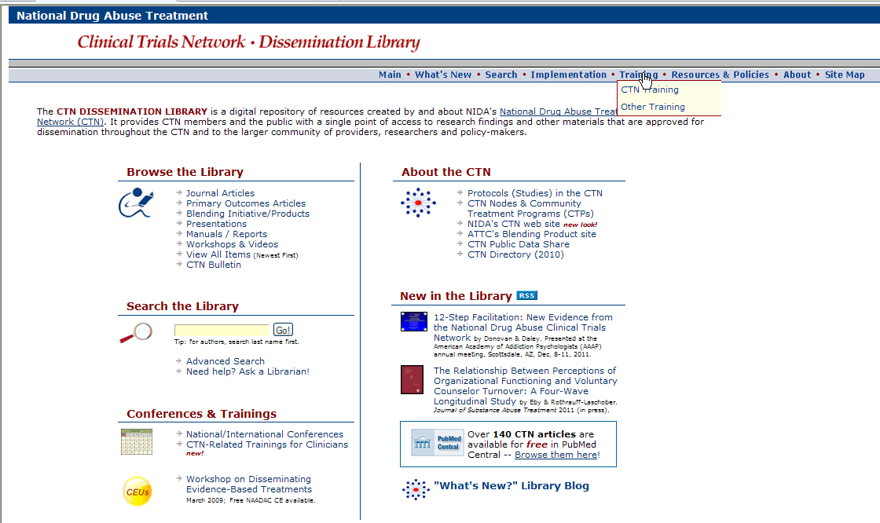
A copy of this presentation will be available electronically after this session.
http://ctndisseminationlibrary.org

